Slide 1
Understanding the Accretion of Gas on to Young Stars
Part III Astrophysics Research Project
Yuchen Pei
Supervised by
Prof Cathie Clarke
Prof Chris Tout

Slide 2
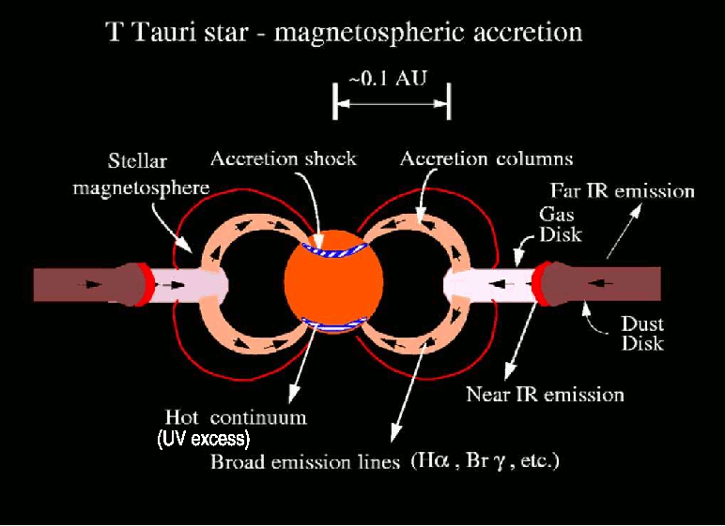



The Background
flux
Measurements:
$L_{∗}$ and $T_{eff}$from fitting a stellar spectrum to observed spectrum (black body and absorption lines)
$L_{acc}$ from measuring the shock (in UV region)
$R$ from $L_{∗}=4πR^{2}σT_{eff}^{4}$
$M$ from observed correlation with $L_{∗}$ and $R$., (Baraffe et al. 1998)
$\dot{M}$ from observed temperature and the equations $L_{acc}=GM_{∗}\dot{M}/R$
$$L_{∗}$$
Gravitational
collapse
$$L_{acc}$$
Star
Protoplanetary disc
Deformation
by spin
wavelength

Slide 3
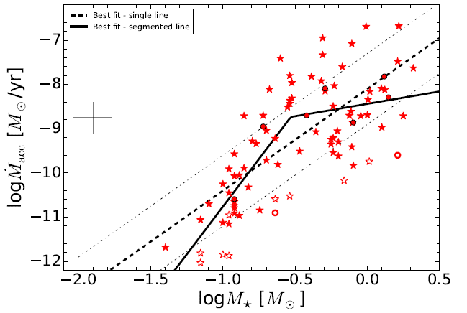
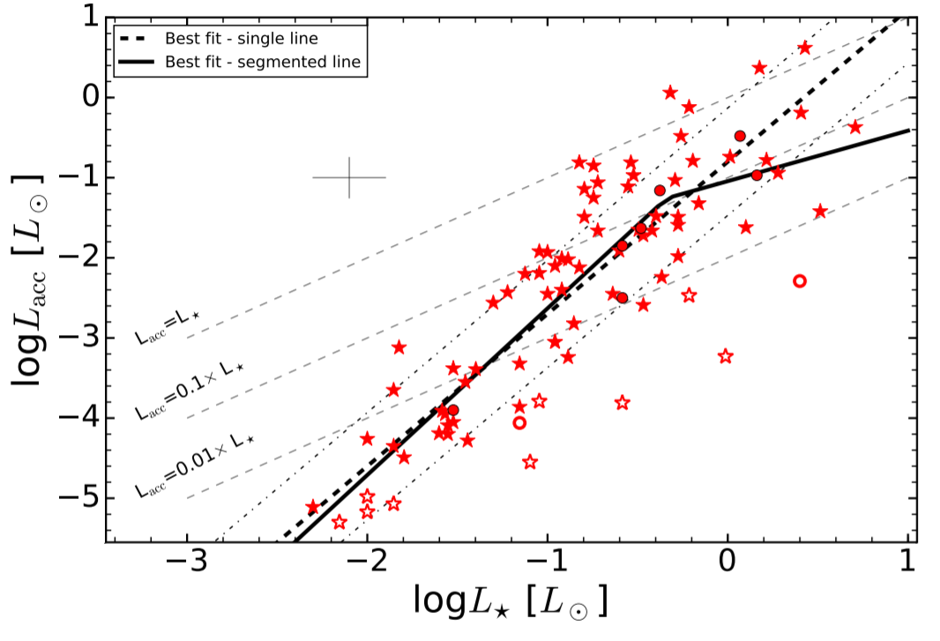


The Problem
$\dot{M}∝M_{∗}^{2}$ observed
$\dot{M}∝M_{∗}$ expected if viscous timescale is independent of $M_{∗}$.
(Alexander & Armitage 2006)
Viscosity dependent on stellar mass? (Natta et al. 2006)
Ionization from stellar radiation? (Muzerolle et al. 2003)
Small star formed by ejection? (Reipurth & Clarke 2011)
Selection & observation bias? (Clarke & Pringle 2006)
Protostars
Mind the Gap
Beyond Observation
$$\dot{M}∝\frac{kRL_{∗}}{M_{∗}}∝kM_{∗}^{1.3}, k=\frac{L_{acc}}{L_{∗}}$$
Data from Manara et al. (2017)
Stars: full disc
Circles: transition disc
Empty symbols: low accretion rate

Slide 4
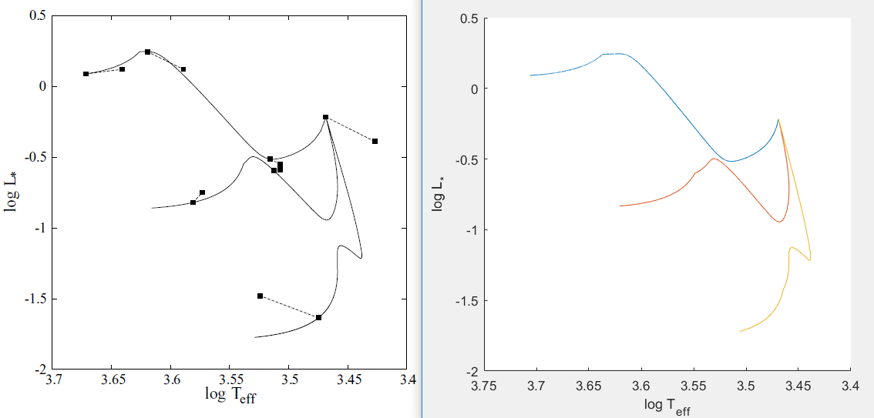
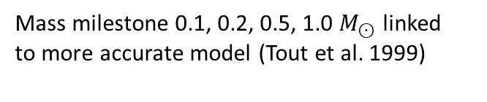





The Preparation
Governing equations (constants, variables):
$\dot{M}=$const
$L_{∗}=−\frac{3}{7}\frac{GM_{∗}^{2}}{R}\left(\frac{1}{3}\frac{\dot{M}}{M_{∗}}+\frac{\dot{R}}{R}\right)+L_{D}$
$\frac{L_{D}}{L_{⊙}}=1.92×{10}^{17}Xf{\left(\frac{M_{∗}}{M_{⊙}}\right)}^{13.8}$ ${\left(\frac{R}{R_{⊙}}\right)}^{−14.8}$
$\frac{df}{dt}=\frac{\dot{M}}{M_{∗}}\left(1−f−\frac{L_{D}}{Q_{D}X_{D}\dot{M}}\right)$
$\frac{L_{∗}}{L_{⊙}}={\left(\frac{M_{∗}}{0.5M_{⊙}}\right)}^{0.9}{\left(\frac{R}{2R_{⊙}}\right)}^{2.34}$for $0.3≤\frac{M_{∗}}{M_{⊙}}≤1$
Last equation does not apply to low masses so that we need a new approach
Resulting system:
$M_{∗}=M_{0}+\dot{M}t$
$\frac{dR}{dt}=\frac{7R^{2}}{3GM_{∗}^{2}}\left(L_{D}−L_{∗}\right)−\frac{R\dot{M}}{3M_{∗}}$
$\frac{L_{D}}{L_{⊙}}=1.92×{10}^{17}Xf{\left(\frac{M_{∗}}{M_{⊙}}\right)}^{13.8}$ ${\left(\frac{R}{R_{⊙}}\right)}^{−14.8}$
$\frac{df}{dt}=\frac{\dot{M}}{M_{∗}}\left(1−f−\frac{L_{D}}{Q_{D}X_{D}\dot{M}}\right)$
$\frac{L_{∗}}{L_{⊙}}={\left(\frac{M_{∗}}{0.5M_{⊙}}\right)}^{0.9}{\left(\frac{R}{2R_{⊙}}\right)}^{2.34}$
Integrate $R,F$ by Runge-Kutta (RK4) method
$${10}^{−6}M_{⊙}{yr}^{−1}$$
$${10}^{−7}M_{⊙}{yr}^{−1}$$
$${10}^{−8}M_{⊙}{yr}^{−1}$$
Left: Tilling et al (2008) Right: My plot
Deuterium fusion starts
Deuterium fusion ends
Mass milestone 0.1, 0.2, 0.5, 1.0 $M_{⊙}$ linked
to more accurate model (Tout et al. 1999)
Evolution terminates at ZAMS (determined with a equation on radius, Tout et al. 1996) or 20 Myr
Equations from Tilling et al (2008)

Slide 5
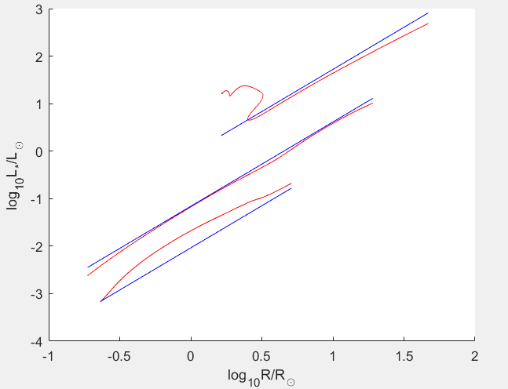
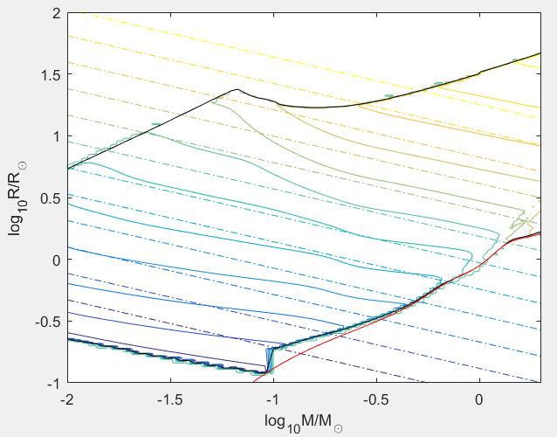
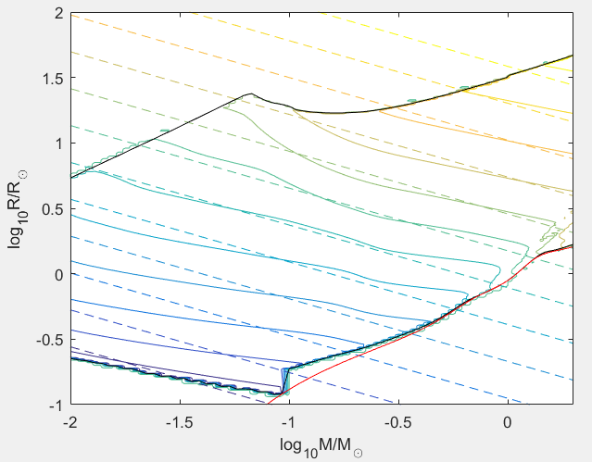

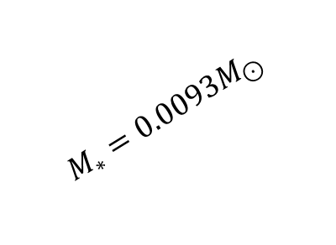
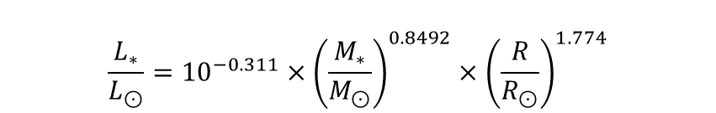
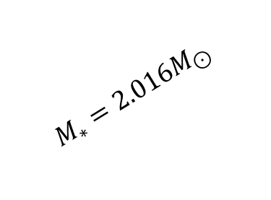
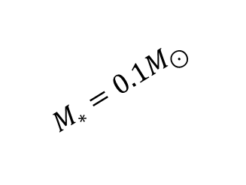
The Improvement
$$\frac{L_{∗}}{L_{⊙}}={\left(\frac{M_{∗}}{0.5M_{⊙}}\right)}^{0.9}{\left(\frac{R}{2R_{⊙}}\right)}^{2.34}$$
$$\frac{L_{∗}}{L_{⊙}}={10}^{−0.311}×{\left(\frac{M_{∗}}{M_{⊙}}\right)}^{0.8492}×{\left(\frac{R}{R_{⊙}}\right)}^{1.774}$$
$$M_{∗}=2.016M_{⊙}$$
Hydrogen Fusion starts,
Interpolation averages duplicate points
$$M_{∗}=0.1M_{⊙}$$
$$M_{∗}=0.0093M_{⊙}$$
Data boundary
Zero-age main-sequence
Tout et al. (1996)
$\log_{10}\left(\frac{L_{∗}}{L_{⊙}}\right)=−0.433+0.9\log_{10}\left(\frac{M_{∗}}{M_{⊙}} \right)+2.34\log_{10}(\frac{R}{R_{⊙}})$
$\log_{10}\left(\frac{L_{∗}}{L_{⊙}}\right)=−0.311+0.8492\log_{10}\left(\frac{M_{∗}}{M_{⊙}} \right)+1.774\log_{10}(\frac{R}{R_{⊙}})$
Data from Tout et al. (1999)

Slide 6
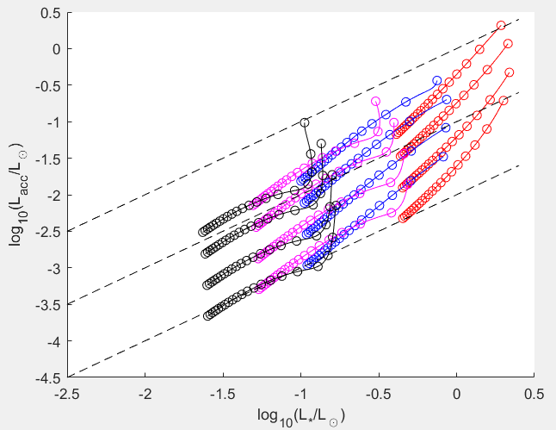
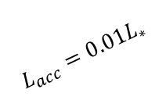
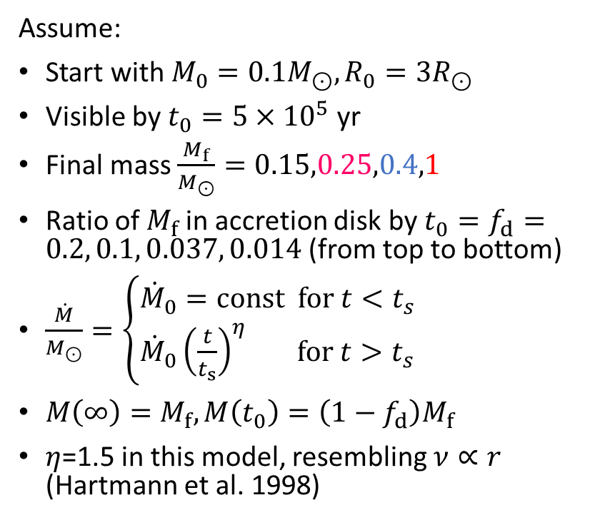
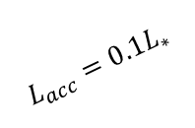
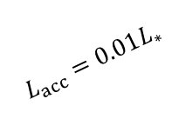
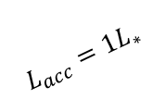
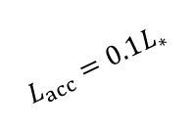

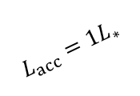
The Application
Assume:
Start with $M_{0}=0.1M_{⊙}, R_{0}=3R_{⊙}$
Visible by $t_{0}=5×{10}^{5}$ yr
Final mass $\frac{M_{f}}{M_{⊙}}=0.15,0.25,0.4,1$
Ratio of $M_{f}$ in accretion disk by $t_{0}=f_{d}=0.2, 0.1, 0.037, 0.014$ (from top to bottom)
$\frac{\dot{M}}{M_{⊙}}=\left\{\begin{matrix}{\dot{M}}_{0}=\text{const} \text{for} t<t_{s} \\ {\dot{M}}_{0}{\left(\frac{t}{t_{s}}\right)}^{η} \text{for} t>t_{s}\end{matrix}\right.$
$M\left(∞\right)=M_{f}, M\left(t_{0}\right)=\left(1−f_{d}\right)M_{f}$
$η$=1.5 in this model, resembling $ν∝r$ (Hartmann et al. 1998)
$$L_{acc}=1L_{∗}$$
$$L_{acc}=1L_{∗}$$
$$L_{acc}=0.1L_{∗}$$
$$L_{acc}=0.1L_{∗}$$
$$L_{acc}=0.01L_{∗}$$
$$L_{acc}=0.01L_{∗}$$
Circle plotted for every $t_{0}$ since $t_{0}$
Method from Tilling et al (2008)

Slide 7
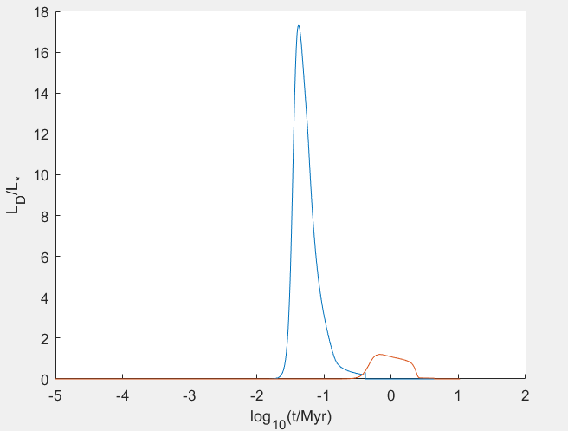
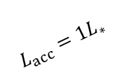



The Explanation
Models with same $f_{d}$ starts and ends at about same $L_{acc}/L_{∗}$
$M_{f}=0.15M_{⊙}$ has a sharp decline in $L_{acc}$ at start
$\frac{L_{D}}{L_{∗}}$ stays significant after $t_{0}$ for $M_{f}=0.15M_{⊙}$
$\frac{L_{D}}{L_{∗}}$ falls to zero before $t_{0}$ for $M_{f}=1M_{⊙}$
Deuterium burning could cause such sharp decline in $L_{acc}/L_{∗}$, thus the gap.
$$t_{0}$$
$$L_{acc}=1L_{∗}$$
$$L_{acc}=1L_{∗}$$
$$L_{acc}=0.1L_{∗}$$
$$L_{acc}=0.1L_{∗}$$
$$L_{acc}=0.01L_{∗}$$
$$L_{acc}=0.01L_{∗}$$
$$t_{0}$$
Circle plotted for every $t_{0}$ since $t_{0}$

Slide 8
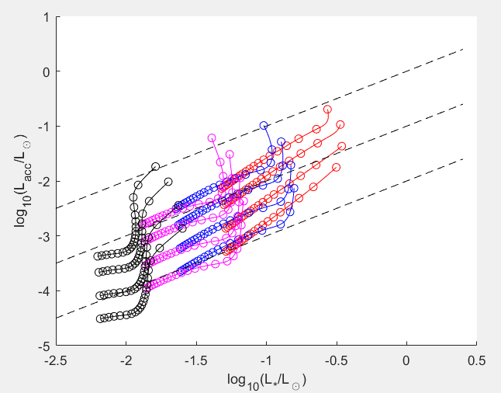
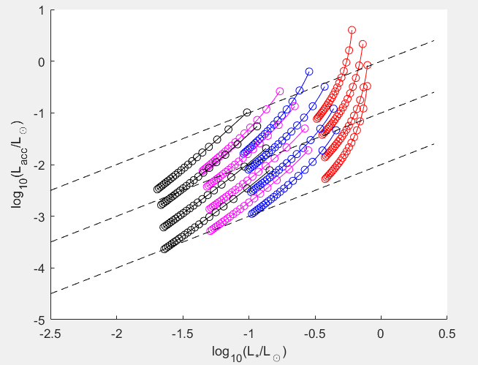
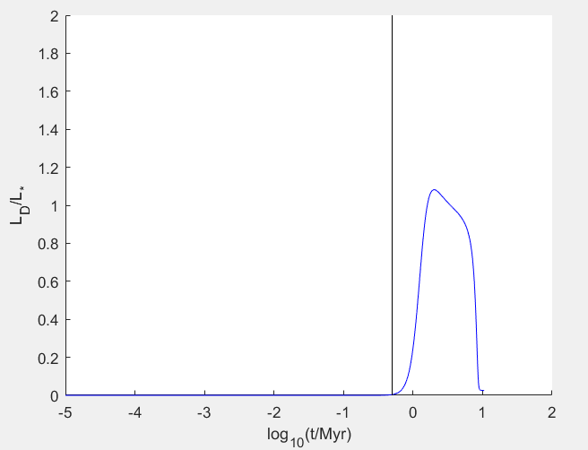
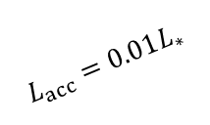
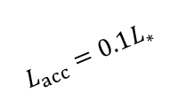
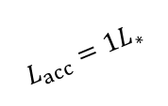
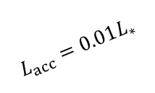
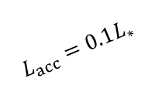
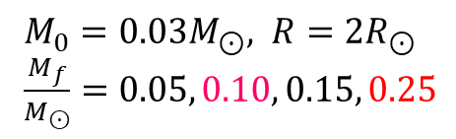
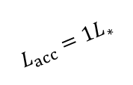
The Exploration
$$L_{acc}=1L_{∗}$$
$$L_{acc}=0.1L_{∗}$$
$$L_{acc}=1L_{∗}$$
$$L_{acc}=0.01L_{∗}$$
$$L_{acc}=0.1L_{∗}$$
$$L_{acc}=0.01L_{∗}$$
Deuterium burning turned off,
other parameters unchanged
$M_{0}=0.03M_{⊙}, R=2R_{⊙}$
$\frac{M_{f}}{M_{⊙}}=0.05, 0.10, 0.15, 0.25$

Slide 9
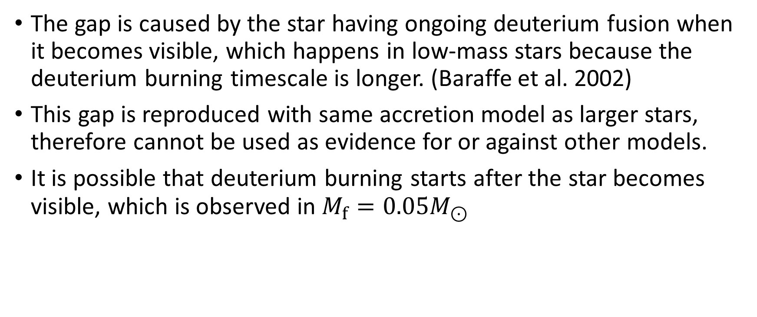
Conclusion
The gap is caused by the star having ongoing deuterium fusion when it becomes visible, which happens in low-mass stars because the deuterium burning timescale is longer. (Baraffe et al. 2002)
This gap is reproduced with same accretion model as larger stars, therefore cannot be used as evidence for or against other models.
It is possible that deuterium burning starts after the star becomes visible, which is observed in $M_{f}=0.05M_{⊙}$

Slide 10
References
Alexander R., Armitage P. 2006 (ApJ, 639, L83-L86)
Baraffe I.,Chabrier G., Allard F., Hauschildt P. 1998 (A&A 337, 403{412)
Baraffe I.,Chabrier G., Allard F., Hauschildt P. 2002 (A&A 382, 563{572)
Clarke C., Pringle J. 2006 (MNRAS 370, L10)
Hartmann L., Calvet N., Gullbring E., D'Alessio P. 1998 (ApJ 495, 385)
Manara C., Testi L., Herczeg G., et al. 2017 (A&A 604, A127)
Muzerolle J., Hillenbrand L., Calvet N., Brice~no C., Hartmann L. 2003 (ApJ 592, 266)
Natta A., Testi L., Randich S. 2006 (A&A 452, 245)
Reipurth B., Clarke C. 2011 (ApJ 122, 432)
Tilling I., Clarke C., Pringle J., Tout C. 2008 (MNRAS 385, 1530)
Tout C., Livio M., Bonnell I. 1999 (MNRAS 310, 360-376)
Tout C., Pols O., Eggleton P., Han Z. 1996 (MNRAS 281,257)

