Slide 1
SLEEF
SIMD Library for
Evaluating Elementary Functions

Slide 2
SLEEF
SIMD Library
for
Evaluating
Elementary
Functions

Slide 3
SLE
EF

Slide 4
SLEEF
SIMD Library for
Evaluating Elementary Functions

Slide 5
SLEEF
SIMD Library for
Evaluating Elementary Functions

Slide 6
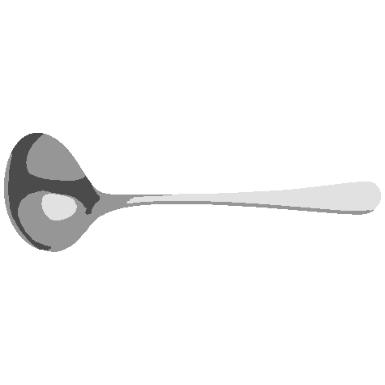
SLEEF
SIMD Library for
Evaluating Elementary Functions

