Slide 1
DEVOPS – CSYE7220 FINAL PROJECT
Keerthana Thoddoon Ravi
Sinthu Kumarasamy

Slide 2
GOAL OF THIS PROJECT
DevOps with AWS CodePipeline on AWS EKS
CI - Continuous Integration
CD – Continuous Deployment or Delivery
Provision AWS Resources using Terraform
AWS CodeCommit
AWS CodeBuild
AWS CodePipeline
Swarm application using Locust
Monitor application using Prometheus

Slide 3
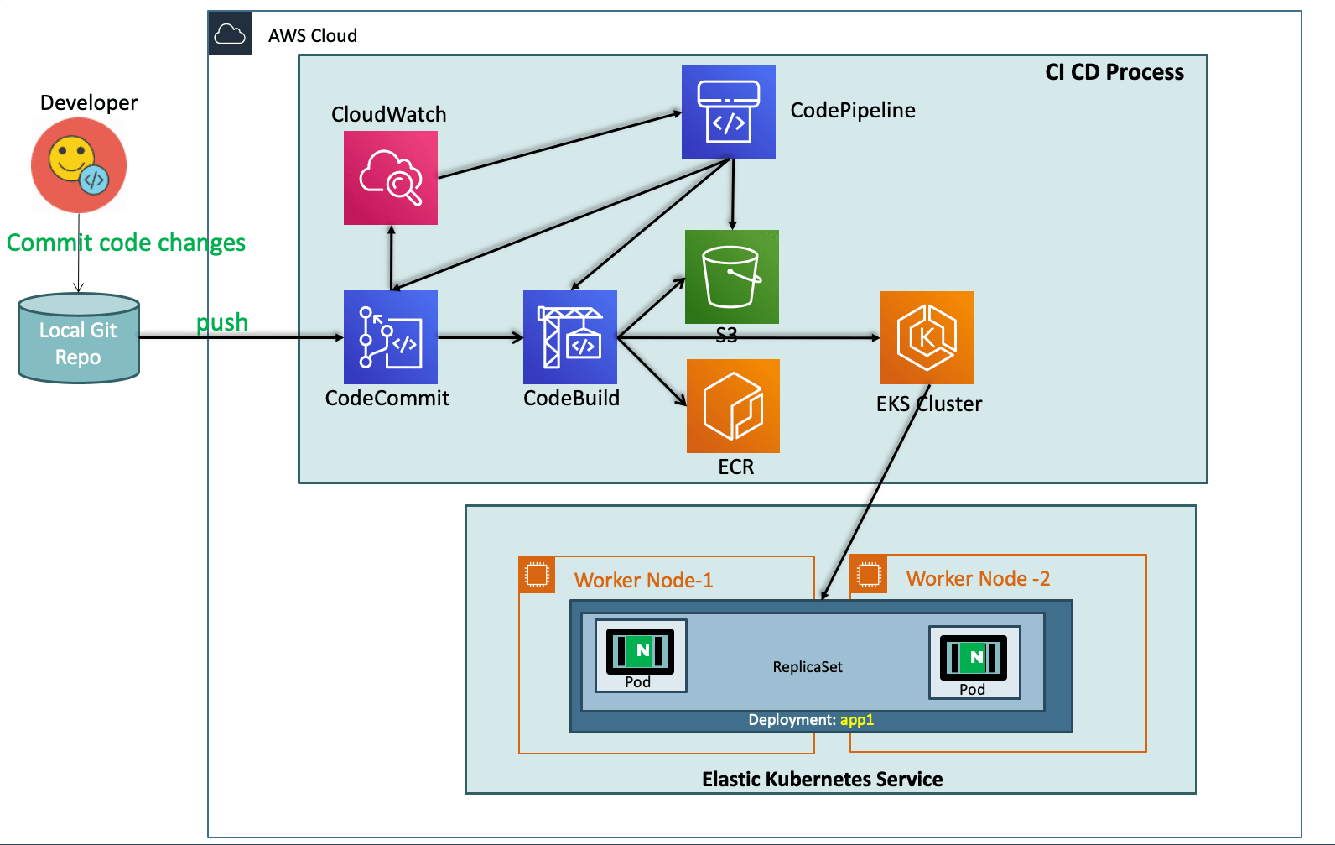
Design

Slide 4
Roles & Policies Used
STS Assume Role: EksCodeBuildKubectlRole Inline Policy: eksdescribe CodeBuild Role: codebuild-eks-devops-cb-for-pipe-service-role ECR Full Access Policy: AmazonEC2ContainerRegistryFullAccess STS Assume Policy: eks-codebuild-sts-assume-role STS Assume Role: EksCodeBuildKubectlRole

Slide 5
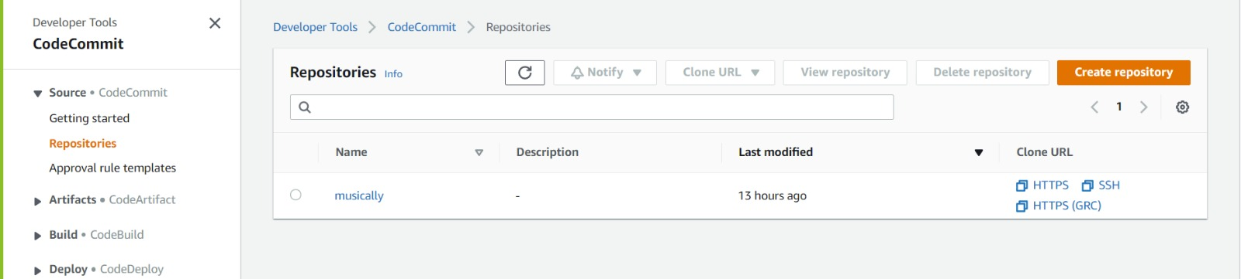
Code Commit

Slide 6
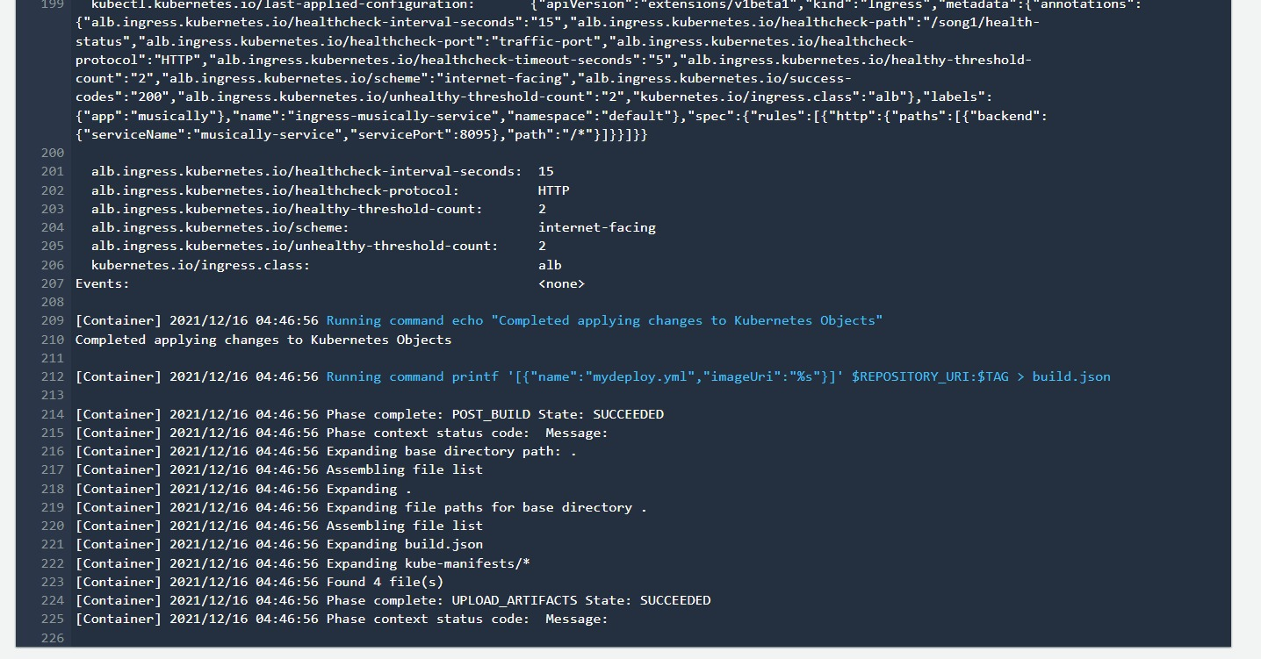
Code Build - CI

Slide 7
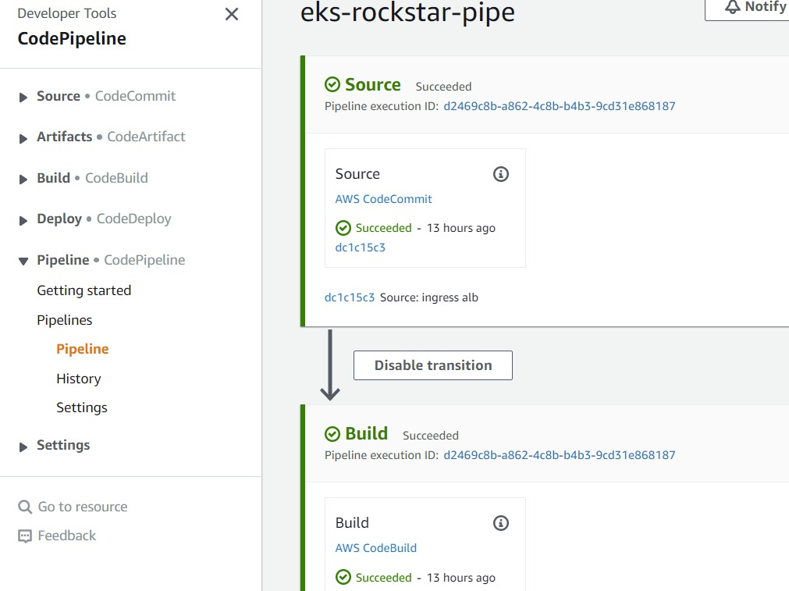
Code Pipeline - CD

Slide 8
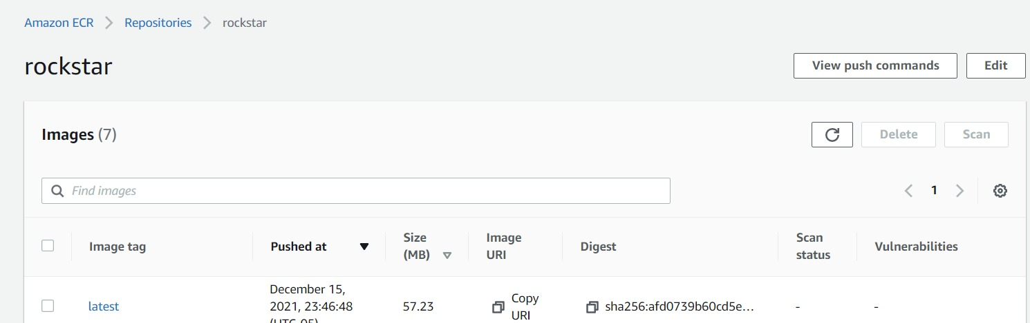
Elastic Container Registry

Slide 9
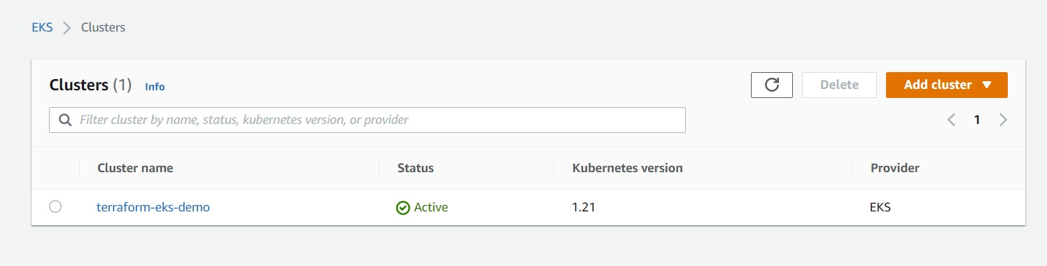
EKS Cluster

Slide 10
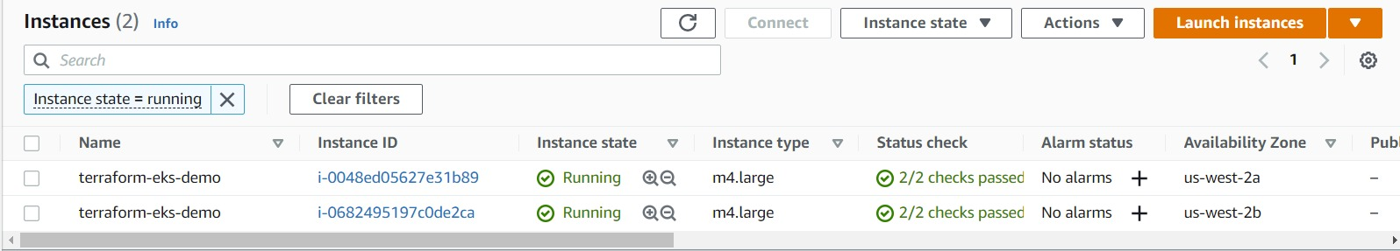
EC2 Instances

Slide 11
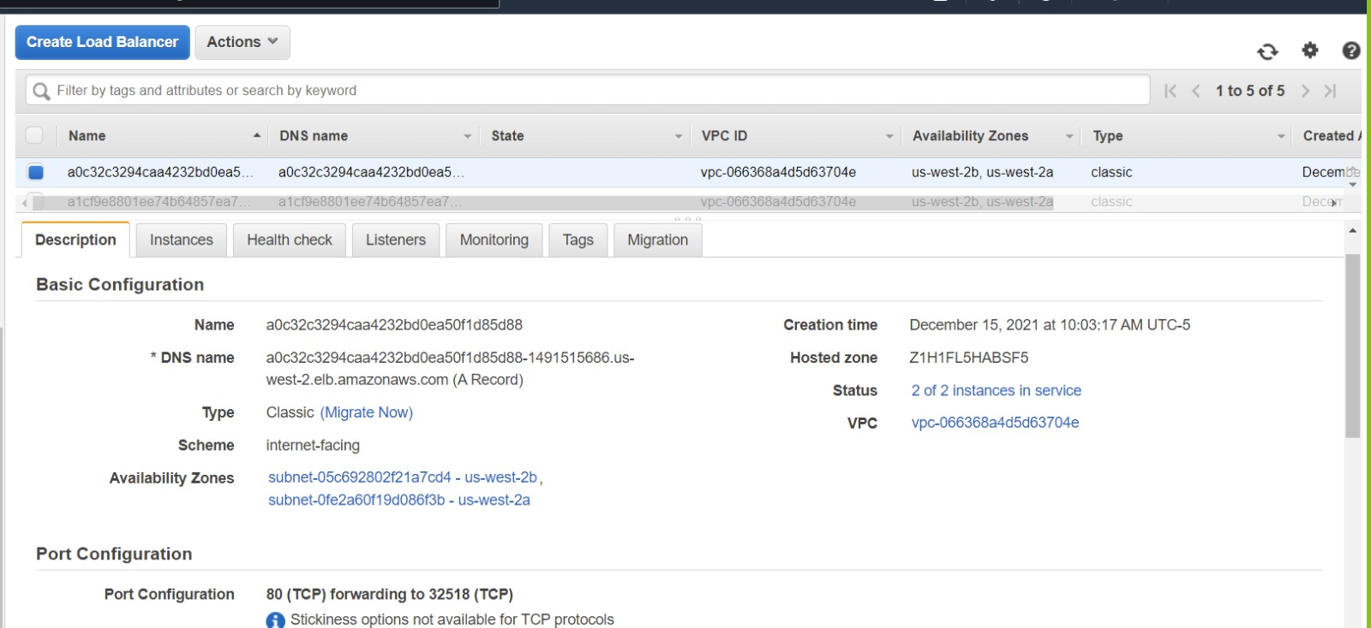
Load Balancer

Slide 12
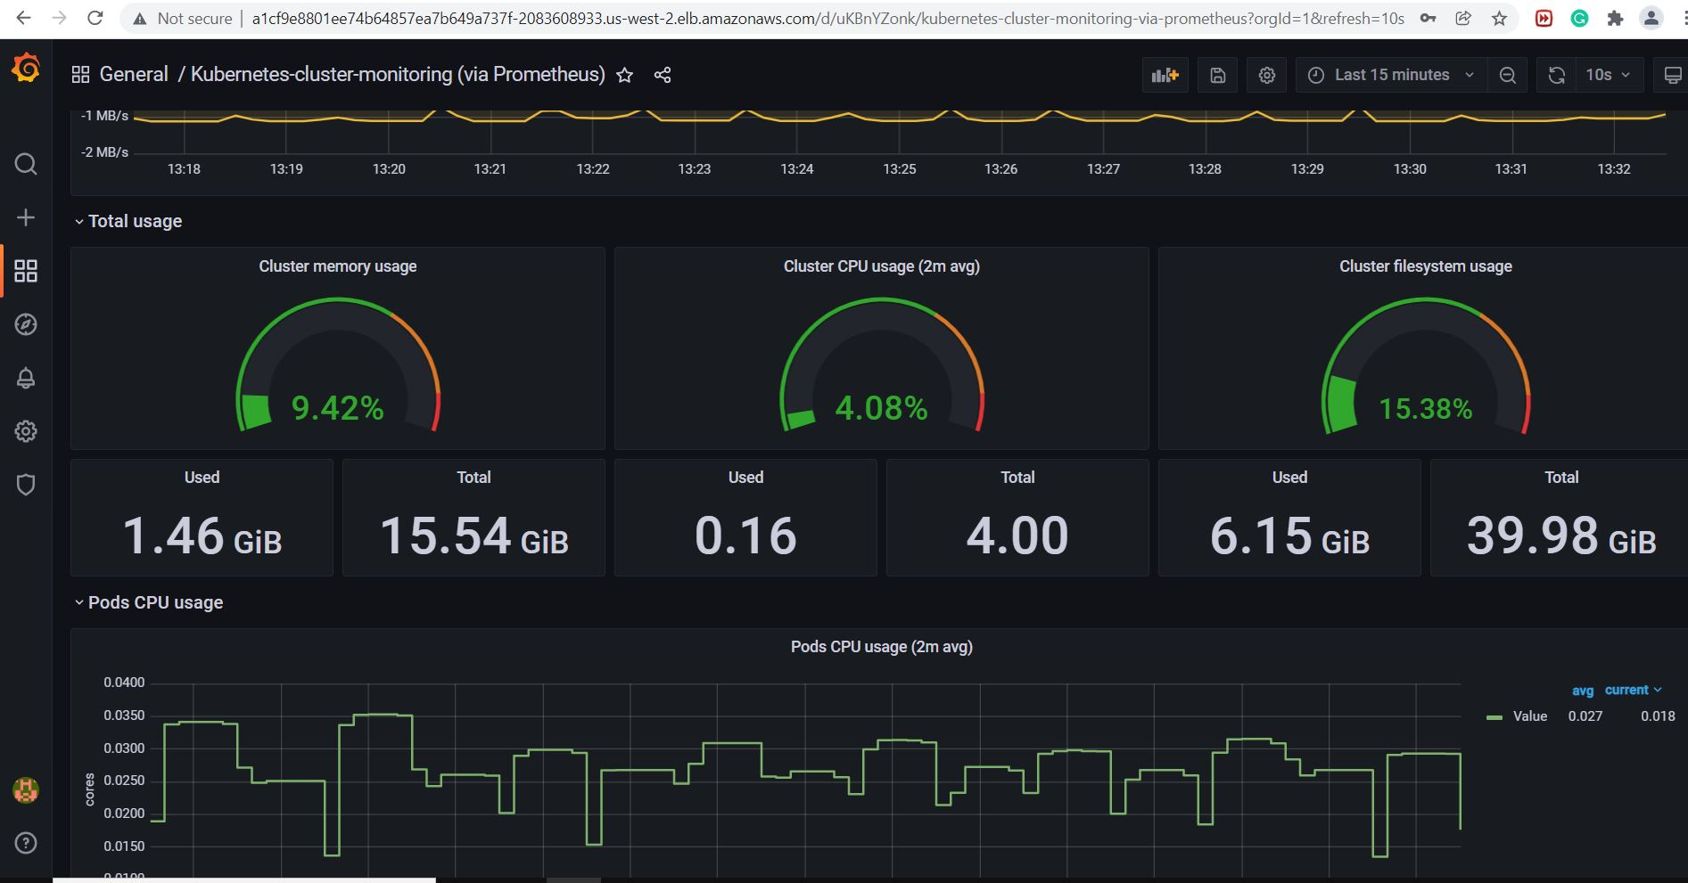
Monitoring - Prometheus

Slide 13
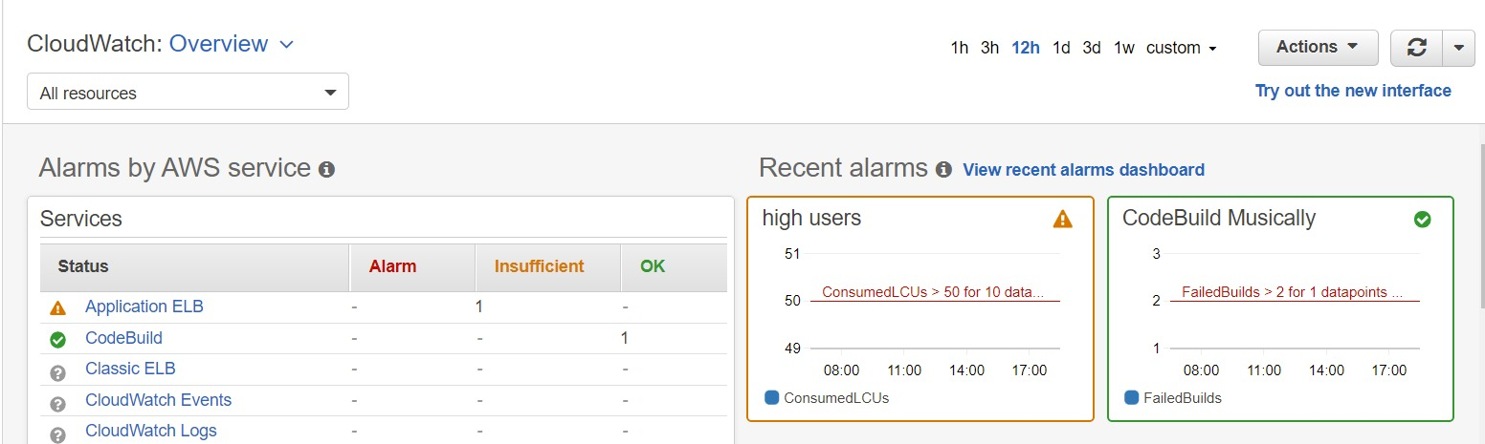
Cloud Watch Logs

Slide 14
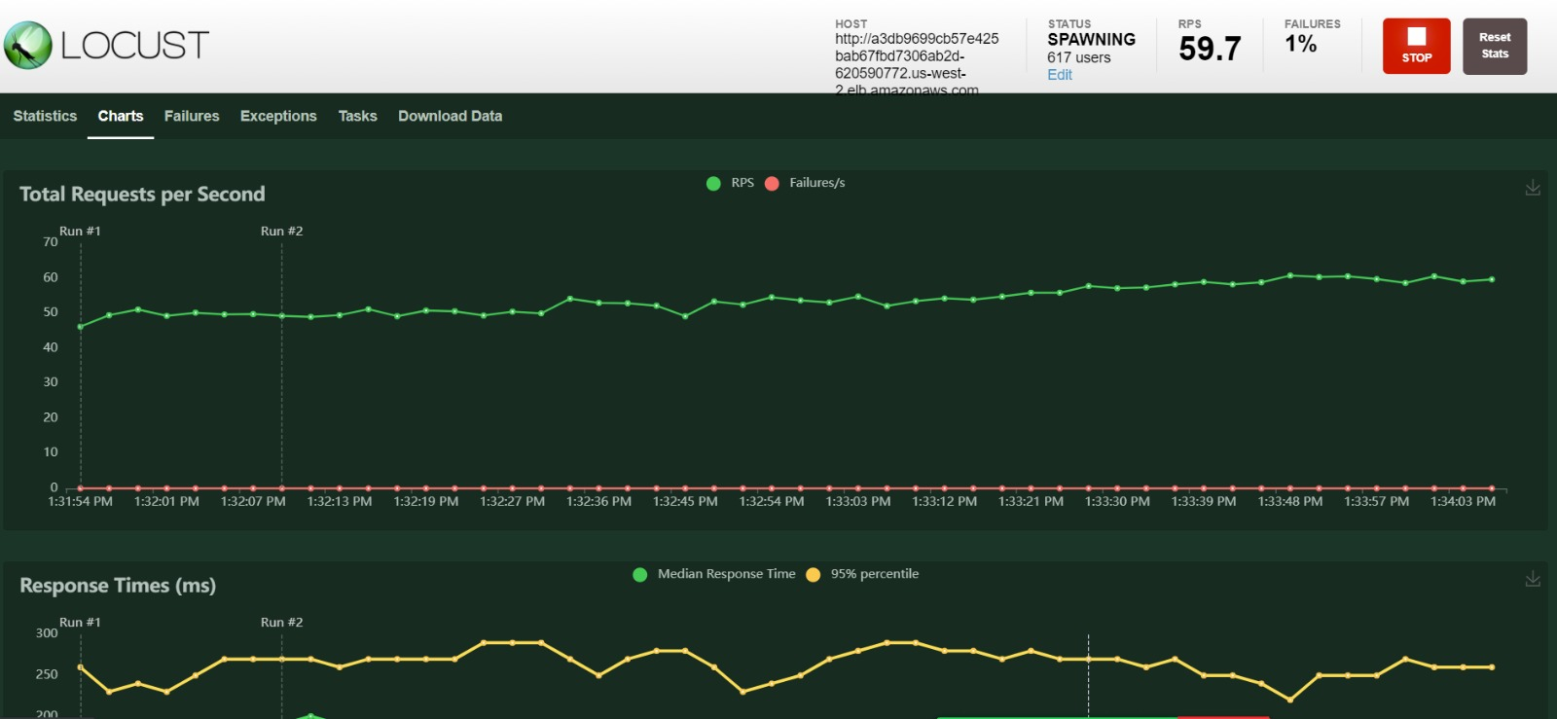
Load Testing - Locust

Slide 15
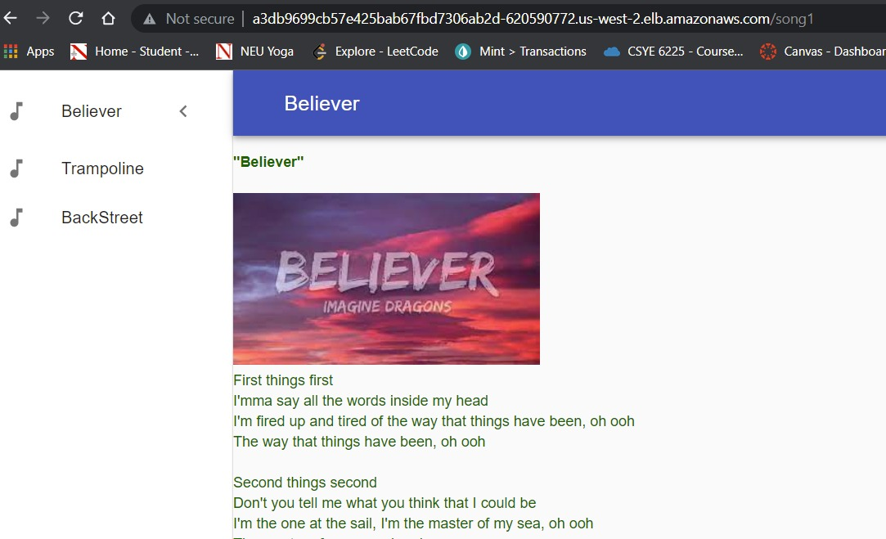
Application - UI

Slide 16
Thank You!

