Slide 1
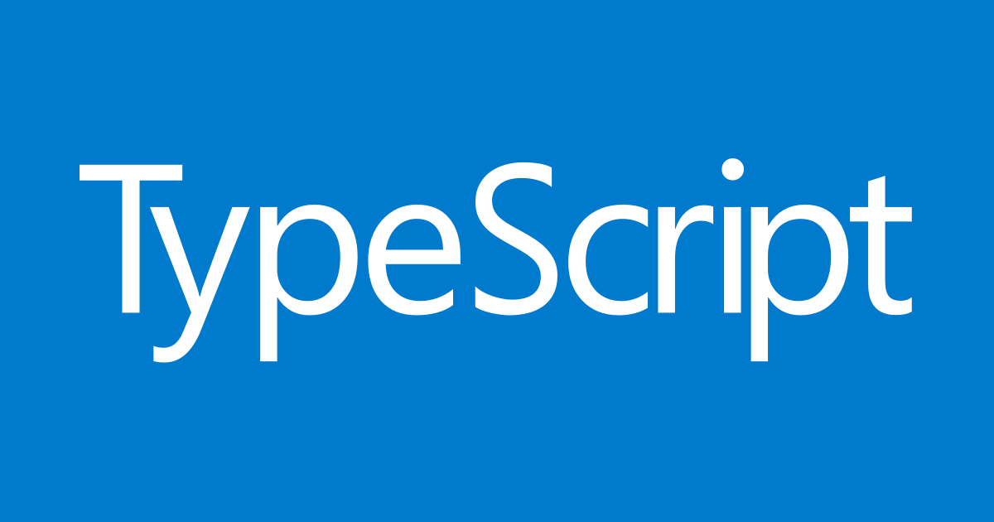
Sintu Singh

Slide 2
In the Session
What is Typescript?
Why Use TypeScript?
Features of TypeScript
Components of TypeScript
Setup typescript
TypeScript – Types
Interfaces
Classes
Enums
TypeScript as Object Oriented
Generics
Modules
Conclusion

Slide 3
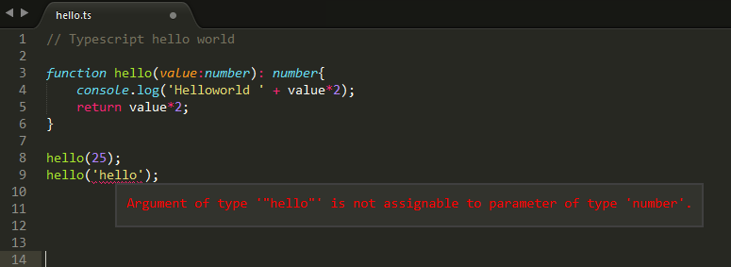
TypeScript ─ Basic Syntax
Notes:
Syntax defines a set of rules for writing programs. Every language specification defines its
own syntax. A TypeScript program is composed of:
• Modules
• Functions
• Variables
• Statements and Expressions
• Comments

Slide 4
Typescript?
TypeScript
JavaScript
Notes:
TypeScript is a superset of JavaScript that provides typed nature to your code. TypeScript can be used for cross-browser development and is an open source project

Slide 5
ES6+Additional features
ES6
Types
TypeScript

Slide 6
Typescript?
Superset of JavaScript
File extension is .ts
Need to compile to JavaScript to be used
.js files are used in actual application
TS files can be debugged with source maps
2.3 is the stable version
First appeared 1 Oct 2012

Slide 7
Why Use TypeScript?
Compilation
Strong Static Typing
TypeScript supports type definitions
supports Object Oriented Programming
Notes:
The benefits of TypeScript include:
• Compilation: JavaScript is an interpreted language. Hence, it needs to be run to
test that it is valid. It means you write all the codes just to find no output, in case
there is an error. Hence, you have to spend hours trying to find bugs in the code.
The TypeScript transpiler provides the error-checking feature. TypeScript will
compile the code and generate compilation errors, if it finds some sort of syntax
errors. This helps to highlight errors before the script is run.
• Strong Static Typing: JavaScript is not strongly typed. TypeScript comes with an
optional static typing and type inference system through the TLS (TypeScript
Language Service). The type of a variable, declared with no type, may be inferred
by the TLS based on its value.
• TypeScript supports type definitions for existing JavaScript libraries. TypeScript
Definition file (with .d.ts extension) provides definition for external JavaScript
libraries. Hence, TypeScript code can contain these libraries.
• TypeScript supports Object Oriented Programming concepts like classes,
interfaces, inheritance, etc

Slide 8
Features of TypeScript
Type annotations and compile-time type checking
Type Inference
Classes
Enums
Interfaces
Access Modifiers and Properties
Function Overloading
Inheritance
Modules
Notes:
Data types:
When you declare any variable in JavaScript you typically do so using var keyword without specifying any particular data type for the variable. For example consider the following variable declaration:
window.onload = function () {
var data = 10;
alert(data);
data = "hello world";
alert(data);
}
In the above piece of code, variable named data is first assigned a number and then a string. As you might have already guessed both the alert() calls correctly output the respective value. However, this can lead to hard to maintain code and can introduce serious errors. TypeScript allows you to declare variables with a specific data type. The types can be classified as primitive or object types. The primitive types include number, bool and string whereas object types include modules, classes and interfaces. The following piece of code shows how this can be done.
Access modifiers
Access modifiers control the accessibility of the members of a class. TypeScript has two access modifiers - public and private. By default the members are public but you can explicitly add a public or private modifier to them. Consider the following piece of code that declares two public and one private variable.
6. Function Overloading
TypeScript allows you to define overloaded functions. This way you can invoke different implementations of a function depending on the parameter. Remember, however, that TypeScript function overloading is bit odd and requires type checking during the implementation. This limitation is due to the fact that TypeScript code finally gets compiled into plain JavaScript and JavaScript doesn't support the concept of function overloading in its true sense. The following simple example shows how two versions of a function can be created in TypeScript:
addCustomer(custId: number);
addCustomer(company:string);
addCustomer(value: any) {
if (value && typeof value == "number") {
alert("First overload - " + value);
}
if (value && typeof value == "string") {
alert("Second overload - " + value);
}
}
As you can see the first two are merely function signatures without any implementation. The first signature has one parameter of type number whereas the second signature has a parameter of type string. The third function contains the actual implementation and has a parameter of type any. The any data type indicates that any type of data can be passed in the parameter. The implementation then has a series of if blocks, each checking the type of the supplied parameter. Accordingly a different piece of code is executed. If you see the IntelliSense for the addCustomer() function it will indicate all the overloaded versions of the function as shown below:
The IntelliSense for the addCustomer() function
The IntelliSense for the addCustomer() function

Slide 9
Components of TypeScript
Language
Compiler
TypeScript Language Service
Notes:
At its heart, TypeScript has the following three components:
1 Language: It comprises of the syntax, keywords, and type annotations.
2 The TypeScript Compiler: The TypeScript compiler (tsc) converts the instructions
written in TypeScript to its JavaScript equivalent.
3 The TypeScript Language Service: The "Language Service" exposes an
additional layer around the core compiler pipeline that are editor-like applications.
The language service supports the common set of a typical editor operations like
statement completions, signature help, code formatting and outlining, colorization,
etc.

Slide 10
Setup Typescript
Steps to install Typescript
1. npm init and create package.json
2. npm install typescript --save -g
3. create a file names tsconfig.json
5. create source files for typescript
6. create typescript source file. Type script source file extension should be filename.ts
7. command "tsc"
8. open sublime
9. install package
10. install typescript definitions
12. Create an html file and include the generated js file

Slide 11
TypeScript – Types
Any
Built in types (number, string, Boolean, null, undefined, object)
Custom types (interface, class, enum)
Notes:
The Type System represents the different types of values supported by the language. The Type System checks the validity of the supplied values, before they are stored or manipulated by the program. This ensures that the code behaves as expected. The Type System further allows for richer code hinting and automated documentation too. TypeScript provides data types as a part of its optional Type System. The data type classification is as given below:

Slide 12
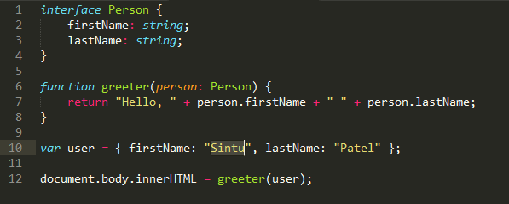
Interfaces
Notes:
Interfaces in TypeScript are similar to interfaces in many object-oriented programming languages. However, in TypeScript, they play the role of defining the "shape" of an object. Objects don't have to explicitly implements interfaces as you would in C# or Java. Instead, interfaces define the expected properties so that the type checker can verify an object with the expected properties is being used.
It often helps in providing a standard structure that the deriving classes would follow.
The following code defines an interface and a function that takes a parameter that adheres to that interface. A new object is then created and passed to the function.
Interfaces in TypeScript are a form of duck typing. If something walks, swims, and quacks like a duck, then it must be a duck. Similarly, if a TypeScript object has all of the properties specified on a particular interface, then that object may be used anywhere an object implementing that interface is expected.
https://www.bricewilson.net/2015/09/27/typescript-interfaces/
https://www.tutorialspoint.com/typescript/typescript_interfaces.htm

Slide 13
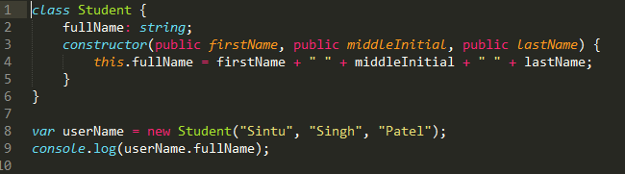
classes
Notes:
TypeScript is object oriented JavaScript. TypeScript supports object-oriented programming features like classes, interfaces, etc. A class in terms of OOP is a blueprint for creating objects. A class encapsulates data for the object. Typescript gives built in support for this concept called class. JavaScript ES5 or earlier didn’t support classes. Typescript gets this feature from ES6.
A class definition can include the following −
Fields − A field is any variable declared in a class. Fields represent data pertaining to objects
Constructors − Responsible for allocating memory for the objects of the class
Functions − Functions represent actions an object can take. They are also at times referred to as methods
These components put together are termed as the data members of the class.
https://www.tutorialspoint.com/typescript/typescript_classes.htm

Slide 14
Class Inheritance
Single − Every class can at the most extend from one parent class
Multiple − A class can inherit from multiple classes. TypeScript doesn’t support multiple inheritance.
Multi-level − The following example shows how multi-level inheritance works.
TypeScript doesn’t support multiple inheritance.
Notes:
TypeScript supports the concept of Inheritance. Inheritance is the ability of a program to create new classes from an existing class. The class that is extended to create newer classes is called the parent class/super class. The newly created classes are called the child/sub classes.
A class inherits from another class using the ‘extends’ keyword. Child classes inherit all properties and methods except constructors from the parent class.
class Shape {
Area:number
constructor(a:number) {
this.Area = a
}
}
class Circle extends Shape {
disp():void {
console.log("Area of the circle: "+this.Area)
}
}
var obj = new Circle(223);
obj.disp()
Inheritance can be classified as −
Single − Every class can at the most extend from one parent class
Multiple − A class can inherit from multiple classes. TypeScript doesn’t support multiple inheritance.
Multi-level − The following example shows how multi-level inheritance works.
class Root {
str:string;
}
class Child extends Root {}
class Leaf extends Child {} //indirectly inherits from Root by virtue of inheritance
var obj = new Leaf();
obj.str ="hello"
console.log(obj.str)

Slide 15
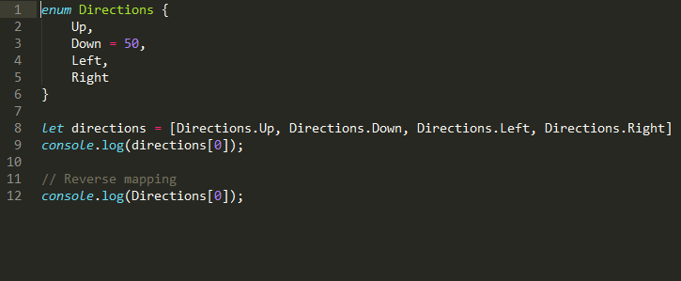
Enums
Notes:
Enums allow us to define a set of named numeric constants. An enum can be defined using the enum keyword.
Enums are real objects that exist at runtime. One reason is the ability to maintain a reverse mapping from enum values to enum names.
The body of an enum consists of zero or more enum members. Enum members have numeric value associated with them and can be either constant or computed. An enum member is considered constant if:
//////
An enum is a way to organize a collection of related values. Many other programming languages (C/C#/Java) have an enum data type but JavaScript does not. However TypeScript does. Here is an example definition of a TypeScript enum:
TypeScript enums are number based. This means that numbers can be assigned to an instance of the enum, and so can anything else that is compatible with number.

Slide 16
TypeScript and Object Orientation
class Greeting
{
greet():void
{
console.log("Hello World!!!")
}
}
var obj= new Greeting();
obj.greet();
Notes:
TypeScript is Object-Oriented JavaScript. Object Orientation is a software development
paradigm that follows real-world modelling. Object Orientation considers a program as a
collection of objects that communicate with each other via mechanism called methods.
TypeScript supports these object oriented components too.
• Object: An object is a real time representation of any entity. According to Grady
Brooch, every object must have three features:
o State: described by the attributes of an object
o Behavior: describes how the object will act
o Identity: a unique value that distinguishes an object from a set of similar
such objects.
• Class: A class in terms of OOP is a blueprint for creating objects. A class
encapsulates data for the object.
• Method: Methods facilitate communication between objects

Slide 17
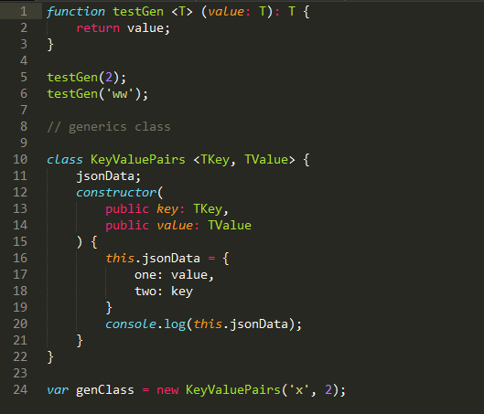
Generics
Notes:
Generics are a way to create functions and classes that define a behavior that can be reused across many different types while retaining the full information about that type.

Slide 18
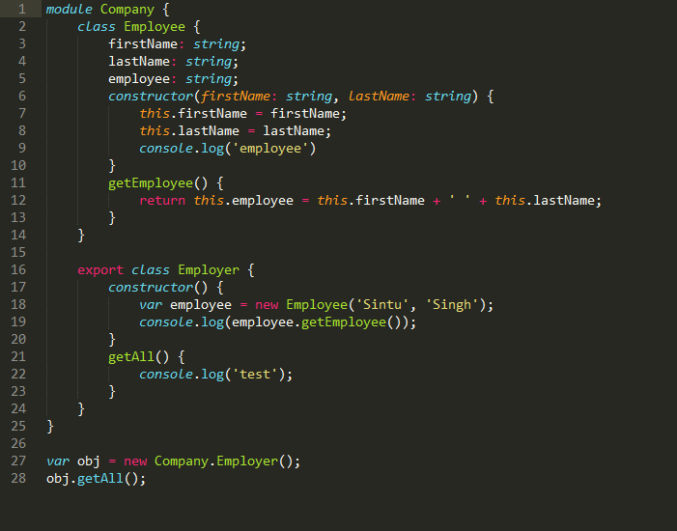
Modules
Notes:
As your TypeScript code base grows it becomes important to organize classes and interfaces for better maintainability. TypeScript modules allow you to do just that. A module is a container for your code that helps you organize your code in a neat way. Conceptually you may find them similar to .NET namespaces. Let's see how to create a module.
The above code defines Company module using the module keyword. The Company module contains three classes - Employee, EmployeeHelper and Customer. By default all the classes from a module are accessible only within that module. That is why it is alright to access the Employee class inside the EmployeeHelper class from the same module but you can't access the Employee class from outside the Company module. If you wish to access a class from a module from the outside world you need to "export" it as in the case of the Customer class.

Slide 19
Thanks
Angular 2

