Slide 1

Sintu Singh

Slide 2
In the Session
What is TypeScript?
What does TypeScript offer?
Static Type Checking
Typescript Types
Class based objects
ES6 features
Setup Typescript
Annotations
Interface
Classes
Polymorphism
Enums
Generic
Modules

Slide 3
What is Typescript?
First appeared 1 Oct 2012 and Developed by Microsoft.
Superset of JavaScript
File extension is .ts
Need to compile to JavaScript.
TS files can be debugged with source maps
2.3 is the stable version
Notes:
Typescript is a superset of JavaScript developed by Microsoft. Superset means here anything you write in JavaScript is a valid typescript. It inherits all the functionalities of JavaScript and add some extra features and syntax. Typescript compiles to JavaScript as the browser can not read the typescript file. It can read the JavaScript file. Typescript can be easily integrated into the JavaScript projects easily. It was designed for larger applications. It does not mean that you can not use it in small applications.

Slide 4
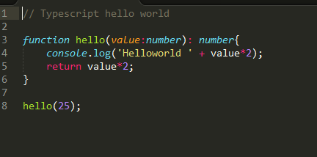
TypeScript ─ Basic Syntax

Slide 5
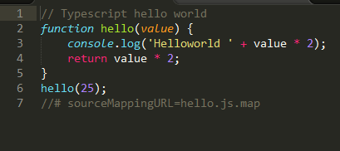
Compiled TS Code

Slide 6
What does Typescript Offer?
Static Type checking
Class based objects
Modularity
ES 6 Features
Notes:
TypeScript gives us static type checking. By default the JavaScript is untyped language. It means we don’t have to specify the type of variables. High level language like java or c requires you to specify the type. The great thing about typescript that types are completely optional. You skip the types as per requirements.
Typescript supports the class based objects. It is fully compatible with ES6.
Typescript also makes the JavaScript more modular. So we can import other files, modules, or components.
We get all ES6 features like Arrow functions. Also we can use let and const for declaring the variables.

Slide 7
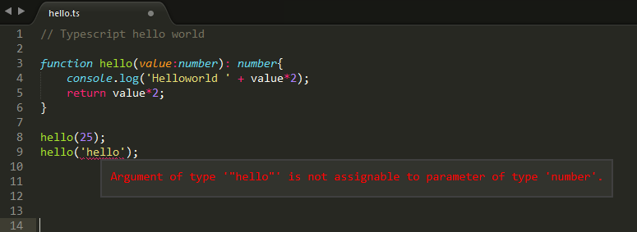
Static Type Checking
Completely optional
Helps us find and prevent bugs
It makes the code more readable and descriptive
Notes:
This is one of the main features of typescript. We can check and assign types for variables, parameters, and functions. This is completely optional. It will throw an error if you define a type to a variable and assign the wrong type value to it. Like if you define a variable number and assign the string value to it. Than it will throw an error.

Slide 8
Typescript?
TypeScript
JavaScript
Notes:
TypeScript is a superset of JavaScript that provides typed nature to your code. TypeScript can be used for cross-browser development and is an open source project

Slide 9
TypeScript ─ Basic Syntax
Notes:
Syntax defines a set of rules for writing programs. Every language specification defines its
own syntax. A TypeScript program is composed of:
• Modules
• Functions
• Variables
• Statements and Expressions
• Comments

Slide 10
TypeScript Types
Basic Types | Advanced Types
String | Any
Number | Void
Boolean | Null
Array | Tuple
 | Enum
 | Generic
Notes:
So here these are the types that are used in type script. There are some basic types that we usually see in JavaScript like String, Number, Boolean, and Array. We have some other types like any. Any mean we can define a variable type any and it will accept any type value. Void is no type return. You can define the void if the function does not return anything.
Tuple: Tuple is an array with fixed types.
Enums: Enums which are for enumerated values.
Generics: It specifies the types of constraints. It is great for reusable code.

Slide 11
Class based objects
Object oriented programming in JS
No Prototypes
Encapsulation
Inheritance.
Modifiers
Notes:
The huge advantage of typescript is the use of classes. It gives and ability to use true object oriented programming to JavaScript applications. We can define classes, properties, method. We can stop prototype based objects. It provides encapsulation. And keeps the functionality of certain resources at one place.
With inheritance, we can inherit classes.
We can use access modifiers like public, private, protected. So the classes is the create reason to use the typescript.

Slide 12
ES6 Features
Default Parameters in ES6
Template Literals in ES6
Multi-line Strings in ES6
Destructuring Assignment in ES6
Arrow Functions in ES6
Promises in ES6
Block-Scoped Constructs Let and Const
Classes in ES6
Modules in ES6

Slide 13
Setup Typescript
Steps to install Typescript
npm init and create package.json
npm install typescript --save -g
create a file names tsconfig.json
create source files for typescript
create typescript source file. Type script source file extension should be filename.ts
command "tsc"
open sublime
install package
install typescript definitions
Create an html file and include the generated js file

Slide 14
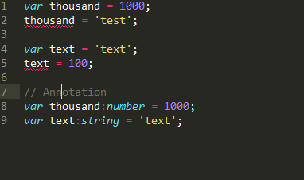
Annotations
Notes:
Typescript provides the concept of annotations. This allows to add meta data to the application.

Slide 15
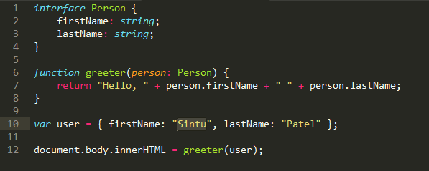
Interfaces
Notes:
Interfaces in TypeScript are similar to interfaces in many object-oriented programming languages. However, in TypeScript, they play the role of defining the "shape" of an object. Objects don't have to explicitly implements interfaces as you would in C# or Java. Instead, interfaces define the expected properties so that the type checker can verify an object with the expected properties is being used.
It often helps in providing a standard structure that the deriving classes would follow.
The following code defines an interface and a function that takes a parameter that adheres to that interface. A new object is then created and passed to the function.
Interfaces in TypeScript are a form of duck typing. If something walks, swims, and quacks like a duck, then it must be a duck. Similarly, if a TypeScript object has all of the properties specified on a particular interface, then that object may be used anywhere an object implementing that interface is expected.
https://www.bricewilson.net/2015/09/27/typescript-interfaces/
https://www.tutorialspoint.com/typescript/typescript_interfaces.htm

Slide 16
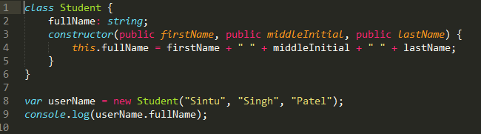
classes

Slide 17
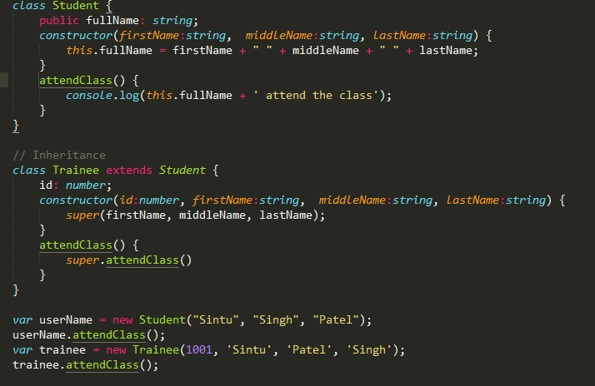
Class Inheritance
Notes:
TypeScript supports the concept of Inheritance. Inheritance is the ability of a program to create new classes from an existing class. The class that is extended to create newer classes is called the parent class/super class. The newly created classes are called the child/sub classes.
A class inherits from another class using the ‘extends’ keyword. Child classes inherit all properties and methods except constructors from the parent class.
class Shape {
Area:number
constructor(a:number) {
this.Area = a
}
}
class Circle extends Shape {
disp():void {
console.log("Area of the circle: "+this.Area)
}
}
var obj = new Circle(223);
obj.disp()
Inheritance can be classified as −
Single − Every class can at the most extend from one parent class
Multiple − A class can inherit from multiple classes. TypeScript doesn’t support multiple inheritance.
Multi-level − The following example shows how multi-level inheritance works.
class Root {
str:string;
}
class Child extends Root {}
class Leaf extends Child {} //indirectly inherits from Root by virtue of inheritance
var obj = new Leaf();
obj.str ="hello"
console.log(obj.str)

Slide 18
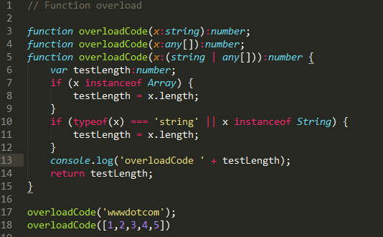
Polymorphism
Method overloading
Notes:
Polymorphism in its pure definition means to have many shapes. When this is applied to software development, it applies to a wide variety of techniques that enable us to use a variety of different objects or methods to perform a task. In pure OOP languages, polymorphism refers to the use of method overloading, operator overloading, and method overriding.

Slide 19
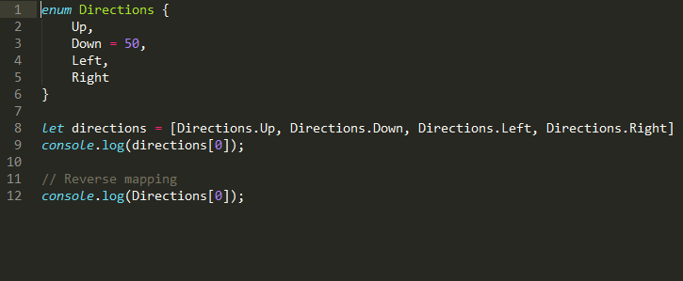
Enums
Notes:
Enums allow us to define a set of named numeric constants. An enum can be defined using the enum keyword.
Enums are real objects that exist at runtime. One reason is the ability to maintain a reverse mapping from enum values to enum names.
The body of an enum consists of zero or more enum members. Enum members have numeric value associated with them and can be either constant or computed. An enum member is considered constant if:
//////
An enum is a way to organize a collection of related values. Many other programming languages (C/C#/Java) have an enum data type but JavaScript does not. However TypeScript does. Here is an example definition of a TypeScript enum:
TypeScript enums are number based. This means that numbers can be assigned to an instance of the enum, and so can anything else that is compatible with number.

Slide 20
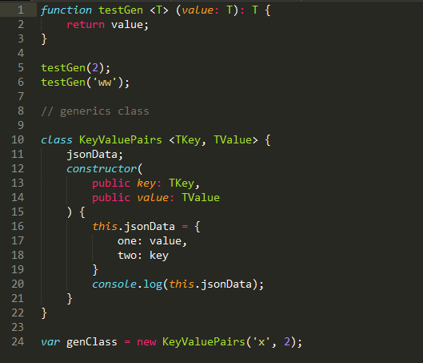
Generics
Notes:
Generics are a way to create functions and classes that define a behavior that can be reused across many different types while retaining the full information about that type.
Components that are capable of working on the data of today as well as the data of tomorrow will give you the most flexible capabilities for building up large software systems.

Slide 21
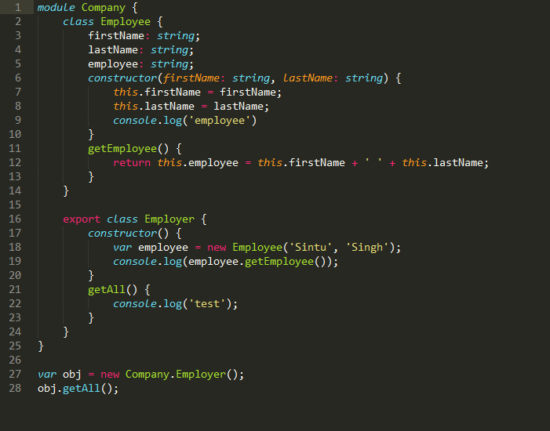
Modules
Notes:
As your TypeScript code base grows it becomes important to organize classes and interfaces for better maintainability. TypeScript modules allow you to do just that. A module is a container for your code that helps you organize your code in a neat way. Conceptually you may find them similar to .NET namespaces. Let's see how to create a module.
The above code defines Company module using the module keyword. The Company module contains three classes - Employee, EmployeeHelper and Customer. By default all the classes from a module are accessible only within that module. That is why it is alright to access the Employee class inside the EmployeeHelper class from the same module but you can't access the Employee class from outside the Company module. If you wish to access a class from a module from the outside world you need to "export" it as in the case of the Customer class.

Slide 22
Thanks
Q&A

