Slide 1


Online Book Store
Submitted By:-
Chetan Gupta
(180968106025)
Department of Bachelor of Computer Applications

Slide 2
Abstract
This project is a web based online book shopping store for an existing shop. The project objective is to deliver the online shopping application into web platform. This project is an attempt to provide the advantages of online shopping to customers of a real shop. It helps buying the products in the shop anywhere through internet by using browser. Thus the customer will get the service of online shopping and home delivery from his favorite shop. This system can be implemented to any shop in the locality or to multinational branded shops having retail outlet chains. If shops are providing an online portal where their customers can enjoy easy shopping from anywhere, the shops won’t be losing any more customers to the trending online shops such as Flipkart. Since the application is available in the Browser it is easily accessible and always available.

Slide 3
Introduction
Online Book store is an online web application where the customer can purchase books online. Through a web browser the customers can search for a book by its title or author, later can add to the shopping cart and finally purchase using credit card transaction.

Slide 4
Module
Master Maintenance: This module consists of information about the book items and services. This includes two sub-modules, old books and new books.
Product master includes the information about particular product, such as product number, item, name, and category, images of products, description, features, and constraints of products. All these will be entered to the database through product master and hence made available in the website. In Other words product master is the admin area for the vendors/sellers where they can put information about their products which are to be displayed in the website.
Price master deals with the cost of the product, discounts applicable for the particular product of a vendor/seller.
Transactions: Payment will be done on Delivery of the items (Cash on Delivery).

Slide 5
Reporting: In this module all reports will be generated. Whenever an item is sold, or customer orders a product, its vendor should be sent an alert via email immediately so that he can ship that item soon. This module has 3 sub modules; Stock Reports, Order Reports and Delivery Reports.
Stock Report will produce reports of the quantity of the products available and product status.
Order Report will have the list of products ordered and the customer details who have bought that product, which are undelivered.
Delivery Reports will generate products list, which are delivered to customers.
House Keeping: This module takes care of data which are older than a certain period. It will allow the vendor to archive the reports generated or transaction and business history reported by Reporting module.

Slide 6
Software Requirements Specification
Operating System : Windows 7 and upwards operating system
Server : Apache Tomcat (Localhost)
Language : Java 11
Database : MySQL 8.0.19
IDE : NetBeans 12.0
Browser : Chrome, Edge, Firefox

Slide 7
Hardware Requirements Specification
Processor : Dual core Intel
Clock Speed : 1.8 GHz
Storage : 750 MB free disk space
RAM : 2GB or more
Keyboard : 101 Keys
Mouse : Optical Mouse

Slide 8
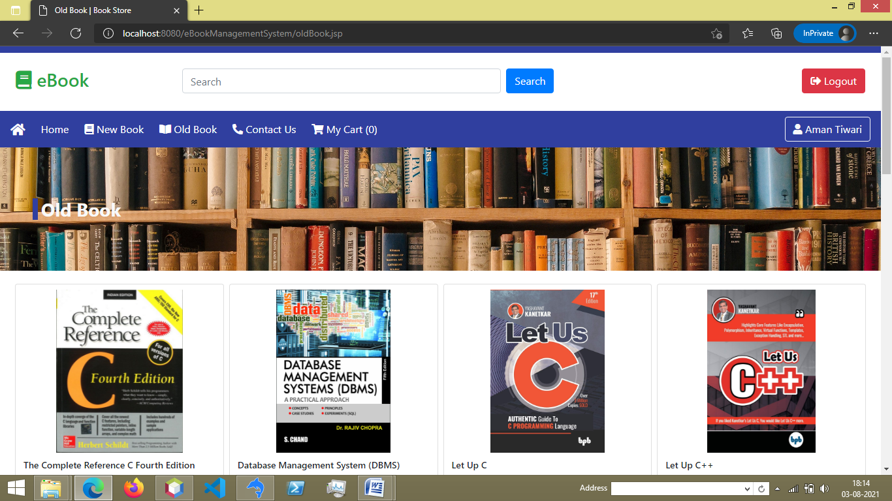
Output

Slide 9
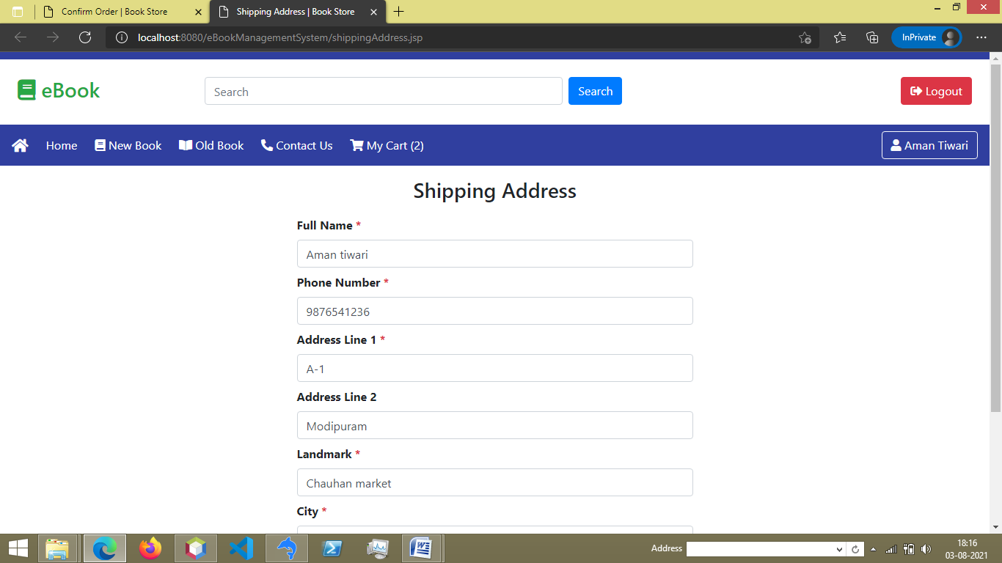

Slide 10
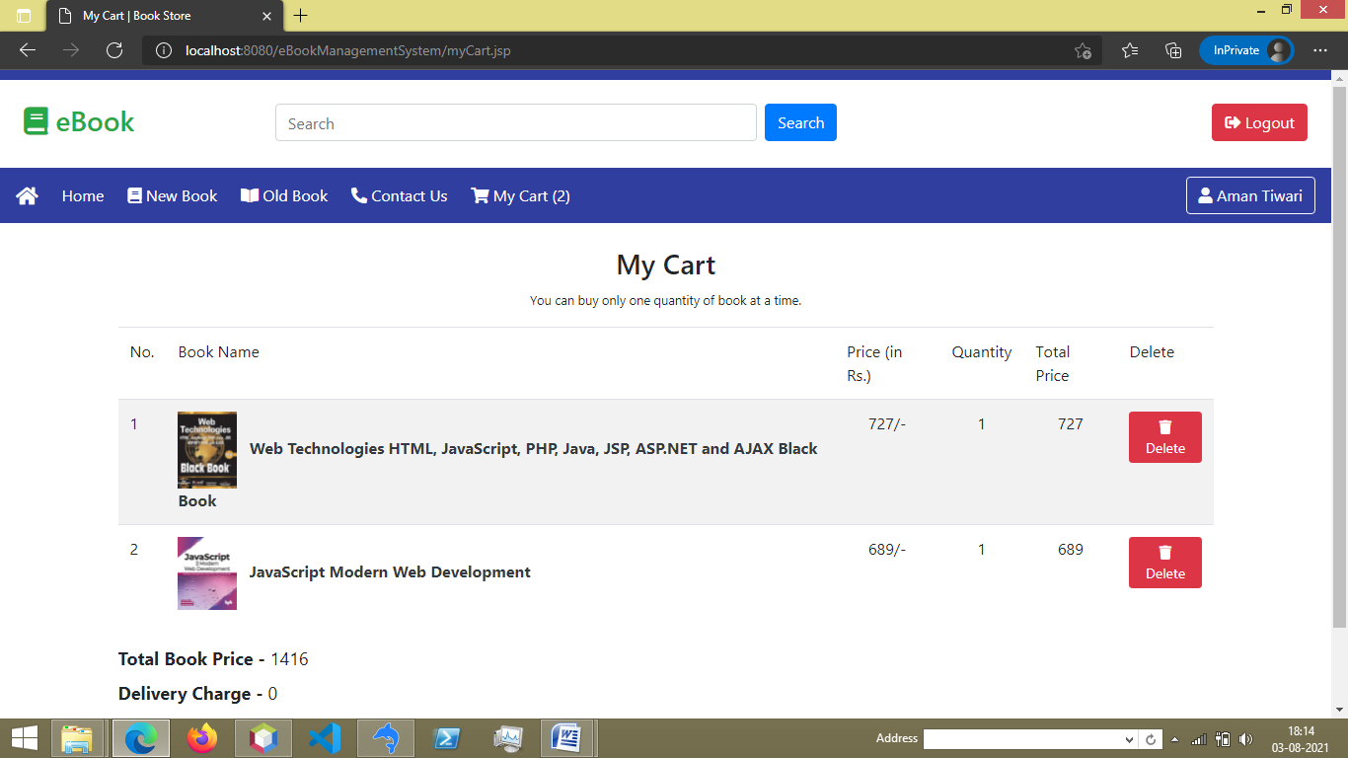

Slide 11
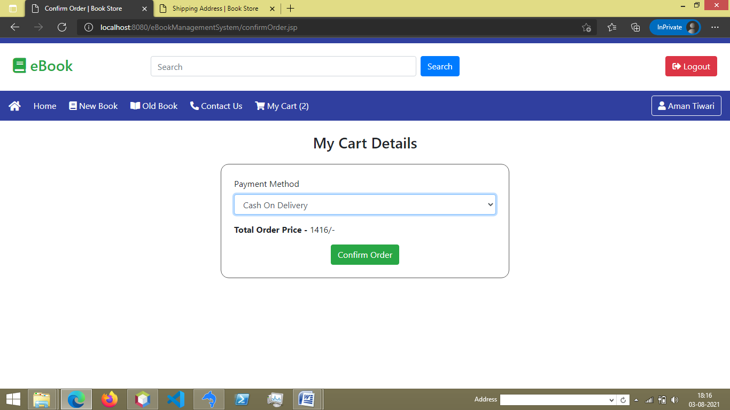

Slide 12
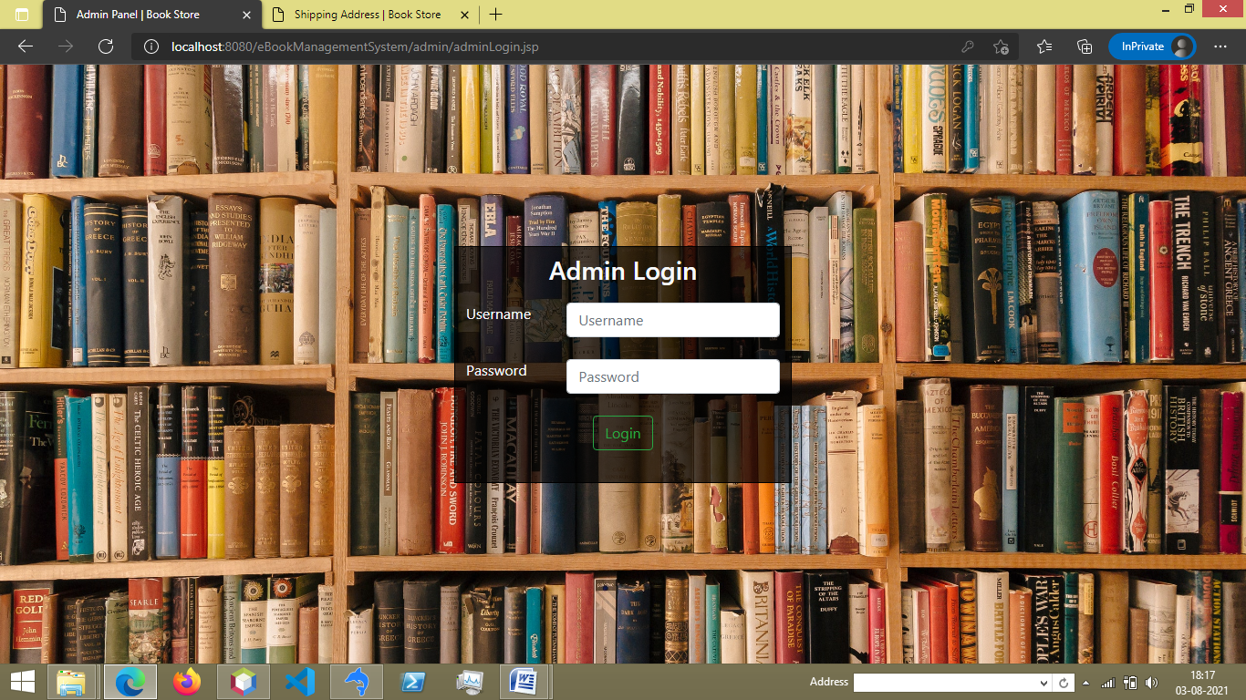

Slide 13
Conclusion
The switch from written books being from bookstores to being ordered online or even just digital copies has had profound effects on the industry including bookstores and libraries and the general people of the world. The positives include easy access for everyone and cheaper books along with saving natural resources. The negatives however are much greater and cannot be ignored. Some of the negatives include the loss of jobs and businesses through the digitalization of books, the loom threat of Google books, as well as losing a sense of our past. Books have played such a large role in human history that it is bittersweet to be replacing them. To me, it seems that e-books, Google books, and online retailers are the future and that the future is good. But, if you look past all the conveniences and look at the people being affected by this then it becomes clear that this is not a future that I want.

Slide 14
Future Work
Should be added payment gateway
Can be added inventory management system
Can be added multiple branches
Can be added multilingual to this site
Many features can be added this project to make it more robust.
Want to Increase facilities of this project.
Want to add printing option.
Want to develop graphical design.
Want to publish this website in online.
Want to remove all the limitation

Slide 15
Bibliography and References
Java Documentation - Get Started (oracle.com)
Java Tutorial | Learn Java - javatpoint
Java Tutorial (w3schools.com)
SQL Tutorial - Tutorialspoint
Stack Overflow - Where Developers Learn, Share, & Build Careers
YouTube
Herbert Schildt “Java: The Complete Reference” Tata McGraw-Hill Publishing
Company Limited, Seventh Edition

