Slide 1
E- Governance using Chatbot System
Team No. 5
Guided by : Mr Shamaun Alam
Lead by : Sinurita Mahapatra
Members : Aayush Kumar Poi
Debasmita Das
Sahil Kumar Dhala
Abhishek Panda
C&P Course
Notes:
Note:

Slide 2
E- Governance using Chatbot System
UNIT 1. E - Governance
1.1. Introduction
1.2. Objective
UNIT 2. Challenges and Solutions
2.1. Challenges
2.2. Solutions
UNIT 3. Chatbot System
3.1. What is a chatbot
3.2. Tools Used
3.3 Prototype model
3.4. Reference
Notes:
Note:

Slide 3
UNIT 1. 1.1. E Governance
Introduction
Electronic governance or e-governance is the application of information technology for delivering government services where there is exchange of information, communication transactions, integration of various stand-alone systems between government to citizen (G2C), government-to-business (G2B), government-to-government (G2G), government-to-employees (G2E [Through e-governance, government services are made available to citizens through IT.
The three main target groups that can be distinguished in governance concepts are government, citizens, and businesses/interest groups.
Notes:
Note:
Some examples of random experiments are:
+Flipping a coin.
+Rolling dices.
You will start with these simple examples and build a basis of probability.

Slide 4
UNIT 1. 1.2. E Governance
Objective
To support and simplify governance for government, citizens, and businesses.
To make government administration more transparent and accountable while addressing the society’s needs and expectations through efficient public services and effective interaction between the people, businesses, and government.
To reduce corruption in the government.
To ensure speedy administration of services and information.
To reduce difficulties for business, provide immediate information and enable digital communication by e-business.
Notes:
Note:
Some examples of random experiments are:
+Flipping a coin.
+Rolling dices.
You will start with these simple examples and build a basis of probability.

Slide 5
UNIT 2. 2.1. CHALLENGES AND SOLUTIONS
Challenges
Reaching to everyone
Lack of awareness about the scheme
Lack of channels for communication
Lack of management and administration
Bureaucracy and corruption
Notes:
Note:
Some examples of random experiments are:
+Flipping a coin.
+Rolling dices.
You will start with these simple examples and build a basis of probability.

Slide 6
UNIT 2. 2.2. CHALLENGES AND SOLUTIONS
Solutions
Inform educate and awareness
Push personalized messages and program announcements
Real time media messaging formats (like text , video and pictures)
Systematic co- ordination between government , employees and citizens
Stringent actions against bureaucracy and corruption
Notes:
Note:
Some examples of random experiments are:
+Flipping a coin.
+Rolling dices.
You will start with these simple examples and build a basis of probability.

Slide 7
UNIT 3. 3.1. CHATBOT
What is Chatbot?
A chatbot is a computer program that simulates and processes human conversation (either written or spoken), allowing humans to interact with digital devices as if they were communicating with a real person.
Chatbots can be as simple as rudimentary programs that answer a simple query with a single-line response, or as sophisticated as digital assistants that learn and evolve to deliver increasing levels of personalization as they gather and process information.
Notes:
Note:
Some examples of random experiments are:
+Flipping a coin.
+Rolling dices.
You will start with these simple examples and build a basis of probability.

Slide 8



UNIT 3. 3.2 CHATBOT
Tools Used
HTML
CSS
JavaScript
Python
Django
ChatGPT
Notes:
Note:
Some examples of random experiments are:
+Flipping a coin.
+Rolling dices.
You will start with these simple examples and build a basis of probability.

Slide 9
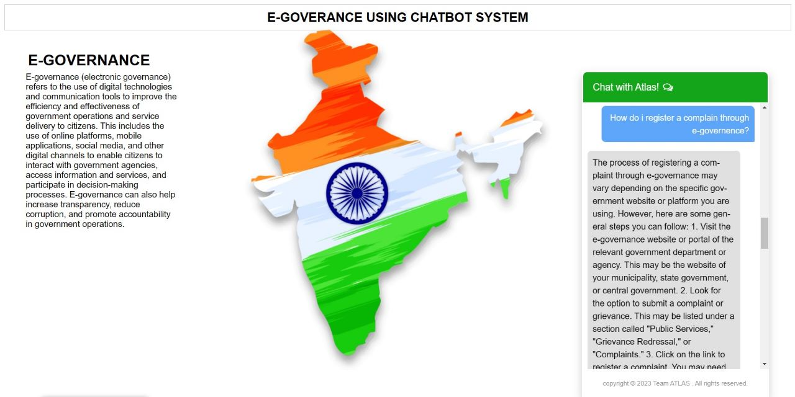
UNIT 3. 3.3. CHATBOT
Prototype Model
Notes:
Note:
Some examples of random experiments are:
+Flipping a coin.
+Rolling dices.
You will start with these simple examples and build a basis of probability.

Slide 10

UNIT 3. 3.4. CHATBOT
Reference
Scan and visit our website for more information
Notes:
Note:
Some examples of random experiments are:
+Flipping a coin.
+Rolling dices.
You will start with these simple examples and build a basis of probability.

