Slide 1
SEMINAR I
ADIABATIC QUANTUM COMPUTATION
Vid Eržen
Advisor: Prof. Dr. Dragan Mihailović
Co-advisor: Dr. Jaka Vodeb
March 2022

Slide 2
Contents
Introduction
The algorithm
The adiabatic theorem
Encoding problems
Example: graph partitioning
Experimental realization
Ising spin glasses
2

Slide 3
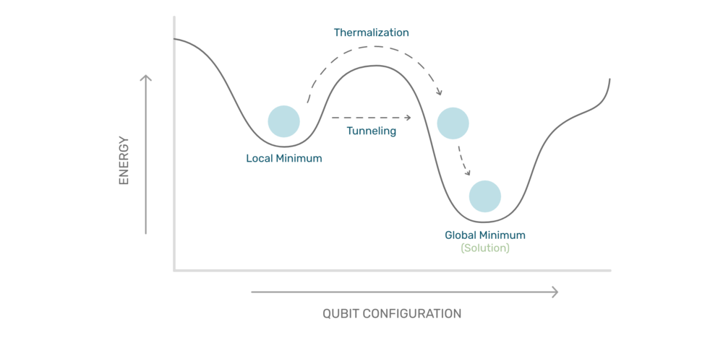
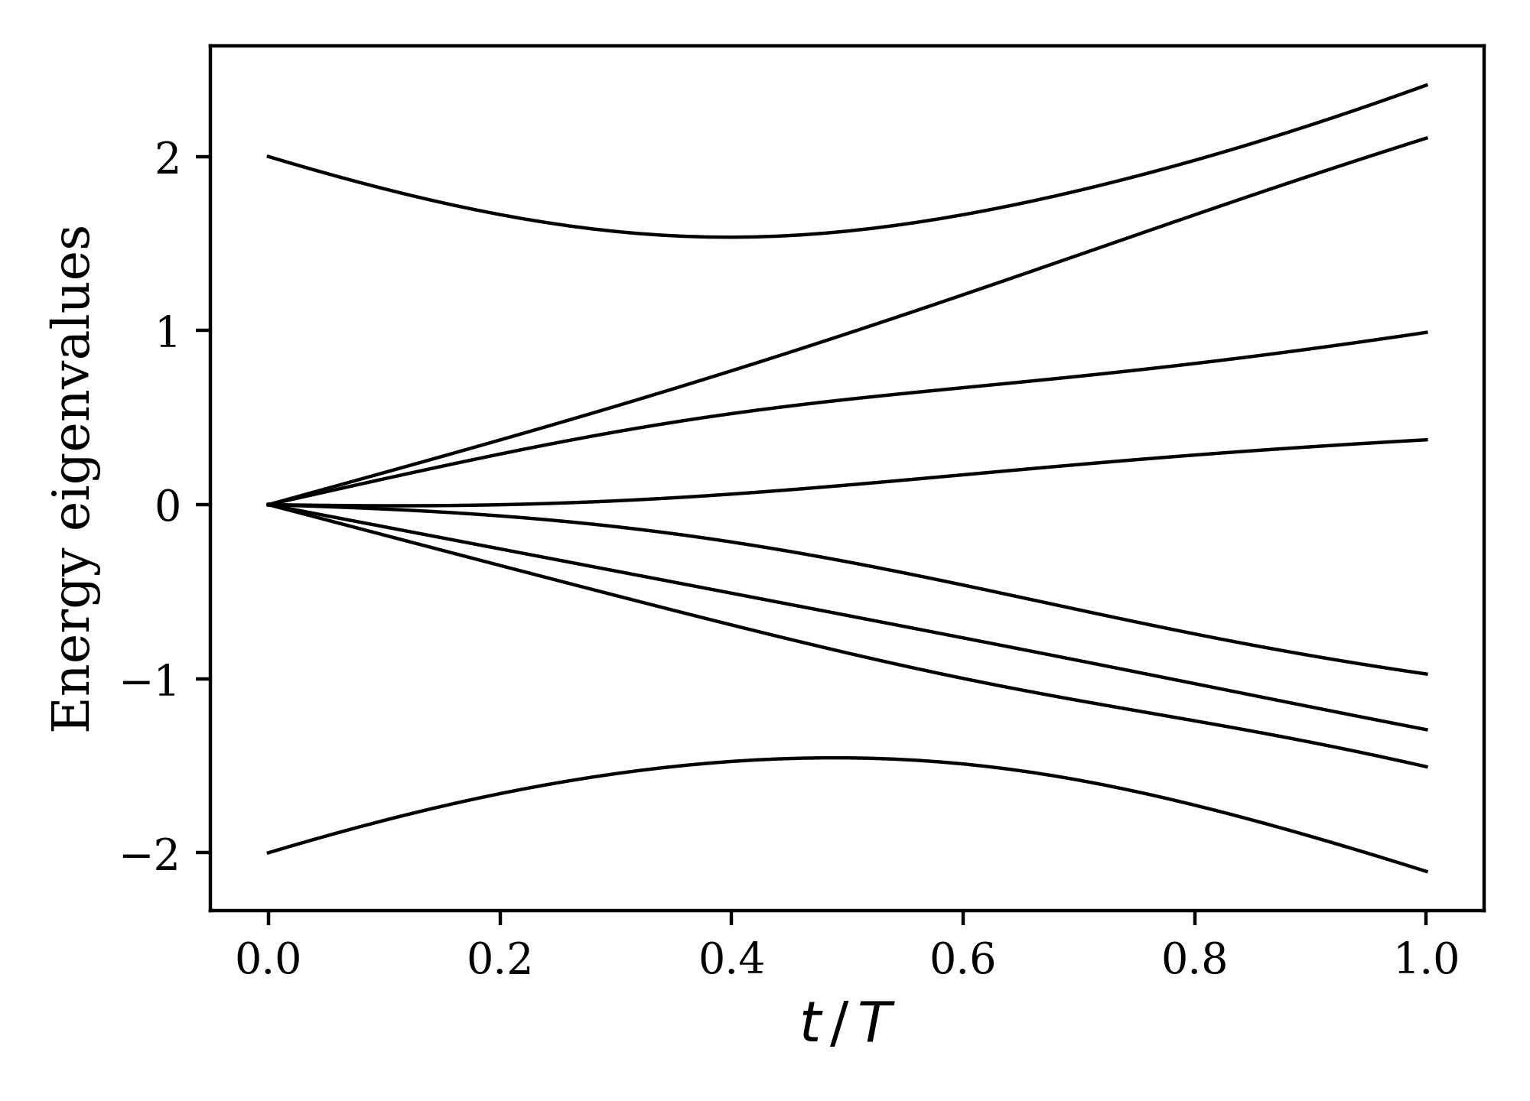
Introduction
Optimization algorithm
Quantum annealing uses quantum fluctuations - tunneling for escaping local minima.
Adiabatic quantum computer (AQC) uses adiabatic evolution to find the solution.
3

Slide 4
The algorithm
Initialize the system in the ground state of the Hamiltonian .
Vary the Hamiltonian for a period T. The final Hamiltonian should encode the optimization problem.
Final state of the system represents the solution of the encoded problem.
4

Slide 5
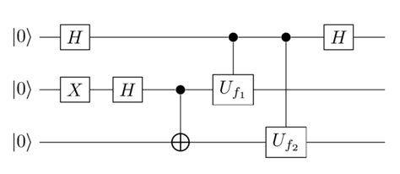
Comparison with the gate model
AQC
Uses only the ground state of a time-dependent Hamiltonian.
Equivalent to the gate model.
Gate model
Series of quantum gates to manipulate qubits.
Uses full Hilbert space.
5

Slide 6
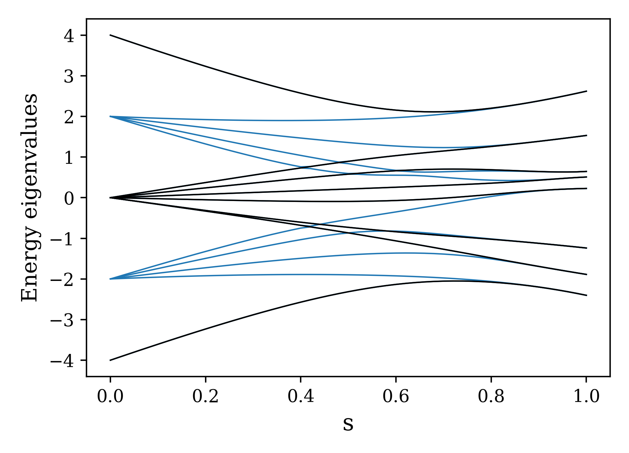
Adiabatic theorem
Define .
Assumptions:
lowest two eigenvalues, , do not cross.
Zero temperature, isolated system
System will remain in the instantaneous
ground state if
Spectrum of
which is invariant under . Only
eigenvalues from different sectors cross.
6

Slide 7
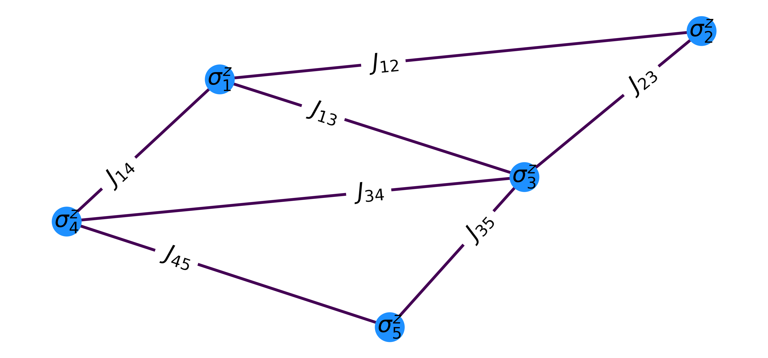
Problem Hamiltonian
Ising Hamiltonian is used by D-Wave.
A lot of optimization problems already translated into this form.
Searching for the ground state of is an NP-hard problem for classical computers.
7

Slide 8
Graph partitioning
Cut a graph with vertices V and edges E into two partitions of equal size, such that the number of edges between them is minimal.
We place a spin on each vertex. Problem is equivalent to the minimization of
is the Ising Hamiltonian with
8

Slide 9
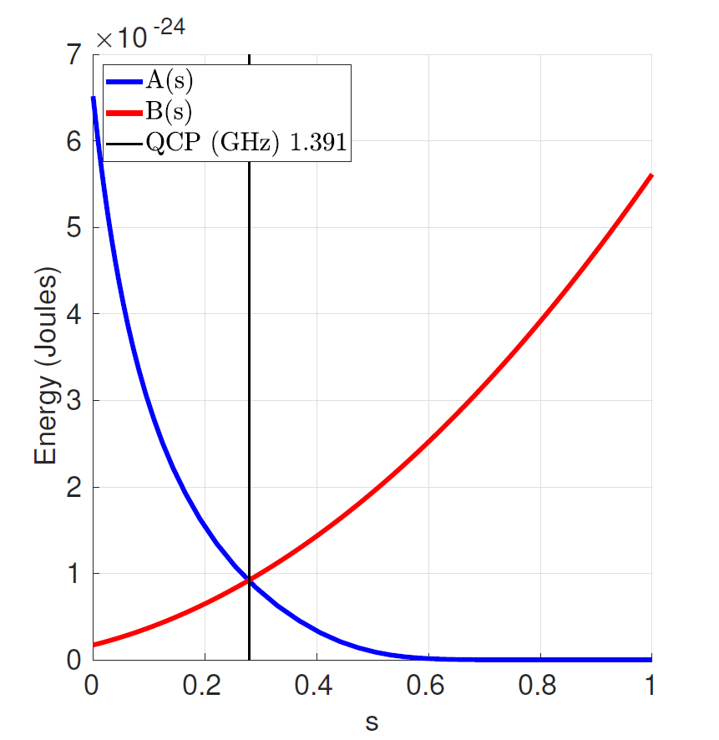
Full Hamiltonian
Initial Hamiltonian requirements:
Easily achievable ground state,
Must not include only operators.
D-Wave has chosen with the
ground state .
Full time-dependent Hamiltonian
D-Wave Systems, D-Wave Annealing implementations and controls
9

Slide 10
Complexity of AQC
System size – number of qubits: for most NP problems.
Time complexity: scaling of time it takes to run an algorithm with problem size :
Scaling of the gap:
For general optimization problems, there is no exponential speedup compared to classical algorithms → improved methods: diabatic, reverse adiabatic computation.
Polynomial speedup (e.g. Grover’s problem: unordered list search)
10

Slide 11
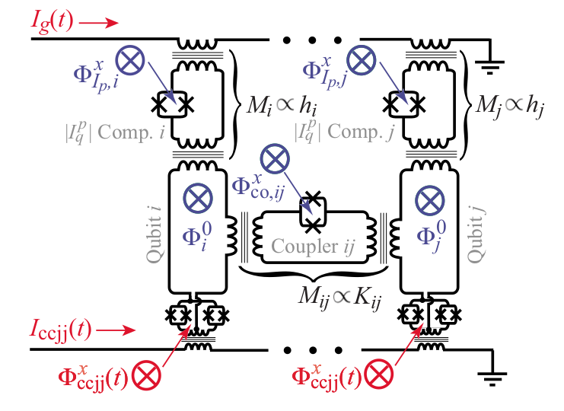
Experimental realization
D-Wave uses radio-frequency SQUIDs (superconducting quantum interference devices) to implement
5700 qubits: each connected with 15 others.
40000 couplers.
Finite temperature (15mK), coupling to the environment and imperfect qubits worsen the results.
D-Wave Systems, D-Wave Annealing implementations and controls
R Harris et al., Physical Review B, vol. 82, no. 2, p. 024511 (2010)
11

Slide 12
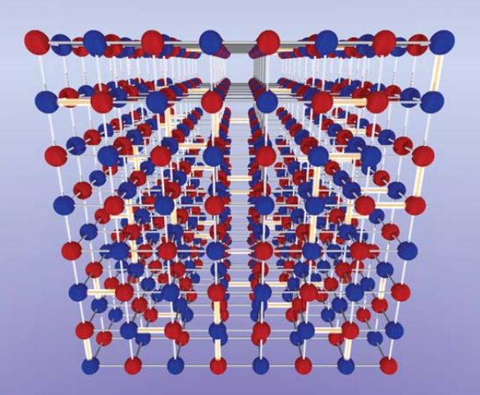
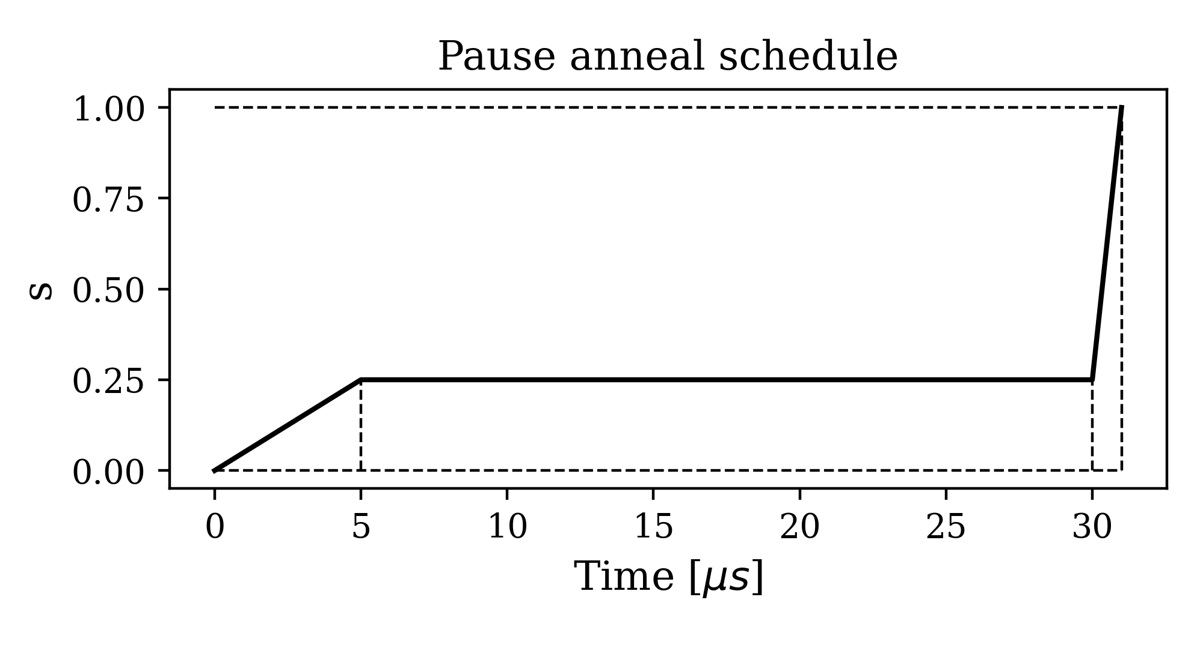
Ising spin glasses
Simulation of Transverse field Ising model (TFIM) on 8x8x8 cubic lattice:
Spin glass: TFIM with .
Pause anneal schedule enables
fixing parameters on the machine
Measurement problem:
Duration:
Energy scale:
R Harris et al., Science, vol. 361, no. 6398, pp. 162–165 (2018)
12

Slide 13
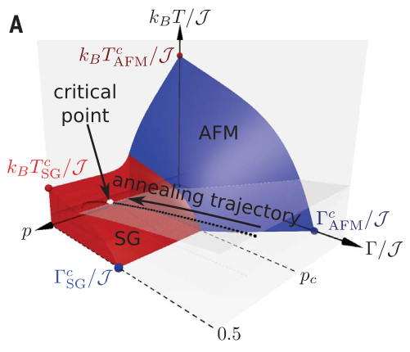
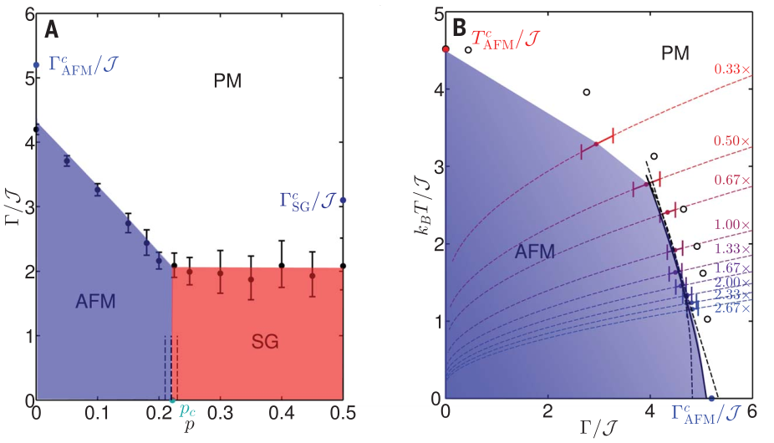
Ising spin glasses
Paramagnetic (PM), antiferromagnetic (AFM) and spin glass (SG) phases.
SG: every instance has many different approximate ground states. We determine the phase of the system by averaging results (e.g. magnetization) over many instances.
Critical values agree with numerical data up to a few percent (less than 1% for )
R Harris et al., Science, vol. 361, no. 6398, pp. 162–165 (2018)
13

Slide 14
Conclusion
Optimization algorithm, can be used to simulate physics
Theoretically equivalent to the gate model
Usable in practice
Ising Hamiltonian as the problem Hamiltonian
:
Only polynomial speedup compared to classical computation.
14

