Slide 1

Encryption and decryption distributed system
Write by Xu Huajie and

Slide 2
Description
This system is a distributed encryption and decryption system. By using nacos server. Springboot and alibaba-cloud are used. N encryption and decryption servers cryptService can be registered to the nacos server. When encryption services are needed, access the nacos registration center, and then the registration center accesses the cryptServices. Registering N encryption and decryption servers to nacos can achieve the effect of a cluster. cryptServices can be called sequentially by nacos to achieve load balancing.

Slide 3
Technology Overview
Java Version 1.8
Spring Boot 2.4.2
Spring-boot-Alibaba 2021.1
Spring-cloud 2020.0.6
Tools : IntelliJ IDEA 2021.3.3 (Ultimate Edition)

Slide 4
Relevent Dependency
<dependency> <groupId>org.springframework.boot</groupId> <artifactId>spring-boot-starter-web</artifactId> </dependency> <dependency> <groupId>com.alibaba.cloud</groupId> <artifactId>spring-cloud-starter-alibaba-nacos-discovery</artifactId> </dependency> <dependency> <groupId>org.springframework.cloud</groupId> <artifactId>spring-cloud-starter-loadbalancer</artifactId> </dependency> <dependency> <groupId>org.springframework.cloud</groupId> <artifactId>spring-cloud-starter-openfeign</artifactId> </dependency> <dependency> <groupId>org.springframework.boot</groupId> <artifactId>spring-boot-starter-test</artifactId> <scope>test</scope> </dependency>

Slide 5
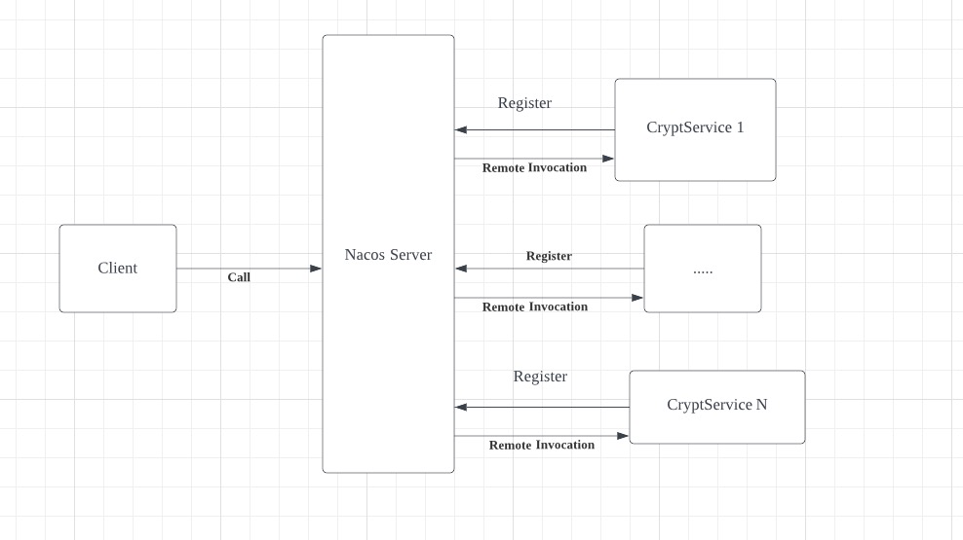
Operating procedures

Slide 6
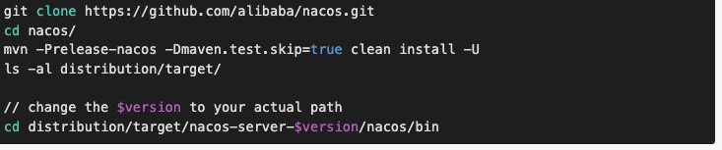
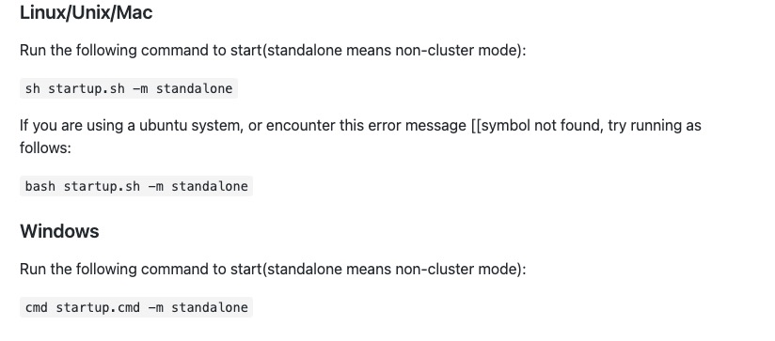
Development Steps
Download and Run Nacos Server

Slide 7
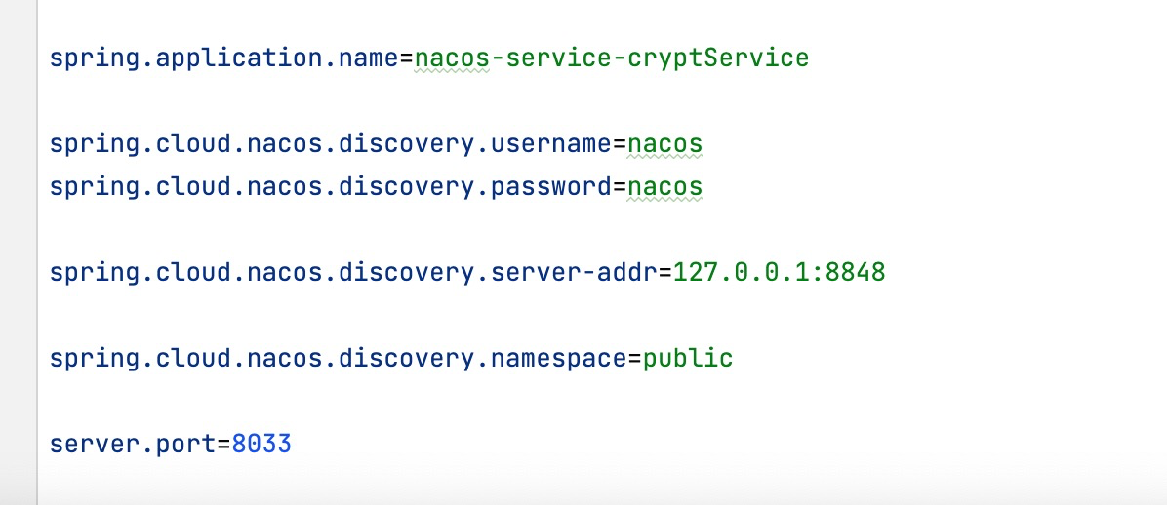
Development Steps
Configer Crypt-Service Of Spring-boot Project :
application.properties

Slide 8
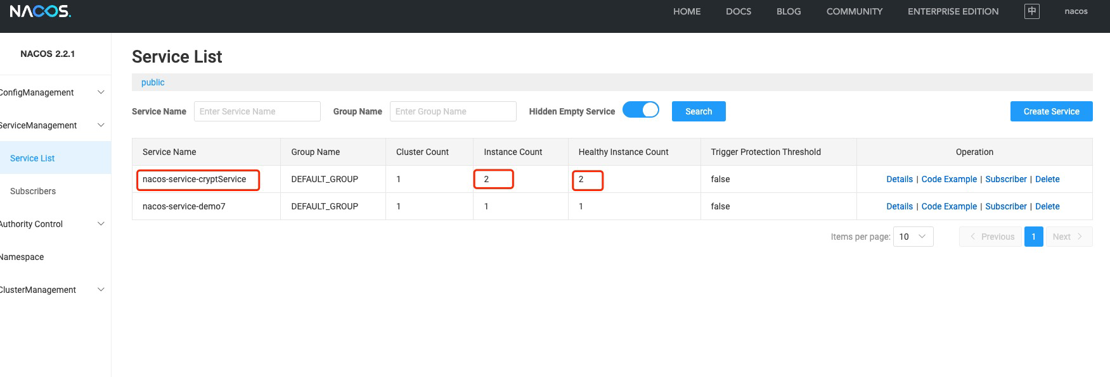
Register To Nacos Server

Slide 9
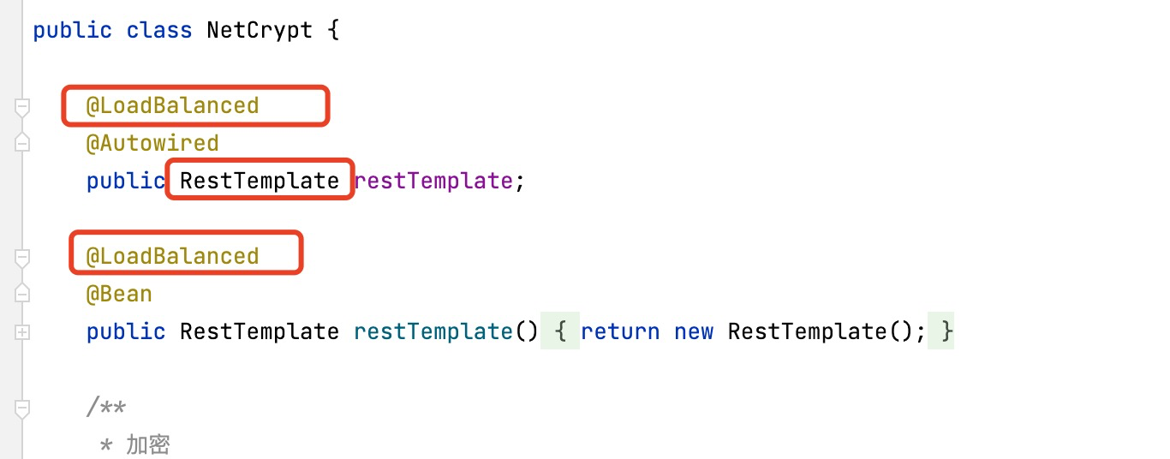
Client Remote Invocation

Slide 10
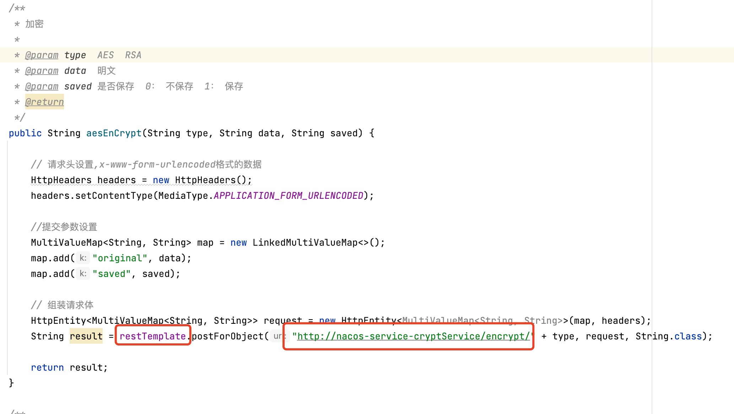
Client Remote Invocation

Slide 11
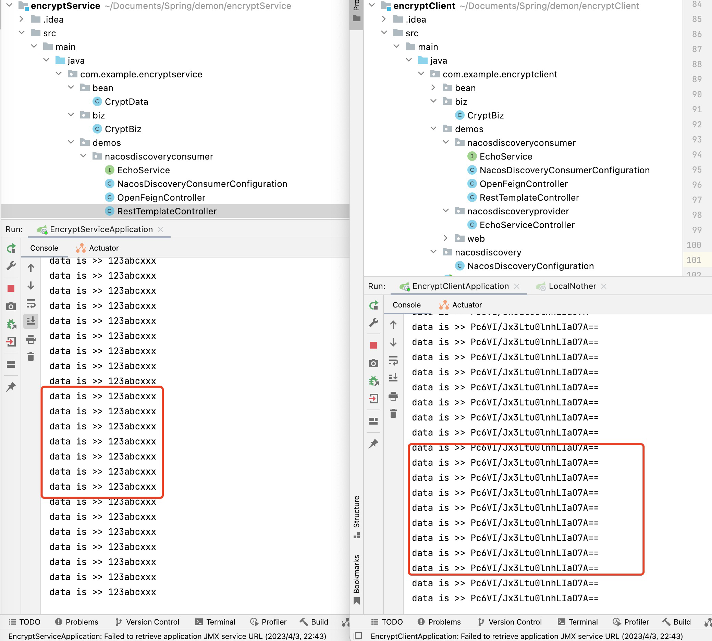
Test The Encryption
Rely on load balancing, while encryption and decryption are on different serversers

Slide 12
The Significance of Centralized Encryption
Purpose: Encryption and decryption are particularly time-consuming operations. If encryption and decryption are involved in the main process, the operation efficiency will be affected.
In addition, the generation and distribution of secret keys are also very troublesome operations. Developing and implementing a dedicated encryption and decryption server and providing services can improve the operating efficiency of the code. If the encryption and decryption cannot meet the needs of the business volume, you can increase the configuration of the encryption and decoding server and improve the code to solve it.

Slide 13
Thank for Wathing

