Slide 1
SQL Fundamentals for Data
Thomas Nield
O’Reilly Media

Slide 2
What to Expect in the Next Two Days
The role of databases and SQL in the business, data science, and data engineering landscape
Understand relational databases
Query and transform data with SQL
Database Design
Writing data in tables

Slide 3
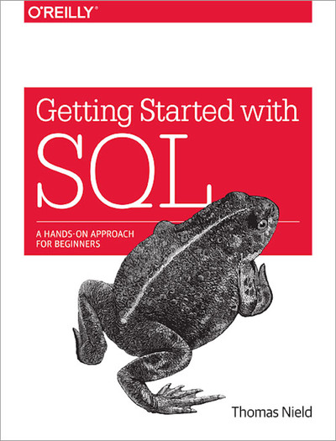
Supplementary Material

Slide 4
Why Learn SQL?
Business, data science, and technology professionals can both reap benefits from learning SQL.
SQL is a highly lucrative skill to have according to StackOverflow’s Annual Survey.
It can be utilized and open up many career paths in both business and IT.
Business Side - Analytical, data science, managerial, strategic, research, and project roles
Technology Side - Database design, database administration (DBA), data engineering, systems engineering, IT project management, machine learning, and software development

Slide 5
Section I
Introduction to Databases

Slide 6
What is a Database?
Broad definition: A database is anything that collects and organizes data
Examples:
Excel spreadsheets
Text files (CSV, XML, JSON)
File cabinet with organized documents
When referred to professionally, a database is typically a Relational Database Management System (RDBMS)

Slide 7
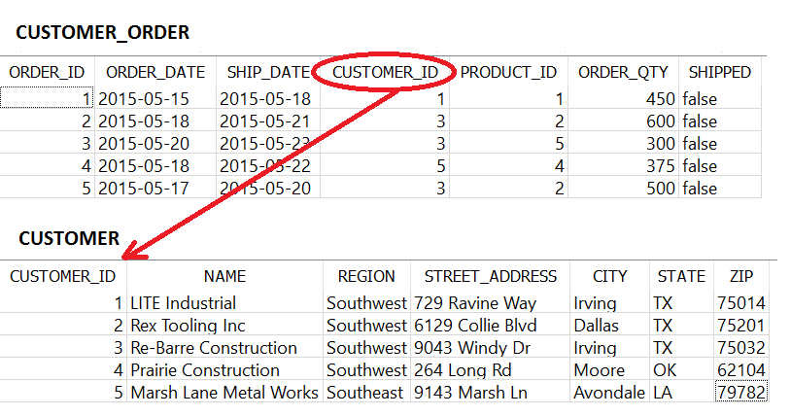
Understanding Relational Databases
A Relational Database Management System is simply a type of database holding tables that may have relationships
A field in a table can point to another table for information

Slide 8
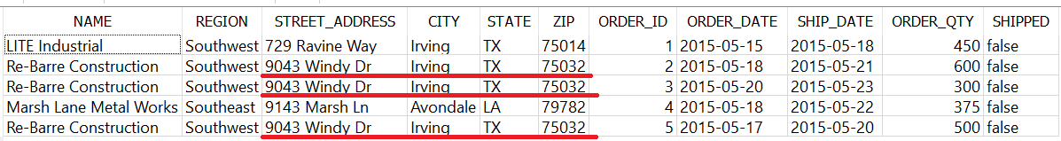
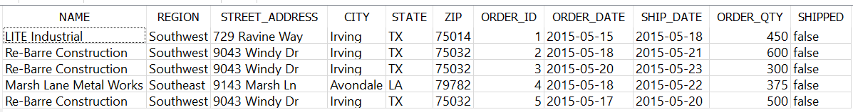
Why Separate Tables?
This idea of separating different types of data (e.g. CUSTOMER versus a CUSTOMER_ORDER) is known as normalization
Putting both CUSTOMER and CUSTOMER_ORDER information in one table would be bloated, redundant and difficult to maintain
Example of a non-normalized table:
Imagine if we needed to change an address.
We would have to do it three times!

Slide 9
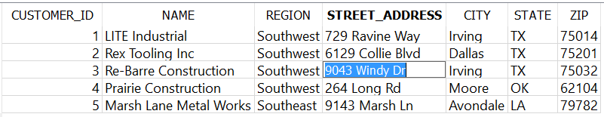
Why Separate Tables?
This is why it is better to separate the CUSTOMER and CUSTOMER_ORDER information into separate tables
You only need to update the address in one place

Slide 10
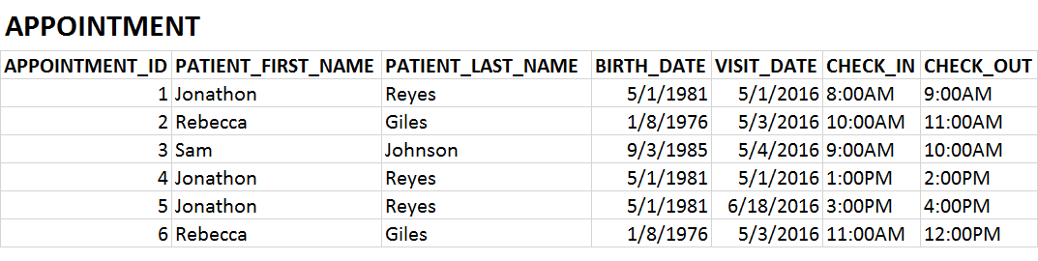
Exercise 1.1
Is this table normalized?

Slide 11
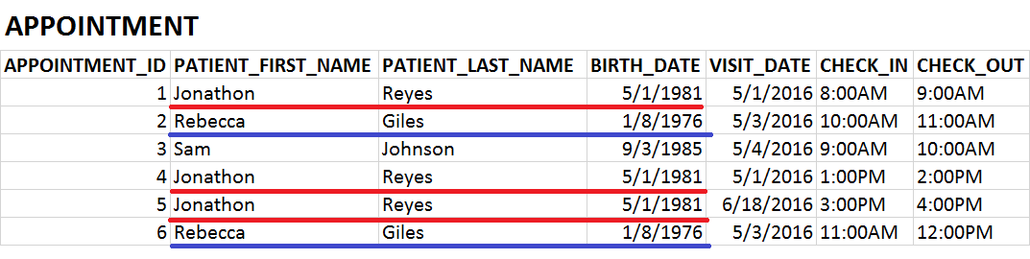
Exercise 1.1
Is this table normalized? It is not!

Slide 12
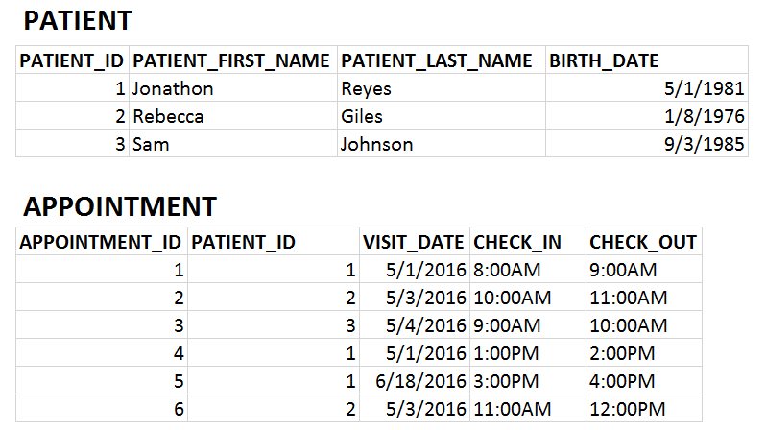
Exercise 1.1
PATIENT and APPOINTMENT data should be in separate tables

Slide 13
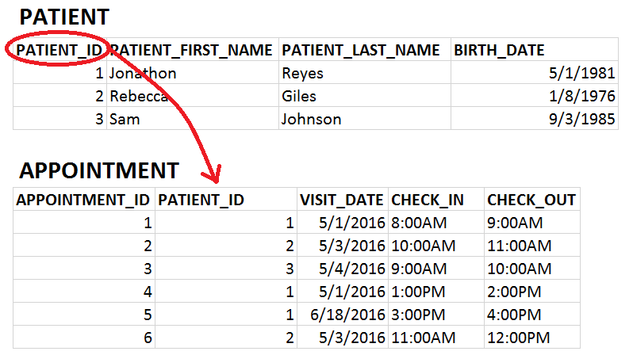
Exercise 1.1
PATIENT and APPOINTMENT data should be in separate tables

Slide 14
Types of Databases
Relational databases and SQL are not proprietary to one company or organization
Many companies and organizations have created their own relational database software
Do not be confused by “SQL” being used to brand database software, like Microsoft SQL Server, MySQL, and SQLite. SQL is the universal language used on all RDBMS platforms
MySQL Oracle IBM DB2 | Microsoft Access Microsoft SQL Server PostgreSQL | SQLite MariaDB SAP Sybase

Slide 15
NoSQL and “Big Data”
NoSQL stands for not only SQL, and is often used to describe “Big Data” platforms that may leverage SQL but are not relational.
NoSQL databases include MongoDB, Couchbase, Apache Cassandra, and Redis.
These platforms store massive amounts of data in a variety of raw and unstructured formats (e.g. documents, key-value).
Most of these solutions are distributed across multiple machines, which is difficult to do with relational databases.
Other “Big Data” solutions such as Apache Hadoop and Apache Spark can be interacted with using SQL, but are not limited to relational databases.
Therefore most of the knowledge in this course can be applied to “Big Data” solutions.
Caution using NoSQL and Big Data: “When all you have is a hammer, everything starts to look like a nail.”
Do not fall into the trap of treating all data problems as Big Data problems, because most are not.
Be aware of the “Silver Bullet Syndrome”: https://www.youtube.com/watch?v=3wyd6J3yjcs

Slide 16
SQL vs NoSQL
Feature | SQL | NoSQL | Winner
Integrity/Consistency | Data is enforced with logical relationships, minimized redundancy, and “Up-to-date” consistency. | Simple key-value and document storage does not enforce any rules or structure. Redundancy and write latency is common. | SQL
Design changes | Easy to “add” to database, but harder to modify. | NoSQL can quickly and arbitrarily change what data it stores. | NoSQL
Analysis | SQL is a universal language that makes accessing and analyzing data simple. | SQL support is sparse, and proprietary languages are esoteric and hardly universal. | SQL
Programming | Programmers of Java, Python, and .NET have to map entities to tables, which can be tedious. But data integrity is given. | Programming against a NoSQL database is quick and simple, but onus is on programmer to validate data. | Draw
Performance | Relational databases can store data for most use cases, but struggle with true “big data” cases. Integrity constraints also slow down performance. | NoSQL is capable of storing vast amounts of data with horizontal scaling. It also performs quickly due to horizontal scaling and no integrity constraints. | NoSQL

Slide 17
SQL versus NoSQL Summary
SQL = integrity and accuracy
NoSQL = speed and scalability
SQL should be a prerequisite before learning NoSQL and “Big data”.
If you are absolutely uncertain which to use, always start with SQL.

Slide 18
Lightweight vs Centralized Databases

Slide 19
Lightweight Databases
When you want a simple solution for a small number of users, lightweight databases are a great place to start
They store data in a file that can be shared, but can break down when edited simultaneously
Common Lightweight Databases
Microsoft Access
SQLite
H2

Slide 20
Centralized Databases
When you need to support tens, hundreds, or thousands of users and applications, you need a centralized database
These databases are designed to handle a high volume of traffic efficiently
Some examples of centralized database platforms
Oracle
Microsoft SQL Server
MySQL
PostgreSQL
Teradata

Slide 21

Typical Centralized Database Setup
CLIENT
Centralized databases use a
Client/Server Setup
SERVER
SQL User 1
Laptop with MySQL
CLIENT
SQL User 2

Slide 22

Typical Centralized Database Setup
CLIENT
For production, you typically use a server computer to host the database rather than a laptop or desktop
SQL User 1
Server Computer with MySQL
CLIENT
SQL User 2

Slide 23


Typical Centralized Database Setup
CLIENT
A popular architecture nowadays is to have cloud services from Amazon, Microsoft and Alphabet host your database for you.
SQL User 1
Cloud Server with MySQL
CLIENT
SQL User 2

Slide 24
What We Will Use
Upon entering a workplace, there is a good chance you will need access to an existing centralized database
We will not be using centralized databases in this course, but we will be using SQLite
The experience between lightweight and centralized databases should largely be the same

Slide 25
Exercise 1.2
Identify the following as being a lightweight or centralized database:
1. Facebook’s MySQL database holding all user data
CENTRALIZED
2. A SQLite database holding an iPhone user’s data locally on the hard drive
LIGHTWEIGHT
3. An Oracle database with shopping data for a storefront website
CENTRALIZED

Slide 26
Section II
SQLite

Slide 27
SQLite
We will be using SQLite with SQLiteStudio/SQLiteOnline in this course
SQLite is a lightweight database and can be found on:
Android, iPhone, iPad, and Windows 10+
Car consoles, thermostats, and other gadgets
Satellites and the Airbus A350 XWB
SQLite excels where simplicity and low overhead is needed

Slide 28
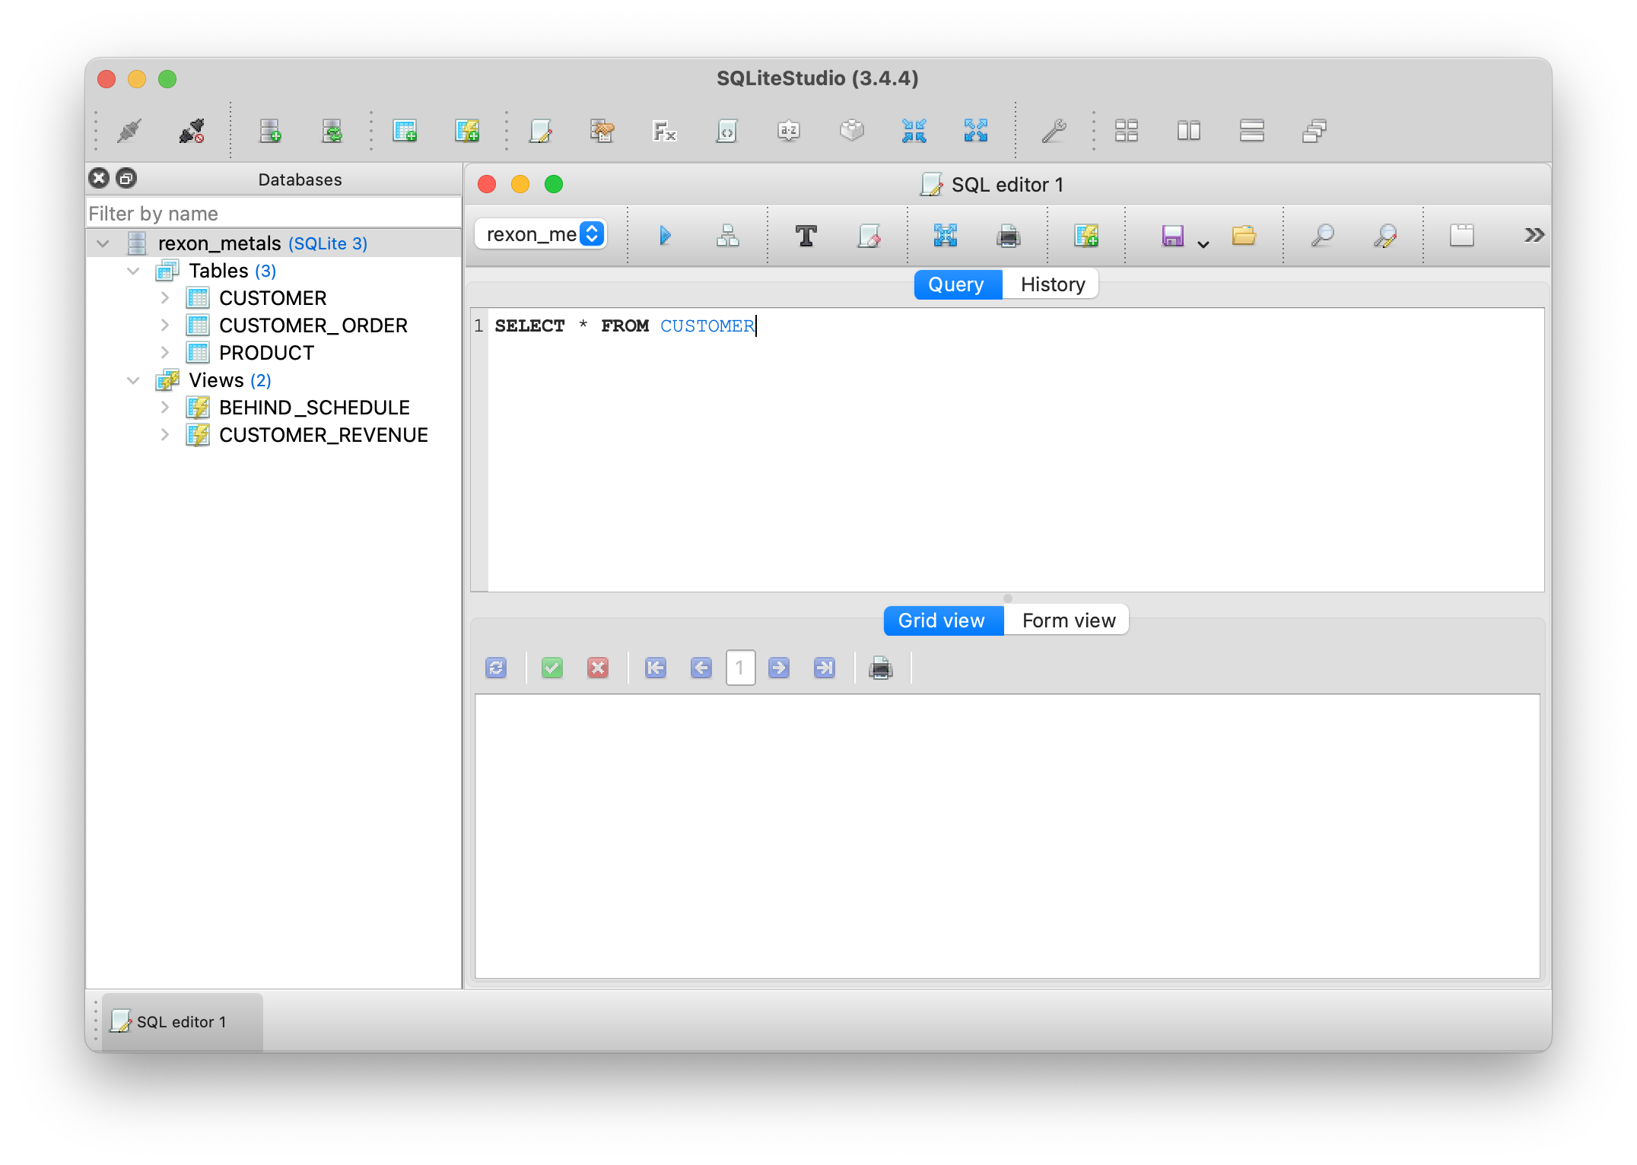
SQLiteStudio and SQLiteOnline
We will be using SQLiteStudio to work with SQLite database files
SQLiteStudio can be downloaded at http://sqlitestudio.pl/
On Windows and Linux, download and copy the folder contents to a location of your choice
On Mac, you can either drag the DMG to the Applications folder or use Homebrew http://macappstore.org/sqlitestudio/
You also have the option of using SQLiteOnline
This requires no installation of software, but you will still have to download the SQLite files.
Just navigate to https://sqliteonline.com and you are set.

Slide 29
Database Files
The database files can be found on GitHub https://github.com/thomasnield/oreilly_sql_fundamentals_for_data
Click the Code then Download ZIP button in the top-right, and then unzip all the contents to a location of your choice
Open the database files in SQLiteStudio or SQLiteOnline

Slide 30
Break and Q&A

Slide 31
Section III
SELECT

Slide 32
Basic Math Operators
Operator | Description | Example
+ | Adds two numbers | STOCK + NEW_SHIPMENT
- | Subtracts two numbers | STOCK - DEFECTS
* | Multiplies two numbers | PRICE * 1.07
/ | Divides two numbers | STOCK / PALLET_SIZE
% | Divides two numbers, but returns the remainder | STOCK % PALLET_SIZE

Slide 33
Exercise 3.1
SELECT all records (with all fields) from the CUSTOMER_ORDER table
ANSWER:
SELECT * FROM CUSTOMER_ORDER;

Slide 34
Exercise 3.2
SELECT the ORDER_ID and SHIP_DATE fields from the CUSTOMER_ORDER table
ANSWER:
SELECT ORDER_ID, SHIP_DATE FROM CUSTOMER_ORDER;

Slide 35
Exercise 3.3
SELECT the PRODUCT_ID, DESCRIPTION, and a REDUCED_PRICE (which subtracts $1.10 from each PRICE) from the PRODUCT table
ANSWER:
SELECT PRODUCT_ID,
DESCRIPTION,
PRICE - 1.10 as REDUCED_PRICE
FROM PRODUCT

Slide 36
Section IV
WHERE

Slide 37
Exercise 4.1
SELECT all records where TEMPERATURE is between 30 and 50 degrees
SELECT * FROM station_data
WHERE temperature BETWEEN 30 AND 50;
OR
SELECT * FROM station_data
WHERE temperature >= 30 and temperature <= 50;

Slide 38
Exercise 4.1
SELECT all records where TEMPERATURE is between 30 and 50 degrees
SELECT * FROM station_data
WHERE temperature BETWEEN 30 AND 50;
OR
SELECT * FROM station_data
WHERE temperature >= 30 and temperature <= 50;

Slide 39
Exercise 4.2
SELECT all records where station_pressure is greater than 1000 and a tornado was present
SELECT * FROM STATION_DATA
WHERE station_pressure > 1000 AND tornado;
OR
SELECT * FROM STATION_DATA
WHERE station_pressure > 1000 AND tornado = 1;

Slide 40
Exercise 4.3
SELECT all records with report codes E6AED7, B950A1, 98DDAD
SELECT * FROM STATION_DATA
WHERE report_code IN ('E6AED7','B950A1','98DDAD')
OR
SELECT * FROM STATION_DATA
WHERE report_code = 'E6AED7‘
OR report_code = 'B950A1‘
OR report_code = '98DDAD'

Slide 41
Exercise 4.4
SELECT all records with report codes E6AED7, B950A1, 98DDAD
SELECT * FROM STATION_DATA
WHERE report_code IN ('E6AED7','B950A1','98DDAD');
OR
SELECT * FROM STATION_DATA
WHERE report_code = 'E6AED7‘
OR report_code = 'B950A1‘
OR report_code = '98DDAD‘;

Slide 42
Exercise 4.5
SELECT all records WHERE station_pressure is null
SELECT * FROM STATION_DATA
WHERE station_pressure IS NULL;

Slide 43
Section V
GROUP BY and ORDER BY

Slide 44
Exercise 5.1
Find the SUM of precipitation by year when a tornado was present, and sort by year descending.
ANSWER:
SELECT year,
SUM(precipitation) as tornado_precipitation
FROM station_data
WHERE tornado = 1
GROUP BY year
ORDER BY year DESC

Slide 45
Exercise 5.2
SELECT the year and max snow depth, but only years where the max snow depth is at least 50.
ANSWER:
SELECT year,
max(snow_depth) AS max_snow_depth
FROM STATION_DATA
GROUP BY year
HAVING max_snow_depth >= 50

Slide 46
Section VI
CASE

Slide 47
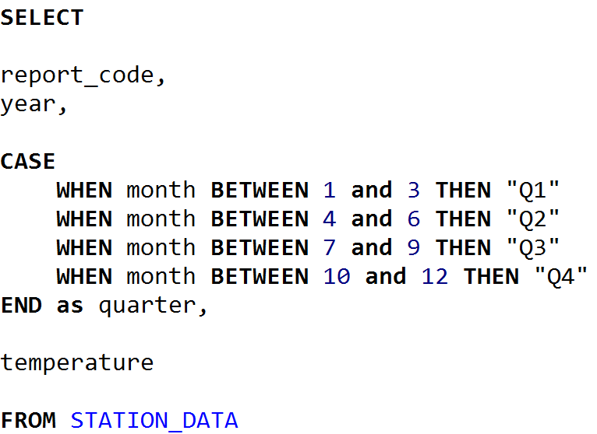
Exercise 6.1
SELECT the report_code, year, quarter, and temperature, where a “quarter” is “Q1”, “Q2”, “Q3”, or “Q4” reflecting months 1-3, 4-6, 7-9, and 10-12 respectively.

Slide 48
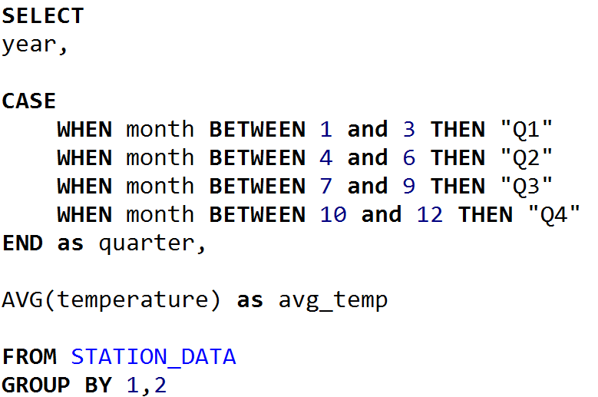
Exercise 6.2
Get the average temperature grouped by quarter and year, where a “quarter” is “Q1”, “Q2”, “Q3”, or “Q4” reflecting months 1-3, 4-6, 7-9, and 10-12 respectively.

Slide 49
Section VII
JOIN

Slide 50
Revisiting Table Relationships
Remember when we were talking about tables having relationships with each other?
A table can supply data to another table, like CUSTOMER information for a CUSTOMER_ORDER

Slide 51
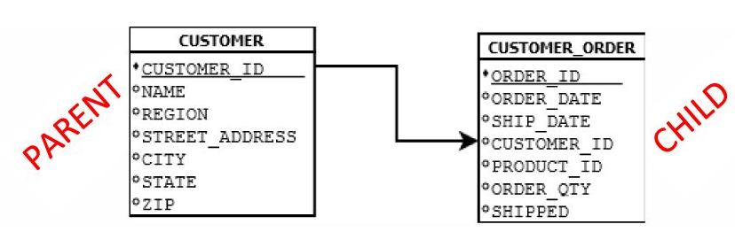
Parent/Child Tables
Because the CUSTOMER table supplies data to CUSTOMER_ORDER, it is the parent table to CUSTOMER_ORDER
Because the CUSTOMER_ORDER table receives data from CUSTOMER, it is the child table to CUSTOMER

Slide 52
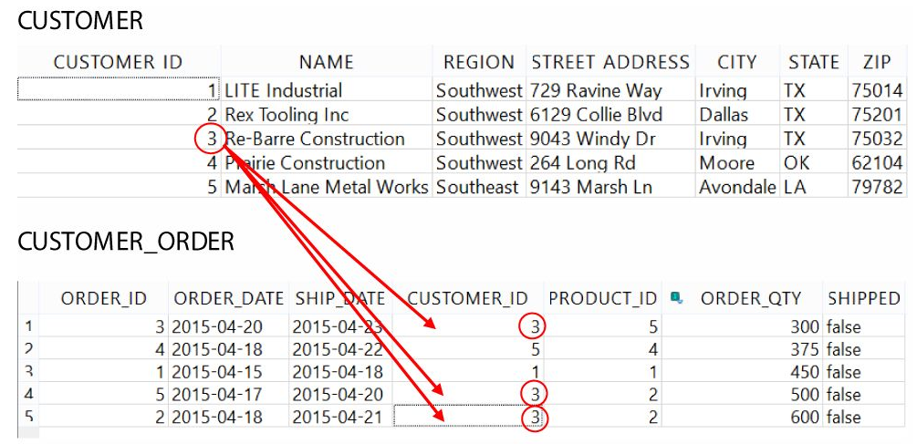
Primary/Foreign Keys
Typically, a parent table will have a primary key and the child table will have a foreign key.
The primary key is unique and can map to multiple foreign keys
Primary Key
Foreign Key

Slide 53
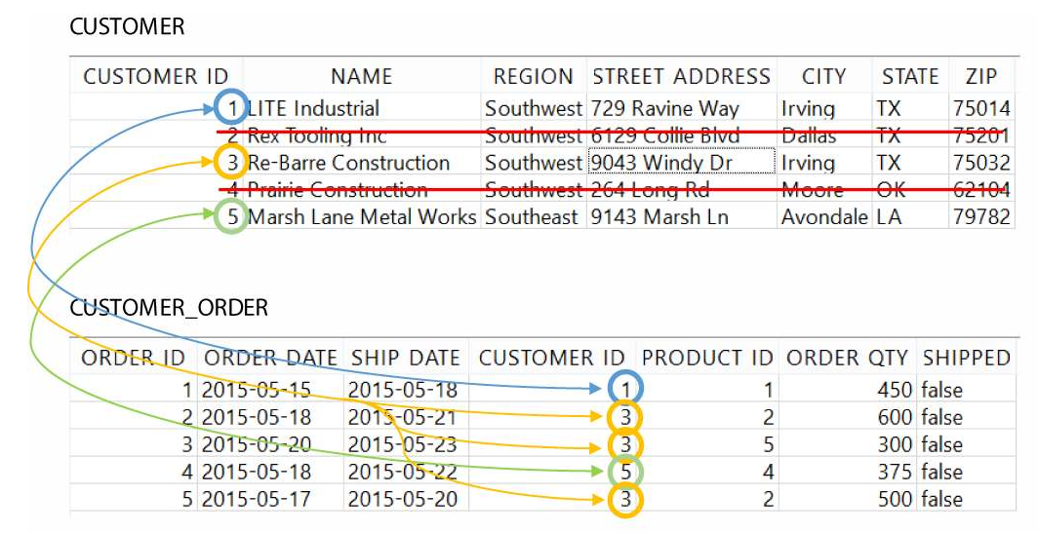
INNER JOIN

Slide 54
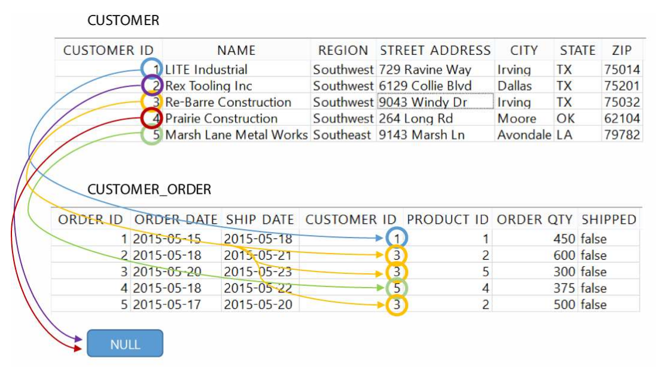
LEFT OUTER JOIN

Slide 55
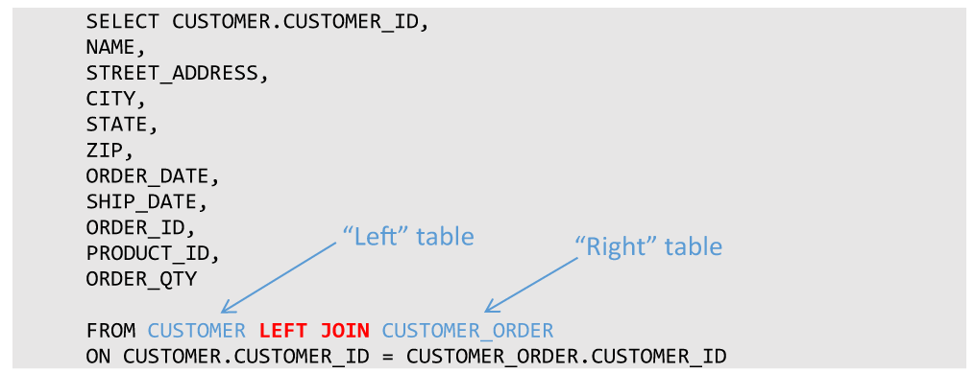
LEFT OUTER JOIN

Slide 56
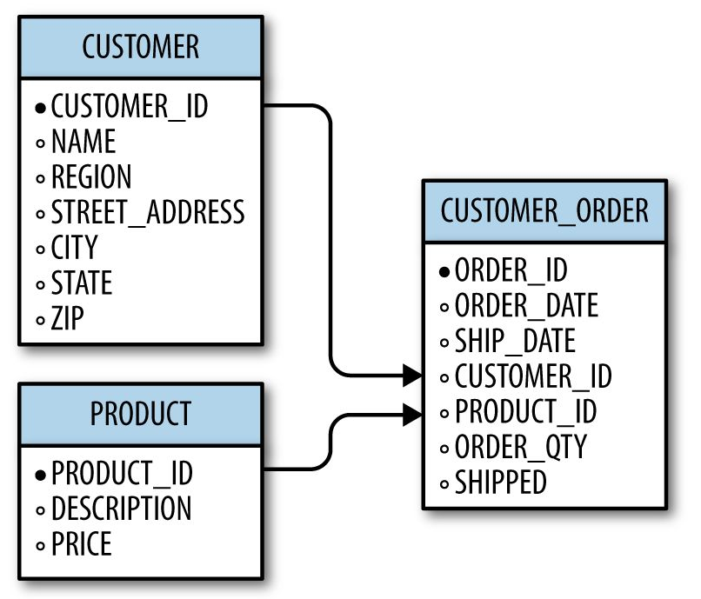
Joining Multiple Tables
It is not uncommon to have a table be a parent to one table, but a child to another
A given table can also be a child to more than one table, so what does this look like?
We can bring in a third table PRODUCT to supply product information to CUSTOMER_ORDER

Slide 57
Exercise 7.1
SELECT the ORDER_ID, ORDER_DATE, and DESCRIPTION (from PRODUCT)
(hint, you will need to INNER JOIN CUSTOMER_ORDER and PRODUCT)
ANSWER:
SELECT ORDER_ID, ORDER_DATE, DESCRIPTION
FROM CUSTOMER_ORDER INNER JOIN PRODUCT
ON CUSTOMER_ORDER.PRODUCT_ID = PRODUCT.PRODUCT_ID

Slide 58
Exercise 7.2
Find the total revenue by product. Include the fields PRODUCT_ID, DESCRIPTION, and then the TOTAL_REVENUE.
(Hint: you will need to join CUSTOMER_ORDER and PRODUCT. Then do a GROUP BY)
ANSWER:
SELECT PRODUCT.PRODUCT_ID,
DESCRIPTION,
COALESCE(SUM (ORDER_QTY * PRICE), 0) AS TOTAL_REVENUE
FROM PRODUCT LEFT JOIN CUSTOMER_ORDER
ON PRODUCT.PRODUCT_ID = CUSTOMER_ORDER.PRODUCT_ID
GROUP BY 1, 2

Slide 59
Section VIII
Database Design

Slide 60
Planning a Database
Design Questions
What are the business requirements?
What tables will I need to fulfill those requirements?
What columns will each table contain?
How will the tables be normalized?
What will their parent/child relationships be?

Slide 61
Planning a Database
Data Questions
How much data will be populated into these tables?
Who/what will populate data into these tables?
Where will the data come from?
Do we need processes to automatically populate these tables?

Slide 62
Planning a Database
Security Questions
Who should have access to this database?
Who should have access to which tables? Read-only access? Write access?
Is this database critical to business operations?
What backup plans do we have in the event of disaster/failure?
Should changes to tables be logged?
If the database is used for websites or web applications, is it secure?

Slide 63

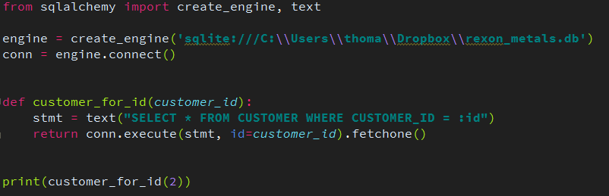
Preventing SQL Injection
To prevent SQL injection, never concatenate a SQL string with parameters
Instead, use the right tools and libraries to safely inject parameters for you
For Python, use SQLAlchemy
More info at:
http://www.sqlalchemy.org/

Slide 64
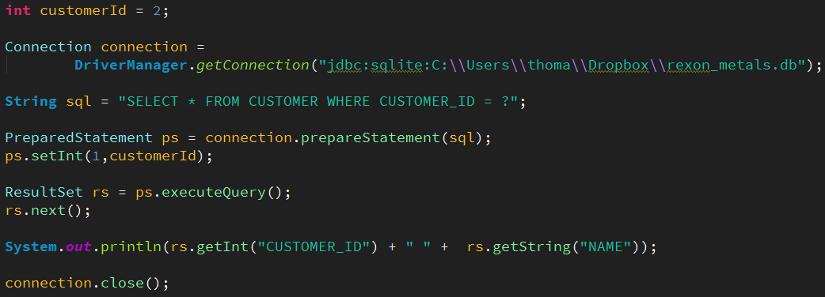
Preventing SQL Injection
For Java, Scala, Kotlin, and other JVM languages use JDBC’s PreparedStatement
More info at:
http://tutorials.jenkov.com/jdbc/index.html
http://www.marcobehler.com/make-it-so-java-db-connections-and-transactions

Slide 65

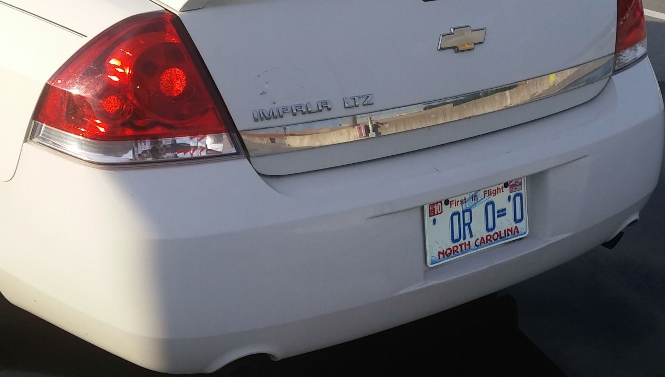
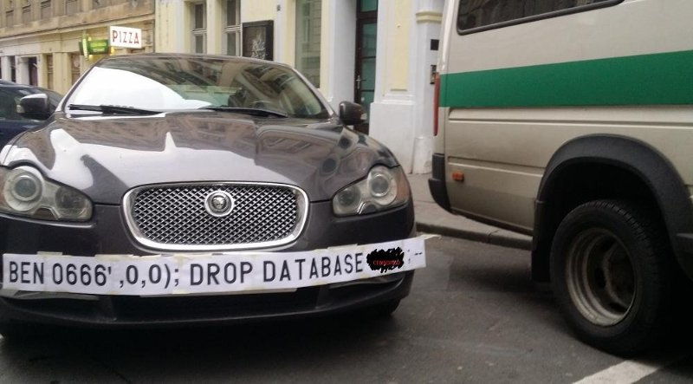

SQL Injection Humor
Source: Google Images
Source: https://xkcd.com/327/

Slide 66
SQL Injection in the News
How to Hack Your Alexa Using a Voice Command SQL Injection
https://hackernoon.com/voice-command-sql-injection-hack-uncovered-for-alexa-9914x3zwp
How a NULL License Plate Landed One Hacker In Ticket Hell
https://www.wired.com/story/null-license-plate-landed-one-hacker-ticket-hell/
This couple cannot do the simplest things online because their last name is ‘Null’
Https://thenextweb.com/insider/2016/03/27/last-name-null-is-tough-for-computers/

Slide 67
The SurgeTech Conference
Let’s design a database for a real-world scenario!
You are a staff member for the SurgeTech conference, a gathering of tech startup companies seeking publicity and investors. The organizer has tasked you with creating a database to manage the attendees, companies, presentations, rooms, and presentation attendance. How should this database be designed?
There are five entities here that can be turned into tables
ATTENDEE
COMPANY
PRESENTATION
ROOM
PRESENTATION_ATTENDANCE

Slide 68
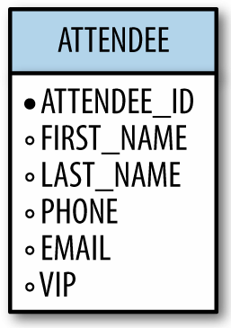
ATTENDEE
The attendees are guests (including some VIP’s) who have registered for the conference
Each attendee holds the following information:
ID
Name
Phone Number
Email
VIP status
To the right is our design for the ATTENDEE table

Slide 69
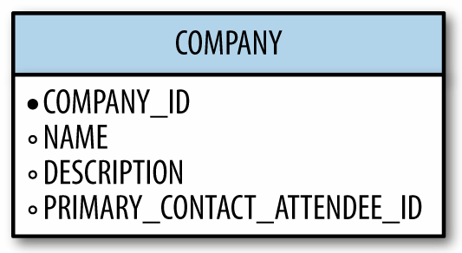
COMPANY
The startup companies need to be tracked as well
Each company holds the following information:
Company ID
Name
Description
Primary contact attendee ID
To the right is our design for the COMPANY table

Slide 70
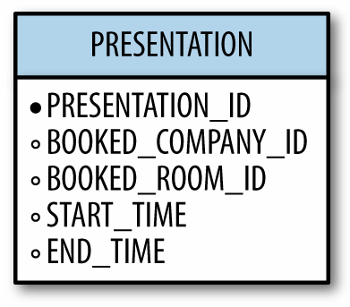
PRESENTATION
Some companies will schedule a presentation for a specific slot of time
Each presentation is defined by:
Presentation ID
Booked company ID
Booked room ID
Start time
End time
To the right is our design for the PRESENTATION table

Slide 71
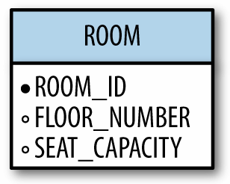
ROOM
Rooms are available for presentations
Each room is defined with these attributes:
Room ID
Floor number
Seat capacity
To the right is our design for the ROOM table

Slide 72
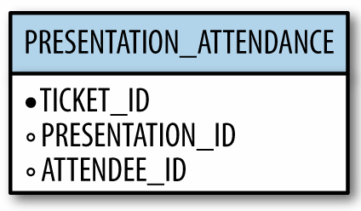
PRESENTATION_ATTENDANCE
When an ATTENDEE wants to attend a PRESENTATION, they can acquire a ticket with a ticket id
We can use these tickets to keep track of presentation attendance
Each presentation attendance is defined with these attributes:
Ticket ID
Presentation ID
Attendee ID
To the right is our design for the PRESENTATION_ATTENDANCE table

Slide 73
Revisiting Primary/Foreign Keys
With table relationships it is important to distinguish the primary key from the foreign key
The field that supplies data to other tables is the primary key, and a field that receives data from another table is a foreign key.
Primary Key
Foreign Key

Slide 74
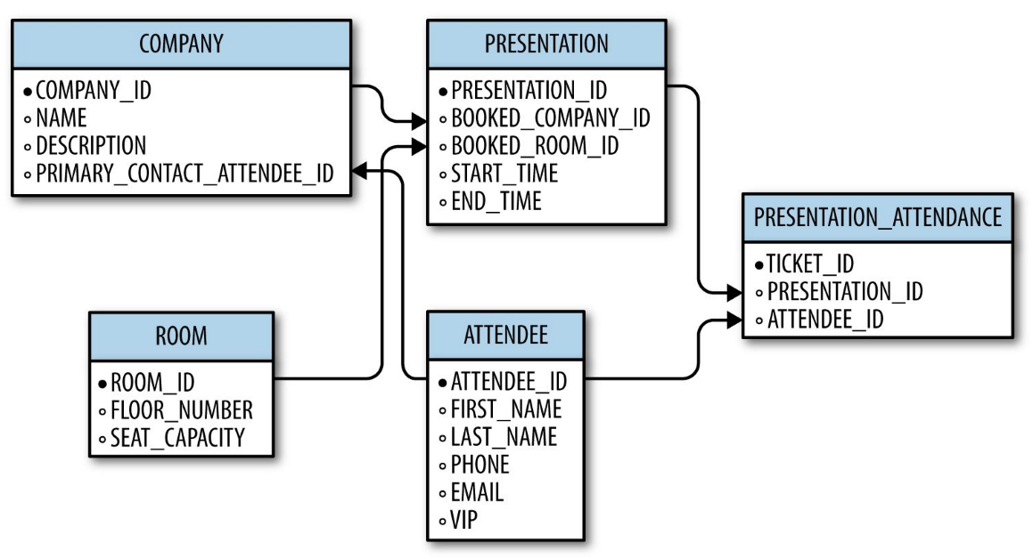
The Database Schema
With our knowledge of primary and foreign keys, we can create a database schema of all tables and their relationships for the SurgeTech conference
*Primary Key → Foreign Key

Slide 75
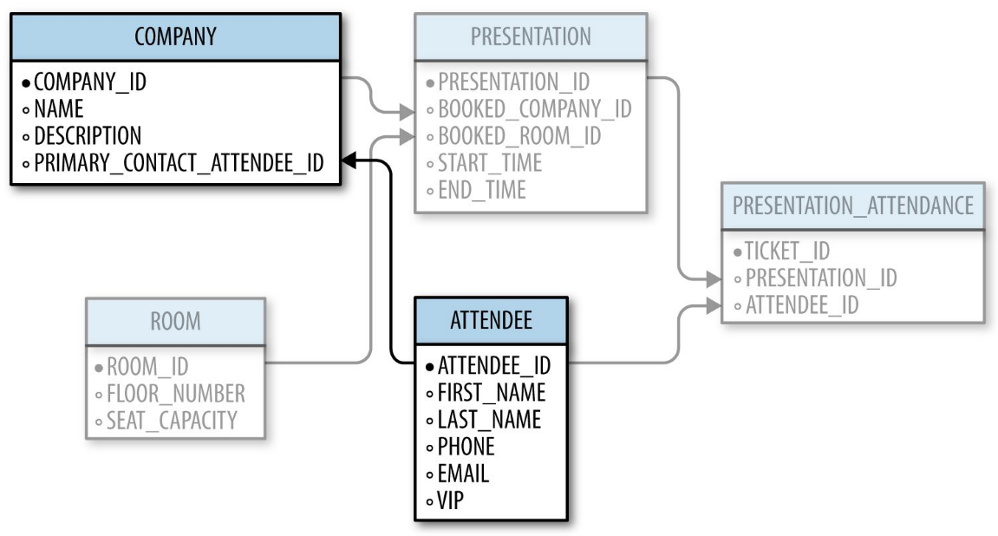
The Database Schema
It can be overwhelming seeing all tables and their relationships at once, so the secret to reviewing a database schema is to focus on 2-3 tables at a time
*Primary Key → Foreign Key

Slide 76
Common Column Types
Type | Description
INTEGER | A simple, whole number
DOUBLE/DECIMAL | Supports non-whole, decimal numbers
BOOLEAN | A True/False value represented by 1 or 0
CHAR | A fixed number of text characters
VARCHAR | Any number of text characters, with an optional maximum
DATE | A calendar date value
TIME | A time value
DATETIME | A date and time value
TEXT | A longer piece of text (such as memos, articles, books, emails)

Slide 77
Common Column Modifiers
Modifier | Behavior
PRIMARY KEY | Makes the column a PRIMARY KEY
FOREIGN KEY | Makes the column a FOREIGN KEY
NOT NULL | Enforces that values can never be null in that column
DEFAULT | Allows you to specify a default value for a column rather than it default to NULL

Slide 78
Section IX
Writing Data

Slide 79
Exercise 9.1
Insert a new record into the COMPANY table for a company named “Pied Piper”, and provide a DESCRIPTION of “Compression platform for mobile and desktop” and a PRIMARY_CONTACT_ATTENDEE_ID of 1.
INSERT INTO COMPANY(NAME,DESCRIPTION, PRIMARY_CONTACT_ATTENDEE_ID)
VALUES ('Pied Piper','Compression platform for mobile and desktop', 1)

Slide 80
Exercise 9.2
Create a new ATTENDEE named Richard Hendricks, with an EMAIL of richard.hendricks@piedpiper.com and a VIP true value
INSERT INTO ATTENDEE (FIRST_NAME, LAST_NAME, EMAIL, VIP)
VALUES ('Richard', 'Hendricks', 'richard.hendricks@piedpiper.com',1)

Slide 81
Exercise 9.3
Make Richard Hendricks’ ATTENDEE_ID the PRIMARY_CONTACT_ATTENDEE_ID for the COMPANY “Pied Piper”
UPDATE COMPANY SET PRIMARY_CONTACT_ATTENDEE_ID = 5
WHERE COMPANY_ID = 2

Slide 82
Section X
Going Forward

Slide 83
What Now?
Did you enjoy this online training? See this document for Intermediate SQL concepts.
https://github.com/thomasnield/oreilly_intermediate_sql_for_data/blob/master/intermediate_sql_class_notes.md

Slide 84
What Now?
You now have the fundamentals of SQL in your tool belt
Get comfortable with consistent use and practice
If your job uses a specific database platform (e.g. MySQL, Oracle), apply this knowledge to learn that platform
Keep practicing with SQLite!
There are SQL features you can advance into:
Subqueries – query off of other queries just like they were tables
Indexing – Configure large tables to perform better with SELECT operations
Transactions – Perform multiple update commands into a single, fail-safe batch
Triggers – Configure databases to react to UPDATE/DELETE/INSERT commands
Database Administration – Fine-tune production databases for large corporate environments
Advanced Business Analysis – Use advanced SQL features to perform deeper business analysis

Slide 85
What Now?
SQL Resources
Getting Started with SQL (O'Reilly) by Thomas Nield
Learning SQL (O'Reilly) by Alan Beaulieu
Using SQLite (O'Reilly) by Jay A. Kreibich
It can be lucrative to combine SQL with another technical skill
Python - versatile scripting language
R – statistical scripting language and environment
Java – Build full software solutions

