Slide 1
Diabetes Risk Assessment Dashboard
Power BI Analytics Project

Slide 2
Project Background
Diabetes is a growing global health concern.
This project analyzes diabetes risk using lifestyle and clinical data.
Goal
Identify patterns and high-risk groups using data analytics.

Slide 3
Project Objectives & Overview
Objectives
• Analyze lifestyle and clinical risk factors
• Build a star schema data model
• Develop interactive Power BI dashboards
• Extract actionable insights
Overview
Attributes analyzed include:
• Glucose levels
• BMI
• Lifestyle factors (calories intake, physical activity, family history of diabetes)
• Outcome status (Diabetic / Non-Diabetic)

Slide 4
Abstract
This project applies data analytics techniques to assess diabetes risk using lifestyle and clinical indicators.
A star schema data model was implemented in Power BI to integrate glucose levels, body mass index (BMI), lifestyle behaviors, and outcome status.
Interactive dashboards were developed to explore patterns between modifiable and non-modifiable risk factors and diabetic outcomes.
The findings highlight the strong association between elevated glucose, high BMI, low physical activity, and diabetes prevalence, emphasizing the role of lifestyle modification in risk reduction

Slide 5
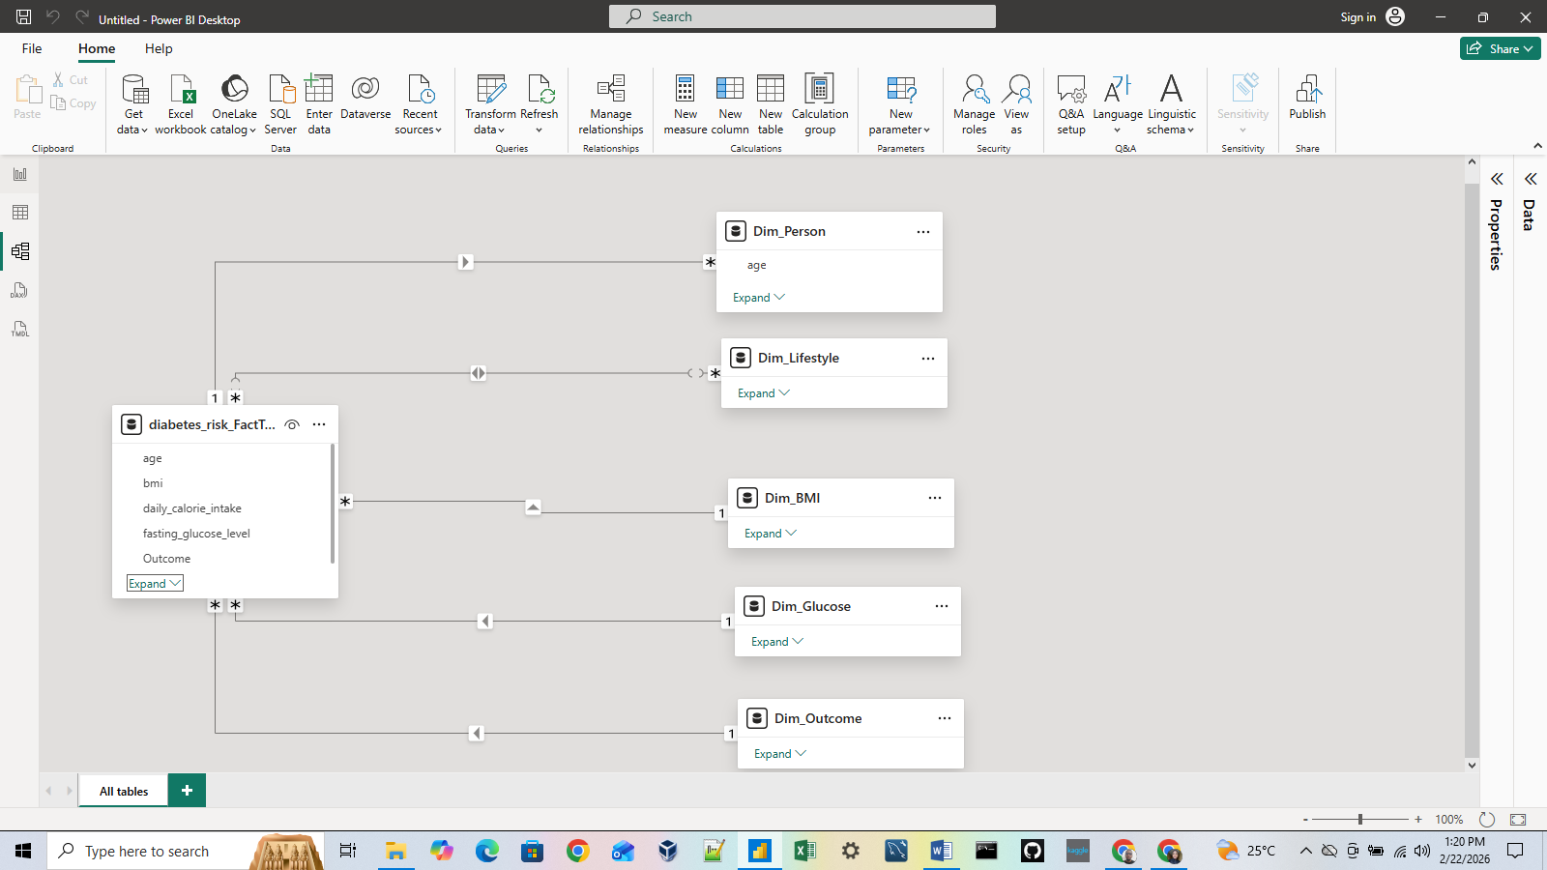
Data Modeling – Star Schema
Fact Table
Diabetes Risk Records
Dimensions
• Person
• Glucose
• BMI
• Lifestyle
• Outcome
Single-direction, many-to-one relationships used

Slide 6
Data Preparation
• Data cleaned using Power Query
• Conditional columns created
• Categories defined for BMI, glucose, and lifestyle
• Errors and nulls handled

Slide 7
Dashboard KPIs
• Total Individuals
• Total Diabetic Cases
• Diabetes Prevalence (%)
• Average Glucose (Diabetic)
• Average BMI (Diabetic)

Slide 8
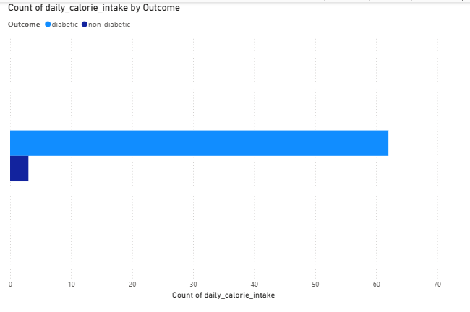
Lifestyle Risk Analysis
• High calorie intake linked to higher diabetes risk

Slide 9
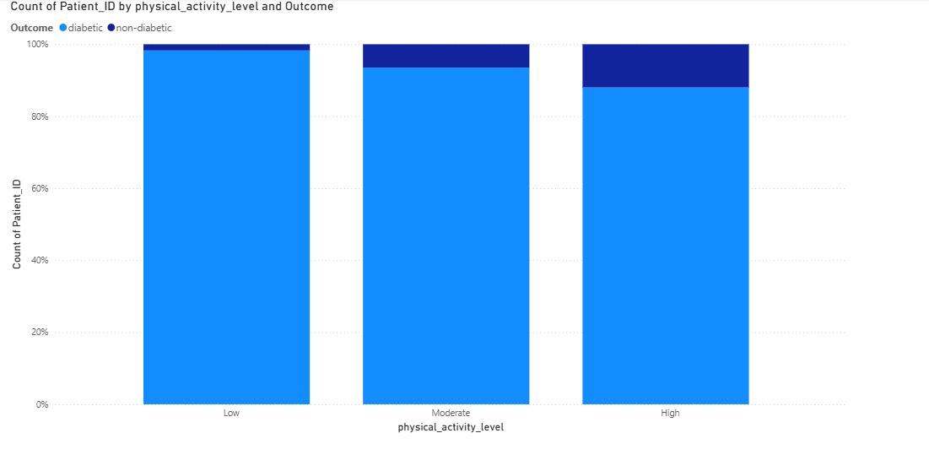
Lifestyle Risk Analysis
• Low physical activity shows higher prevalence

Slide 10
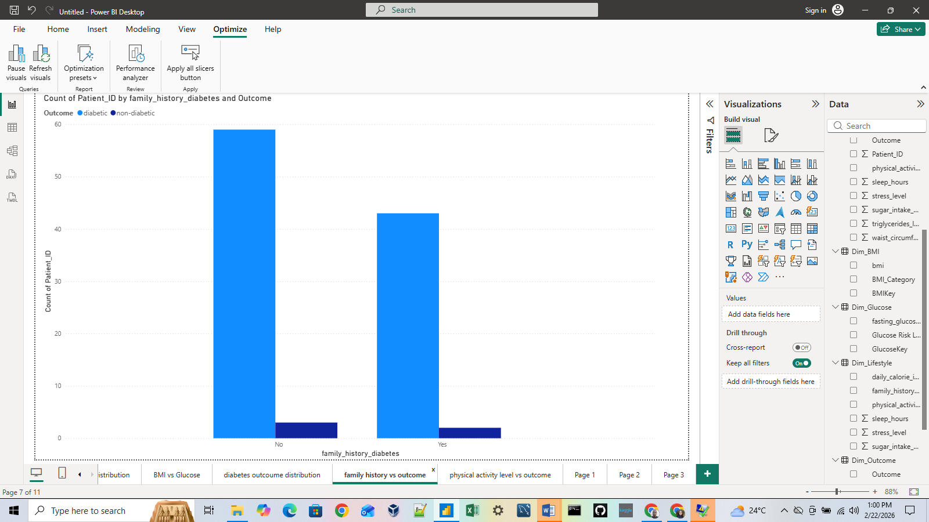
Lifestyle Risk Analysis
• Family history amplifies risk

Slide 11
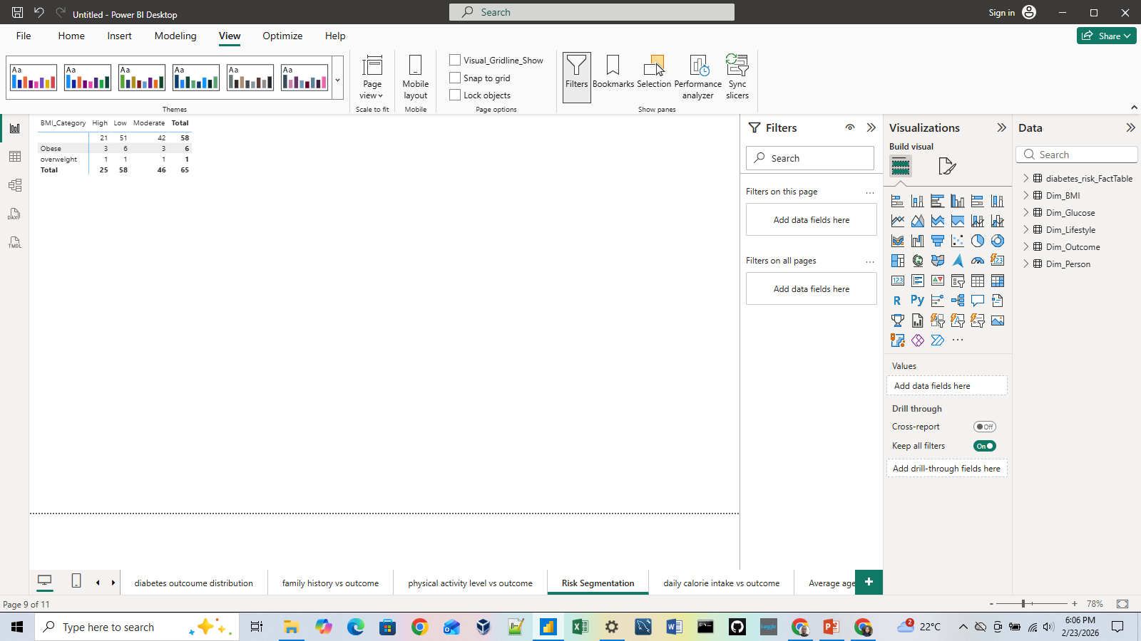
Risk Segmentation
Matrix analysis combining:
• BMI Category
• Physical Activity Level
Identifies highest-risk population groups

Slide 12
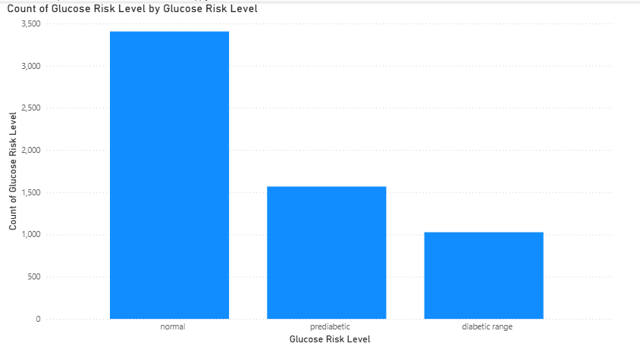
Key Insights
• Glucose is the strongest predictor

Slide 13
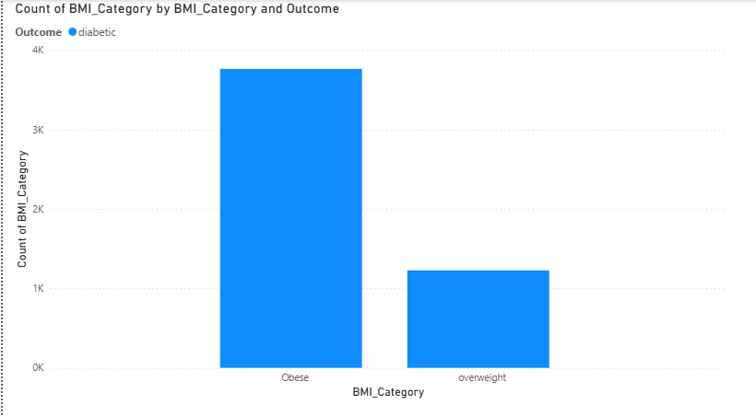
Key Insights
BMI significantly influences risk

Slide 14
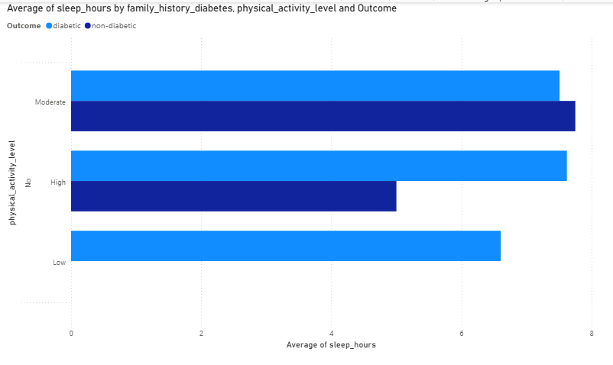
Key Insights
Lifestyle factors are modifiable
• Prevention strategies should target behavior

Slide 15
Limitations
• Observational data
• No causal inference
• Dataset assumptions may affect outcomes

Slide 16
Executive Summary
The diabetes risk assessment dashboard provides a visual and analytical overview of factors contributing to diabetic outcomes.
Key insights reveal that individuals with higher glucose levels and BMI are more likely to be diabetic, especially when combined with low physical activity and a positive family history.
While age and genetic predisposition increase susceptibility, lifestyle behaviors remain the most influential modifiable risk factors.
This dashboard supports data-driven health awareness and prevention strategies

Slide 17
Conclusion & Recommendations
• Lifestyle modification is critical
• Data-driven dashboards support decision-making
• Power BI enables scalable health analytics

