Slide 1
BMW Global Sales Analytics
Data Analytics Project
Power BI & Power Query

Slide 2
Project Objective
Analyze BMW global sales
Create clean star schema
Develop executive KPIs
Tell a data-driven story

Slide 3
Dataset Overview
This analysis evaluates BMW’s global sales performance using a structured star schema model and interactive Power BI dashboard.
The dataset was cleaned and transformed using Power Query, with categorical dimensions created to support strategic analysis across markets, products, and time.

Slide 4
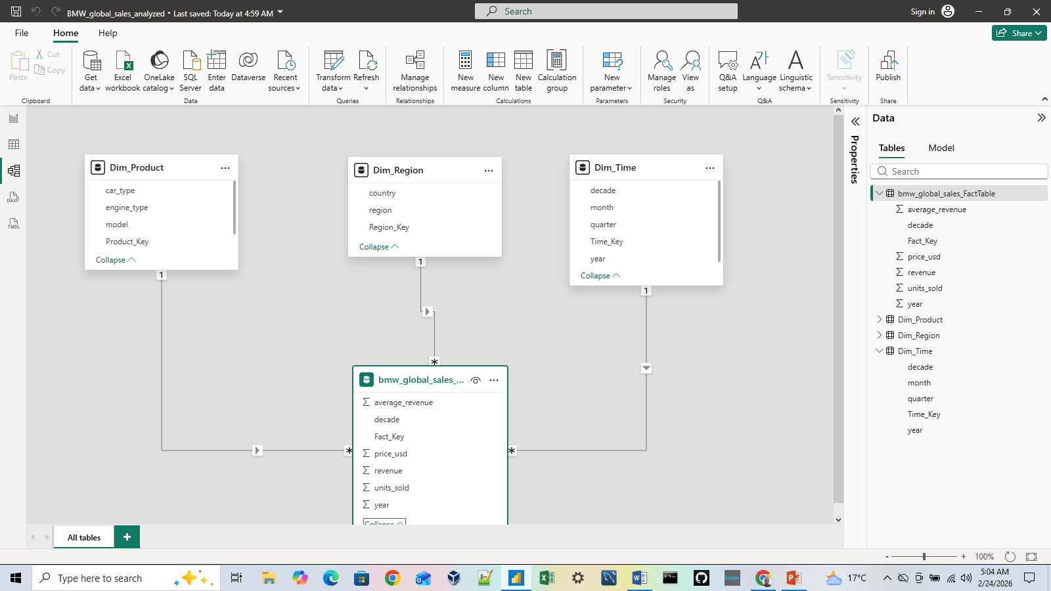
Star Schema Design

Slide 5
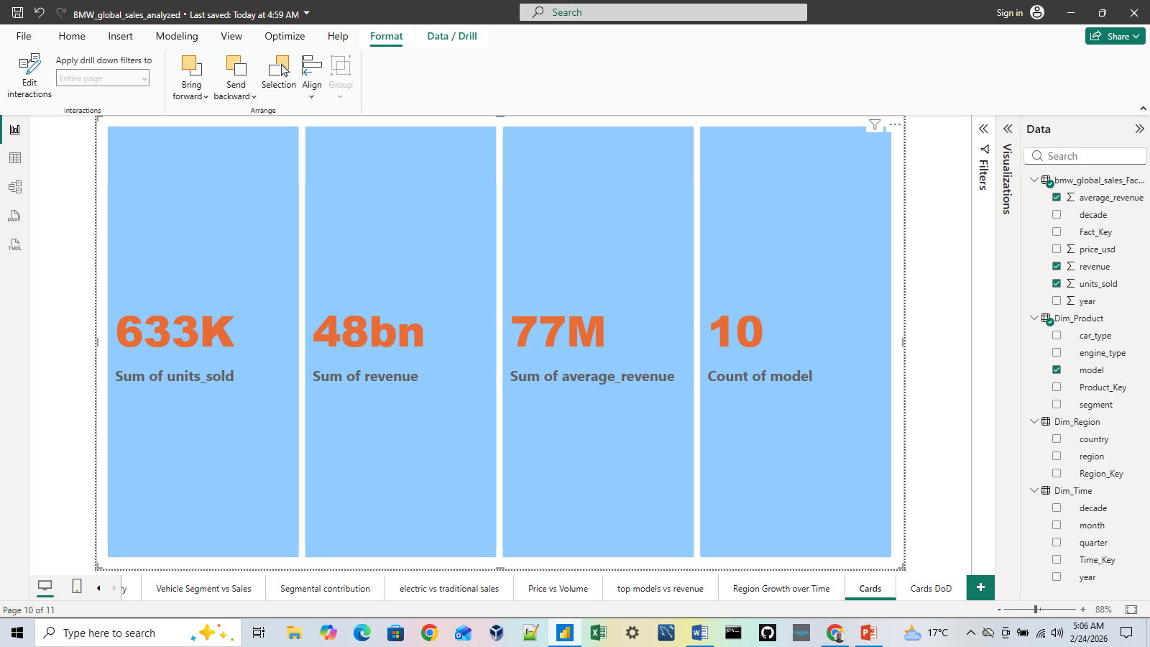
KPIs

Slide 6
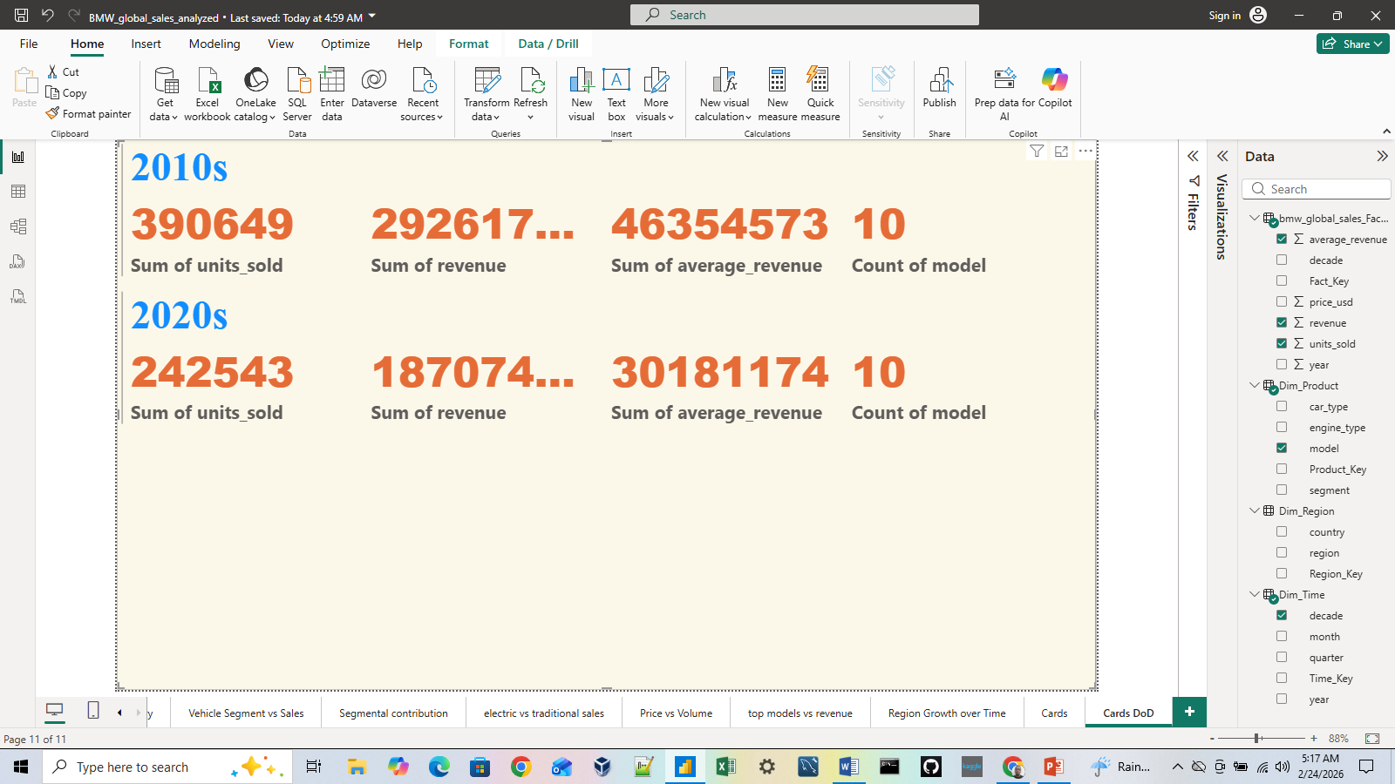
KPIs

Slide 7
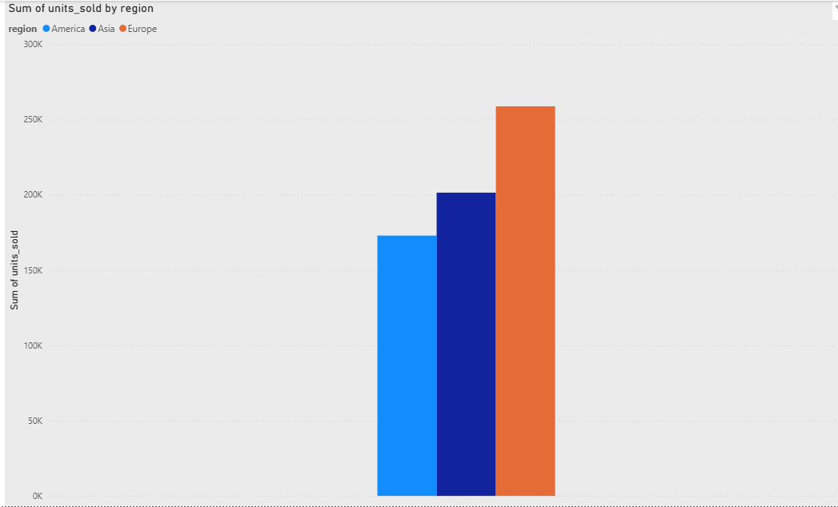
Market Performance

Slide 8
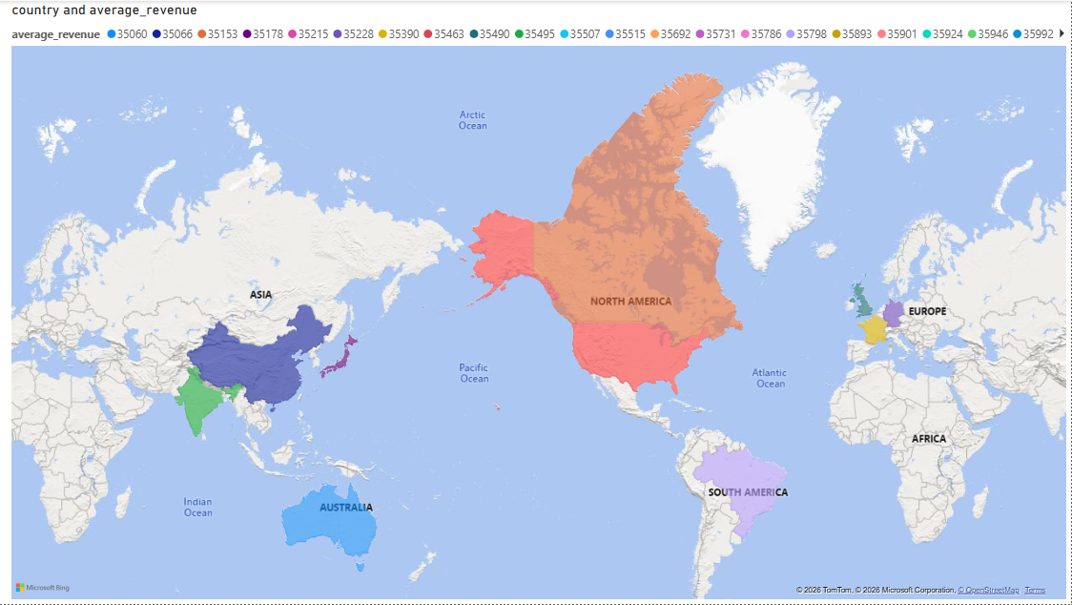
Market Performance

Slide 9
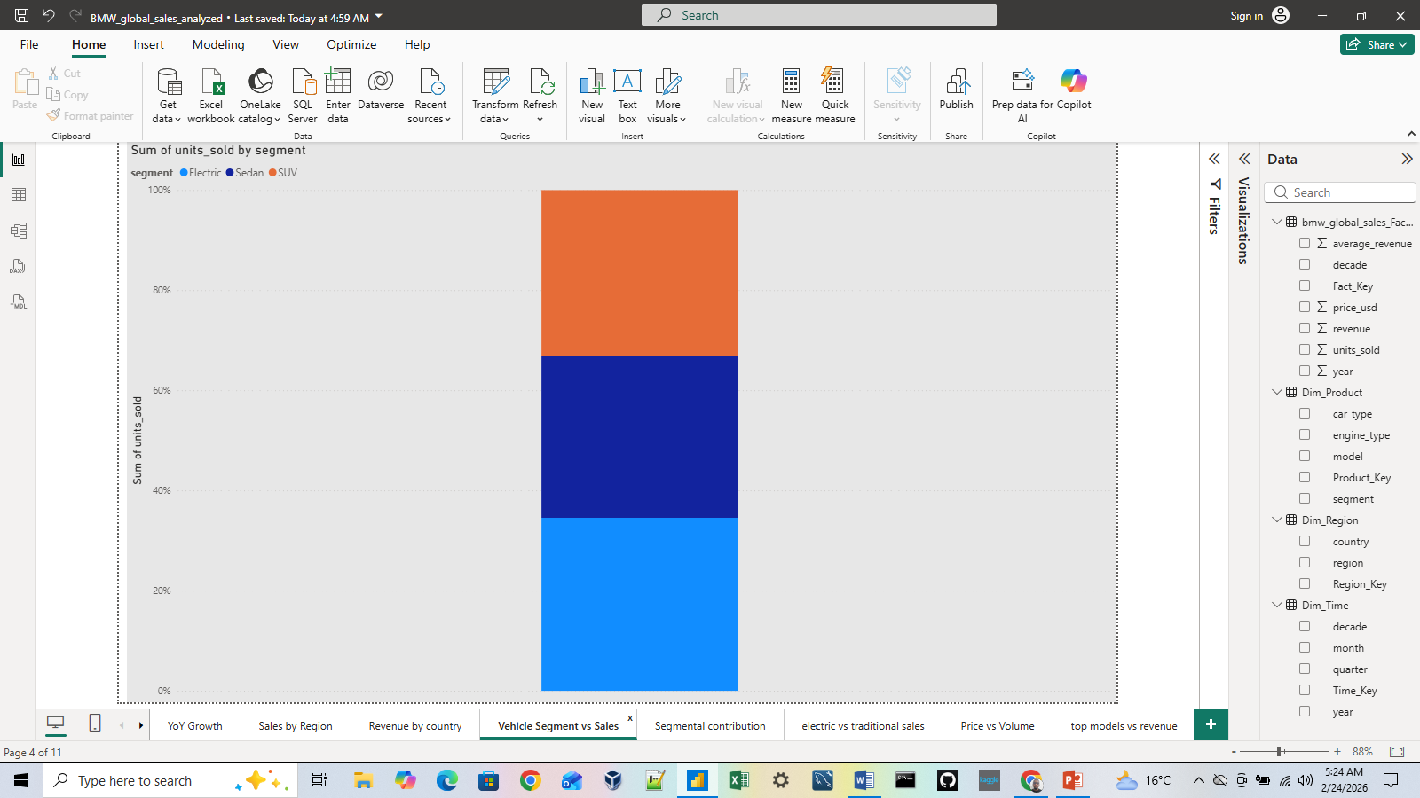
Product Strategy

Slide 10
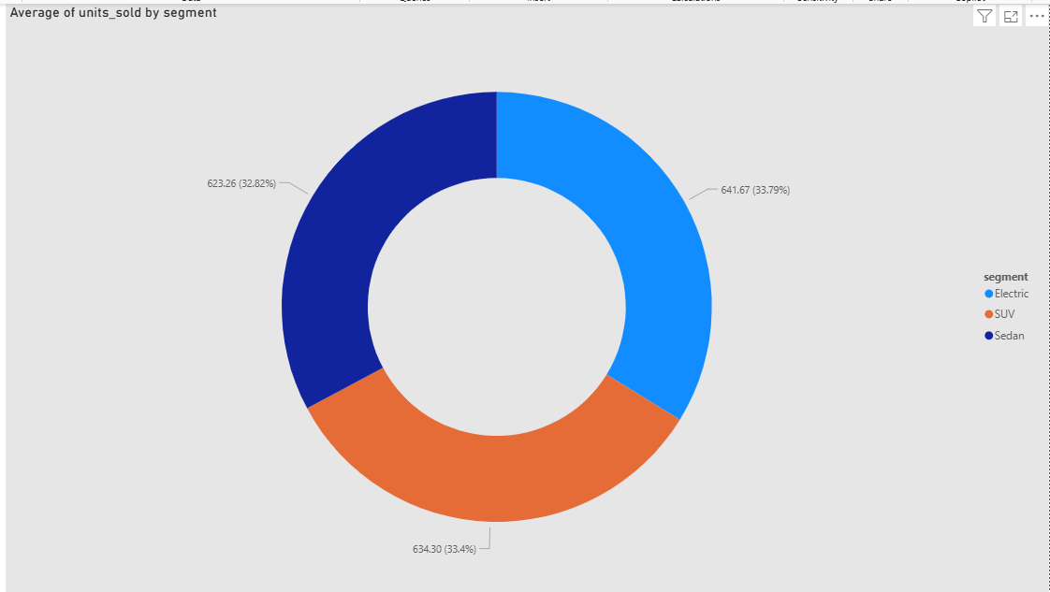
Product Strategy

Slide 11
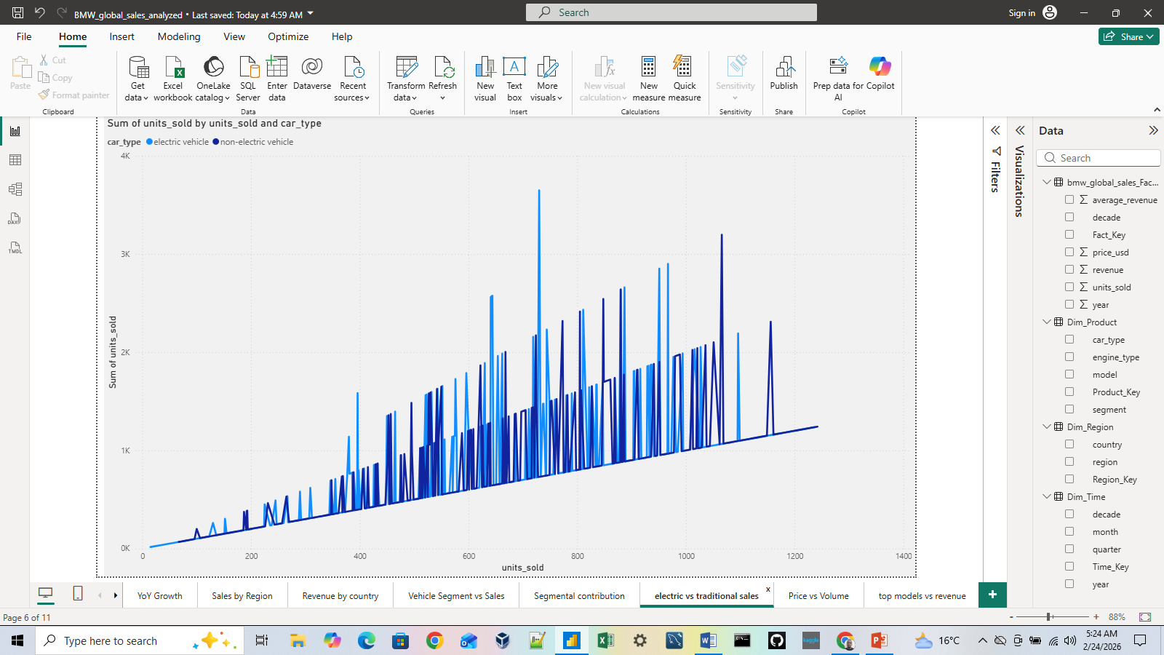
Product Strategy

Slide 12
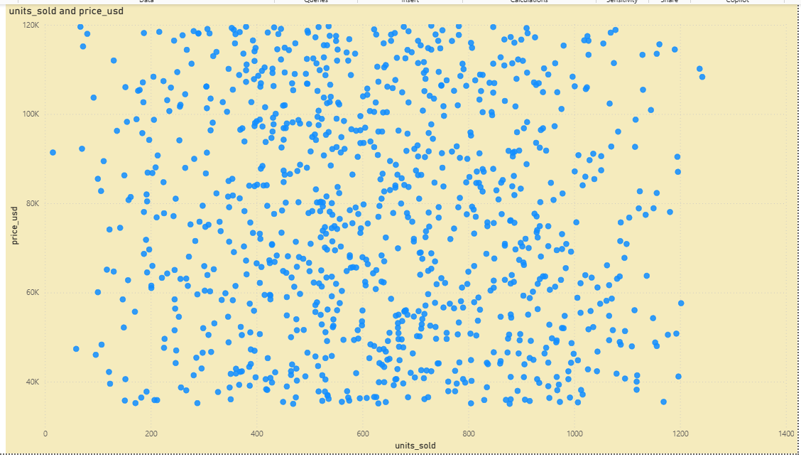
Financial Insights

Slide 13
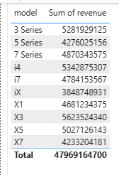
Financial Insights

Slide 14
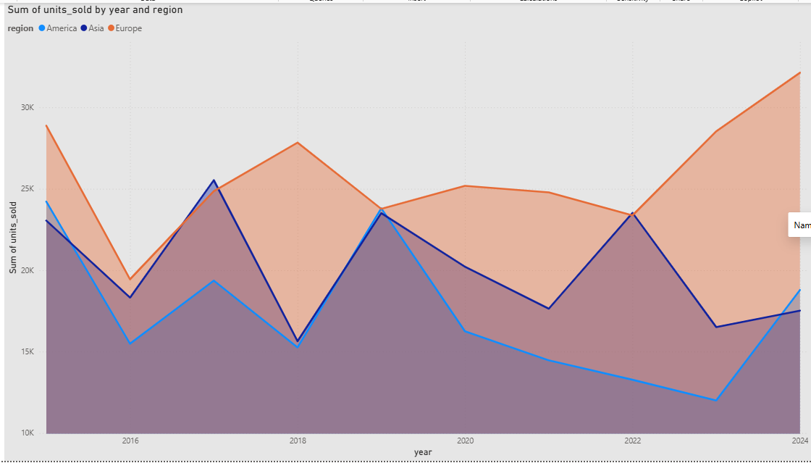
Time Trends

Slide 15
Key Insights
Revenue is more concentrated than sales volume
Although multiple BMW models contribute to total unit sales, a smaller subset of premium and high-performing models accounts for a disproportionately large share of total revenue.
This indicates that revenue growth is driven more by product value than by sales volume alone.
BMW should prioritize:
  premium model positioning
  pricing strategy optimization
  sustained investment in high-margin vehicle lines

Slide 16
Key Insights
Geographic markets contribute unevenly to performance
Sales and revenue are not evenly distributed across regions.
Certain regions consistently outperform others in both unit sales and revenue contribution, suggesting market maturity and purchasing power differences.
Business implication:
  High-performing regions should be protected and optimized
  Underperforming regions represent opportunities for targeted marketing, localized pricing, or product realignment

Slide 17
Key Insights
Average revenue highlights product efficiency
The average revenue metric reveals that not all sales contribute equally to financial performance.
Models with lower sales volume can still outperform others financially due to higher unit prices.
Business implication:
  Strategic decisions should not rely solely on unit sales but should incorporate average revenue per model to guide portfolio decisions.

Slide 18
Key Insights
Stable time trends support forecasting
Sales and revenue trends over time show identifiable growth and stabilization patterns, enabling reliable forecasting and strategic planning.
Historical performance can be confidently used for:
  demand forecasting
  production planning
  long-term investment decisions

Slide 19
Conclusion
Overall, the findings suggest that BMW’s global strategy benefits from a balanced portfolio of high-value products in mature markets while maintaining growth potential through innovation and emerging market expansion.
The dashboard supports data-driven decision-making in pricing, market prioritization, and product strategy.

