Slide 1
CISC7201 Project Presentation “Crimes in Chicago”
GROUP E
CHEONG CHI MENG, LEI HOI WAI, SU SIO TONG

Slide 2

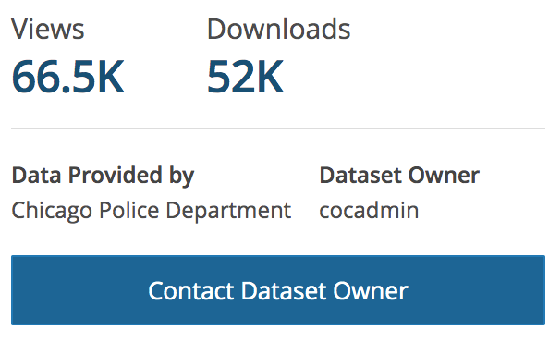
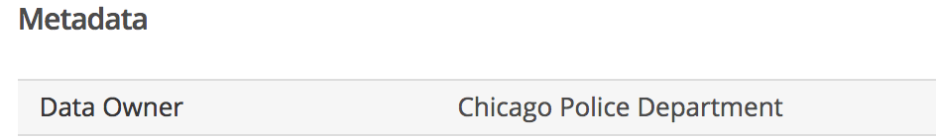
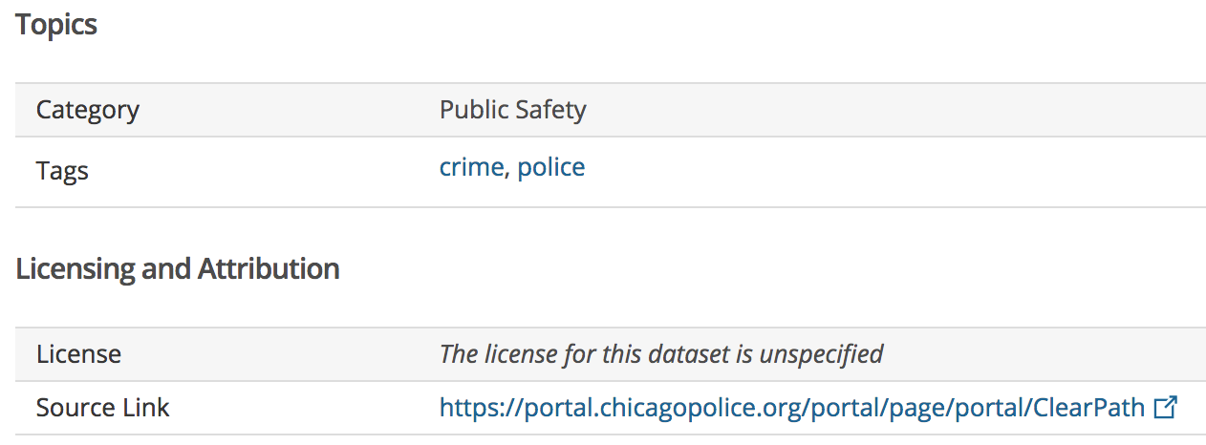
SOURCE OF DATA SET
SOURCE: Chicago Data Portal
KIND: CSV
ORIGINAL SIZE: 368.3MB
COLUMNS/FEATURES: 23columns
ROWS: 1,456,714 rows

Slide 3
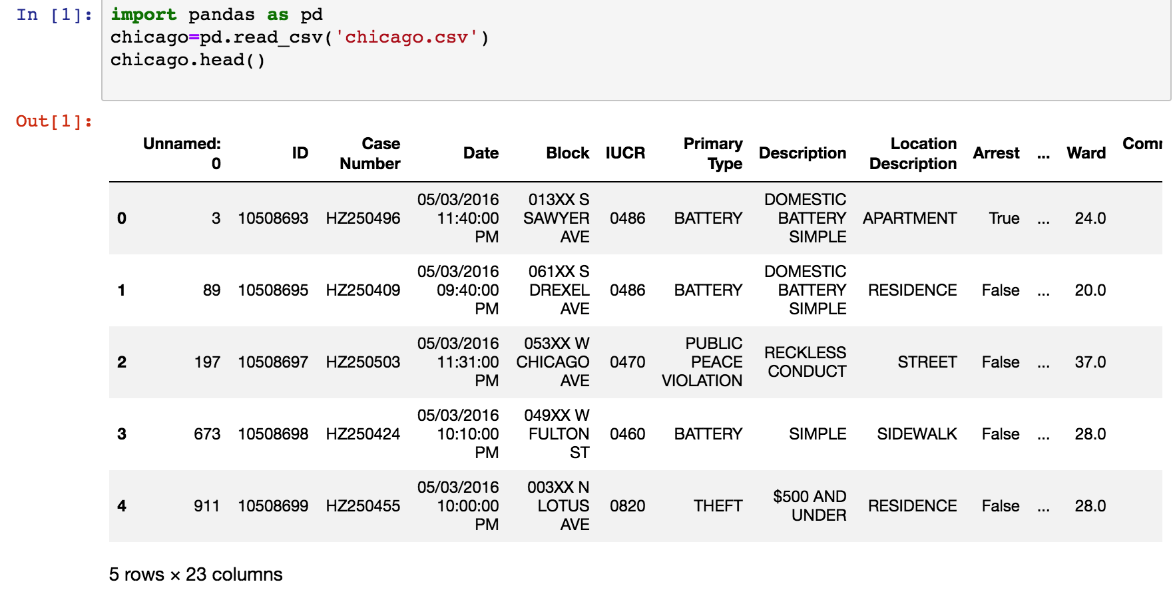
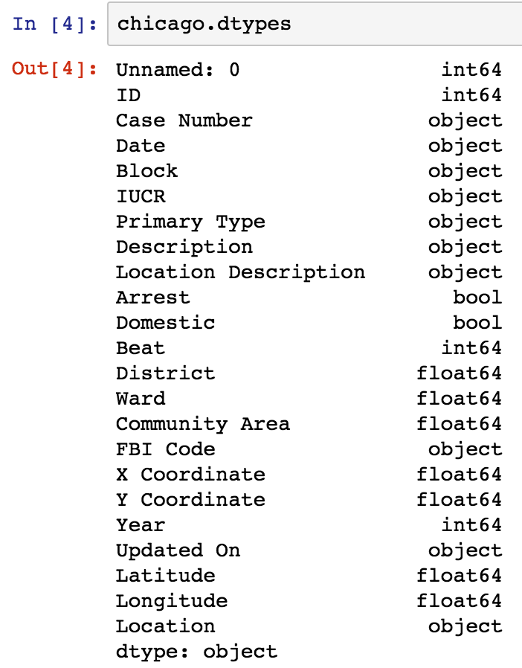
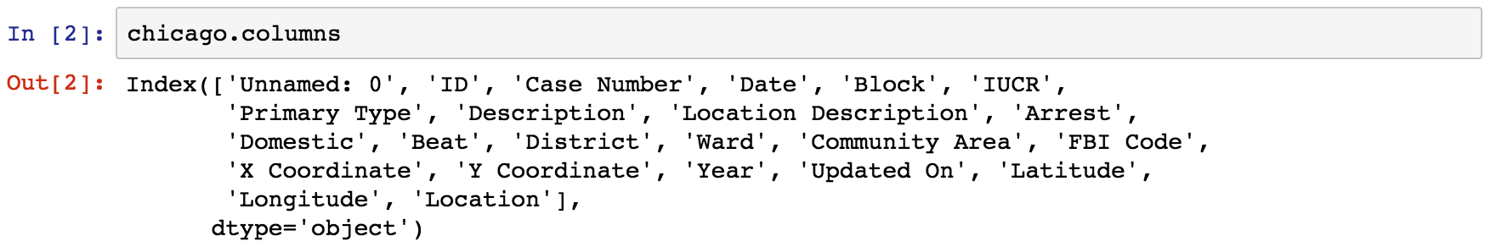
STEPS OF DATA CLEANING & TRANSFORMING 1. Knowing the features (columns)
Overview each columns

Slide 4
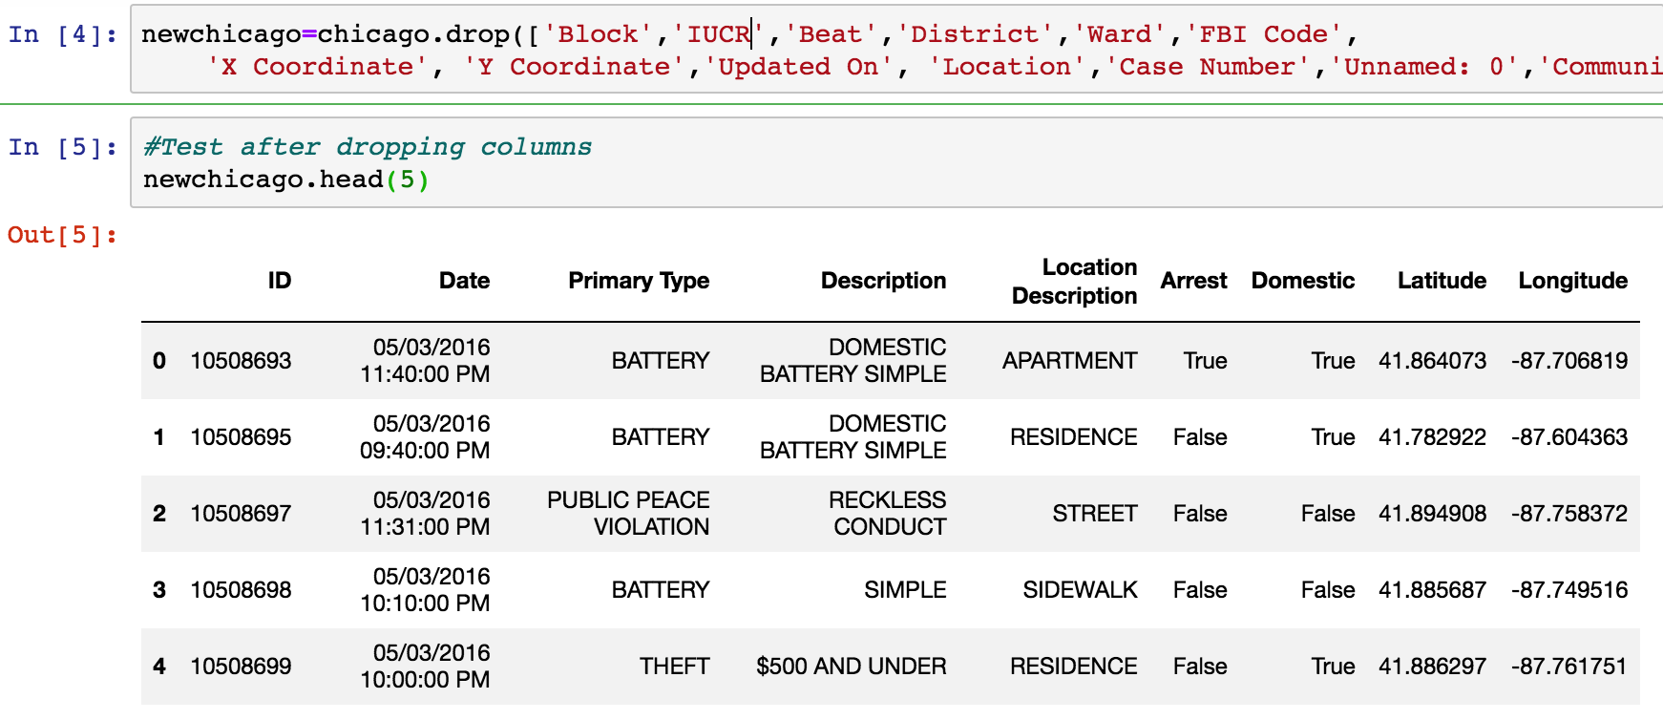
STEPS OF DATA CLEANING & TRANSFORMING 1. Knowing the features (columns)
Drop unnecessary features:
Pure unnecessary columns (Informational, Duplicated)
Weakness features
(Irrelevant features for analysis)
“Year”
“Unnamed ID”
Drop out 14 Columns
”IUCR Code”
“Community Area”
“FBI Code”
Uniqueness
Time
Nature of crimes
Other descriptions
Geo
Columns that relevant and enough for our analysis

Slide 5
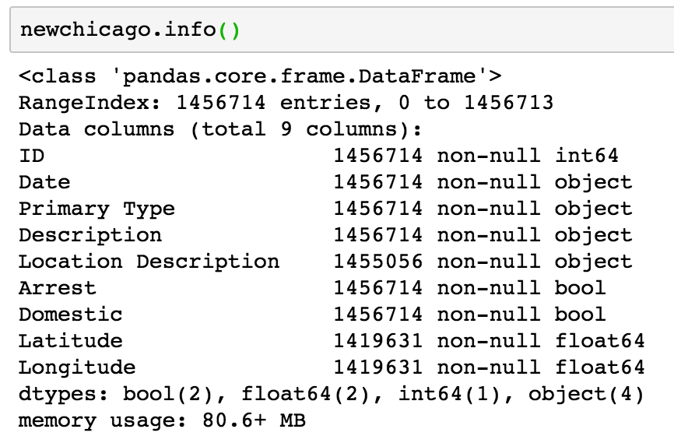
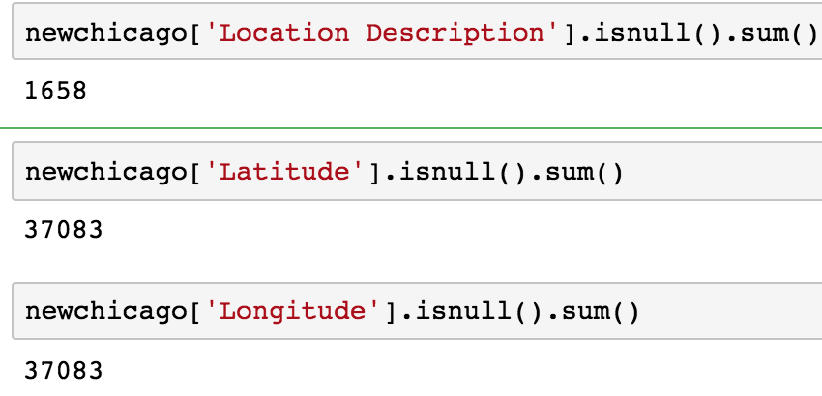
STEPS OF DATA CLEANING & TRANSFORMING 2. Dealing with missing values
Use “isnull().sum()” to find the numbers of missing values
In conclusion, these are only 0.113% and 2.5% of
the total rows of 1,456,714.
Cleaning Method: “DROP N/A VALUES”
Observe missing values in three columns

Slide 6
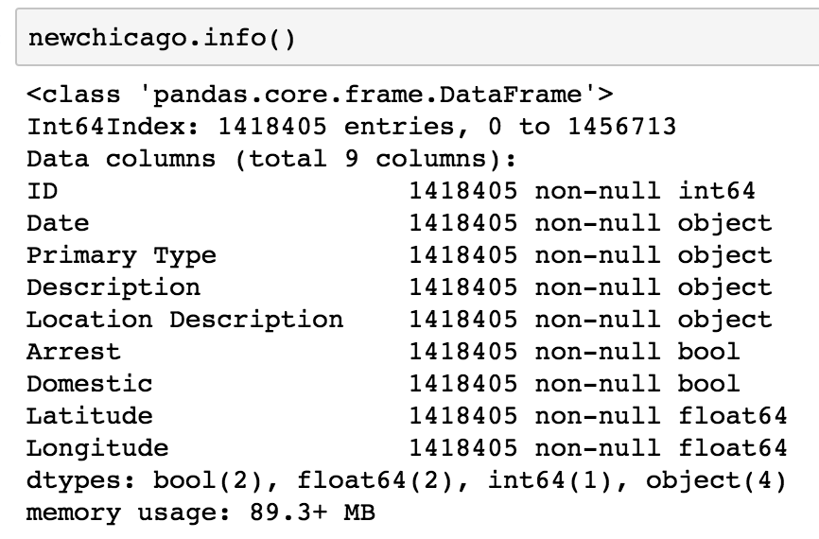
STEPS OF DATA CLEANING & TRANSFORMING 2. Dealing with missing values
“DROP N/A VALUES”
Drop all the rows that included missing
values.
Consistent

Slide 7
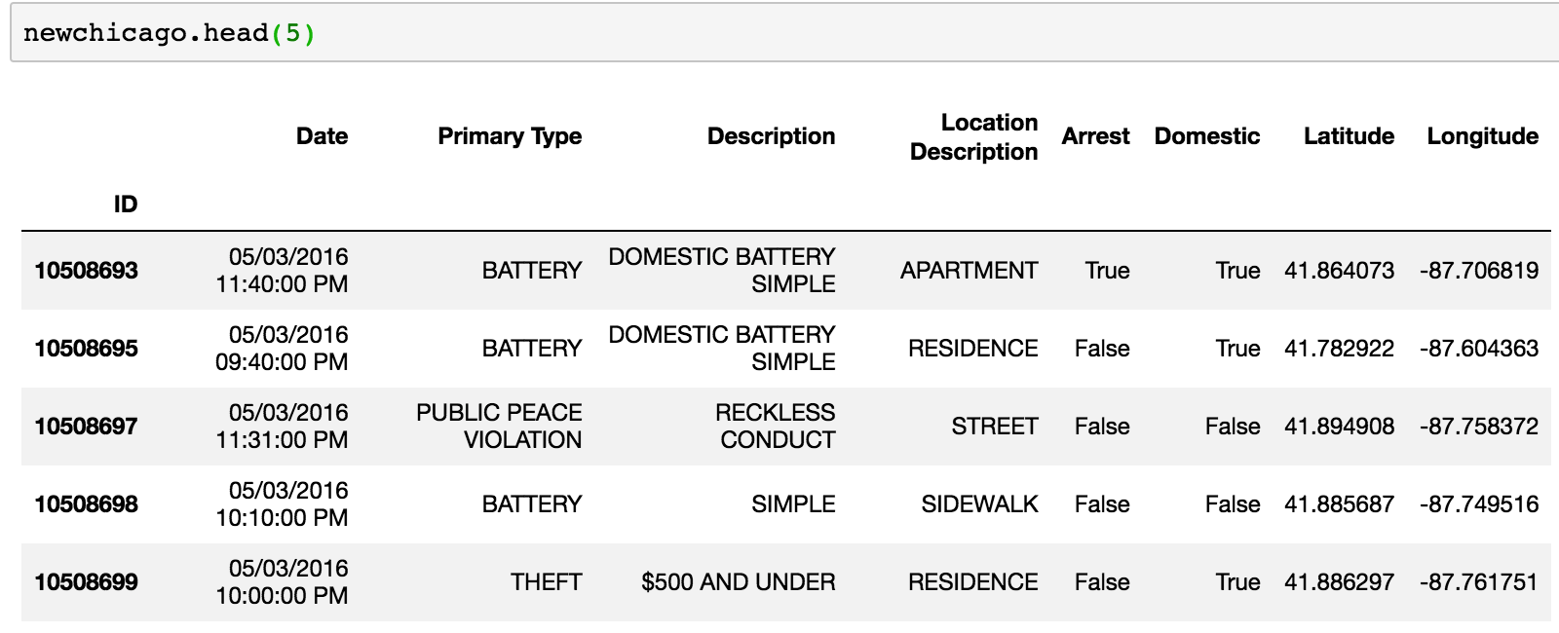
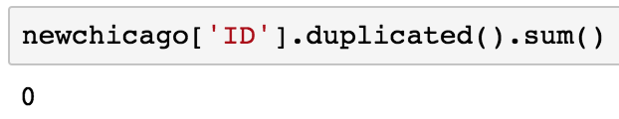

STEPS OF DATA CLEANING & TRANSFORMING 3. Set “ID” as Index
1.Check the Uniqueness of “ID”
2.See “ID” as Index

Slide 8
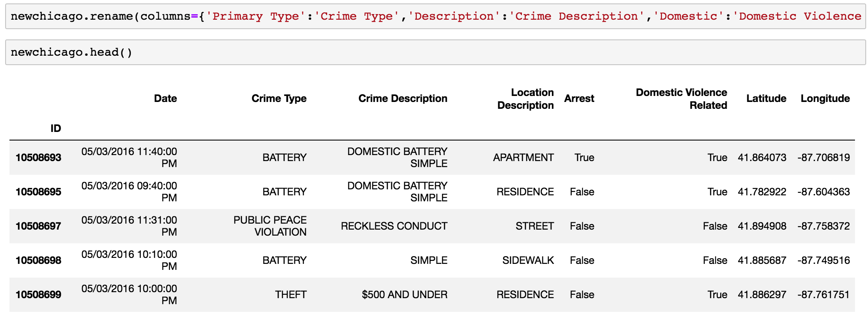
STEPS OF DATA CLEANING & TRANSFORMING 4. Renaming the Columns to reasonable form
Transfer the columns to be reasonable, concise and readable.

Slide 9
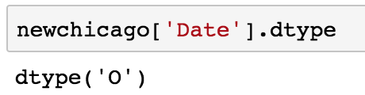
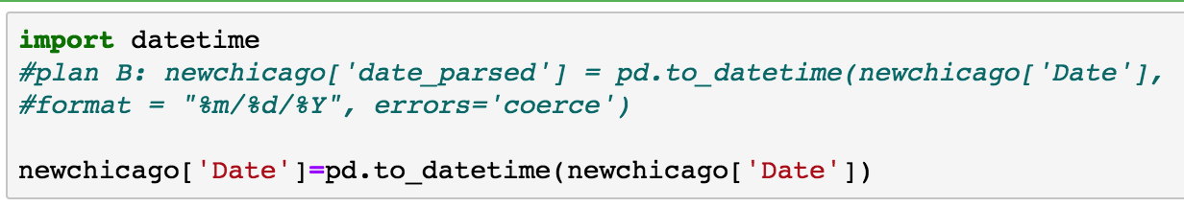
STEPS OF DATA CLEANING & TRANSFORMING 5. Datetime Format
Transfer the dtype from “object” to “Datetime 64”
“Datetime 64”: defined as a standard date format for computation by other applications(E:Excel).
Import the DateTime library
Use pd.to_datetime to transfer the values in “Date” column

Slide 10
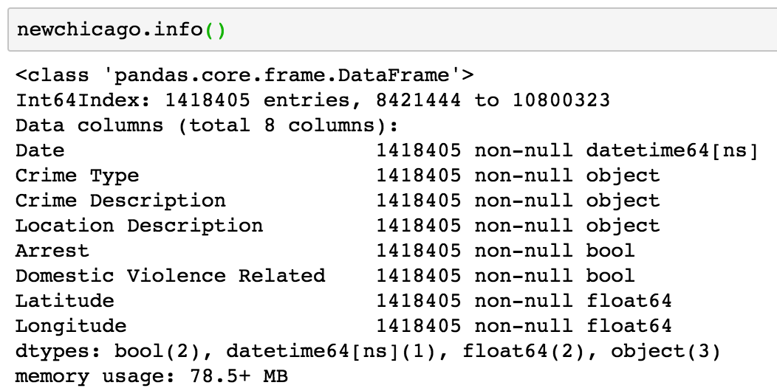
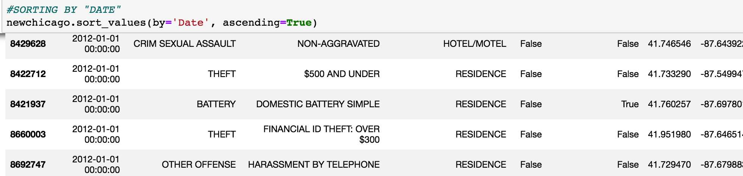
STEPS OF DATA CLEANING & TRANSFORMING 5. Datetime Format
After adjustment:
Sorting the data set by “Date”:

Slide 11
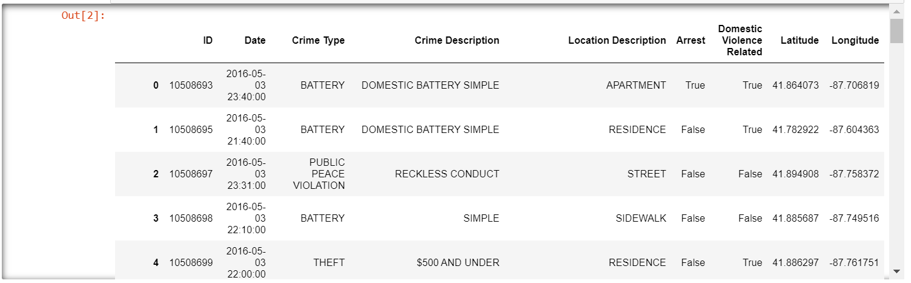
Visualization

Slide 12
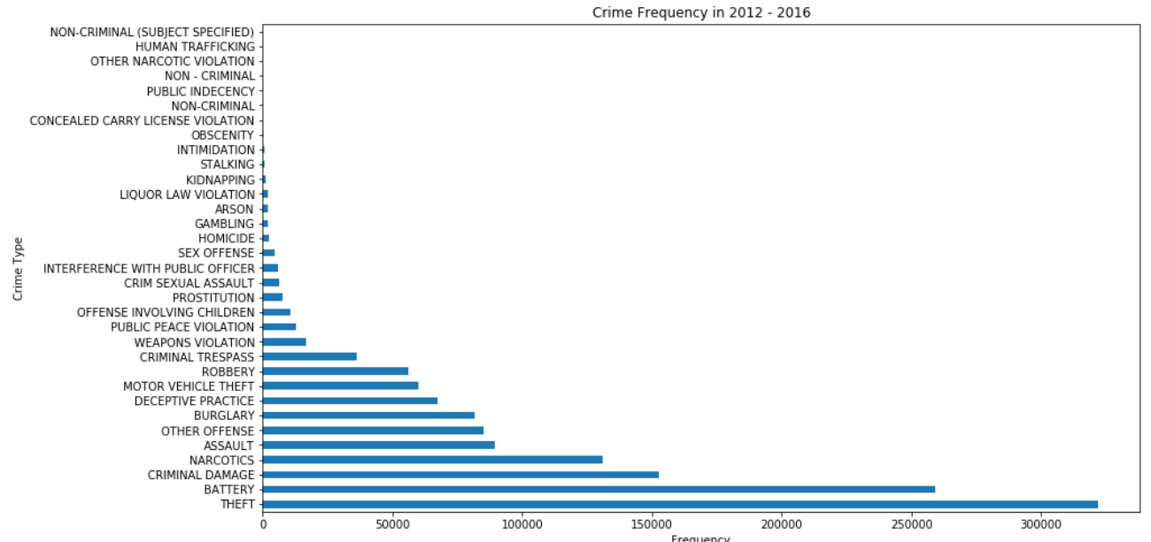
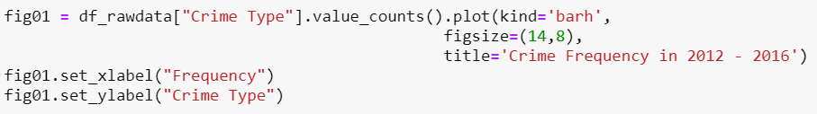
Visualization

Slide 13
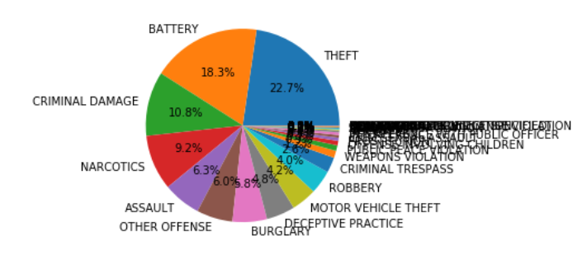
Visualization

Slide 14
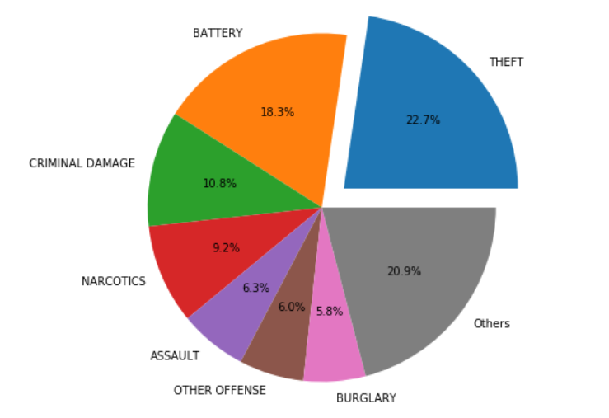
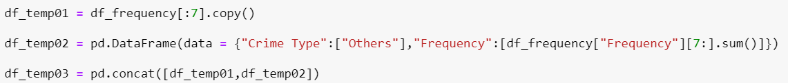
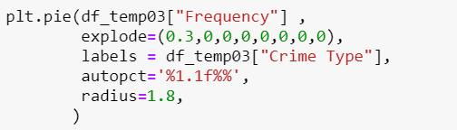
Visualization

Slide 15
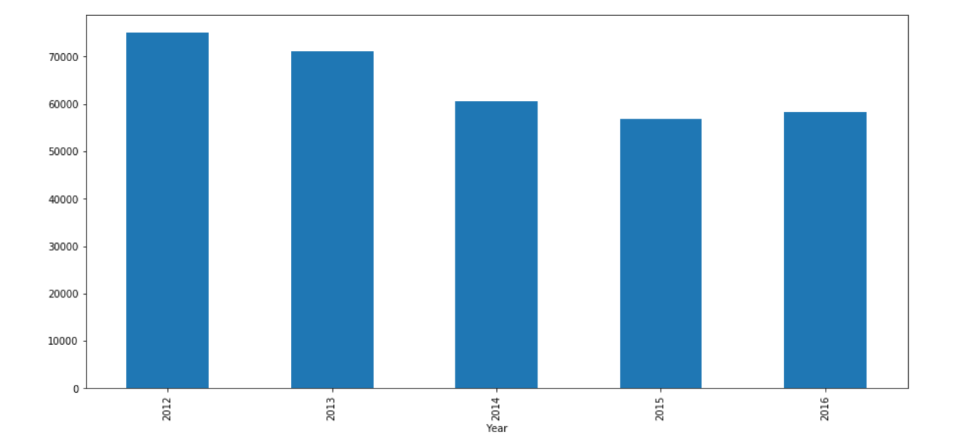
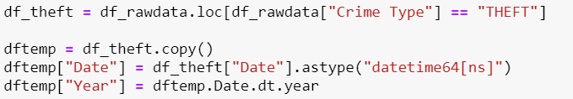
Visualization

Slide 16
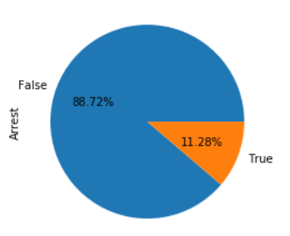

Visualization

Slide 17
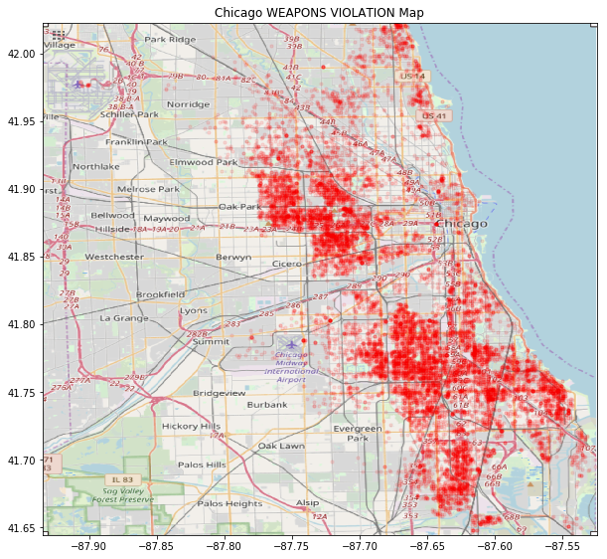
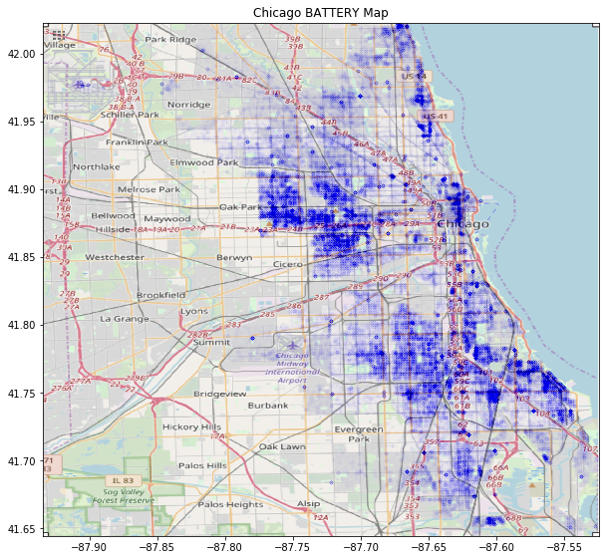
Visualization

Slide 18
Thank you

