Slide 1

Case study
Jaemean Shine

Slide 2


Business Task
🎯 Business Question:
How do annual members and casual riders use Cyclistic bikes differently?
📈 Objective:
Identify behavioral differences to support the goal of converting casual riders into annual members.
🛠️ Approach:
Insights were extracted using five SQL queries focused on usage patterns, ride duration, peak times, and top stations.
👤 Stakeholder:
Lily Moreno – Director of Marketing (Cyclistic)
📚 Context:
Google Data Analytics Capstone – Real-world case scenario​

Slide 3
SQL Description
Usage Patterns by Usertype
Popular Stations
Compare ride frequency between casual vs. member
Explore Peak Riding Times and duration
Helps understand how engagement differs
Identify top start and end stations for each usertype
Useful for targeted station-based marketing
Helps optimise station placement

Slide 4
SQL Description
Trip Length
Time Preference
Usertype Ratio
Check how often each usertype returns to the same station
Measure average trip duration by group
Suggests commuter vs. leisure pattern
Compare hourly distribution of rides
Useful for time-based promotion planning
Simple percentage breakdown of casual vs. member
Establish scale for targeting efforts

Slide 5
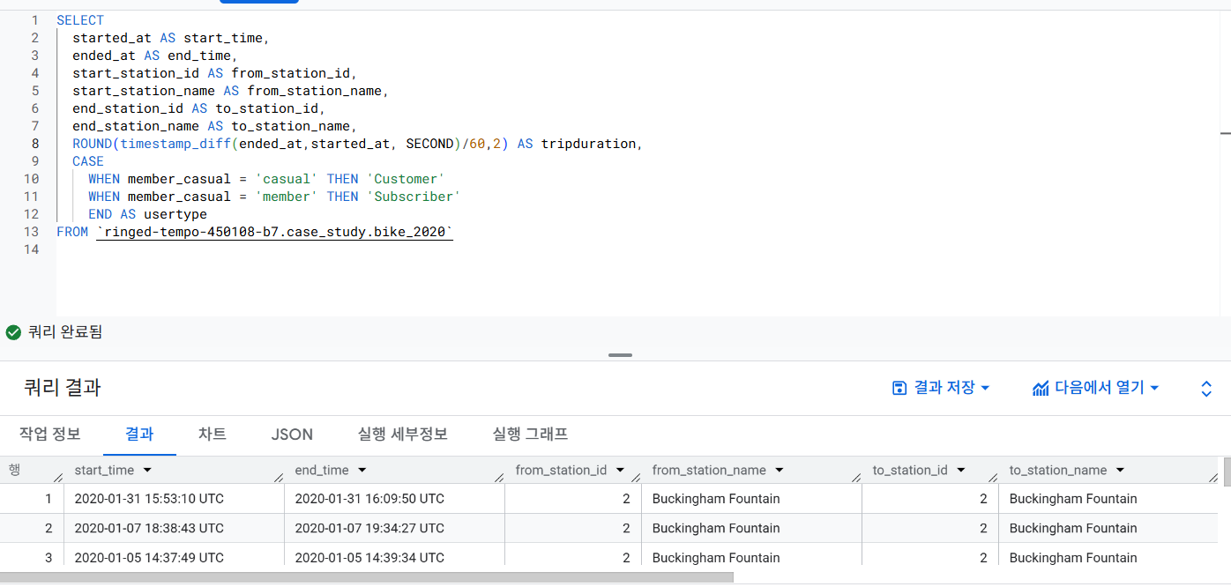
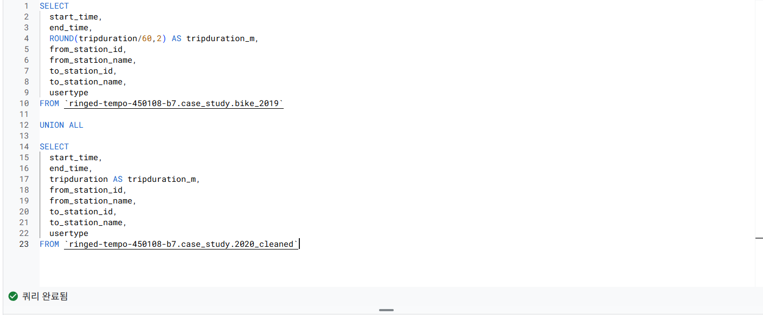
Data Preparation Using SQL

Slide 6
Usage Pattern by Usertype & Time Preference

Slide 7
Popular Stations

Slide 8
Trip Length

Slide 9
Usertype Ratio

Slide 10

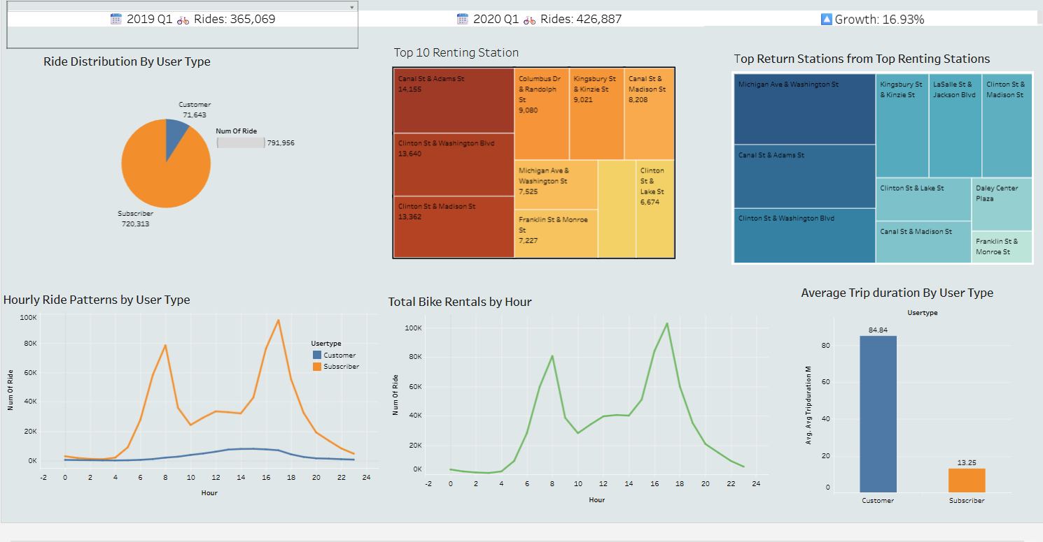
Key Insight Visualisation
With Tableau

Slide 11



Recommendation
• Launch weekend and midday promotional campaigns to match peak casual usage hours.
• Display subscription upgrade banners at high-volume casual stations to increase visibility.
• Target long-duration casual riders with cost-saving messages highlighting benefits of annual plans.

