Slide 1
15 MARCH 2017 | Imperial College Business School
ASSIGNMENT 2 PRESENTATION
GROUP 4
BIG DATA
IN FINANCE
15 MARCH 2017 | Imperial College Business School

Slide 2

ASSIGNMENT 2 PRESENTATION
VARIABLE
CONSTRUCTION
BLAh
Blah
And more blah
15 MARCH 2017 | Imperial College Business School

Slide 3
ASSIGNMENT 2 PRESENTATION
MODEL
LINEAR REGRESSION
LASSO REGRESSION
RANDOM FORREST
PREDIC-
TION
Blah
Blah
...
blah
15 MARCH 2017 | Imperial College Business School

Slide 4
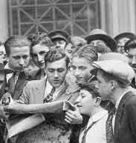
15 MARCH 2017 | Imperial College Business School
ASSIGNMENT 2 PRESENTATION
VARIABLE
CONSTRUCTION
Blah
Blah
...
blah
15 MARCH 2017 | Imperial College Business School

Slide 5
ASSIGNMENT 2 PRESENTATION
UNDERSTANDING
PERFORMANCE
Blah
Blah
...
blah
15 MARCH 2017 | Imperial College Business School

Slide 6
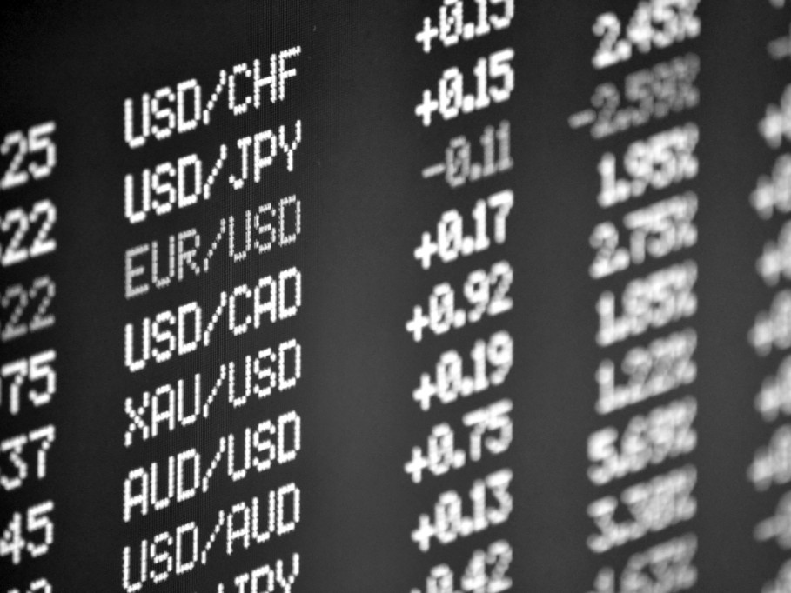
ASSIGNMENT 2 PRESENTATION
UNDERSTANDING
PERFORMANCE
Blah
Blah
...
blah
15 MARCH 2017 | Imperial College Business School

Slide 8
ASSIGNMENT 2 PRESENTATION
UNDERSTANDING
PERFORMANCE
15 MARCH 2017 | Imperial College Business School

Slide 9
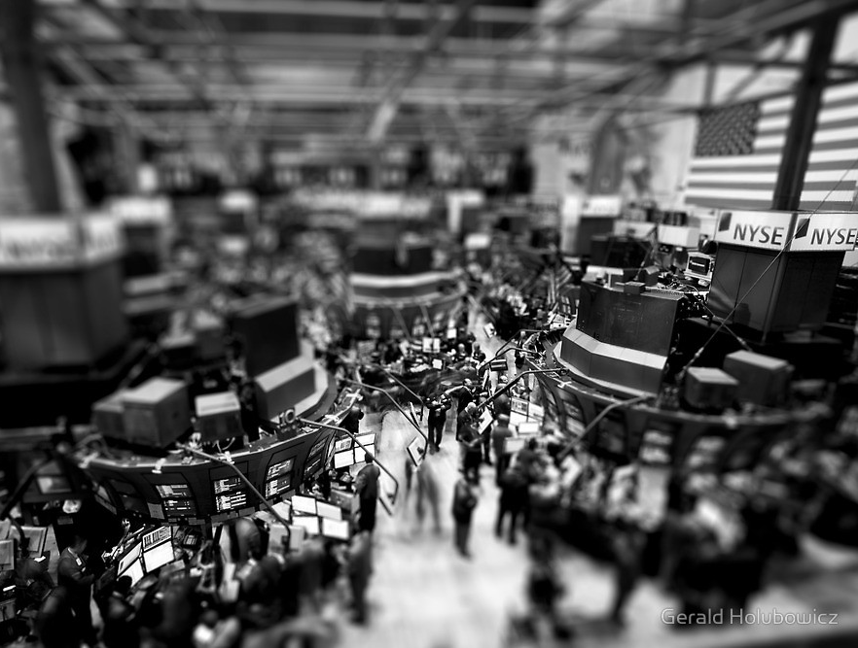
ASSIGNMENT 2 PRESENTATION
CONSTRUCTION
BLAh
Blah
And more blah
15 MARCH 2017 | Imperial College Business School

