Slide 1
15 MARCH 2017 | Imperial College Business School
ASSIGNMENT 2 PRESENTATION
GROUP 2 | Akos Furton, Marnelia Scribante, Siow Meng Low, Joaquin Coitino
BIG DATA
IN FINANCE
15 MARCH 2017 | Imperial College Business School

Slide 2

ASSIGNMENT 2 PRESENTATION
CONTEMPORANEOUS
VARIABLE RELATIONSHIPS
Direct relationship (positive (+) correlation):
Interest differential - ⬆ forward exchange rate = ⬆ future spot rate
- more attractive to save money in currency with higher interest rate
IP differential - higher demand for goods and services = ⬆ production
= stronger economy = ⬆ value of currency
Indirect relationship (negative (−) correlation):
Inflation differential - ⬆ inflation = more money buys fewer goods = ⬇ value of currency
MS differential - all else equal, ⬆ supply with constant demand = ⬇ spot rate
15 MARCH 2017 | Imperial College Business School

Slide 3
ASSIGNMENT 2 PRESENTATION
MODEL
WINDOW SIZE
60 months (5 years)
Long enough to avoid over-sensitivity to recent events
Short enough to contain relevant information
COEFFICIENTS
Changes according to model
Changes with every iteration
PARA-
METERS
Hyper-parameters tuned via cross-validation:
LASSO regression: alpha
Elastic net: L1 ratio and alpha
Random forest: minimum leaf size
Bayesian ridge regression: lambda
15 MARCH 2017 | Imperial College Business School

Slide 4
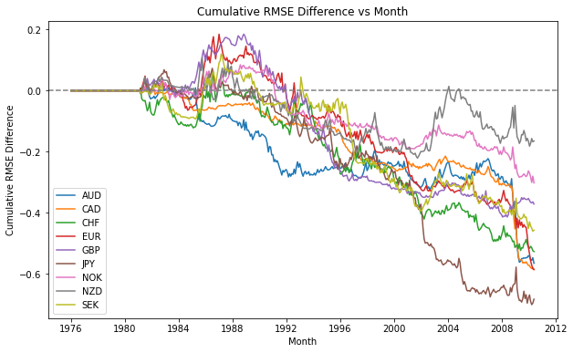
15 MARCH 2017 | Imperial College Business School
ASSIGNMENT 2 PRESENTATION
PERFORMANCE
LINEAR REGRESSION
Maximum drawdown
AUD: 0.593
CAD: 0.605
CHF: 0.584
EUR: 0.770
GBP: 0.599
JPY: 0.773
NOK: 0.386
NZD: 0.328
SEK: 0.580
R²_{OOS} = -0.1394
Economic significance
= -1161.72 %
15 MARCH 2017 | Imperial College Business School

Slide 5
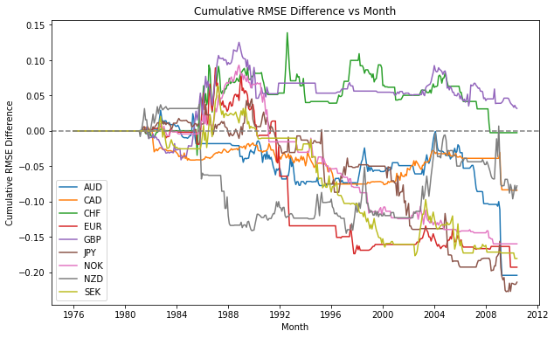
15 MARCH 2017 | Imperial College Business School
ASSIGNMENT 2 PRESENTATION
PERFORMANCE
LASSO REGRESSION
Maximum drawdown
AUD: 0.233
CAD: 0.089
CHF: 0.141
EUR: 0.282
GBP: 0.094
JPY: 0.273
NOK: 0.253
NZD: 0.182
SEK: 0.244
R²_{OOS} = -0.0375
Economic significance
= -312.68%
15 MARCH 2017 | Imperial College Business School

Slide 6
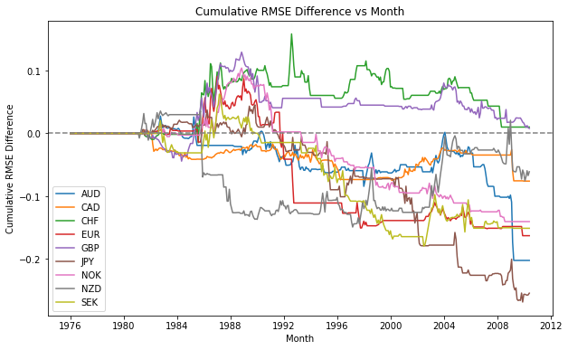
15 MARCH 2017 | Imperial College Business School
ASSIGNMENT 2 PRESENTATION
PERFORMANCE
ELASTIC NET
Maximum drawdown
AUD: 0.230
CAD: 0.081
CHF: 0.148
EUR: 0.254
GBP: 0.122
JPY: 0.314
NOK: 0.244
NZD: 0.185
SEK: 0.242
R²_{OOS} = -0.0351
Economic significance
= -292.13%
15 MARCH 2017 | Imperial College Business School

Slide 7
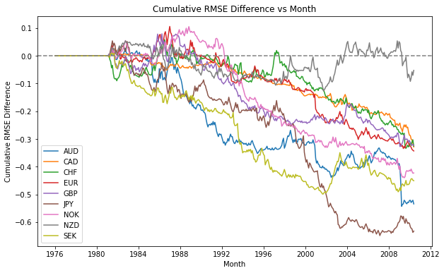
15 MARCH 2017 | Imperial College Business School
ASSIGNMENT 2 PRESENTATION
PERFORMANCE
RANDOM FOREST
Maximum drawdown
AUD: 0.570
CAD: 0.356
CHF: 0.392
EUR: 0.449
GBP: 0.407
JPY: 0.703
NOK: 0.545
NZD: 0.181
SEK: 0.508
R²_{OOS} = -0.0981
Economic significance
= -817.77%
15 MARCH 2017 | Imperial College Business School

Slide 8
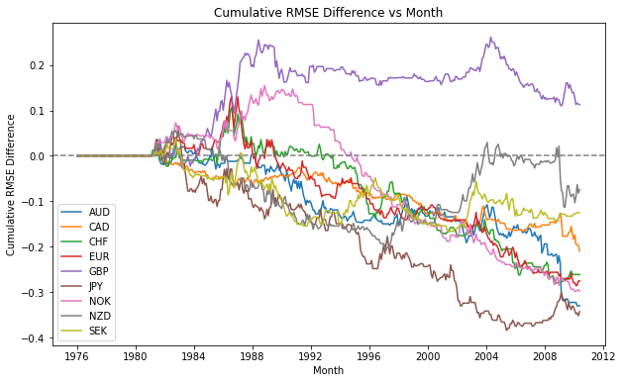
15 MARCH 2017 | Imperial College Business School
ASSIGNMENT 2 PRESENTATION
PERFORMANCE
RANDOM FOREST WITH LASSO
Maximum drawdown
AUD: 0.355
CAD: 0.221
CHF: 0.385
EUR: 0.415
GBP: 0.151
JPY: 0.450
NOK: 0.452
NZD: 0.263
SEK: 0.204
R²_{OOS} = -0.0617
Economic significance
= -514.45%
15 MARCH 2017 | Imperial College Business School

Slide 9
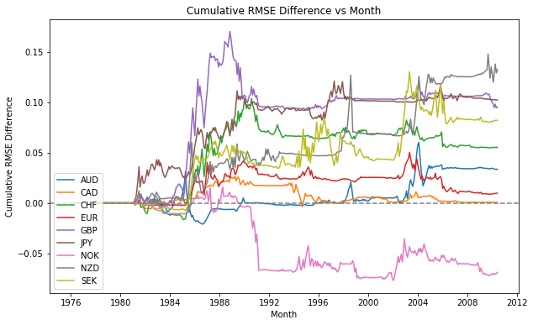
15 MARCH 2017 | Imperial College Business School
ASSIGNMENT 2 PRESENTATION
PERFORMANCE
BAYESIAN RIDGE REGRESSION
Maximum drawdown
AUD: 0.052
CAD: 0.030
CHF: 0.049
EUR: 0.042
GBP: 0.077
JPY: 0.029
NOK: 0.093
NZD: 0.060
SEK: 0.052
R²_{OOS} = 0.0056
Economic significance
= 46.50%
15 MARCH 2017 | Imperial College Business School

Slide 10
ASSIGNMENT 2 PRESENTATION
UNDERSTANDING
PERFORMANCE
Consistency:
Consistent performance with limited downside risk
Long periods of performance similar to the mean
Short bursts when model outperforms and delivers abnormal returns
Economic forces:
Structural change in the currency itself to dislodge Bayesian estimators
(monetary policy, inflation, interest rate etc.)
15 MARCH 2017 | Imperial College Business School

