Slide 1

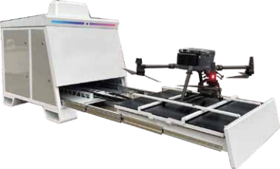









UAV Autonomous Inspection System
Automated Airport
Product Description
The UAV automated airport integrates advanced automation technology, UAV management system and safety protection mechanism.
It integrates advanced automation technology, UAV management system and safety protection mechanism, aiming to provide a safe and convenient storage and take-off platform for UAVs, reduce manual intervention, increase the attendance rate of UAVs, and ensure the safe storage of UAVs. Equipped with the M350RTK series UAV, it can realize the remote and automated operation process from automatic takeoff, automatic cruise, automatic shooting, automatic returning to the nest for charging, data analysis to automatic takeoff. This eliminates the need for professional UAV pilots, ensures the stability and consistency of UAV flight results, and reduces the overall cost of UAS operation.
Product Features
Miniaturized design
Extremely compressed product size, width
only 1 meter in width
Extremely fast charging and switching
100 seconds to change the battery, support up to 8 batteries at the same time charging
High compatibility
It can be adapted to DJI Matrix M350 RTK,
M300 RTK drones, according to the industry
Adaptable to relevant mounts according to industrial application scenarios.
High Reliability
Adopts advanced visual fusion guidance landingtechnology, no matter day or night, wind or rain, the
UAV can land accurately
Weather Monitoring
Equipped with weather station and video surveillance for real-time operation and automatic judgment of takeoff environment, UPS and self-developed industrial air-conditioning are provided.
A large number of mounting free collocation
H30 | H20 | Shouter | Methane Telemeters | Gas Detector | ......

Slide 2
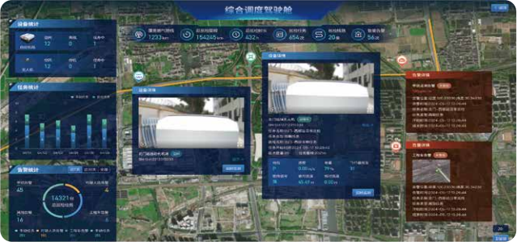
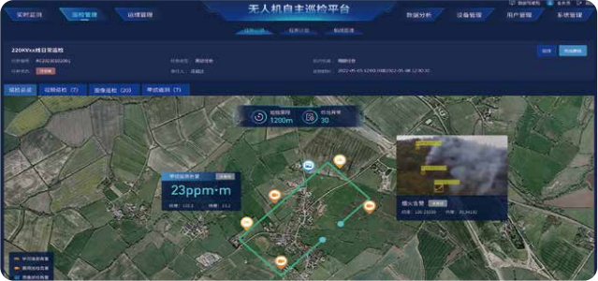
Drone Autonomous Inspection Platform
Integrating automatic airports, drones, pods and other flight resources, the full-stack selfdeveloped low-altitude drone autonomous inspection platform aims to promote the development of low-altitude economy and comprehensively meet the needs of different layers.
economic development, and comprehensively meet the actual needs of users at different levels. Combined with AI intelligent algorithms, it realizes intelligent applications in various industries, providing services for gas, electricity, transportation, forestry, public security, and other industries.
power, transportation, forestry, public security, urban management, emergency response and other multi-industry applications and customized support.
Support situational awareness, in the form of charts and graphs, easy for leaders to command, decision-making
Support multi-device cluster scheduling, one screen to grasp the regional situation.
Supports viewing demand details, event feedback, flight results and other information.
Supports remote tasking, pointing flights, timed/periodic/instant flights.
Support taking over the drone manually by keyboard/joystick, etc., and remotely controlling loads such as yellers.
Support digital twin display, online collection or one-key import orthophoto and other files, through the three-dimensional scene to assist route development and task monitoring.
Supporting the AI visual model and industry model based on the drone autonomous inspection aviation platform, providing AI visual inspection services covering equipment and facilities, people, roads, vehicles, fires, ships, and many other aspects of safety protection and standardized management.

