Slide 1
R for Reproducible Scientific Analysis -- session 1
June 17, 2025
Morgan Feeney, Leighton Pritchard, and Steve Ford

Slide 2
Part 1. Introduction to R and R Studio
Before we begin:
Do you have the latest version of R and R Studio installed?
Housekeeping notes

Slide 3
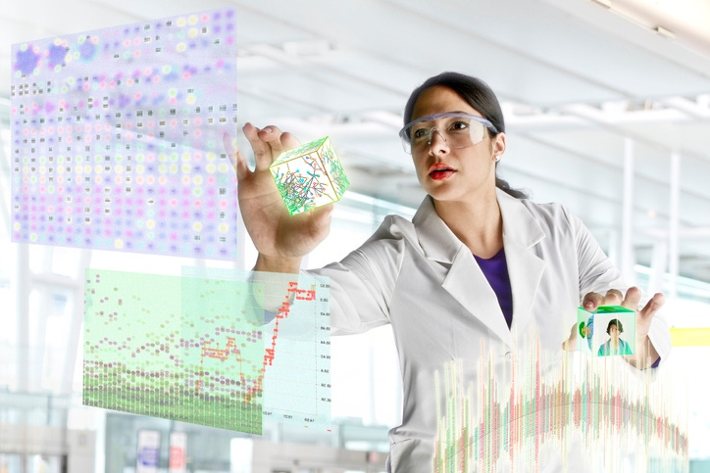
The problem: you have (or will have) some data
Image credit: IoT World Today

Slide 4
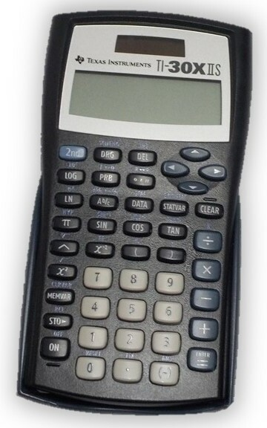


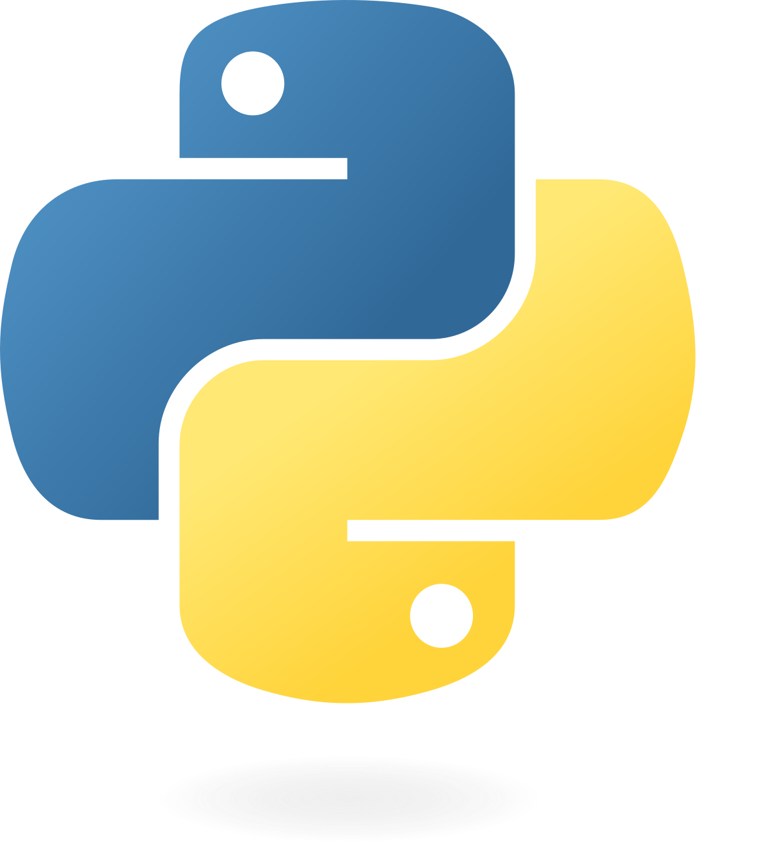


There are many tools you could use to analyse your data…
etc….
….Why use R and R Studio?

Slide 5
A note on terminology: R versus R studio
Live demo:
Introduction to the R Studio console
Basic mathematical operations
Assigning and using variables
Using basic functions
Using R packages

Slide 6
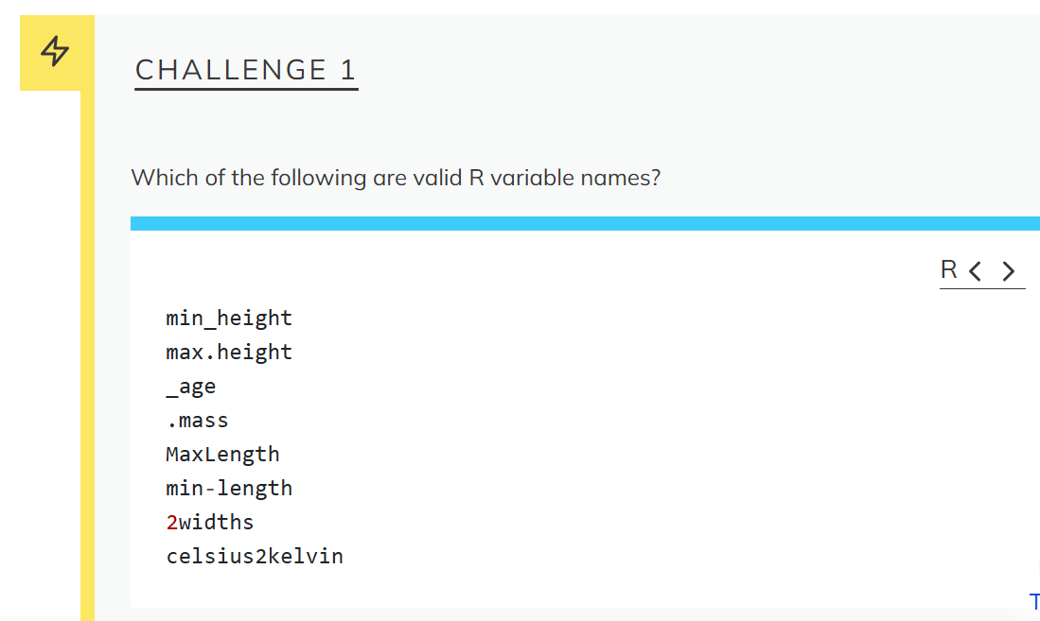

Slide 7
⮾
(hidden)
⮾
⮾

Slide 8
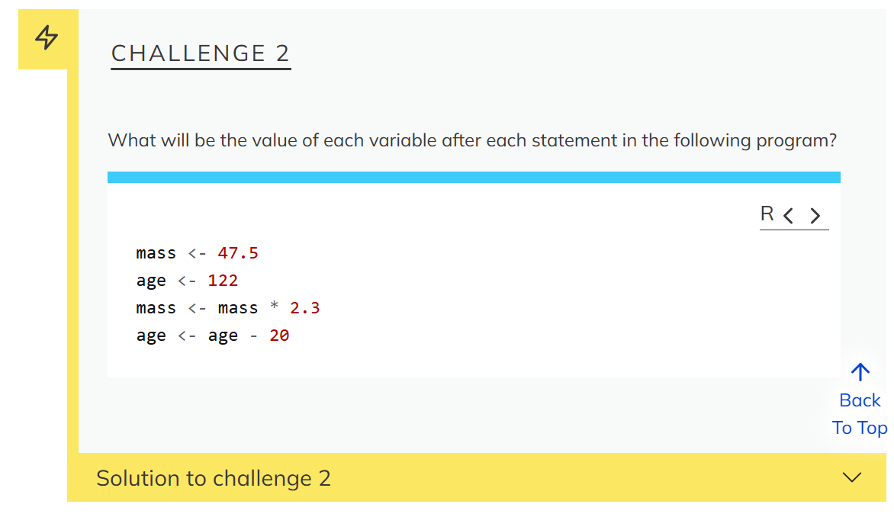

Slide 9
mass <- 47.5
mass is 47.5
age <- 122
age is 122
mass <- mass * 2.3
mass is 47.5 * 2.3 = 109.25
age <- age - 20
age is 122 – 20 = 102

Slide 10
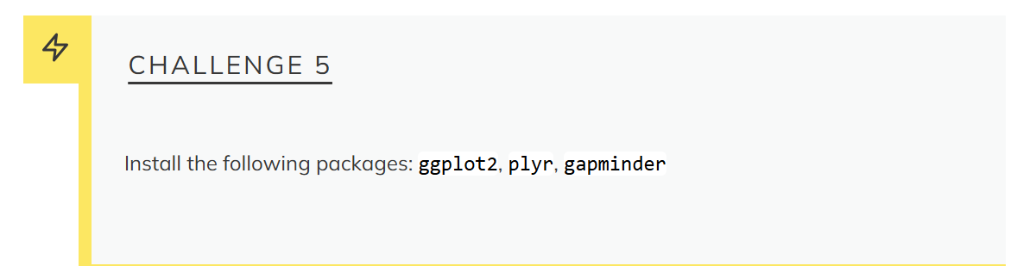

Slide 11
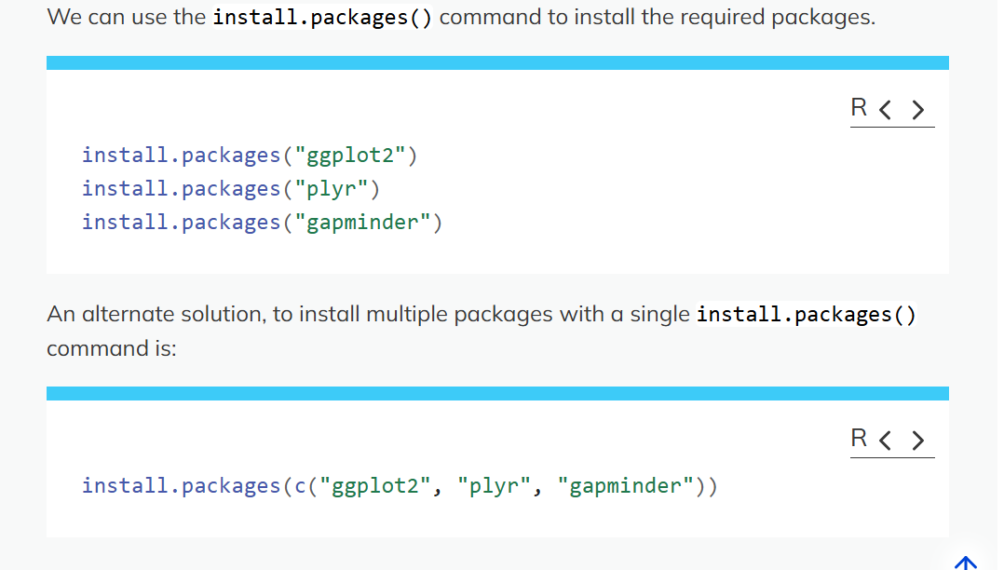

Slide 12
Lesson 1 – Key Points
Use RStudio to write and run R programs.
R has the usual arithmetic operators and mathematical functions.
Use <- to assign values to variables.
Use ls() to list the variables in a program.
Use rm() to delete objects in a program.
Use install.packages() to install packages (libraries).

Slide 13
Part 2. Project Management with R Studio
Before we begin:
Any questions?
Housekeeping notes

Slide 14
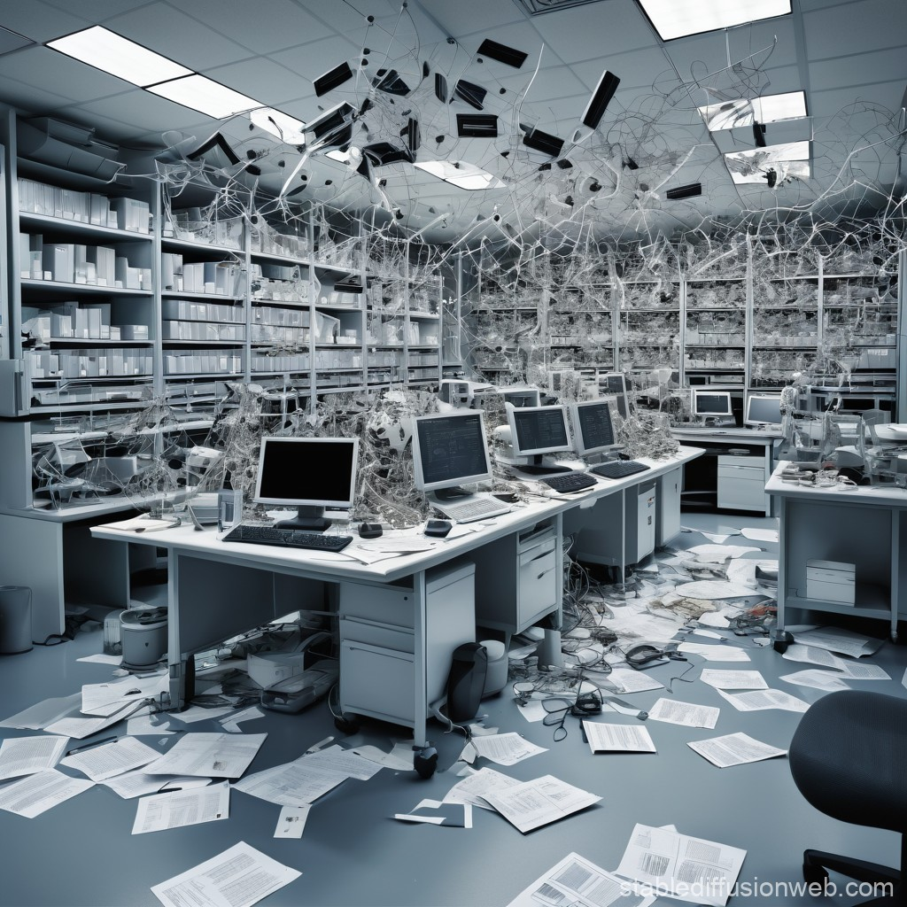
Why do I need to manage my projects?

Slide 15
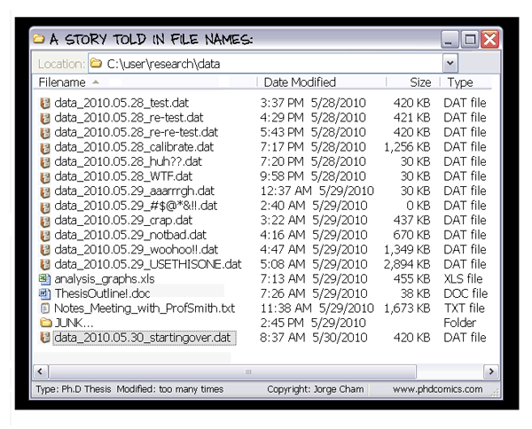

Slide 16
Project organization must-haves
What features or design elements make a project layout good (“good” = useful, helpful, makes your life easier)
What features are less good?

Slide 17
Some tips for best practices
Preserve original data, and easily distinguish between original data and modified data
Original data (and sometimes, cleaned data) should be treated as read-only
Generated data (output) should be treated as disposable (you should be able to regenerate it from the original/cleaned data using your scripts)
Organize in a way that makes it easy for you to find things, and to relate the output (e.g., figures, tables) to the original data and code used to generate them
Readable and shareable with other people (including your future self)
Separate function definition and application

Slide 18
Good Enough Practices for Scientific Computing recommendations for project organization:
Put each project in its own directory, which is named after the project.
Put text documents associated with the project in the doc directory.
Put raw data and metadata in the data directory, and files generated during cleanup and analysis in a results directory.
Put source for the project’s scripts and programs in the src directory, and programs brought in from elsewhere or compiled locally in the bin directory.
Name all files to reflect their content or function.

Slide 19
Additional project planning tips
Include a descriptive README.txt file in each folder, containing a clear description of the folder’s contents
Use version control to manage your projects
Consider FAIR (Findable, Accessible, Interoperable, and Reusable) principles from the beginning when planning your projects

Slide 20
Live demo: project management in R
Create a new project
Save data: from this link, https://swcarpentry.github.io/r-novice-gapminder/data/gapminder_data.csv
Change working directory

Slide 21
Lesson 2 Key Points
Use RStudio to create and manage projects with consistent layout.
Treat raw data as read-only.
Treat generated output as disposable.
Separate function definition and application.

Slide 22
Part 3. Seeking help
Before we begin:
Any questions?
Housekeeping notes

Slide 23
Sources of help
R help files and vignettes
Cheatsheets: https://posit.co/resources/cheatsheets/
Google
Online fora …. c.f. Stack Overflow: How to ask good questions: https://stackoverflow.com/help/how-to-ask
Friends, colleagues, rubber ducks
Sometimes LLMs

Slide 24
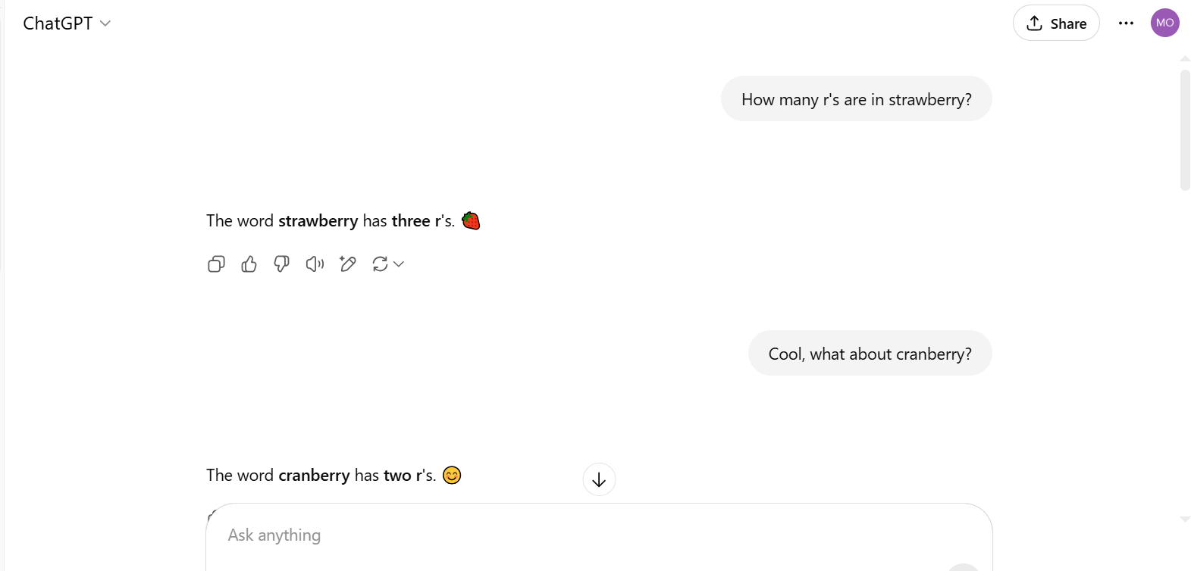
Using LLMs: Caveat emptor

Slide 25
Lesson 3 Key Points
Use help() to get online help in R.

