Slide 1
R for Reproducible Scientific Analysis -- session 4
June 17, 2025
Morgan Feeney, Leighton Pritchard, and Steve Ford

Slide 2
Lesson 8. Creating Publication-Quality Graphics with ggplot2
Before we begin:
Make sure you installed the “ggplot2” package in the previous session and downloaded the “gapminder” data
Housekeeping notes

Slide 3
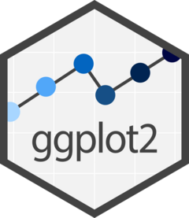
What is “ggplot2” and why use it?
“grammar of graphics” – a data visualisation package in R
Powerful and flexible way of exploring and plotting data
A relatively easy and quick way to produce readable (and beautiful) plots
All of the broader advantages of working in R discussed earlier: easy to reproduce or repeat analyses, open-source community, etc.

Slide 4
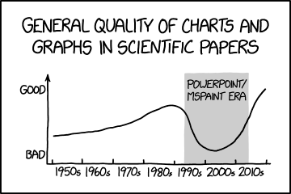
Basics of plotting data
Figure title and legend
Annotations, maybe
Some sort of data, represented
Legend, if necessary
Axes, with
some sort of scale, and with
titles (units)
Image credit: xkcd

Slide 5
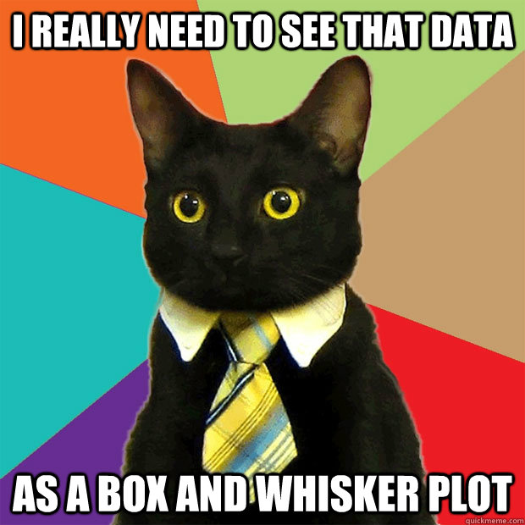
Tips before we get started
When it comes to your own data – think about what is the best way to plot it (and why)
Keep in mind the conventions in your field (read broadly, look at the ways that other people visualise similar data)
Don’t forget the principles previously discussed (e.g., version control, keeping data read-only, etc.)
Image credit: QuickMeme

Slide 6
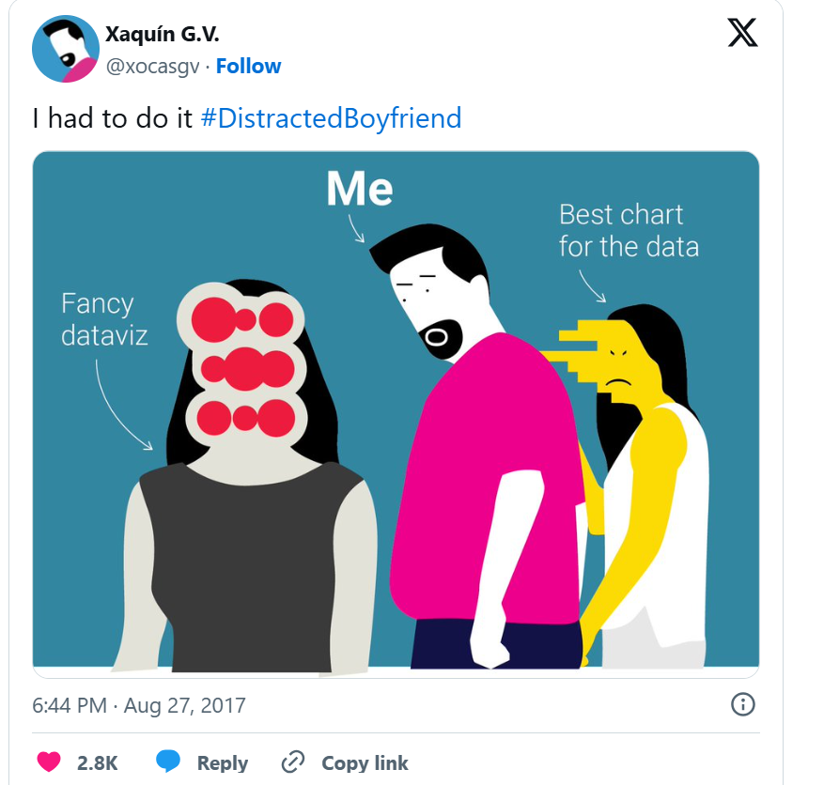
Keep in mind the principles of good data visualisation – and what you want to plot

Slide 7
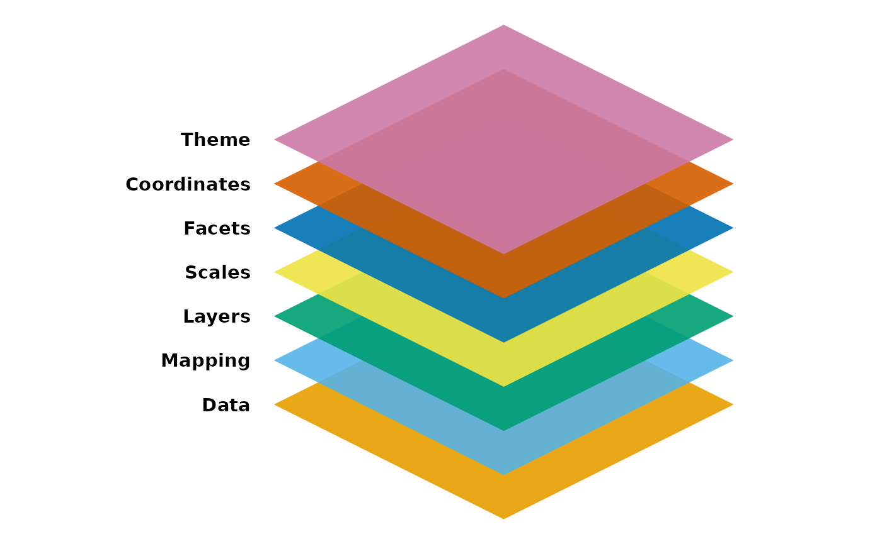
ggplot2 uses layers to build data visualisations
Usually have sensible defaults, but can be modified as needed
Need at least data, a mapping, and a layer to produce a plot
Image credit: Introduction to ggplot2

Slide 8
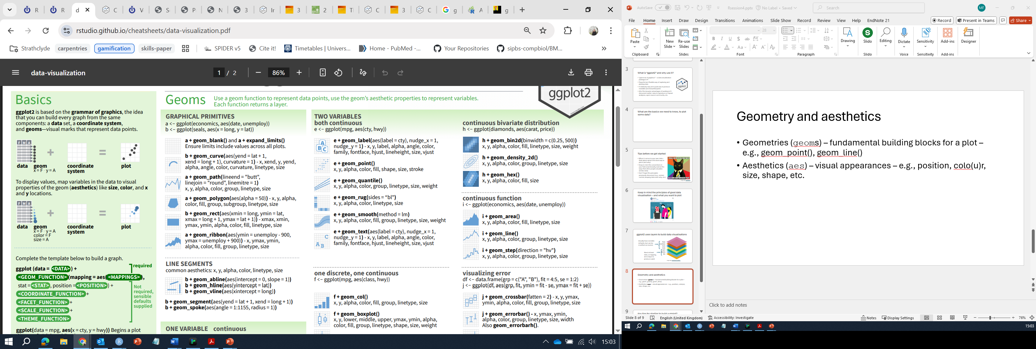
Geometry and aesthetics
Geometries (geoms) – fundamental building blocks for a plot – e.g., geom_point(), geom_line()
Aesthetics (aes) – visual appearances of the data – e.g., position, colo(u)r, size, shape, etc.
Image credit: ggplot2 cheatsheet

Slide 9
Tips for starting to build a ggplot2 visualisation
Load the ggplot2 package
Build up a ggplot2 command by specifying data, mapping, geom
Add/edit layers as necessary by adding arguments to your command
Try to keep your code tidy and readable
break up long lines where helpful
use comments where helpful
Don’t be afraid to use a cheatsheet/Google
Don’t be afraid to experiment
Remember to design your plots for accessibility

Slide 10
Live demo: using ggplot2
Building basic plots and figures
Using colours
Modifying axes
Facet plots
Labels
Themes and design choices
Saving your work

Slide 11
Lesson 8 Key Points
Use ggplot2 to create plots.
Think about graphics in layers: aesthetics, geometry, statistics, scale transformation, and grouping.

Slide 12
Lesson 14 -Producing Reports With knitr
Before we begin:
Questions?
Housekeeping notes
Check if you have the package knitr installed

Slide 13
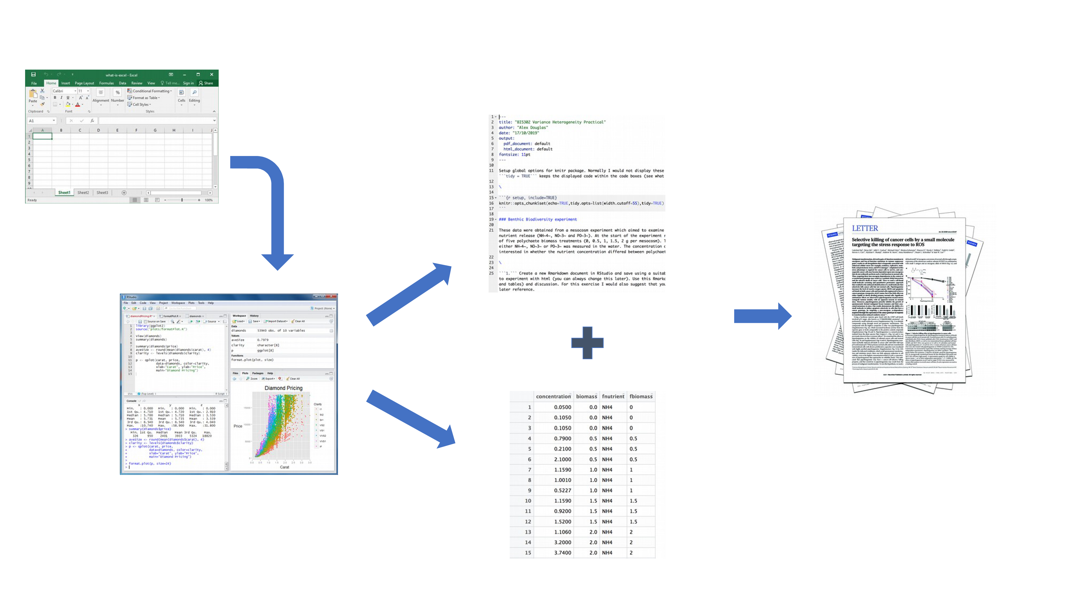
Why use R markdown/knitr to produce reports?
Image credit: an introduction to R

Slide 14
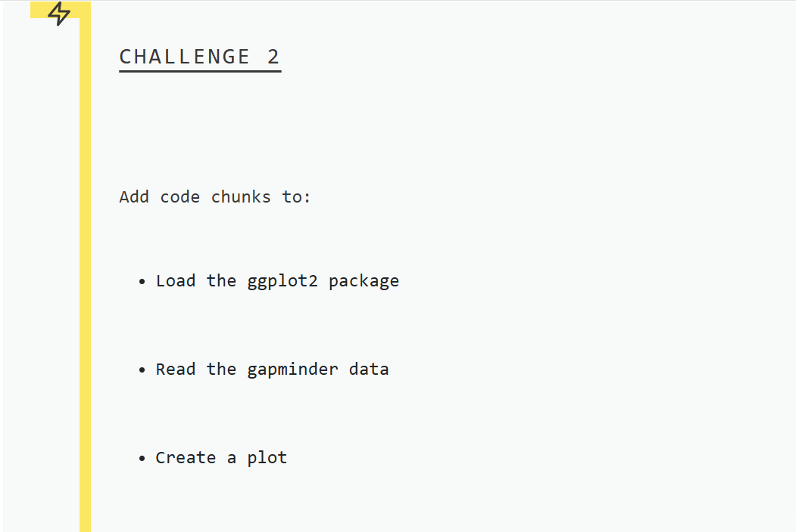

Slide 15
Lesson 14 Key Points
Mix reporting written in R Markdown with software written in R.
Specify chunk options to control formatting.
Use knitr to convert these documents into PDF and other formats.

