Slide 1
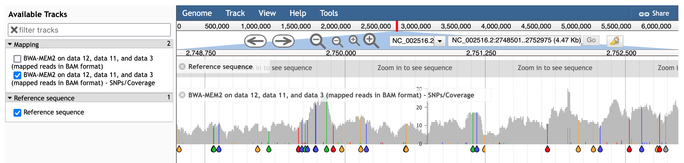
1. Reference sequence
2. Mapping coverage
3. SNPs

Slide 2
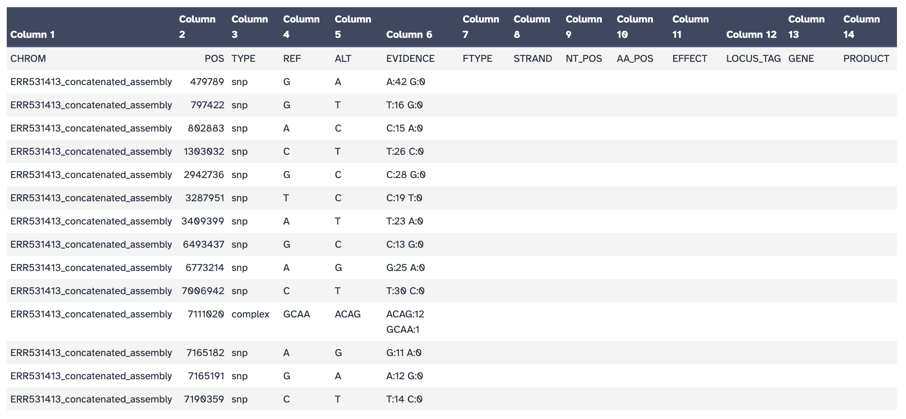
1. SNP position
4. Counts of variants in mapped reads
2. Bases in reference
3. Dominant SNP

