Slide 1
style, grammar, and other tips
How to write a scientific paper well
Dr. Morgan Feeney
morgan.feeney@strath.ac.uk
October 2021

Slide 2
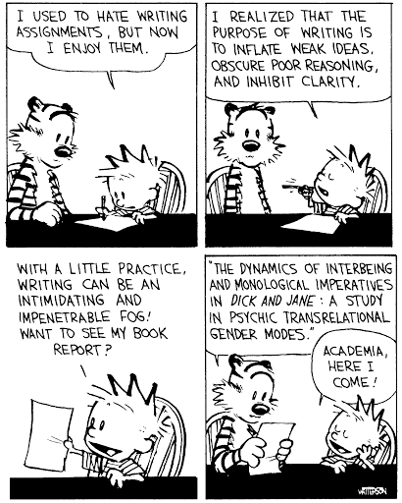
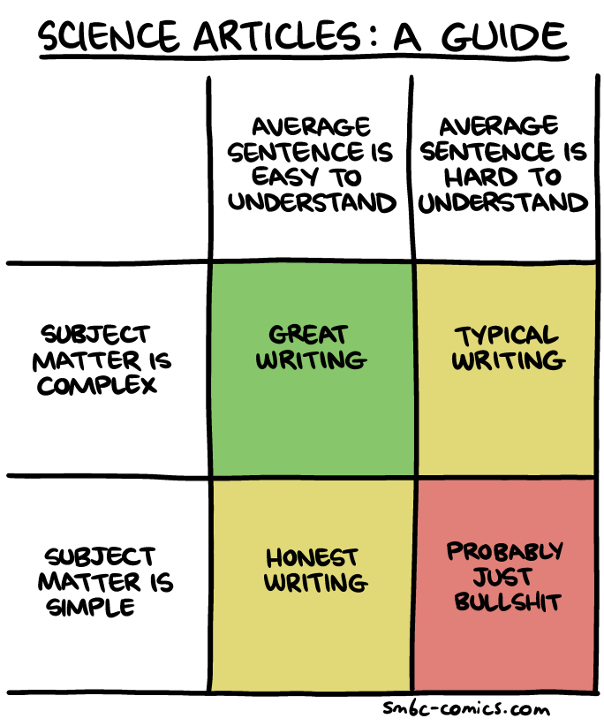
Why bother?

Slide 3
Part 1: what is good scientific writing?

Slide 4
Exercise 1: evaluating scientific writing
3 questions:
Is it well-written?
Why (or why not?)
How can it be improved?

Slide 5
The RAG endonuclease initiates Igh V(D)J assembly in B cell progenitors by joining D segments to J_{H} segments, before joining upstream V_{H} segments to DJ_{H} intermediates¹. In mouse progenitor B cells, the CTCF-binding element (CBE)-anchored chromatin loop domain² at the 3′ end of Igh contains an internal subdomain that spans the 5′ CBE anchor (IGCR1)³, the D_{H} segments, and a RAG-bound recombination centre (RC)⁴. The RC comprises the J_{H}-proximal D segment (DQ52), four J_{H} segments, and the intronic enhancer (iEμ)⁵.
The fundamental role of chromatin loop extrusion in physiological V(D)J recombination.
Zhang et al (2019) Nature 573, 600–604.

Slide 6
The nucleotide second messenger c-di-GMP nearly ubiquitously promotes bacterial biofilm formation, with enzymes that synthesize and degrade c-di-GMP being controlled by diverse N-terminal sensor domains. Here, we describe a novel class of widely occurring c-di-GMP phosphodiesterases (PDE) that feature a periplasmic "CSS domain" with two highly conserved cysteines that is flanked by two transmembrane regions (TM1 and TM2) and followed by a cytoplasmic EAL domain with PDE activity. Using PdeC, one of the five CSS domain PDEs of Escherichia coli K-12, we show that DsbA/DsbB-promoted disulfide bond formation in the CSS domain reduces PDE activity.
Transmembrane redox control and proteolysis of PdeC, a novel type of c-di-GMP phosphodiesterase.
Herbst et al (2018) EMBO J. 37(8). pii: e97825. doi: 10.15252/embj.201797825.

Slide 7
Transition metals serve as an important class of micronutrients that are indispensable for bacterial physiology but are cytotoxic when they are in excess. Bacteria have developed exquisite homeostatic systems to control the uptake, storage, and efflux of each of biological metals and maintain a thermodynamically balanced metal quota. However, whether the pathways that control the homeostasis of different biological metals cross talk and render cross resistance or sensitivity in the host-pathogen interface remains largely unknown.
Zinc excess increases cellular demand for iron and decreases tolerance to copper in Escherichia coli.
Xu et al (2019) J Biol Chem.. doi: 10.1074/jbc.RA119.010023.

Slide 8
Tip #1: Read broadly & pay attention to how papers are written
A few examples of papers that I consider to be exceptionally well-written:
Tschowri N, Schumacher MA, Schlimpert S, Chinnam NB, Findlay KC, Brennan RG, Buttner MJ. Tetrameric c-di-GMP mediates effective transcription factor dimerization to control Streptomyces development. Cell. 2014 Aug 28;158(5):1136-1147.
Kuznedelov, K., Minakhin, L., Niedziela-Majka, A., Dove, S., Rogulja, D., Nickels, B., . . . Severinov, K. (2002). A Role for Interaction of the RNA Polymerase Flap Domain with the σ Subunit in Promoter Recognition. Science, 295(5556), 855-857.
Chen, X., Schauder, S., Potier, N., Van Dorsselaer, A., Pelczer, I., Bassler, B. L., & Hughson, F. M. (2002). Structural identification of a bacterial quorum-sensing signal containing boron. Nature, 415(6871), 545–549. doi:10.1038/415545a

Slide 9
Part 2: how can you write well?

Slide 10
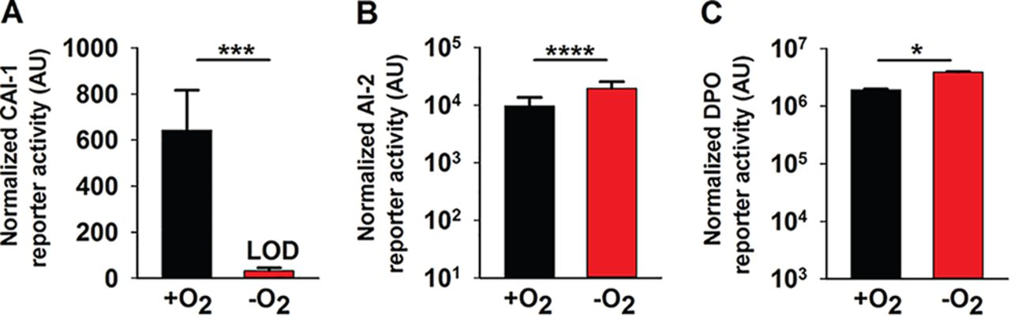
Exercise 2: describe the results in this figure
Figure 2. Oxygen deprivation modulates V. cholerae AI production. (A) 80%, (B) 25%, or (C) 30% cell-free culture fluids prepared from WT V. cholerae grown in the presence or absence of O₂ were provided to V. cholerae reporter strains that produce bioluminescence in response to exogenous (A) CAI-1, (B) AI-2, or (C) DPO. Data represent the average values from biological replicates (n = 3), and error bars represent SD. Statistical significance was calculated using a two-tailed Student t test. Asterisks are as follows: * denotes P < 0.05, *** denotes P < 0.001, and **** denotes P < 0.0001. LOD, limit of detection; AU, arbitrary units.
Ameya A. Mashruwala, and Bonnie L. Bassler mBio 2020; doi:10.1128/mBio.01572-20

Slide 11

Tip #2: Pay attention to the mechanics of writing -- Use a style guide
Rules on the following pages all come from
Strunk & White
section II: Principles of Composition
Available http://www.gutenberg.org/ebooks/37134 or at your friendly university library

Slide 12
Strunk & White: Principles of Composition
8. Make the paragraph the unit of composition: one paragraph to each topic.
Notes:
If the subject on which you are writing is of slight extent, or if you intend to treat it very briefly, there may be no need of subdividing it into topics. Thus a brief description, a brief summary of a literary work, a brief account of a single incident, a narrative merely outlining an action, the setting forth of a single idea, any one of these is best written in a single paragraph. After the paragraph has been written, examine it to see whether subdivision will not improve it.
Ordinarily, however, a subject requires subdivision into topics, each of which should be made the subject of a paragraph. The object of treating each topic in a paragraph by itself is, of course, to aid the reader. The beginning of each paragraph is a signal to him that a new step in the development of the subject has been reached.
The extent of subdivision will vary with the length of the composition. For example, a short notice of a book or poem might consist of a single paragraph. One slightly longer might consist of two paragraphs:
A. Account of the work.
B. Critical discussion.
A report on a poem, written for a class in literature, might consist of seven paragraphs:
A. Facts of composition and publication.
B. Kind of poem; metrical form.
C. Subject.
D. Treatment of subject.
E. For what chiefly remarkable.
F. Wherein characteristic of the writer.
G. Relationship to other works.
The contents of paragraphs C and D would vary with the poem. Usually, paragraph C would indicate the actual or imagined circumstances of the poem (the situation), if these call for explanation, and would then state the subject and outline its development. If the poem is a narrative in the third person throughout, paragraph C need contain no more than a concise summary of the action. Paragraph D would indicate the leading ideas and show how they are made prominent, or would indicate what points in the narrative are chiefly emphasized.
A novel might be discussed under the heads:
A. Setting.
B. Plot.
C. Characters.
D. Purpose.
An historical event might be discussed under the heads:
A. What led up to the event.
B. Account of the event.
C. What the event led up to.
In treating either of these last two subjects, the writer would probably find it necessary to subdivide one or more of the topics here given.
As a rule, single sentences should not be written or printed as paragraphs. An exception may be made of sentences of transition, indicating the relation between the parts of an exposition or argument. Frequent exceptions are also necessary in textbooks, guidebooks, and other works in which many topics are treated briefly.
In dialogue, each speech, even if only a single word, is a paragraph by itself; that is, a new paragraph begins with each change of speaker. The application of this rule, when dialogue and narrative are combined, is best learned from examples in well-printed works of fiction.

Slide 13
Strunk & White: Principles of Composition
9. As a rule, begin each paragraph with a topic sentence, end it in conformity with the beginning.
(a) the topic sentence comes at or near the beginning;
(b) the succeeding sentences explain or establish or develop the statement made in the topic sentence; and
(c) the final sentence either emphasizes the thought of the topic sentence or states some important consequence.
Ending with a digression, or with an unimportant detail, is particularly to be avoided.
Notes:
Again, the object is to aid the reader. The practice here recommended enables him to discover the purpose of each paragraph as he begins to read it, and to retain this purpose in mind as he ends it. For this reason, the most generally useful kind of paragraph, particularly in exposition and argument, is that in which
(a) the topic sentence comes at or near the beginning;
(b) the succeeding sentences explain or establish or develop the statement made in the topic sentence; and
(c) the final sentence either emphasizes the thought of the topic sentence or states some important consequence.
Ending with a digression, or with an unimportant detail, is particularly to be avoided.
If the paragraph forms part of a larger composition, its relation to what precedes, or its function as a part of the whole, may need to be expressed. This can sometimes be done by a mere word or phrase (again; therefore; for the same reason) in the topic sentence. Sometimes, however, it is expedient to precede the topic sentence by one or more sentences of introduction or transition. If more than one such sentence is required, it is generally better to set apart the transitional sentences as a separate paragraph.
According to the writer's purpose, he may, as indicated above, relate the body of the paragraph to the topic sentence in one or more of several different ways. He may make the meaning of the topic sentence clearer by restating it in other forms, by defining its terms, by denying the contrary, by giving illustrations or specific instances; he may establish it by proofs; or he may develop it by showing its implications and consequences. In a long paragraph, he may carry out several of these processes.

Slide 14
Example of paragraph structure: Tschowri et al 2014
BldD sits at the top of the regulatory cascade controlling development, serving to repress expression of sporulation genes during vegetative growth (den Hengst et al., 2010). In Streptomyces coelicolor, BldD controls the expression of at least 167 genes, including 42 genes (∼25% of the regulon) that encode regulatory proteins (Elliot et al., 2001, den Hengst et al., 2010). Among these BldD targets are many genes known to play critical roles in Streptomyces development, including other bld regulators (e.g., bldA, bldC, bldH/adpA, bldM, and bldN), several whi (white) regulators required for the differentiation of aerial hyphae into spores (e.g., whiG and whiB), and genes encoding critical components of the cell division and chromosome segregation machineries such as FtsZ, SsgA, SsgB, and the DNA translocase SffA (den Hengst et al., 2010, McCormick, 2009). How BldD activity is regulated, however, has been unknown.

Slide 15
Strunk & White: Principles of Composition
10. Use the active voice.
Examples from Tschowri et al 2014
Having shown that BldD binds c-di-GMP, we tested the effect of c-di-GMP on BldD DNA binding.
Using global chromatin immunoprecipitation-microarray analysis (ChIP-chip), we previously identified the complete BldD regulon in S. coelicolor, showing that it encompasses ∼167 transcription units
Notes:
The active voice is usually more direct and vigorous than the passive:
I shall always remember my first visit to Boston.
This is much better than
My first visit to Boston will always be remembered by me.
The latter sentence is less direct, less bold, and less concise. If the writer tries to make it more concise by omitting “by me,”
My first visit to Boston will always be remembered,
it becomes indefinite: is it the writer, or some person undisclosed, or the world at large, that will always remember this visit?
This rule does not, of course, mean that the writer should entirely discard the passive voice, which is frequently convenient and sometimes necessary.
The dramatists of the Restoration are little esteemed to-day.
Modern readers have little esteem for the dramatists of the Restoration.
The first would be the right form in a paragraph on the dramatists of the Restoration; the second, in a paragraph on the tastes of modern readers. The need of making a particular word the subject of the sentence will often, as in these examples, determine which voice is to be used.
As a rule, avoid making one passive depend directly upon another.
In both the examples above, before correction, the word properly related to the second passive is made the subject of the first.
A common fault is to use as the subject of a passive construction a noun which expresses the entire action, leaving to the verb no function beyond that of completing the sentence.
Compare the sentence, “The export of gold was prohibited,” in which the predicate “was prohibited” expresses something not implied in “export.”
The habitual use of the active voice makes for forcible writing. This is true not only in narrative principally concerned with action, but in writing of any kind. Many a tame sentence of description or exposition can be made lively and emphatic by substituting a verb in the active voice for some such perfunctory expression as there is, or could be heard.
There were a great number of dead leaves lying on the ground.
Dead leaves covered the ground.
The sound of a guitar somewhere in the house could be heard.
Somewhere in the house a guitar hummed sleepily.
The reason that he left college was that his health became impaired.
Failing health compelled him to leave college.
It was not long before he was very sorry that he had said what he had.
He soon repented his words.
A survey of this region was made in 1900.
This region was surveyed in 1900.
Mobilization of the army was rapidly effected.
The army was rapidly mobilized.
Confirmation of these reports cannot be obtained.
These reports cannot be confirmed.
Gold was not allowed to be exported.
It was forbidden to export gold (The export of gold was prohibited).
He has been proved to have been seen entering the building.
It has been proved that he was seen to enter the building.

Slide 16
Strunk & White: Principles of Composition
10. Use the active voice.
EXCEPTION: methods sections!
Determination of c-di-GMP Binding to Proteins by Differential Radial Capillary Action of Ligand Assay
Radiolabeled c-di-GMP was synthesized in vitro using [γ32-P]-GTP and the purified diguanylate cyclase PleD∗ as described (Paul et al., 2004). The DRaCALA assays (Roelofs et al., 2011) were performed using 2 μg of His6-BldD or its N-terminally His-tagged domains that were incubated with ∼11 nM 32P-c-di-GMP in DGC buffer (250 mM NaCl, 25 mM Tris pH 8, 10 mM MgCl2, 5 mM β-mercaptoethanol). For competition experiments, 266 μM cold c-di-GMP or GTP were added to the reaction. After a 5 min incubation at room temperature, 5 μl of the binding sample were spotted onto nitrocellulose membrane and the dried membranes were analyzed using a Phosphorimager.
Notes:
The active voice is usually more direct and vigorous than the passive:
I shall always remember my first visit to Boston.
This is much better than
My first visit to Boston will always be remembered by me.
The latter sentence is less direct, less bold, and less concise. If the writer tries to make it more concise by omitting “by me,”
My first visit to Boston will always be remembered,
it becomes indefinite: is it the writer, or some person undisclosed, or the world at large, that will always remember this visit?
This rule does not, of course, mean that the writer should entirely discard the passive voice, which is frequently convenient and sometimes necessary.
The dramatists of the Restoration are little esteemed to-day.
Modern readers have little esteem for the dramatists of the Restoration.
The first would be the right form in a paragraph on the dramatists of the Restoration; the second, in a paragraph on the tastes of modern readers. The need of making a particular word the subject of the sentence will often, as in these examples, determine which voice is to be used.
As a rule, avoid making one passive depend directly upon another.
In both the examples above, before correction, the word properly related to the second passive is made the subject of the first.
A common fault is to use as the subject of a passive construction a noun which expresses the entire action, leaving to the verb no function beyond that of completing the sentence.
Compare the sentence, “The export of gold was prohibited,” in which the predicate “was prohibited” expresses something not implied in “export.”
The habitual use of the active voice makes for forcible writing. This is true not only in narrative principally concerned with action, but in writing of any kind. Many a tame sentence of description or exposition can be made lively and emphatic by substituting a verb in the active voice for some such perfunctory expression as there is, or could be heard.
There were a great number of dead leaves lying on the ground.
Dead leaves covered the ground.
The sound of a guitar somewhere in the house could be heard.
Somewhere in the house a guitar hummed sleepily.
The reason that he left college was that his health became impaired.
Failing health compelled him to leave college.
It was not long before he was very sorry that he had said what he had.
He soon repented his words.
A survey of this region was made in 1900.
This region was surveyed in 1900.
Mobilization of the army was rapidly effected.
The army was rapidly mobilized.
Confirmation of these reports cannot be obtained.
These reports cannot be confirmed.
Gold was not allowed to be exported.
It was forbidden to export gold (The export of gold was prohibited).
He has been proved to have been seen entering the building.
It has been proved that he was seen to enter the building.

Slide 17
Strunk & White: Principles of Composition
11. Put statements in positive form.
Make definite assertions. Avoid tame, colorless, hesitating, non-committal language. Use the word not as a means of denial or in antithesis, never as a means of evasion.
Example from Tschowri et al 2014:
Strikingly, the bldD null mutant formed small colonies lacking aerial hyphae, but—when examined by SEM—even young colonies of the bldD mutant were found to contain spore chains embedded in an excess of extracellular matrix
Notes:
He was not very often on time.
He usually came late.
He did not think that studying Latin was much use.
He thought the study of Latin useless.
The Taming of the Shrew is rather weak in spots. Shakespeare does not portray Katharine as a very admirable character, nor does Bianca remain long in memory as an important character in Shakespeare's works.
The women in The Taming of the Shrew are unattractive. Katharine is disagreeable, Bianca insignificant.
not honest
dishonest
not important
trifling
did not remember
forgot
did not pay any attention to
ignored
did not have much confidence in
distrusted

Slide 18
Strunk & White: Principles of Composition
12. Use definite, specific, concrete language.
Prefer the specific to the general, the definite to the vague, the concrete to the abstract.
Example from Tschowri et al 2014:
Arg114 is the only CTD residue that makes contacts to both intercalated c-di-GMP dimers. Arg114 hydrogen bonds to the guanines contacted by Asp128, as well as the O6 atoms of the adjacent guanines of the other c-di-GMP dimer (Figures 5A and 5B).
Notes:
A period of unfavorable weather set in.
It rained every day for a week.
He showed satisfaction as he took possession of his well-earned reward.
He grinned as he pocketed the coin.
There is a general agreement among those who have enjoyed the experience that surf-riding is productive of great exhilaration.
All who have tried surf-riding agree that it is most exhilarating.

Slide 19
Strunk & White: Principles of Composition
13. Omit needless words.
Vigorous writing is concise. A sentence should contain no unnecessary words, a paragraph no unnecessary sentences, for the same reason that a drawing should have no unnecessary lines and a machine no unnecessary parts. This requires not that the writer make all his sentences short, or that he avoid all detail and treat his subjects only in outline, but that he make every word tell.

Slide 20
Strunk & White: Principles of Composition
15. Express co-ordinate ideas in similar form.
This principle, that of parallel construction, requires that expressions of similar content and function should be outwardly similar. The likeness of form enables the reader to recognize more readily the likeness of content and function.
Example from Tschowri 2014:
The sparse list of known c-di-GMP-responsive transcriptional regulators includes the TetR-like activator LtmA from Mycobacterium smegmatis (Li and He, 2012), the CRP-FNR-like transcription factor Clp from Xanthomonas (Chin et al., 2010, Leduc and Roberts, 2009), Bcam1349 from Burkholderia (Fazli et al., 2011), the NtrC-type protein FleQ from Pseudomonas aeruginosa (Baraquet and Harwood, 2013), and VpsR from Vibrio cholerae (Srivastava et al., 2011).
Notes:
Formerly, science was taught by the textbook method, while now the laboratory method is employed.
Formerly, science was taught by the textbook method; now it is taught by the laboratory method.

Slide 21
Strunk & White: Principles of Composition
17. In summaries, keep to one tense.
Example from Tschowri et al 2014:
BldD sits at the top of the regulatory cascade controlling development, serving to repress expression of sporulation genes during vegetative growth (den Hengst et al., 2010). In Streptomyces coelicolor, BldD controls the expression of at least 167 genes, including 42 genes (∼25% of the regulon) that encode regulatory proteins (Elliot et al., 2001, den Hengst et al., 2010). Among these BldD targets are many genes known to play critical roles in Streptomyces development, including other bld regulators (e.g., bldA, bldC, bldH/adpA, bldM, and bldN), several whi (white) regulators required for the differentiation of aerial hyphae into spores (e.g., whiG and whiB), and genes encoding critical components of the cell division and chromosome segregation machineries such as FtsZ, SsgA, SsgB, and the DNA translocase SffA (den Hengst et al., 2010, McCormick, 2009). How BldD activity is regulated, however, has been unknown.
Notes:
In summarizing the action of a drama, the writer should always use the present tense. In summarizing a poem, story, or novel, he should preferably use the present, though he may use the past if he prefers. If the summary is in the present tense, antecedent action should be expressed by the perfect; if in the past, by the past perfect.
An unforeseen chance prevents Friar John from delivering Friar Lawrence's letter to Romeo. Meanwhile, owing to her father's arbitrary change of the day set for her wedding, Juliet has been compelled to drink the potion on Tuesday night, with the result that Balthasar informs Romeo of her supposed death before Friar Lawrence learns of the non-delivery of the letter.

Slide 22
Strunk & White: Principles of Composition
18. Place the emphatic words of a sentence at the end.
The proper place in the sentence for the word, or group of words, which the writer desires to make most prominent is usually the end.
Examples from Tschowri et al 2014:
Transcription factors that sense c-di-GMP lack these common c-di-GMP-binding motifs and thus must be identified experimentally.
Importantly, the DRaCALA assays demonstrated that the previously uncharacterized CTD of BldD functions as the c-di-GMP-binding domain.
Notes:
Humanity has hardly advanced in fortitude since that time, though it has advanced in many other ways.
Humanity, since that time, has advanced in many other ways, but it has hardly advanced in fortitude.
This steel is principally used for making razors, because of its hardness.
Because of its hardness, this steel is principally used in making razors.

Slide 23
Exercise 3: Write a paragraph
Keep in mind the rules we just discussed
Write a topic sentence, elaborate on it (2-3 sentences), and a concluding sentence
Suggested topics: the weather, the nutritional content of the last meal you ate, something you learned about in class recently, the microbe you’re focusing on for your project….

Slide 25
Part 3: The structure of scientific writing

Slide 26
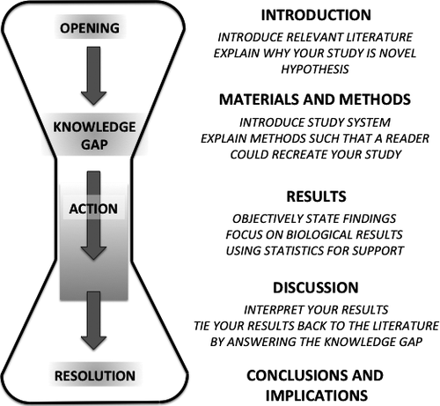
Structuring a scientific paper
Introduction
Start broad (“In all domains of life…”)
Give all necessary background information your reader will need
Edit later if necessary
End with your hypothesis and aims
Turbek et al (2016) Scientific Writing Made Easy: A Step‐by‐Step Guide to Undergraduate Writing in the Biological Sciences

Slide 27
Make your train of thought logical and clear
To describe an experiment:
1. What you were trying to do (aim)
2. How
3. Results
4. Significance (what it means)
You should follow this format for every experiment (in writing your thesis or giving a formal/informal presentation)

Slide 28
Example:
The opposing effects of the overexpression of the DGC CdgB and the PDE YhjH suggested that high levels of c-di-GMP retard sporulation and low levels of c-di-GMP accelerate sporulation. Because the BldD-(c-di-GMP) complex serves to keep sporulation genes shut off during vegetative growth, loss of BldD should have a similar effect on Streptomyces development as depletion of c-di-GMP levels. To test this hypothesis, we deleted bldD from the S. venezuelae chromosome. Strikingly, the bldD null mutant formed small colonies lacking aerial hyphae, but—when examined by SEM—even young colonies of the bldD mutant were found to contain spore chains embedded in an excess of extracellular matrix (Figure 3A).
rationale
hypothesis
experiment
result

Slide 29
Example:
To gain insight into the cellular processes controlled by c-di-GMP in streptomycetes, we overexpressed either the active DGC CdgB from S. coelicolor (Tran et al., 2011) or the active PDE YhjH from E. coli (Pesavento et al., 2008). Strikingly, overexpression of both CdgB and YhjH blocked the generation of aerial mycelium by S. venezuelae (Figure 1B). However, scanning electron micrographs (SEMs) revealed that, whereas overexpression of CdgB blocked development, resulting in a classical bald phenotype, overexpression of the PDE YhjH in fact promoted sporulation, but the colonies appeared bald to the naked eye because aerial mycelium formation had been bypassed (Figure 1C). As judged by heat resistance, the spores made by the YhjH overexpression strain were as robust as those of the wildtype (WT) (Figure S1A available online). Moreover, overexpression of catalytically inactive versions of YhjH or CdgB had no effect on S. venezuelae development (Figure S1B). These data suggest that intracellular levels of c-di-GMP influence the timing of development. In particular, they suggest that increased c-di-GMP levels delay differentiation, arresting the colonies in the vegetative growth stage, whereas decreased levels of the second messenger accelerate development, favoring sporulation.

Slide 30
Tip #3: Make your train of thought logical and clear
Use transitional words and phrases (long list @ http://writing2.richmond.edu/writing/wweb/trans1.html)
However
Moreover
In spite of
Although
For example
Therefore

Slide 31
Example:
c-di-GMP is monomeric in solution at physiological concentrations (Gentner et al., 2012). However, intercalated c-di-GMP dimers have been observed in crystal structures of the nucleotide alone and in complexes with effector proteins. Higher order c-di-GMP structures such as tetramers and octamers have thus far only been inferred from NMR and spectroscopic studies and require very high c-di-GMP concentrations (up to 30 mM) and monovalent cations (Zhang et al., 2006). These higher order structures are characterized by G-quartet interactions with a centrally bound potassium ion coordinated by four guanines. There are minimal base contacts and no base stacking interactions in these structures (Figure S4A) (Zhang et al., 2006; Gentner et al., 2012). By sharp contrast, the BldD-bound tetrameric c-di-GMP is a tightly packed structure that is not secured by ions. Rather, the c-di-GMP molecules are closely spaced and optimally positioned for interbase pairing, leading to the formation of a multistranded, base-stacked structure with top, middle, and bottom layers (Figures 5D and ​andS4A).S4A). There are 12 hydrogen bonds between the two intercalated dimers within the c-di-GMP tetramer, including contacts between the N3 atoms and exocyclic NH₂ amides of an adjacent base (Figures 5C and ​andS4B).S4B). Such contacts could not be formed with c-di-AMP due to its lack of an exocyclic NH₂ atom. Therefore, in addition to contacts from motifs 1 and 2, guanine-guanine base hydrogen bonds serve to specify c-di-GMP tetramer binding to BldD. Notably, formation of the c-di-GMP tetramer buries 24% of the total surface area (buried surface area [BSA]) of the c-di-GMP molecules (Figure S4B). By comparison, in most protein oligomers the BSA between protomers is ∼15% (Wang et al., 2009). Finally, the interface between the intercalated c-di-GMP dimers that forms the tetramer is remarkably complementary in shape (Figure S4B). Thus, the combination of multiple contacts between the c-di-GMP moieties along with its extensive BSA and molecular shape complementarity lead to the creation of a compact and highly specific c-di-GMP tetramer. However, BldD is necessary to stabilize this tetramer and template its formation.

Slide 32
Exercise 4: Describe an experiment
Write a paragraph describing an experiment
Keep in mind the rules we just discussed
Explain the point of the experiment, how it was done, what the results were, and what the results mean
Suggested topics: dropping a pen to test the theory of gravity, flicking a light switch or changing a light bulb, attempting to delete ftsZ to show that it is an essential gene in E. coli, performing an experiment that you plan to do during your project…

Slide 33
Part 3: Edit, edit, edit…

Slide 34
Edit for clarity
Remember our 3 questions:
Is it well-written?
Why (or why not?)
How can it be improved?
Does it make logical sense?
Does it mean what you intend it to mean?
Can a colleague/friend understand it?
Edit for grammar; proofread
Put it in a drawer
Ask Dr. Google (or a style guide) – which versus that, affect versus effect, etc.
Details matter – italicize species names, get chemical formulae correct, fix typos
Ask for help

Slide 35
Exercise 5: Edit, edit, edit
Can you improve this paragraph?
Staphylococcus aureus is notoriously known for its rapid development of resistance to conventional antibiotics. S. aureus can alter its membrane composition to reduce the killing effect of antibiotics and antimicrobial peptides (AMPs). To obtain a more complete picture, this study identified the resistance genes of S. aureus in response to human cathelicidin LL-37 peptides by screening the Nebraska Transposon Mutant Library.
Golla, R., Mishra, B., Dang, X., Lakshmaiah Narayana, J., Li, A., Xu, L., & Wang, G. (2020). Resistome of Staphylococcus aureus in Response to Human Cathelicidin LL-37 and Its Engineered Antimicrobial Peptides. ACS Infectious Diseases.

Slide 36
Exercise 5: Edit, edit, edit
Can you improve this paragraph?
Corynebacterium pseudotuberculosis is a pathogen of great veterinary and economic importance, since it affects livestock, mainly sheep and goats, worldwide, together with reports of its presence in camels in several Arabic, Asiatic, and East and West African countries, as well as Australia. In this article, we report the genome sequence of Corynebacterium pseudotuberculosis strain Cp162, collected from the external neck abscess of a camel in the United Kingdom.
Hassan et al. Whole-genome sequence of Corynebacterium pseudotuberculosis strain Cp162, isolated from camel. J Bacteriol. 2012 Oct;194(20):5718-9. doi: 10.1128/JB.01373-12. PMID: 23012291; PMCID: PMC3458653.

Slide 37
Exercise 6: Edit your own writing
Exercise 2 (figure description)
Exercise 3 (your own paragraph)
Exercise 4 (describe an experiment)

Slide 38
Exercise 2
Figure 2. Oxygen deprivation modulates V. cholerae AI production. (A) 80%, (B) 25%, or (C) 30% cell-free culture fluids prepared from WT V. cholerae grown in the presence or absence of O₂ were provided to V. cholerae reporter strains that produce bioluminescence in response to exogenous (A) CAI-1, (B) AI-2, or (C) DPO. Data represent the average values from biological replicates (n = 3), and error bars represent SD. Statistical significance was calculated using a two-tailed Student t test. Asterisks are as follows: * denotes P < 0.05, *** denotes P < 0.001, and **** denotes P < 0.0001. LOD, limit of detection; AU, arbitrary units.
Ameya A. Mashruwala, and Bonnie L. Bassler mBio 2020; doi:10.1128/mBio.01572-20

Slide 39
Exercise 2: Compare with the authors’ description
V. cholerae does not produce the CAI-1 QS AI under anaerobic conditions.To our knowledge, V. cholerae QS has been studied only under aerobic conditions. We know that the marine-human host life cycle demands that V. cholerae transition between environments containing widely varying oxygen levels (17, 18). Moreover, QS is crucial in both V. cholerae habitats. Thus, we sought to investigate whether oxygen modulates V. cholerae QS. First, we assessed the relative levels of the three known QS AIs from V. cholerae C6706 Sm^{r} (here wild type [WT]) following aerobic and anaerobic growth. AI activity in cell-free culture fluids was measured using a set of three bioluminescent V. cholerae strains, each of which exclusively reports on one QS AI (either AI-2, CAI-1, or DPO) when it is supplied exogenously.
Unlike V. cholerae cultured in the presence of oxygen (here +O₂), V. cholerae grown in the absence of oxygen (here −O₂) produced no CAI-1 (Fig. 2A). Twice as much AI-2 and DPO accumulated in V. cholerae cultured −O₂ as in +O₂ (Fig. 2B and C). We note that the dynamic ranges for the CAI-1 and DPO assay are ∼1,000- and ∼4-fold, respectively, while that for the AI-2 assay is ∼100,000-fold (2, 11). Thus, we consider the changes in CAI-1 and DPO to be physiologically relevant, whereas that for AI-2 is likely not, so we do not consider AI-2 further in this work. Additionally, V. cholerae cultured −O₂ grew to a lower final cell density than when grown +O₂ (see Fig. S1A in the supplemental material). We controlled for the reduced cell growth that occurs under the −O₂ conditions; nonetheless, no CAI-1 could be detected (Fig. S1B). Beyond lacking O₂, our culture medium lacked an alternative terminal electron acceptor. Thus, we also considered the possibility that V. cholerae cultured under −O₂ conditions was unable to respire and therefore unable to drive CAI-1 generation. However, supplementation of the V. cholerae −O₂ cultures with the alternative terminal electron acceptor fumarate, which is readily consumed by V. cholerae (29), did not rescue CAI-1 production (Fig. S1B). Collectively, these data suggest that production of CAI-1 and DPO by V. cholerae is affected by oxygen levels. In the remainder of this study, we focus on the functioning of the DPO-VqmA QS circuit under different conditions that are predicted to be encountered in the host. We address possible ramifications of our results concerning CAI-1 and AI-2 in Discussion.
Ameya A. Mashruwala, and Bonnie L. Bassler mBio 2020; doi:10.1128/mBio.01572-20

Slide 40
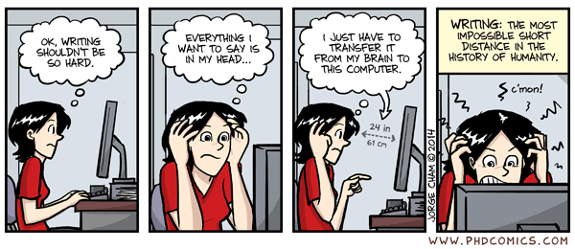
Tip #4: Practice, practice, practice
Write a little every day (anything)

