Slide 1
ChainStreamer Revolutionizing Live Streaming with Sui Ecosystem
Calvin Li

Slide 2
The Challenges in Live Streaming Today
High Costs: Traditional streaming services involve significant infrastructure and bandwidth costs
Content Manipulation: Current systems allow for content modification, leading to authenticity concerns
Limited Accessibility: Users may face geographical restrictions on accessing streams

Slide 3
Introducing ChainStreamer
ChainStreamer is a cutting-edge platform that leverages Sui ecosystem to deliver live streaming services. The solution decentralizes storage for video segments, ensuring an unalterable record of content while reducing costs.

Slide 4
How It Works
Live Stream via Blockchain: Users stream their content directly onto the blockchain in real-time
Decentralized Storage: Segments are automatically saved to decentralized storage networks (Walrus)
Video-on-Demand (VOD): Viewers can access past streams anytime, securely and efficiently

Slide 5
Advantages of ChainStreamer
Low Cost with Walrus
Reduced Infrastructure Cost
- Storage: Walrus ~0.5WAL/TB/Epoch v.s. Amazon S3 $23.5/TB/Month v.s. Cloudflare R2 $15.4/TB/Month v.s. Alicloud OSS ¥153.6/TB/Month
- Free accessing operations
Scalable with the underlying distributed infrastructure of Sui & Walrus
Content Integrity
Immutable Record: Once streamed, the content cannot be modified or tampered with
Trust and Transparency: Builds trust among viewers by providing verifiable and authentic content

Slide 6
Who Can Benefit from ChainStreamer?
Content Creators: Streamers, gamers, and influencers looking for cost-effective and secure streaming solutions
Businesses: Companies wishing to host live events, webinars, or product launches without high overhead
Decentralized Applications (dApps): Platforms needing reliable video storage and streaming capabilities

Slide 7
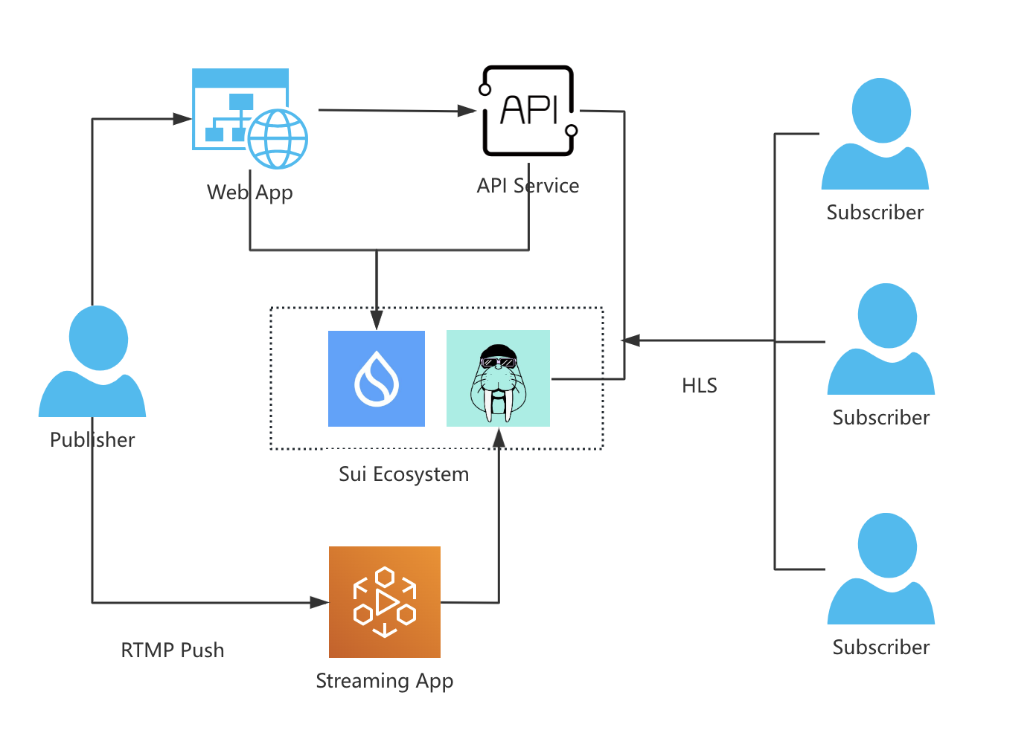
ChainStreamer Architecture

Slide 8
Thank you!

