Slide 1

NYC Taxi Trip Duration Prediction
Student Number : 218070302
Surname Initial : S NDLALANE
AIS117V

Slide 2
PROBLEM STATEMENT
To build a model that can predict the total duration of a taxi trips in New York City
This will help in placing the cabs in the rightful places so that the drivers can reduce the waiting time of customers and also will help them save the fuel they were using travelling from a far location to pick up a certain customer at a certain point.

Slide 3
Factors that might affect the trip duration
Distance between the locations (Pick up locations and drop off location).
Date – On weekends, the trip duration can be lesser compared to weekdays.
Time - late night trip duration will be less since there’s few people driving compared to day time.

Slide 4
Data Collection
id - a unique identifier for each trip.
vendor_id - a code indicating the provider associated with the trip record.
pickup_datetime - date and time when the meter was engaged .
dropoff_datetime - date and time when the meter was disengaged.
passenger_count - the number of passengers in the vehicle (driver entered value).
pickup_longitude - the longitude where the meter was engaged.
pickup_latitude - the latitude where the meter was engaged.
dropoff_longitude - the longitude where the meter was disengaged.
dropoff_latitude - the latitude where the meter was disengaged.
store_and_fwd_flag - This flag indicates whether the trip record was held in vehicle memory before sending to the vendor because the vehicle did not have a connection to the server (Y=store and forward; N=not a store and forward trip).
trip_duration - (target) duration of the trip in secondsHere, we have 2 variables dropoff_datetime and store_and_fwd_flag which are not available before the trip starts and hence will not be used as features to the model.

Slide 5
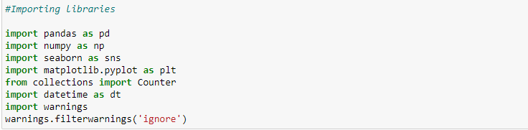
Importing libraries

Slide 6
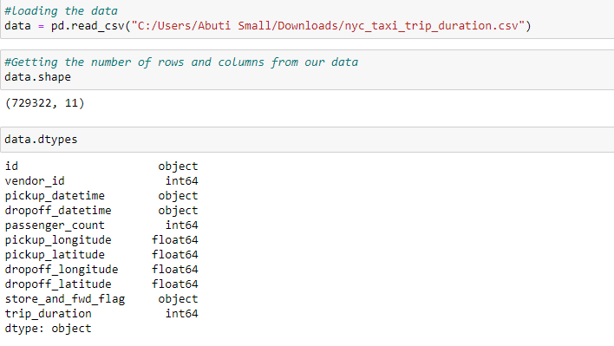
File Structure, Content and Data types

Slide 7
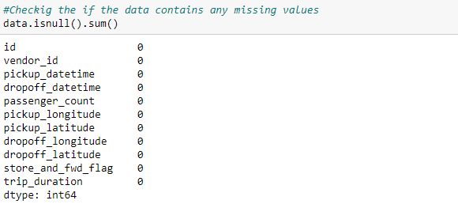
Detect missing values
The data doesn’t contain any missing values

Slide 8
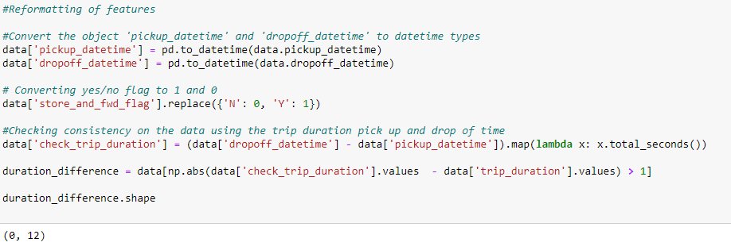
Reformatting and checking consistency of data
The following shows that there’s no consistency between the pickup or drop location and trip duration

Slide 9
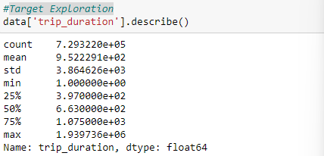
Target Exploration and describe

Slide 10
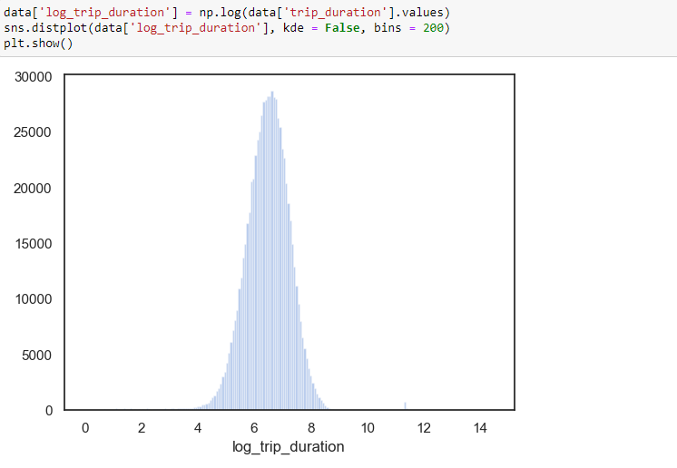
Log trip_duration and plot
There are several suspiciously short rides with less than 10 seconds duration and there are a few huge outliers near 12.

Slide 11
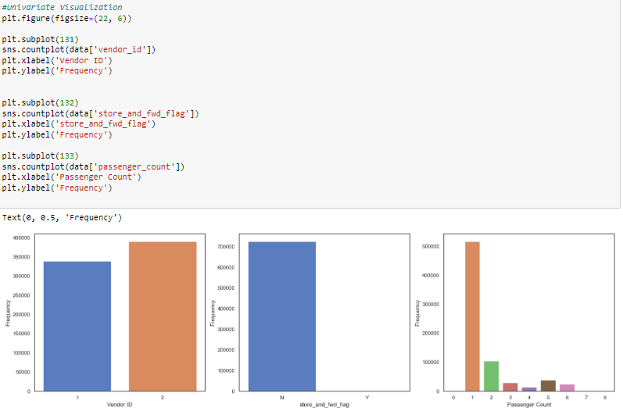
Univariate Visualization

Slide 12
Observations from the Univariate analysis
Vendor 2 has more trips compared to vendor 1
The store_and_fwd_flag indicates if the trips were stored in the vehicle memory and based on the analysis it shows that storing never took place in all the trips travelled.
Most of the trips involved only 1 passenger.

Slide 13
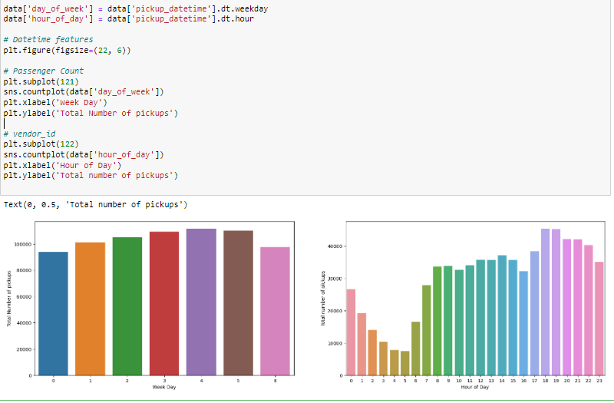
Plot pickup tie against total number of pickups

Slide 14
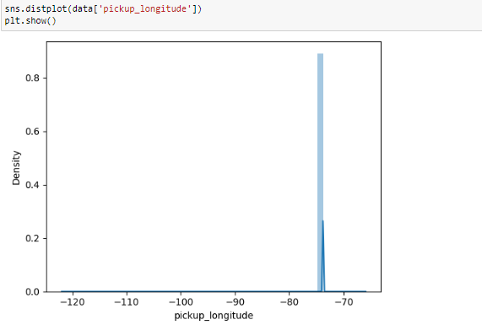
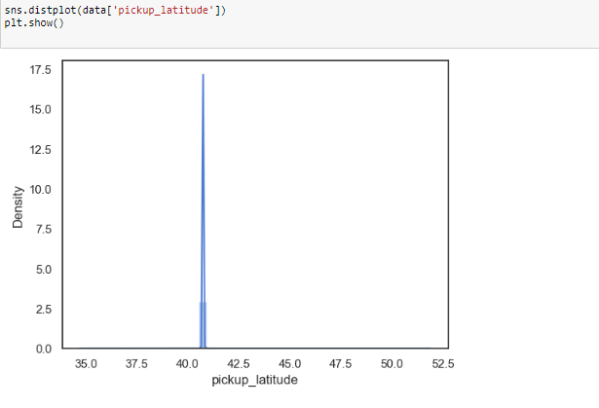
Distribution plots on pickup and drop-off latitude and longitude.

Slide 15
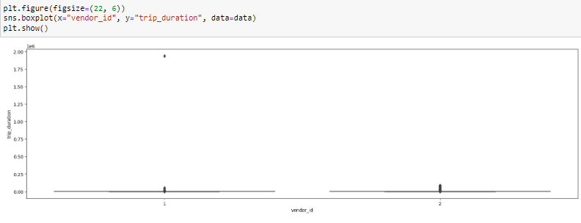
Bivariate Relations with Target-After your exploration of related data

Slide 16
Observation for Bivariate analysis
The only thing we can see from this boxplot is that for vendor 2, there are a number of outliers exceeding 24 hours while vendor 1 does not have such long trips.
There could be 2 solutions to this
1. Remove the huge outliers and plot again
2. Look at median trip duration for both vendors on hourly basis, Let's try the first technique now and check trips below 50000 seconds only

Slide 17
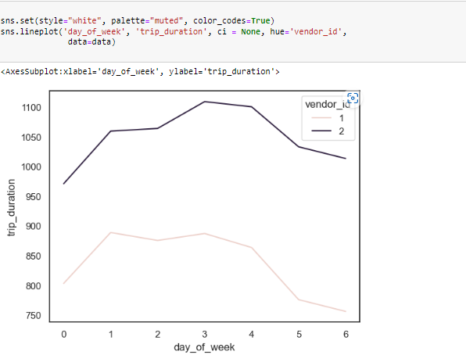
Plot vendor_id vs Trip Duration

Slide 18
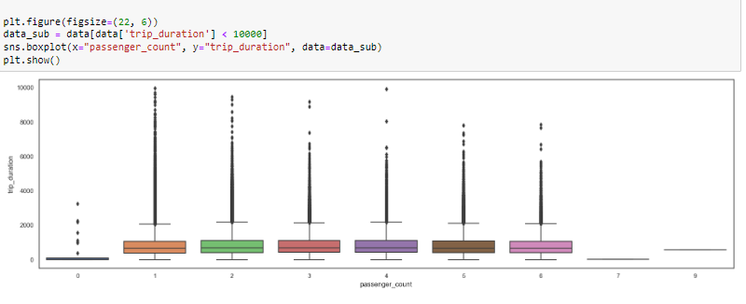
Plot Trip Duration vs Passenger Count
To be able to plot this, we have to cutoff 10000 seconds since the trip duration has some huge outliers

Slide 19
Another key observation is that the number of outliers are reduced for higher passenger counts but that only comes down to the individual frequencies of each passenger count.

Slide 20
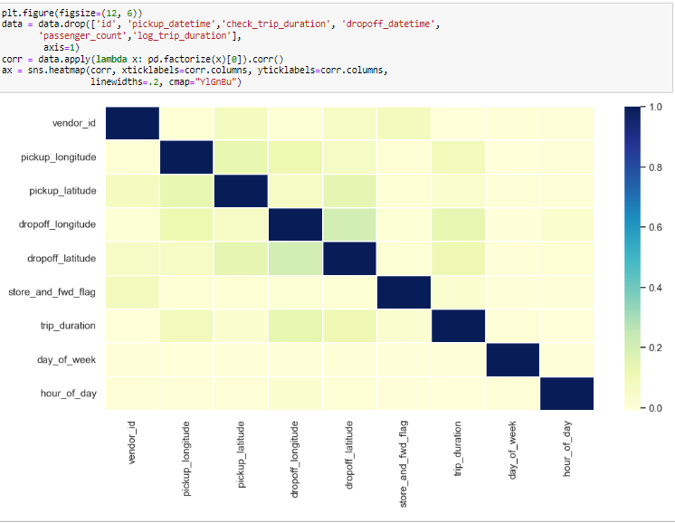
Correlation heat map

Slide 21
Conclusions
There are several suspiciously short rides with less than 10 seconds duration.
There are a few huge outliers near 12 hours.
Most of the trips involve only 1 passenger
Vendor 2 has more number of trips as compared to vendor 1
Number of pickups for weekends is much lower than week days with a peak on Thursday (4)
Number of pickups as expected is highest in late evenings. However, it is much lower during the morning peak hours.
From the correlation heat map we see that the latitude and longitude features have higher correlation with the target as compared to the other features.

