Slide 1
Burger Restaurant Thesis
Database – Webpage – Desktop Application
Created by:
Ferenc Sipos, Dániel Szabó, Zsolt Majercsik
Supervisor:
Sándor Lendér

Slide 2






Overview
Complex Database
ASP.NET Core WebAPI
PHP Website
Desktop App (C#-WPF)
Communication happens ONLY through the API, webpage uses Curl, the WPF app uses HttpClient.
Used Technologies

Slide 3
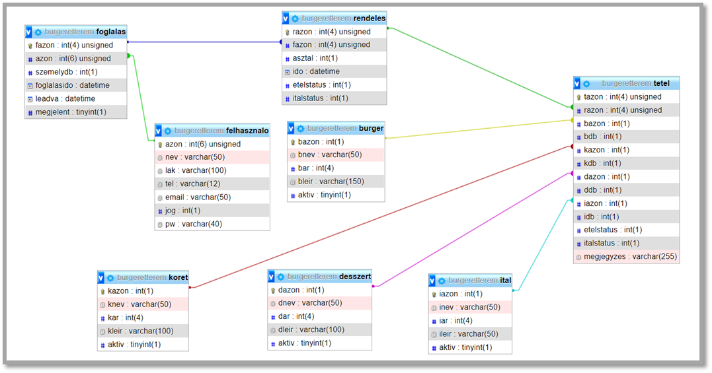
Database
Using MySQL
8 tables
Triggers

Slide 4
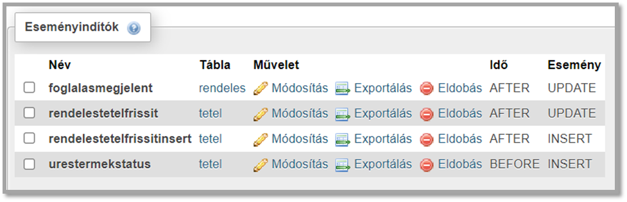
Database - triggers
After Update
Before / after insert
Responsible for:
Setting status of only food/drink orders.
Setting the order status depending on its item status.
Setting a reservation’s status.

Slide 5
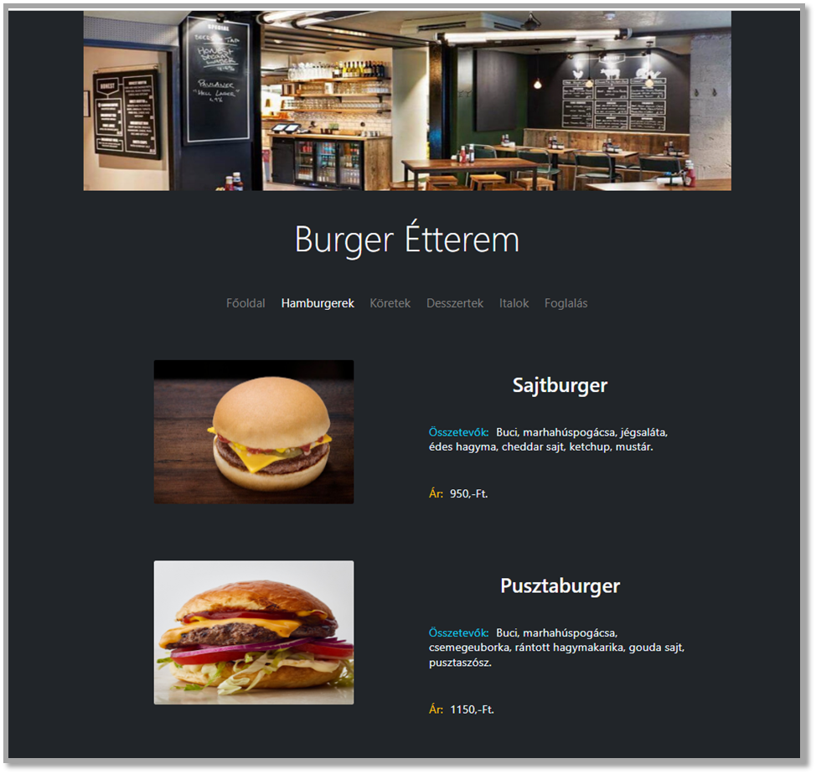
Website
Using PHP + React
Dynamic website
Populated from the DB
Login / Register
cURL for communicating with the ASP.NET Api

Slide 6
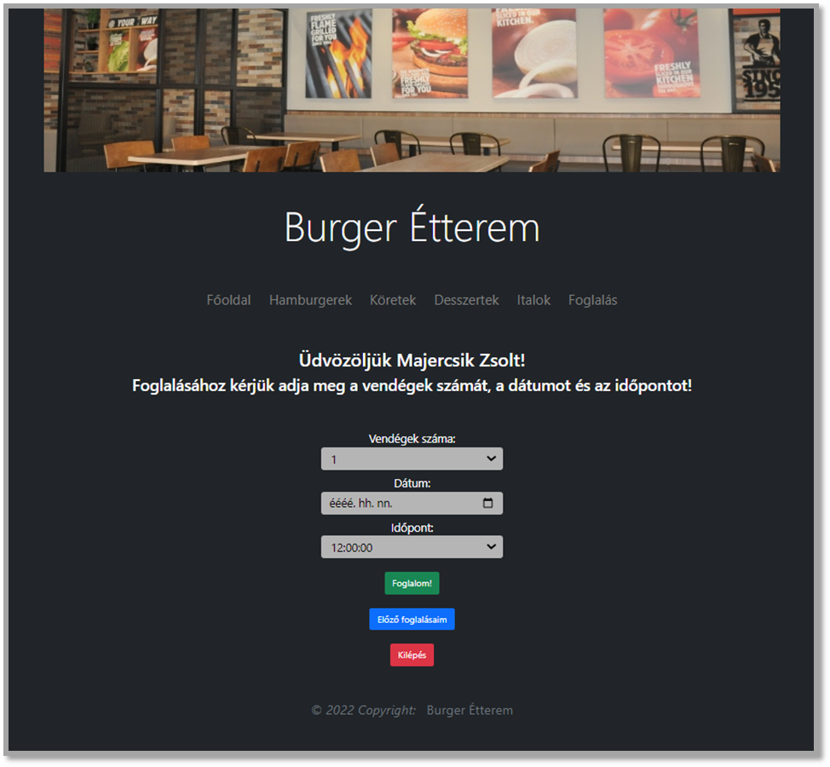
Website – reservations
Placing reservations
Checking current / previous reservations
Cancelling reservations

Slide 7
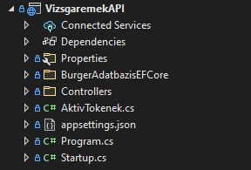
Web API (RESTful)
Using .NET 5
ASP.NET WebAPI
Stateless
Communicating with JSON
Entity Framework Core

Slide 8
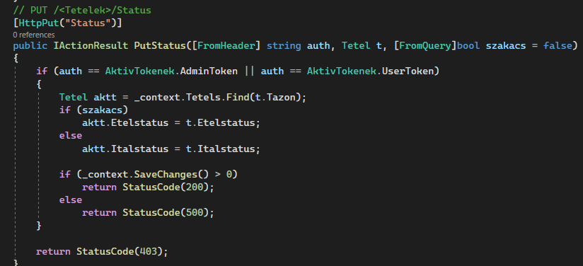
Web API - Controllers
Reading data from Header, Body and Query
Denying unauthorized requests
Proper response codes

Slide 9
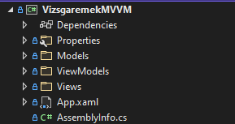
Desktop Application (WPF)
Using .NET 5
XAML
MVVM architecture
No code behind Views
Data Binding
Material Design
HttpClient for communicating with the ASP.NET Api

Slide 10
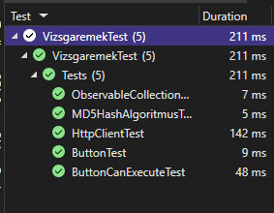
Desktop Application (WPF) - Tests
Button model tests
ObservableCollection extension method test
HttpClient wrapper StringContent creation test
MD5 hashing algorithm test

Slide 11




Platforms
Discord and Google Meet for communication
GitHub for version control and file sharing

Slide 12
Thank you for your attention

Slide 13
Source:
https://codeschoolofanalytics.com/asp-net-professional-course/asp-net-3/
https://pngwing.com

