Slide 1
Campus Event
Management &
Feedback Analyzer
SIPRA KUNDU
Student Code: BWU/MCA/26/049 | MCA – Computational Sciences
Brainware University
Subject Name: Problem Solving Using Python
Subject Code: MCA17400(P)

Slide 2
PROJECT OVERVIEW
Introduction
Universities organize workshops, hackathons, cultural festivals and sports events—but event workflows are often fragmented.
One platform
Rule-based booking
Data-led decisions
Bring event scheduling, registration, attendance and feedback into a shared workflow.
Validate capacity, deadlines, event status and duplicate registrations before issuing tickets.
Turn ratings and participation into statistics, charts and a comparable performance score.
ADMINISTRATORS
STUDENTS
ANALYTICS
The system covers the full event lifecycle—from planning to post-event review.
CAMPUS EVENT MANAGEMENT & FEEDBACK ANALYZER
02

Slide 3
WHY THE PROJECT IS NEEDED
Problem Statement
Manual and disconnected event processes create operational risks and leave organizers without reliable outcome measures.
Fragmented communication
Registration errors
Paper forms, notice boards and messaging groups scatter event information.
Duplicate bookings, over-capacity halls and late sign-ups can occur.
Unverified feedback
No comparable measure
Feedback may be missing or not limited to students who attended.
Organizers struggle to compare events using consistent performance indicators.
Core challenge: manage event participation reliably and measure student experience in a consistent way.
CAMPUS EVENT MANAGEMENT & FEEDBACK ANALYZER
03

Slide 4
WHAT THE SYSTEM AIMS TO ACHIEVE
Project Objectives
Centralize operations
Enforce booking rules
Collect verified feedback
Replace paper-based registration with one online system.
Automatically check capacity, deadline, status and duplicate bookings.
Allow reviews only after completed events attended by the student.
Analyze satisfaction
Score event performance
Visualize and export
Calculate mean, median, standard deviation, variance and IQR.
Combine capacity use, ratings and review engagement into a 0–100 score.
Provide static/interactive charts and downloadable reports.
CAMPUS EVENT MANAGEMENT & FEEDBACK ANALYZER
04

Slide 5
COVERAGE AND BOUNDARIES
Scope of the Project
Included in this version
Users and limitations
• Event scheduling and lifecycle management
• Student directory and enrollment
• Smart registration, ticketing and cancellation
• Attendance tracking
• Post-event 1–5 star ratings and comments
• Statistical analysis, charts and report exports
• Administrator: manages events, students, attendance and analytics
• Student: discovers events, books seats and submits reviews
• CSV files are used for persistent storage
• QR-code check-in and certificates are not yet implemented
• Text-based AI sentiment analysis is outside the current version
CAMPUS EVENT MANAGEMENT & FEEDBACK ANALYZER
05

Slide 6
CURRENT APPROACHES AND GAPS
Existing System & Review
Common approaches used in campus event coordination
Approach
Strength
Limitation / opportunity
Paper forms / spreadsheets
Familiar and low setup effort
Manual updates; weak duplicate/capacity controls
Notice boards / messaging groups
Quick announcements
Information is scattered; deadlines may be missed
Standalone feedback forms
Easy rating collection
Feedback is detached from registration and attendance
Proposed integrated platform
One lifecycle with validation + analytics
Requires disciplined data maintenance and future scaling
Design response: connect operations, eligibility checks and feedback analysis in one application.
CAMPUS EVENT MANAGEMENT & FEEDBACK ANALYZER
06

Slide 7
ONE WORKFLOW FOR STUDENTS AND ADMINISTRATORS
Proposed System
1
2
3
4
5
DISCOVER
REGISTER
ATTEND
REVIEW
ANALYZE
Browse events
Validate booking
Mark attendance
Rate & comment
KPIs & scores
Student portal
Admin command center
Analytics hub
Browse, book, manage tickets and submit eligible feedback.
Manage events, students, registrations and attendance.
Compare engagement, satisfaction and event performance.
CAMPUS EVENT MANAGEMENT & FEEDBACK ANALYZER
07

Slide 8
IMPLEMENTATION STACK
Project Methodology & Technology
LANGUAGE
WEB UI
Python 3.10+
Streamlit
Business logic and application code
Role-based pages, forms and dashboards
DATA ANALYSIS
VISUALIZATION
Pandas + NumPy
Matplotlib + Plotly
Joins, aggregates and descriptive statistics
Eight static chart routines and interactive filtered charts
STORAGE
TESTING
CSV + Repository Pattern
Python unittest
Thread-safe file access with a replaceable backend
Automated unit tests for rules and exceptions
Execution: pip install -r requirements.txt → streamlit run app.py
CAMPUS EVENT MANAGEMENT & FEEDBACK ANALYZER
08

Slide 9
EACH LAYER HAS A DEFINED RESPONSIBILITY
Internal Structure: Layered Architecture
1 PRESENTATION
Streamlit • app.py • admin/student views • UI components
2 APPLICATION & SERVICES
EventService • StudentService • RegistrationService • FeedbackService • AuthService
3 DOMAIN & BUSINESS LOGIC
Event / Student / Registration / Feedback models • validators • exceptions
4 DATA ACCESS
BaseRepository[T] • EventRepo • StudentRepo • RegistrationRepo • FeedbackRepo
5 STORAGE
events.csv • students.csv • registrations.csv • feedback.csv
Repository Pattern isolates storage: PostgreSQL/MySQL can be added without changing services or UI.
CAMPUS EVENT MANAGEMENT & FEEDBACK ANALYZER
09

Slide 10
REGISTRATION AND FEEDBACK CONTROLS
Implementation: Core Modules
Smart registration pipeline
Feedback rules & services
• Validate student ID and event ID
• Check event status and registration deadline
• Check remaining capacity
• Reject duplicate bookings
• Generate unique registration ID
• Persist record and synchronize capacity
• Return confirmation ticket
• FeedbackService accepts reviews only for completed events attended by the student
• One review per student per event
• Rating boundaries: 1–5 stars
• AuthService manages sessions and password hashing
• Custom exceptions provide clear rule-failure outcomes
• Repository layer serializes CSV reads and writes
CAMPUS EVENT MANAGEMENT & FEEDBACK ANALYZER
10

Slide 11
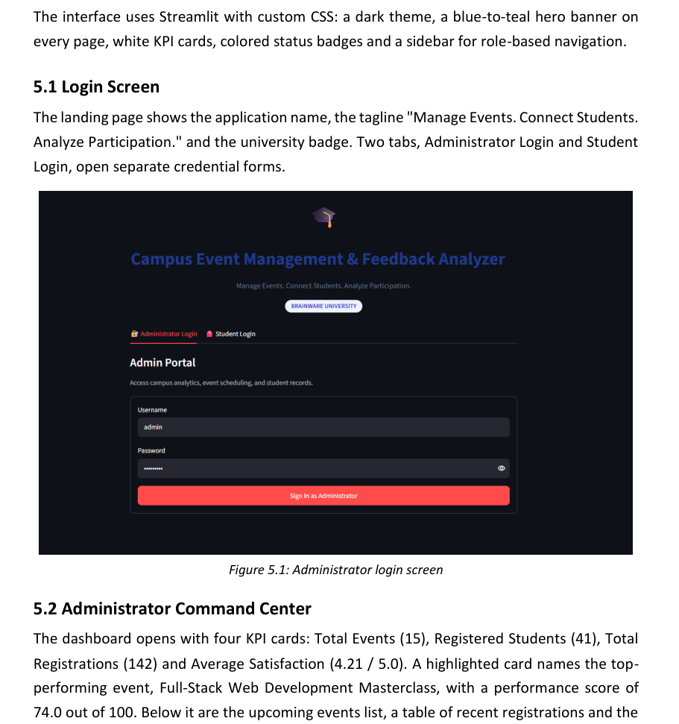
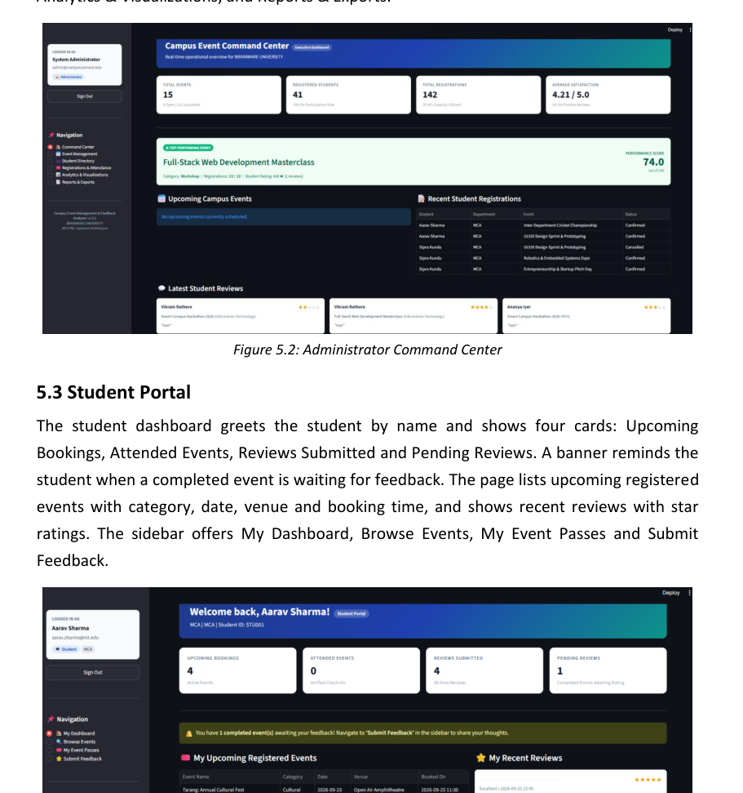
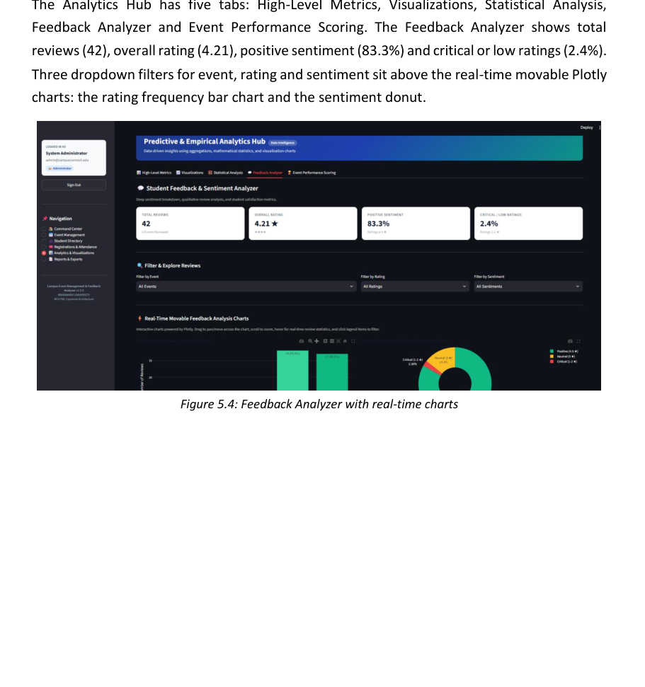
ROLE-BASED NAVIGATION
User Interface & Experience
Login / landing
Admin command center
Student & analytics views
Separate administrator and student login tabs
KPI cards, top event spotlight and activity feeds
Student bookings, reviews and interactive feedback charts
UI design: dark theme • blue-to-teal hero banner • KPI cards • status badges • role-aware sidebar
CAMPUS EVENT MANAGEMENT & FEEDBACK ANALYZER
11

Slide 12
FROM RAW ACTIVITY TO COMPARABLE METRICS
Analytics & Event Performance Score
Descriptive analytics
Event Performance Score (EPS)
• Pandas joins registrations, students and events
• Enrollment by department and category
• Venue and capacity utilization
• Mean and median ratings
• Standard deviation, variance and IQR
• Eight Matplotlib chart routines
EPS = 0.40 × Capacity + 0.40 × Rating + 0.20 × Engagement
Capacity = min(registered / capacity, 1) × 100
Rating = (average rating / 5) × 100
Engagement = min(reviews / registered, 1) × 100
TOP PERFORMER ≥ 70
AVERAGE 40–69.9
NEEDS IMPROVEMENT < 40
Plotly Feedback Analyzer supports event, star-rating and sentiment filters.
CAMPUS EVENT MANAGEMENT & FEEDBACK ANALYZER
12

Slide 13
AUTOMATED VALIDATION AND DEMONSTRATION METRICS
Testing & Results
15
41
142
20 / 20
Total events
Registered students
Registrations
UNIT TESTS PASSED
0 failures • 0 errors
4.21 / 5
42
83.3%
Average satisfaction
Reviews across 6 events
Positive reviews
Coverage includes events, students, registrations and feedback.
Other observed results: 35.4% capacity utilization • 14.3% neutral reviews • 2.4% critical reviews
Tests cover duplicate prevention, capacity limits, date validation, booking cancellation and feedback eligibility.
CAMPUS EVENT MANAGEMENT & FEEDBACK ANALYZER
13

Slide 14
ACHIEVEMENTS AND NEXT STEPS
Conclusion & Future Scope
Conclusion
Future enhancements
• Centralizes event scheduling, booking, attendance and feedback
• Uses a 10-step registration pipeline to enforce booking rules
• Combines statistical analysis, eight chart routines and interactive Plotly charts
• Introduces a 0–100 performance score for event comparison
• Core business rules validated by 20 passing unit tests
• Migrate CSV storage to PostgreSQL or MySQL via repository implementation
• Add QR-code attendance check-in
• Generate automated PDF participation certificates
• Use AI to analyze written feedback by aspect (venue, speaker, pace)
• Improve concurrent usage and operational scalability
CAMPUS EVENT MANAGEMENT & FEEDBACK ANALYZER
14

Slide 15
REFERENCES
• Streamlit Documentation — https://docs.streamlit.io
• Pandas Documentation — https://pandas.pydata.org/docs
• NumPy Documentation — https://numpy.org/doc
• Matplotlib Documentation — https://matplotlib.org/stable
• Plotly Python Documentation — https://plotly.com/python
• Python unittest — https://docs.python.org/3/library/unittest.html
• Fowler, M. — Patterns of Enterprise Application Architecture
• Research literature on learning analytics, student engagement and Likert-scale feedback analysis
15

Slide 16
THANK YOU…

