Slide 1

Requirement Specifications
Prepared by: Prince Kumar

Slide 2
Requirement Analysis
Organizes and regulates the process of landing aircraft at an airport.
Simulator to find out best utilization of holding pattern.
The system will have a holding pattern.
Instructions to the aircrafts is issued according to the holding pattern.

Slide 3

Objective
Develop an Air Traffic Controller simulation over an airport.
To achieve a safe, orderly and expeditious flow of air traffic.

Slide 4
Functionalities
Configure
Configure holding pattern
Add
Add new aircraft for landing.
Instruction
Issue instructions for aircrafts at every time tick.
Change
Change the current fuel capacity with time.
Schedule
Randomly schedule emergency landing

Slide 5
Requirement Analysis(Cont.)
Proposed system is intended to be used by ATC trainees, pilots.
Success Metrices:
Robust and Efficient holding Pattern
Minimal Collison
Highly Efficient use of runways

Slide 6


Hey, Lemme land
Functional Specification
Hmm, No/Yes
Quagmire(Pilot)
Lois (ATC controller)
Suppose a scenario where Quagmire(Pilot) wants to land his aircraft on Delhi Airport the he will send his request for landing to the Lois(ATC Controller).
In the request Quagmire will mention
Current fuel capacity
Current altitude
Emergency Siren(If applicable)

Slide 7
Functional Specifications(Cont.)
Based on the request Lois(ATC Controller) will try to fit Quagmire(the pilot) in the holding queue.
If a runway is not occupied, then Lois will allocate the runway to Quagmire and send instruction to promote from holding pattern to final approach.
If the runway is not available but it will be available for Quagmire before his fuel capacity hits critical mark, Lois will instruct Quagmire to demote from final approach to holding pattern.

Slide 8

Bran(travller)
I'm sick
Functional Specifications(Cont.)
Bran(Traveller)
If Bran( a traveller) needs immediate medical attention, then Quagmire will raise emergency signal and Lois will check if emergency runway is available if yes the Quagmire will be instructed to emergency promote to front of file approach.
If emergency runway is occupied then Lois will check if any other aircraft have extra fuel if yes then that aircraft will be instructed to abort landing, return to back of final approach, Quagmire lands.

Slide 9
Functional Specifications(Cont.)
If Lois(ATC Controller) is not able to plan landing for Quagmire(The pilot) and he has sufficient fuel to go to nearest airport, then Quagmire will be instructed to redirect to another airport.
If Quagmire does not have sufficient fuel, then he will be instructed to emergency promote to front of file approach.

Slide 10
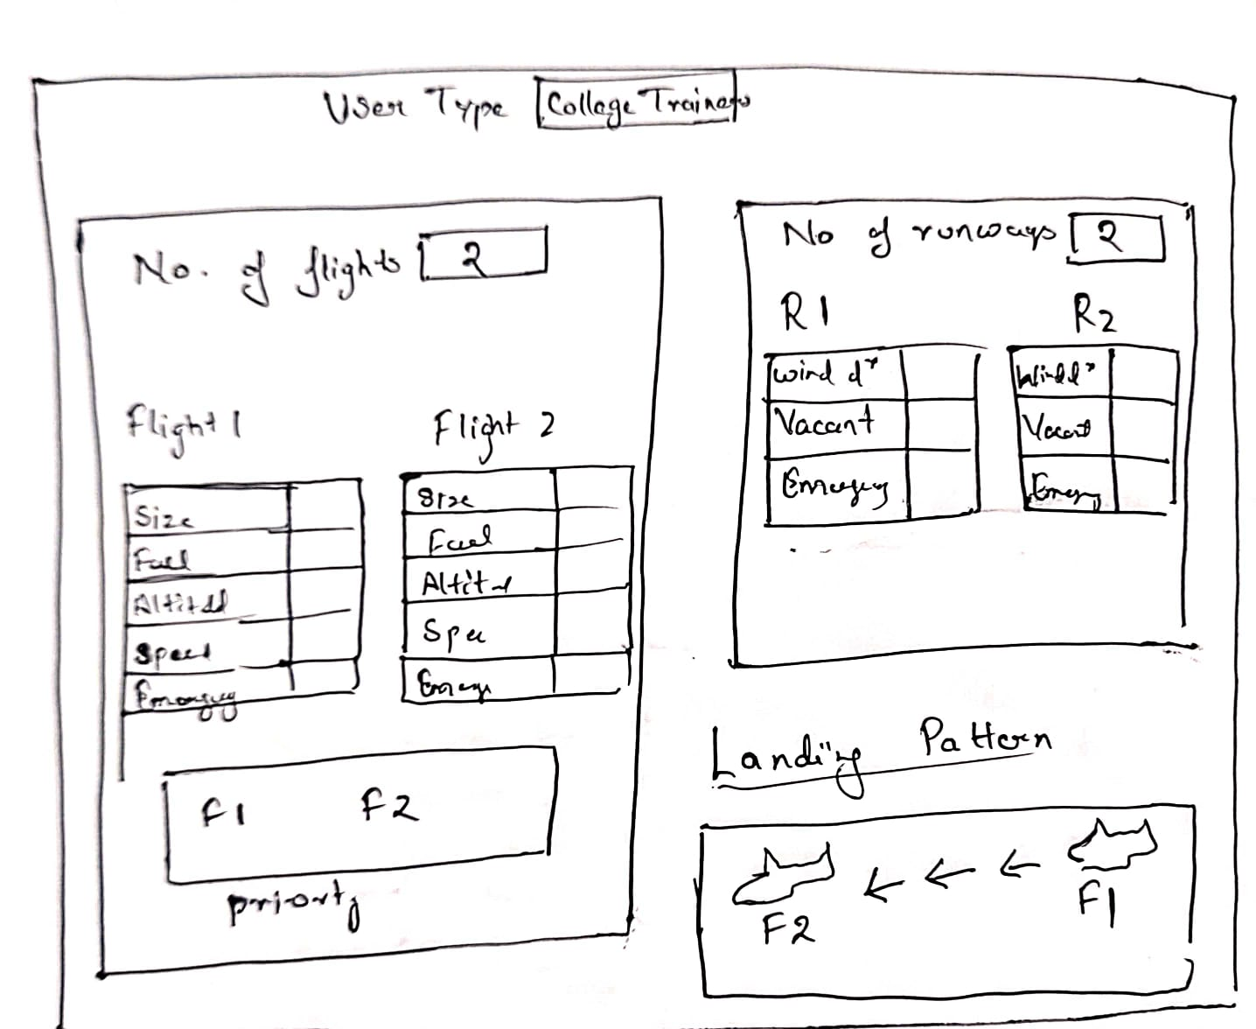
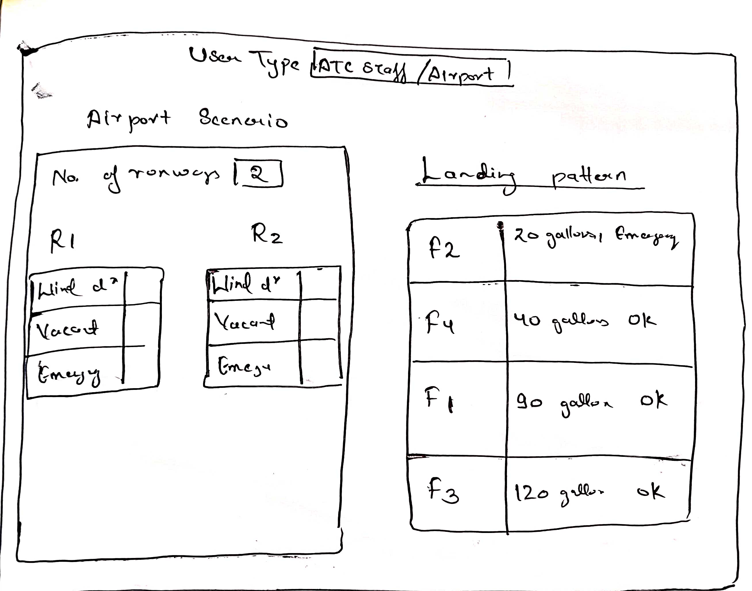
User Interface

Slide 11
External Interface Specification
Https communication Protocol will used for the interaction of aircraft with ATC server.
GUI will be used to send request and show the respective responses.

Slide 12

Technical Specifications
Software Specifications
Browser
Internet Connection
Hardware Specifications
Laptop or PC
This Photo by Unknown author is licensed under CC BY-SA-NC.

Slide 13

Thank You !

