Slide 1
Poisson Solver
Nathan Chiu

Slide 2
Physics Engine
3D charge density
QM Simulator
Poisson Solver
Electrode properties
Material properties
Simulation parameters
3D Electric Potential

Slide 3
Purpose
QM simulator finds a 3D charge density based on initial assumptions on potential and state, sends it to Poisson Solver
Poisson Solver finds a potential from 3D charge density, returns potential to QM simulator
Repeat until convergence

Slide 4
I/O
Inputs:
  3D volumetric charge density (including doping)
  Electrode geometry and potentials
  Material properties (workfunction, electron affinity, relative permittivity)
  Simulation parameters (sample length, number of grid points, boundary condition type)
Outputs:
  3D electrostatic potential

Slide 5
Algorithm
Initialize
(Define electrodes,
set sample parameters,
generate equation RHS)
Electrode
potential error
acceptable?
Call PoisFFT
Generate 3D potential
from electrode and charge
density information
Done!
Y
N
Apply correction to
charge density at
electrode surfaces

Slide 6
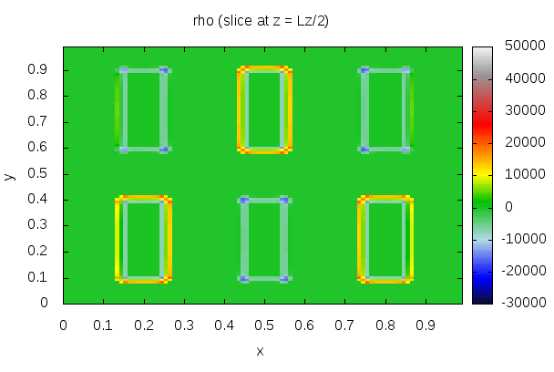
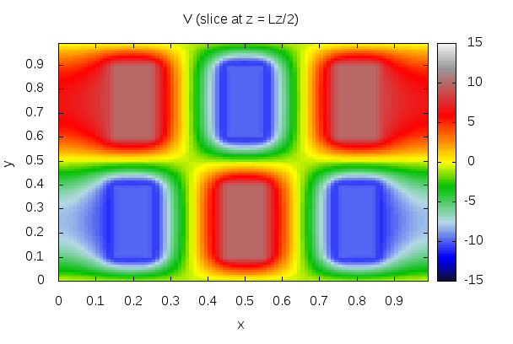
Examples (1):
Periodic boundary condition
Metre length scale
100x100x100 grid
~35 CPU seconds, ~11 wall clock seconds

Slide 7
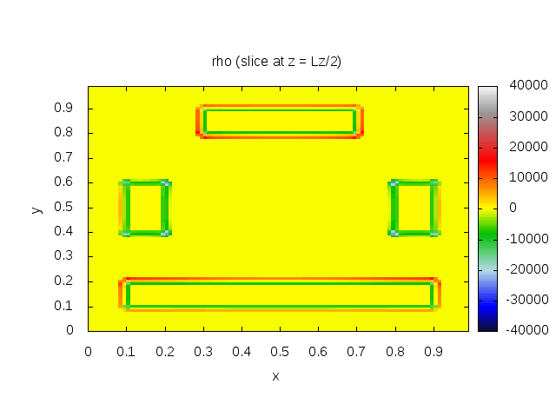
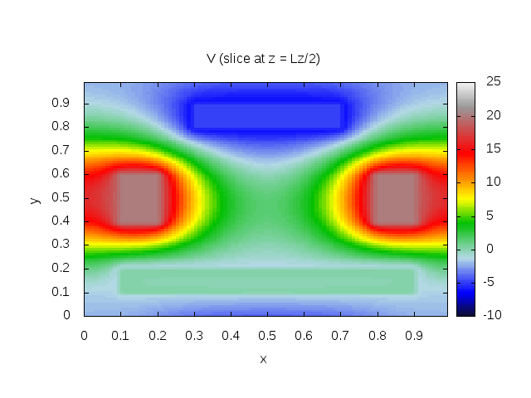
Examples (2):
Periodic boundary condition
Metre length scale
100x100x100 grid
~50 CPU seconds, ~20 wall clock seconds

Slide 8
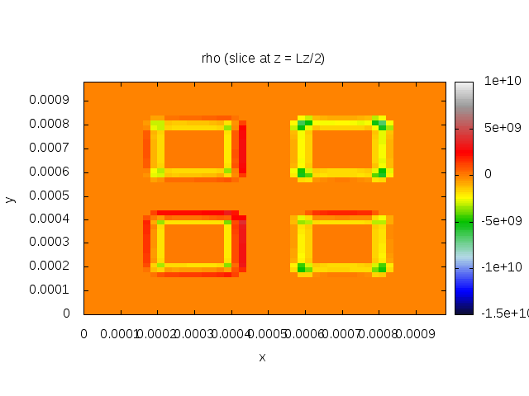
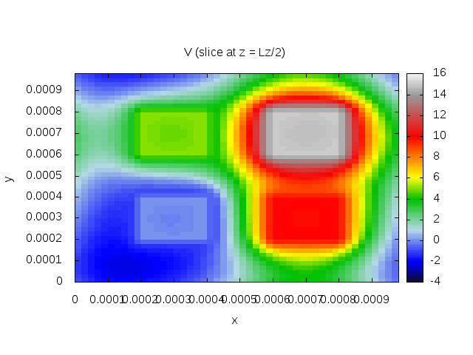
Examples (3):
Periodic boundary condition
Metre length scale
50x50x50 grid
~12 CPU seconds, ~5 wall clock seconds

Slide 9
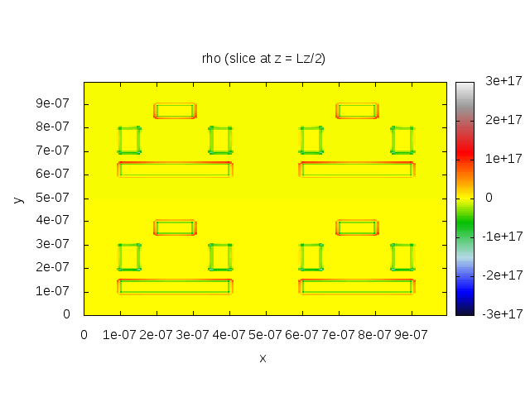
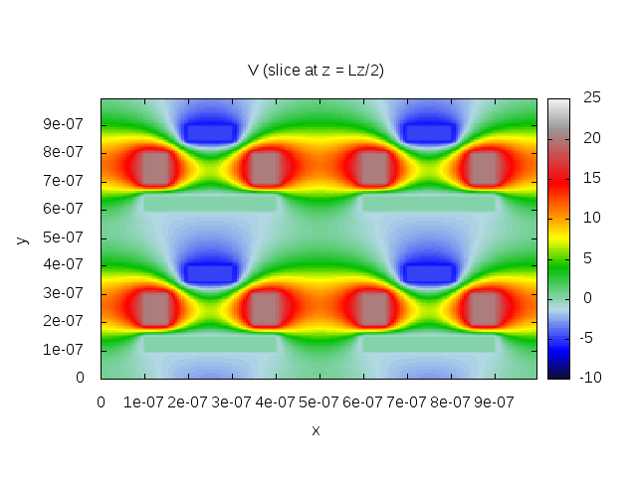
Examples (4):
Periodic boundary condition
Micrometre length scale
200x200x200 grid
~1163 CPU seconds, ~360 wall clock seconds

Slide 10
Summary
Iterative Poisson's equation solver using C++ FFT implementation
Speed depends heavily on number of grid points and electrode placement complexity
Parametrized in:
  Physical material properties (permittivity, length)
  Electrode properties (workfunction, electron affinity)
  Simulation parameters (number of grid points, boundary condition type)

