Slide 1
Online Conditional Outlier Detection in Nonstationary Time Series
Siqi Liu¹, Adam Wright², and Milos Hauskrecht¹
¹Department of Computer Science, University of Pittsburgh
²Brigham and Women's Hospital and Harvard Medical School

Slide 2
Outline
Introduction
Method
Experiments and Results
Conclusion

Slide 3
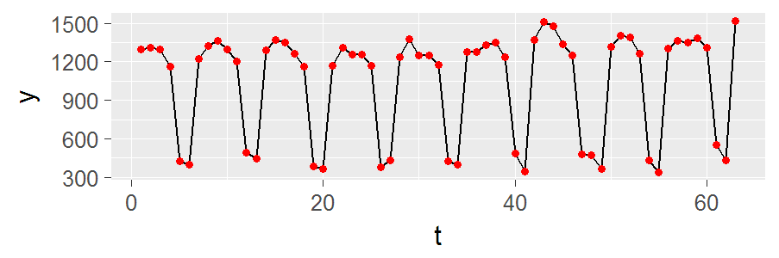

Time Series
A time series is a sequence of data points indexed by (discrete) time.
For example, a univariate time series
$$\left\{y_{t}∈ℝ:t=1, 2,…\right\}.$$
Generally, the points are not independent of each other.

Slide 4
Time Series are Everywhere
Daily prices of stocks
Monthly usage of electricity
Daily temperature, humidity, ...
Patient’s heart rate, blood pressure, ...
Number of items sold every month
Number of cars passed through a highway every hour
…

Slide 5
Monitoring Systems
By monitoring some attribute of a target (e.g., the heart rate of a patient), we naturally get a time series.
Analyzing the time series gives us insights about the target.
In this work, we are interested in finding outliers in the time series in real time.

Slide 6
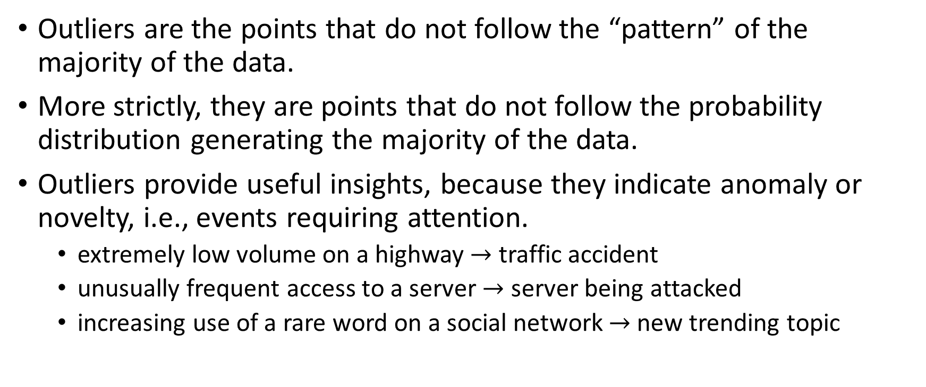
Outliers
Outliers are the points that do not follow the “pattern” of the majority of the data.
More strictly, they are points that do not follow the probability distribution generating the majority of the data.
Outliers provide useful insights, because they indicate anomaly or novelty, i.e., events requiring attention.
extremely low volume on a highway $→$ traffic accident
unusually frequent access to a server $→$ server being attacked
increasing use of a rare word on a social network $→$ new trending topic

Slide 7
Challenge 1: Nonstationarity
Detecting outliers in time series is challenging because of the nonstationarity (i.e., the distribution of the data changes over time)
Specifically, the changes could be
long-term changes
periodic changes (a.k.a. seasonality)
These hinder outlier detection, because they result in false positives and false negatives

Slide 8
Challenge 1.1: Long-Term Changes
An extreme value in the past could be normal now
A normal value in the past could be extreme now
normal
outlier
value
outlier
time

Slide 9
Challenge 1.2: Seasonality
outlier
value
normal
normal
time

Slide 10
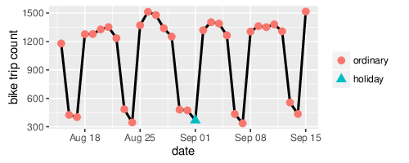
Challenge 2: Context
By considering the context, some “outliers” become normal; some “normal” points become outliers.

Slide 11
Existing Work in Outlier Detection in Time Series
Existing work in outlier detection in time series usually assumes a model like autoregressive-moving-average (ARMA). (e.g., Tsay 1988; Yamanishi and Takeuchi 2002)
These models cannot deal with nonstationary (seasonal) time series directly.
A solution is to difference the time series, resulting in: autoregressive-integrated-moving-average (ARIMA).
We use it as a baseline in our experiments.

Slide 12
Outline
Introduction
Method
Experiments and Results
Conclusion

Slide 13
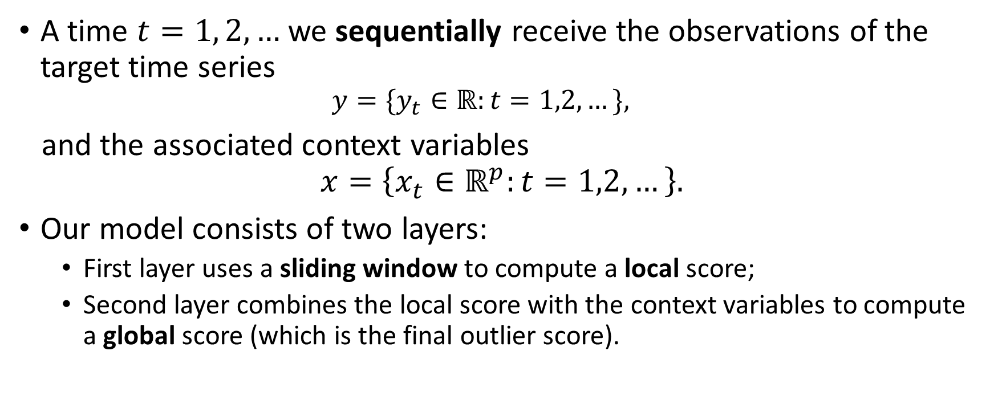
Method: Two Layers
A time $t=1, 2,…$ we sequentially receive the observations of the target time series
$$y=\{y_{t}∈ℝ:t=1,2,…\},$$
and the associated context variables
$$x=\left\{x_{t}∈ℝ^{p}:t=1,2,…\right\}.$$
Our model consists of two layers:
First layer uses a sliding window to compute a local score;
Second layer combines the local score with the context variables to compute a global score (which is the final outlier score).

Slide 14
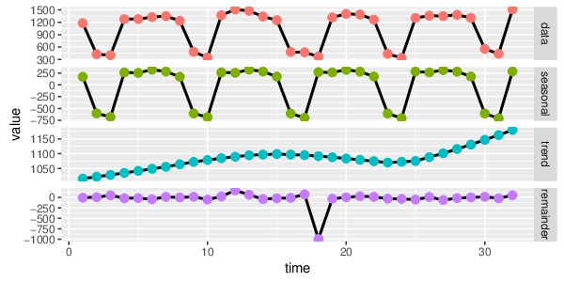
First Layer
First, we decompose the time series (within a sliding window) into 3 components using a nonparametric decomposition algorithm called STL (Cleveland et al. 1990).

Slide 15

First Layer
Then, we compute a local deviation score $z_{t}=\frac{y_{t}^{(R)}−{\overset{^}{μ}}_{t}^{(R)}}{{\overset{^}{σ}}_{t}^{(R)}}$ on the remainder.

Slide 16
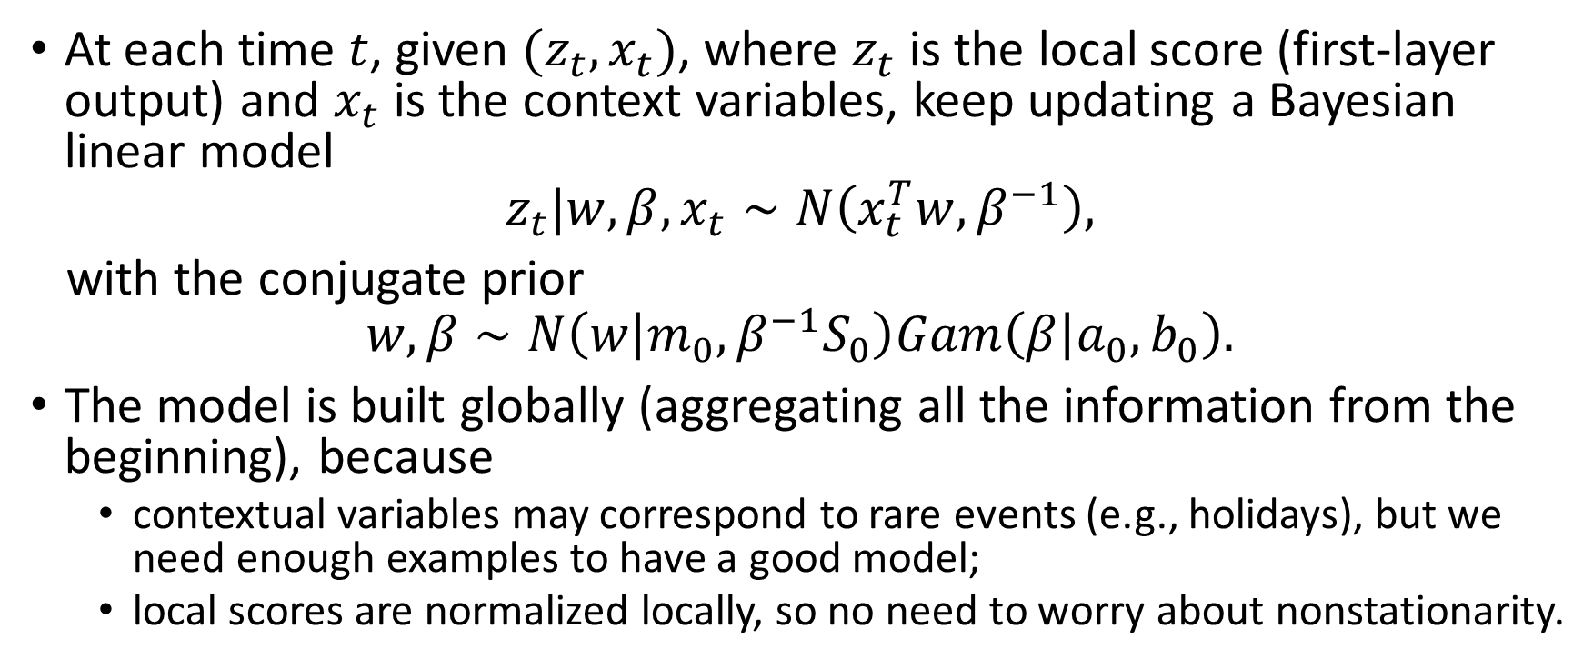
Second Layer
At each time $t$, given $(z_{t},x_{t})$, where $z_{t}$ is the local score (first-layer output) and $x_{t}$ is the context variables, keep updating a Bayesian linear model
$$z_{t}|w,β,x_{t}∼N\left(x_{t}^{T}w,β^{−1}\right),$$
with the conjugate prior
$$w,β∼N\left(w | m_{0},β^{−1}S_{0}\right)Gam\left(β | a_{0},b_{0}\right).$$
The model is built globally (aggregating all the information from the beginning), because
contextual variables may correspond to rare events (e.g., holidays), but we need enough examples to have a good model;
local scores are normalized locally, so no need to worry about nonstationarity.

Slide 17

Second Layer
The final outlier score is calculated based on the marginal distribution of $z_{t}$ given $x_{t}$ and the history
$$z_{t}|D_{t−1},x_{t}∼St(z_{t}|μ_{t},σ_{t}^{2},ν_{t}),$$
where $D_{t−1}=\left\{\left(z_{u},x_{u}\right) \right| u=1, 2, …, t−1\}.$

Slide 18
Outline
Introduction
Method
Experiments and Results
Conclusion

Slide 19
Data Sets
Bike data consists of the time series (of length 733) that records the daily bike trip counts taken in San Francisco Bay Area through the bike share system from August 2013 to August 2015 .
CDS data consists of daily rule firing counts of a clinical decision support (CDS) system in a large teaching hospital. (111 time series of length 1187)
Traffic data consists of time series of vehicular traffic volume measurements collected by sensors placed on major highways. (2 time series of length 365)

Slide 20
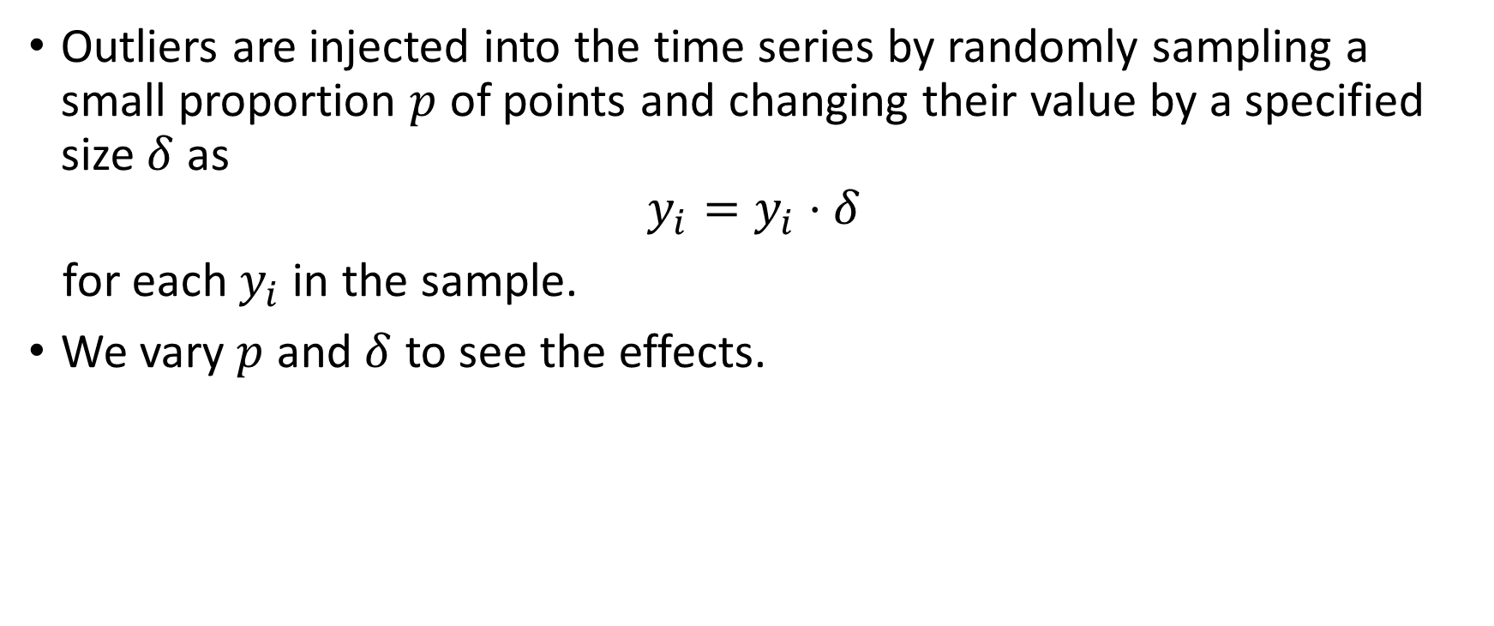
Injecting Outliers
Outliers are injected into the time series by randomly sampling a small proportion $p$ of points and changing their value by a specified size $δ$ as
$$y_{i}=y_{i}⋅δ$$
for each $y_{i}$ in the sample.
We vary $p$ and $δ$ to see the effects.

Slide 21
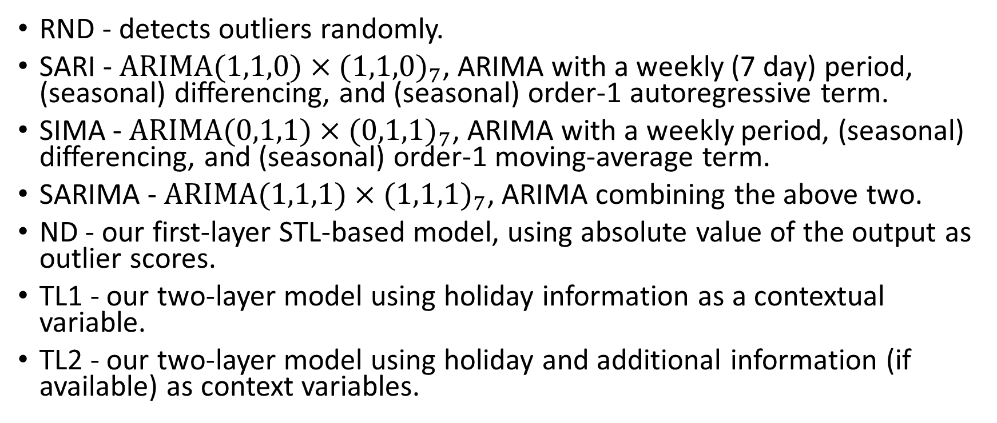
Methods Compared
RND - detects outliers randomly.
SARI - $ARIMA(1,1,0)×(1,1,0)_{7}$, ARIMA with a weekly (7 day) period, (seasonal) differencing, and (seasonal) order-1 autoregressive term.
SIMA - $ARIMA(0,1,1)×(0,1,1)_{7}$, ARIMA with a weekly period, (seasonal) differencing, and (seasonal) order-1 moving-average term.
SARIMA - $ARIMA(1,1,1)×(1,1,1)_{7}$, ARIMA combining the above two.
ND - our first-layer STL-based model, using absolute value of the output as outlier scores.
TL1 - our two-layer model using holiday information as a contextual variable.
TL2 - our two-layer model using holiday and additional information (if available) as context variables.

Slide 22
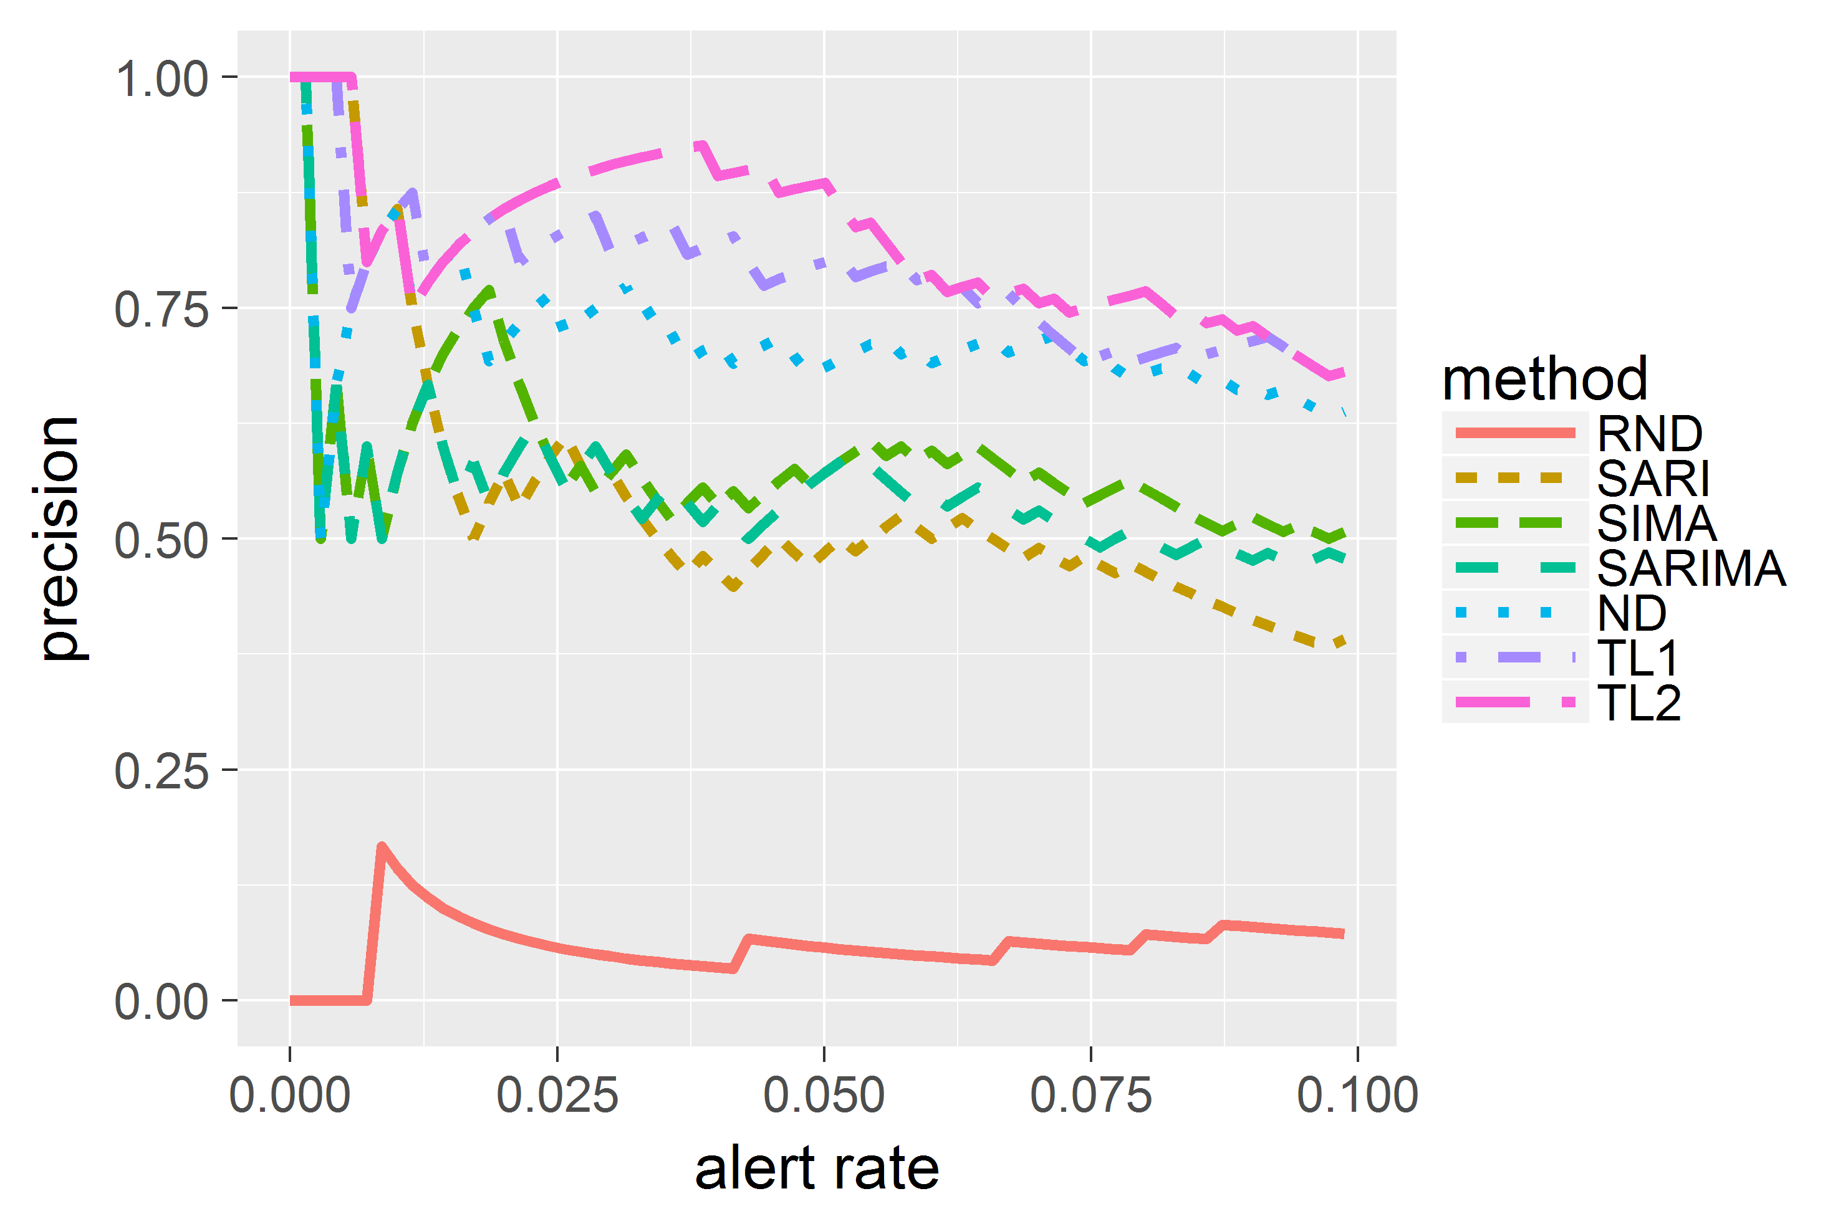
Evaluation: Precision-Alert-Rate Curves (Hauskrecht et al. 2016)
Alert rate: the proportion of alerts raised out of all points.
Precision: the proportion of true outliers out of alerts raised.
We calculate AUC to compare the overall performance.
Notice we focus on low-alert-rate region for practicality.

Slide 23
Varying Outlier Rate (0.1) - Bike Data

Slide 24
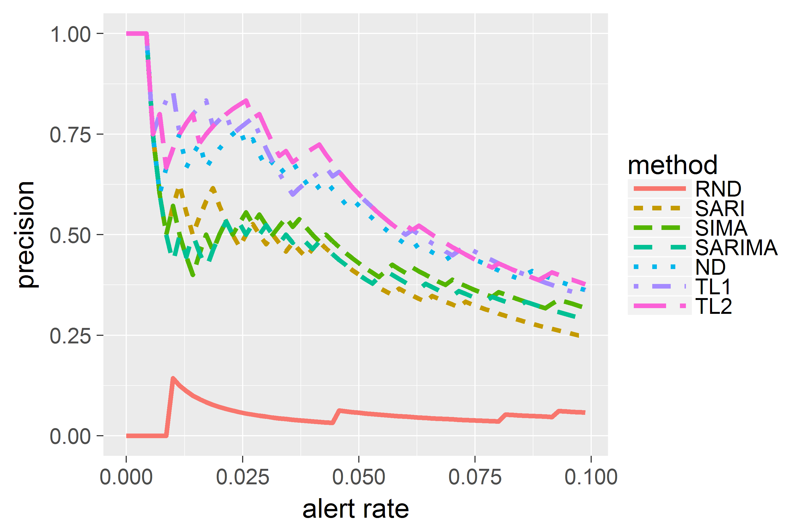
Varying Outlier Rate (0.05) - Bike Data

Slide 25
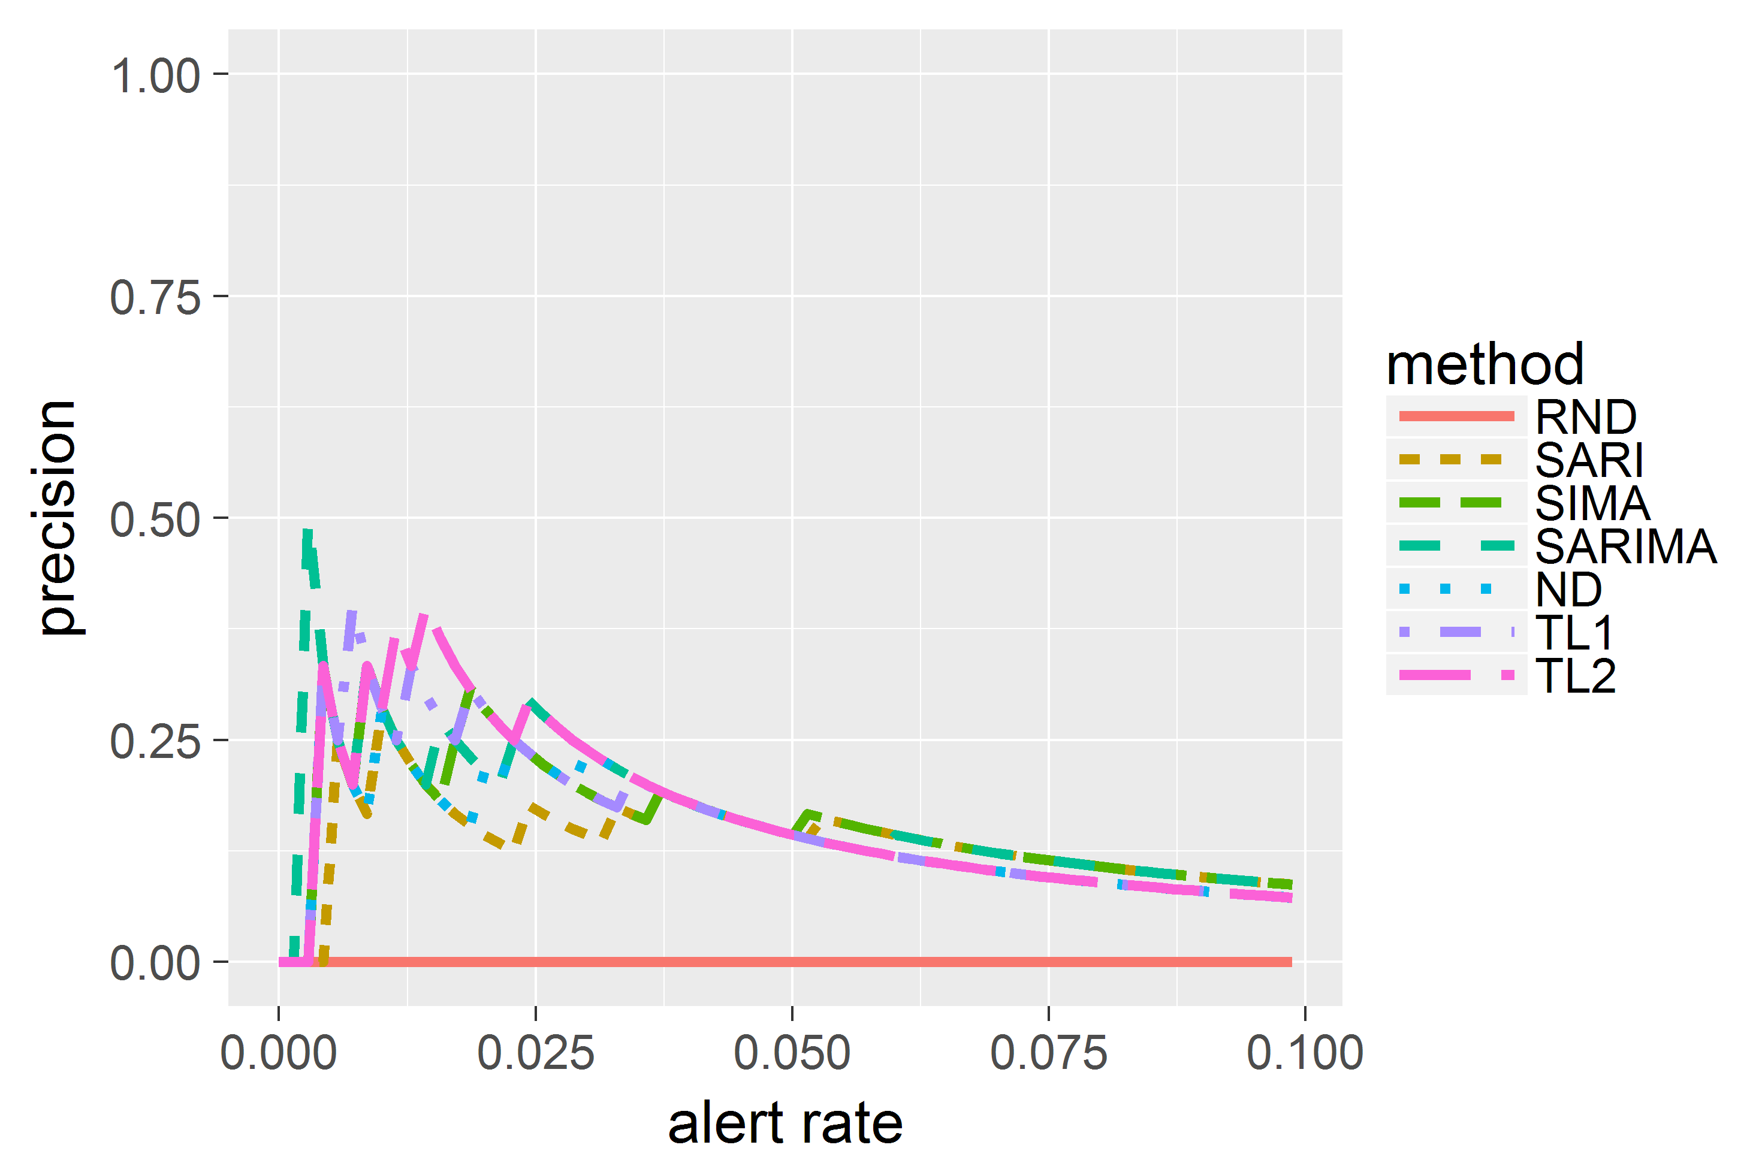
Varying Outlier Rate (0.01) - Bike Data

Slide 26
Varying Outlier Size (2.0) - Bike Data

Slide 27
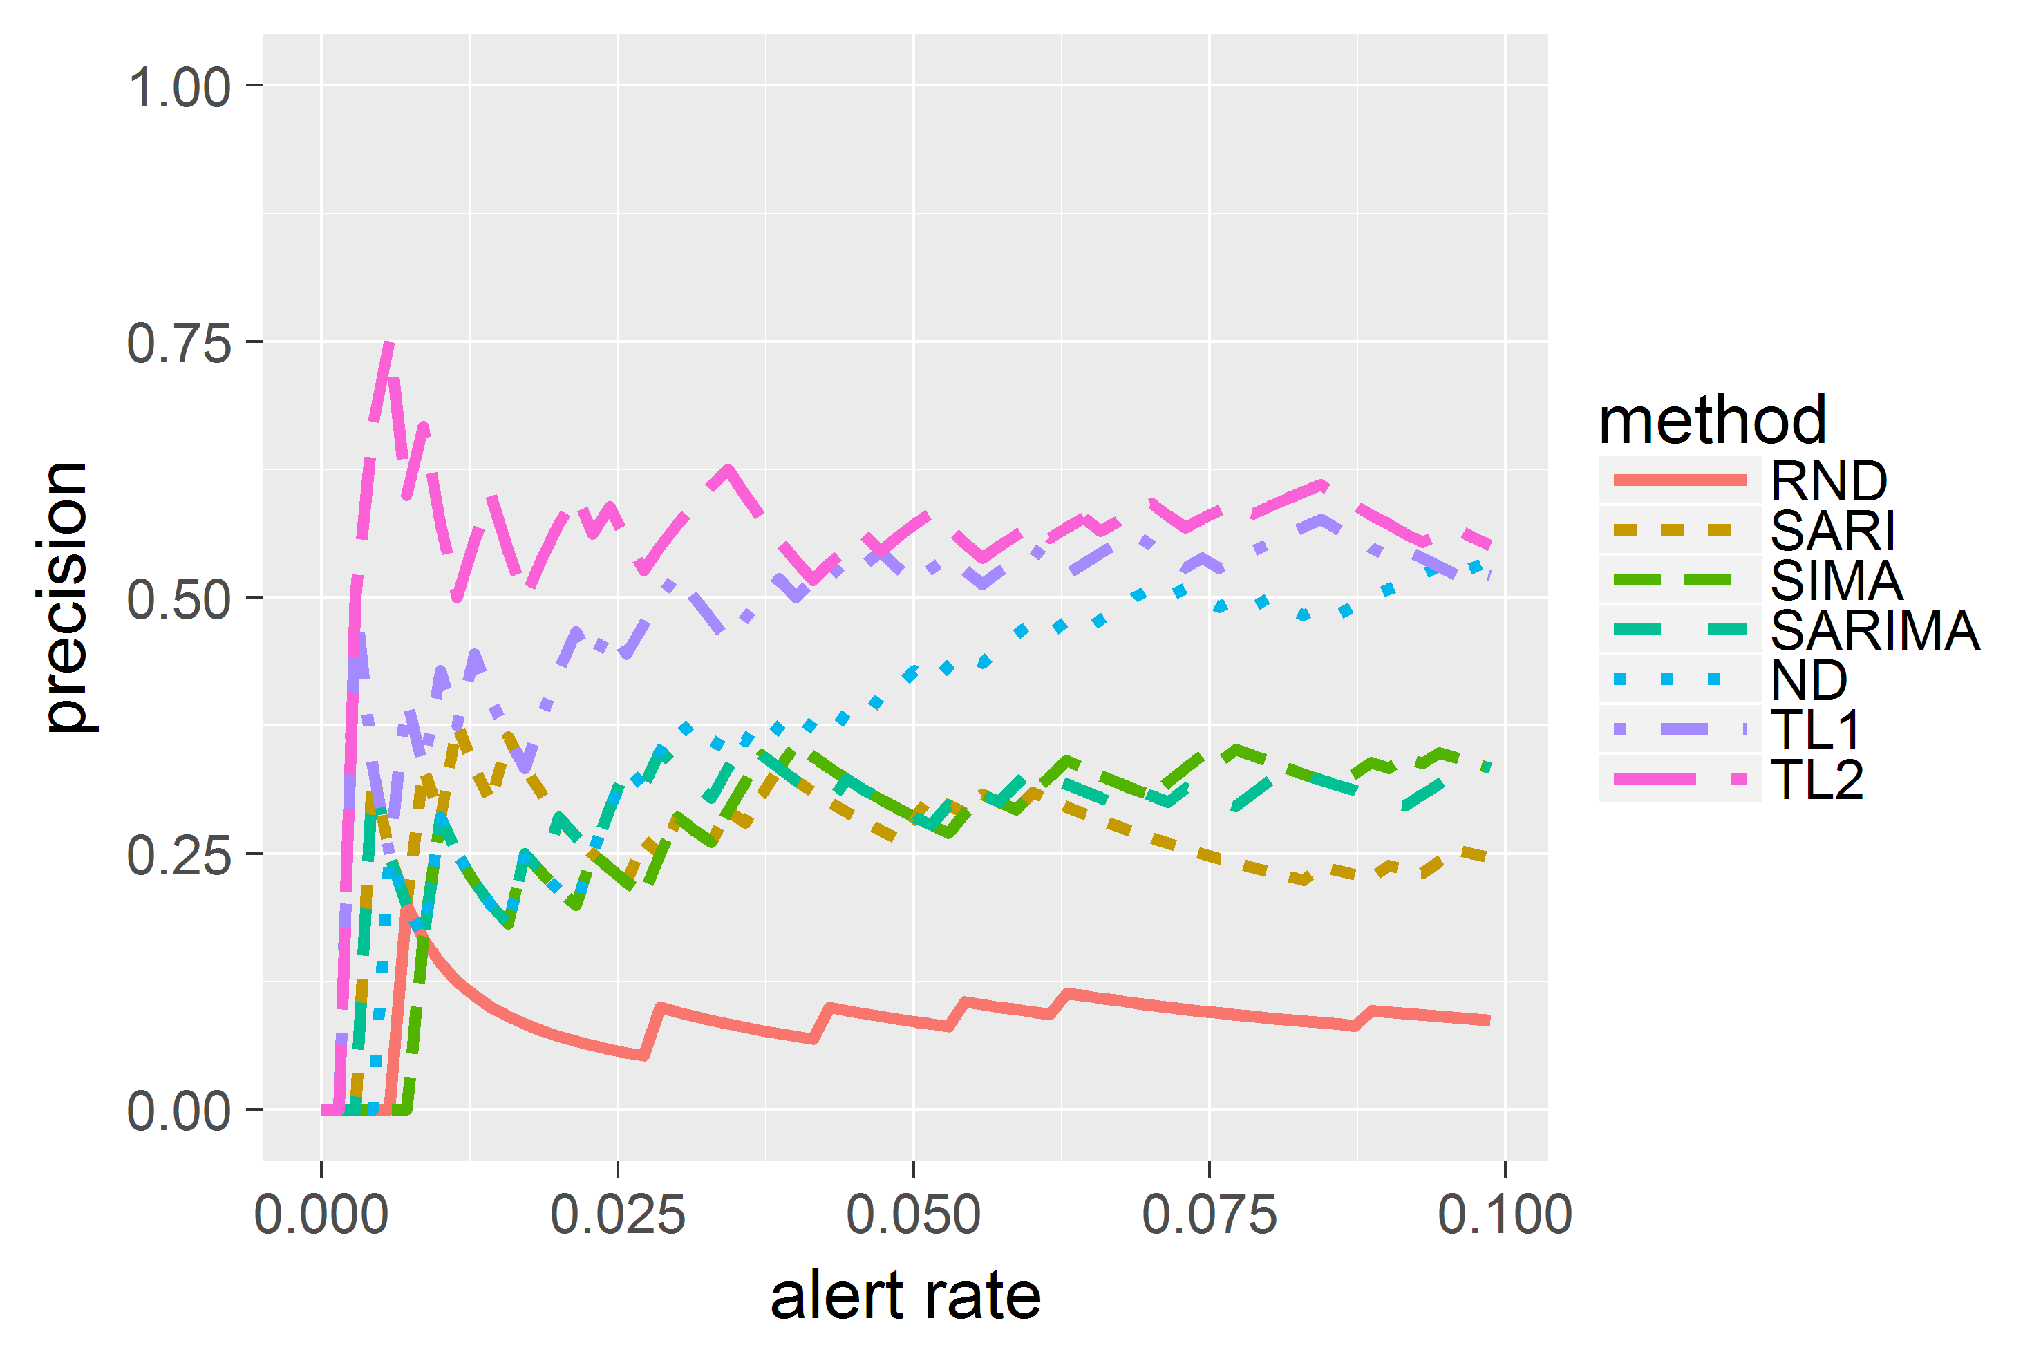
Varying Outlier Size (1.5) - Bike Data

Slide 28
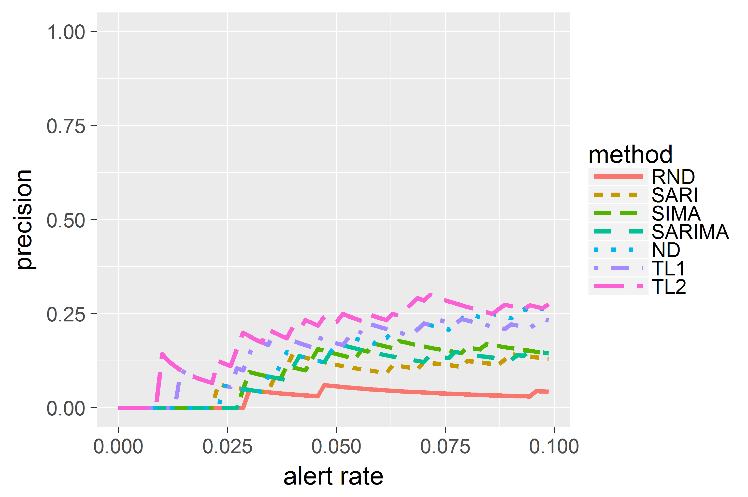
Varying Outlier Size (1.2) - Bike Data

Slide 29
Overall Performance
By comparing the AUC, we have the following observations:
When the size of the outliers are small, all methods perform similarly to random.
In the other cases, our two-layer method is almost always the best method.
Even using only the first-layer can achieve similar or better results as the ARIMA-based methods.
Using additional information (e.g., using weather besides holiday info) improves the performance of the two-layer method.

Slide 30
Outline
Introduction
Method
Experiments and Results
Conclusion

Slide 31
Conclusion
We have proposed a two-layer method to detect outliers in time series in real time.
Our method takes account of the nonstationarity and the context of the data to detect outliers more accurately.
Experiments on data sets from different domains have shown the advantages of our method.

Slide 32
Thank you! Q & A

