Slide 1
Cloud Computing Programming Models ─ Issues and Solutions
Yi Pan
Distinguished University Professor and Chair
Department of Computer Science
Georgia State University
Atlanta, Georgia, USA

Slide 2
Historical Perspective
From Supercomputing
To Cluster Computing
To Grid Computing
To Cloud Computing

Slide 3
Killer Applications
Science and Engineering:
Scientific simulations, genomic analysis, etc.
Earthquake prediction, global warming, weather forecasting, etc.
Business, Education, service industry, and Health Care:
Telecommunication, content delivery, e-commerce, etc.
Banking, stock exchanges, transaction processing, etc.
Air traffic control , electric power Grids, distance education, etc.
Health care, hospital automation, telemedicine, etc.
Internet and Web Services and Government
Internet search, datacenters, decision-make systems, etc.
Traffic monitory , worm containment, cyber security, etc.
Digital government, on-line tax return, social networking, etc.
Mission-Critical Applications
Military commend, control, intelligent systems, crisis management, etc.

Slide 4
Problems with Traditional Supercomputers
Too costly
Hard to maintain
Hard to implement parallel codes
No rapid configuration (virtualization) → not easily available
Hard to share computing power
Not available to small companies

Slide 5
Solutions
Cluster computing – use of local networks
Low cost
easy to maintain
Grid computing
Resource sharing
Easy to access
Rich resources
How to charge a user becomes a probelm

Slide 6
Similarities among Grids
Water Grid
Electrical Power Grid
Computing Grid
We do not need to know where and how to get the resources (water, electricity or computing power)
In reality, it is impossible for Computing Grid
Why should people share resources with you?

Slide 7
A Computational “Power Grid”
Goal is to make computation a utility
Computational power, data services, peripherals (Graphics accelerators, particle colliders) are provided in a heterogeneous, geographically dispersed way
Standards allow for transportation of these services
Standards define interface with grid
Architecture provides for management of resources and controlling access
Large amounts of computing power should be accessible from anywhere in the grid

Slide 8
Types of Grids
Computational Grid
Data Grid
Scavenging Grid
Peer-to-Peer
Public Computing

Slide 9
Cloud Computing Background
“Cloud” is a common metaphor for an Internet accessible infrastructure.
Users don’t need to spend time and money on purchasing and maintaining machines.
Users also don’t have to purchase the latest licenses for operating systems and software;
These features provided by cloud service allow developer to focus on developing their applications.
Economical for both vendors and users

Slide 10
IBM Definition
“A cloud is a pool of virtualized computer resources. A cloud can host a variety of different workloads, including batch-style backend jobs and interactive, user-facing applications, allow workloads to be deployed and scaled-out quickly through the rapid provisioning of virtual machines or physical machines, support redundant, self-recovering, highly scalable programming models that allow workloads to recover from many unavoidable hardware/software failures; and monitor resource use in real time to enable rebalancing of allocations when needed.”

Slide 11
Ian Foster’s Definition
“A large-scale distributed computing paradigm that is driven by economics of scale, in which a pool of abstracted virtualized, dynamically-scalable, managed computing power, storage, platforms, and services are delivered on demand to external customers over the Internet”.

Slide 12
Virtual machine multiplexing

Slide 13
Virtual machine migration in a distributed computing environment,

Slide 14
Everything as a service

Slide 15
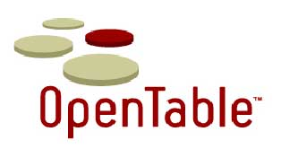


























Cloud Services Stack
Application
Cloud Services
Platform
Cloud Services
Compute & Storage
Cloud Services
Co-Location
Cloud Services
Network
Cloud Services

Slide 16
Cloud service stack ranging from application, platform, infrastructure to co-location and network services in 5 layers
PaaS is provided by Google, Salesforce, facebook, etc.
IaaS is provided by Amazon, WindowsAsure, RackRack, etc.
The co-location services involve multiple cloud providers to work together such as supporting supply chains in manufacturing.
The network cloud services provide communications such as those by AT&T, Qwest, AboveNet

Slide 17
Ideal Characteristics
(1) a scalable computing built around the datacenters.
(2) dynamical provision on demand
(3) available and accessible anywhere and anytime
(4) virtualization of all resources.
(5) everything as a service
(6) cost reduction through pay-per-use pricing model (driven by economics of scale)
(7) unlimited resources

Slide 18
In reality
The previous characteristics are not completely realizable yet using current technologies
New challenges require new solutions
Examples, data replication for fault tolerance, programming model, automatic parallelization (MapReduce), scheduling, low CPU utilization, security, trust, etc

Slide 19
Cloud technologies
Google MapReduce, Google File System (GFS), Hadoop and Hadoop Distributed File System (HDFS), Microsoft Dryad, and CGL-MapReduce adopt a more data-centered approach to parallel runtimes.
In these frameworks, the data is staged in data/compute nodes of clusters and the computations move to the data in order to perform data processing.

Slide 20
Parallel applications can utilize various communication constructs to build diverse communication topologies. E.g., a matrix multiplication application
The current cloud runtimes, which are based on data flow models such as MapReduce and Dryad, do not support this behavior

Slide 21
Scientific Computing on Cloud
Cloud computing has been very successful for many data parallel applications such as web searching and database applications.
Because cloud computing is mainly for large data center applications, the programming models used in current cloud systems have many limitations and are not suitable for many scientific applications.

Slide 22
Review of Parallel, Distributed, Grid and Cloud Programming Models
Message Passing Interface (MPI) (Distributed computing)
OpenMP (Parallel computing)
HPF (Parallel computing)
Globus Toolkit (Grid computing)
MapReduce (Cloud computing)
iMapReduce (Cloud computing)

Slide 23
MPI
Objectives and Web Link
Message-Passing Interface is a library of subprograms that can be called from C or Fortran to write parallel programs running on distributed computer systems
Attractive Features Implemented
Specify synchronous or asynchronous point-to-point and collective communication commands and I/O operations in user programs for message-passing execution

Slide 24
MPI Example - 2D Jacobi
call MPI_BARRIER( MPI_COMM_WORLD, ierr )
t1 = MPI_WTIME()
do 10 it=1, 100
call exchng2( b, sx, ex, sy, ey, comm2d, stride,
$ nbrleft, nbrright, nbrtop, nbrbottom )
call sweep2d( b, f, nx, sx, ex, sy, ey, a )
call exchng2( a, sx, ex, sy, ey, comm2d, stride,
$ nbrleft, nbrright, nbrtop, nbrbottom )
call sweep2d( a, f, nx, sx, ex, sy, ey, b )
dwork = diff2d( a, b, nx, sx, ex, sy, ey )
call MPI_Allreduce( dwork, diffnorm, 1, MPI_DOUBLE_PRECISION,
$ MPI_SUM, comm2d, ierr )
if (diffnorm .lt. 1.0e-5) goto 20
if (myid .eq. 0) print *, 2*it, ' Difference is ', diffnorm
10 continue

Slide 25
MPI – 2D Jacobi (Boundary Exchange)
subroutine exchng2( a, sx, ex, sy, ey, ……
......
call MPI_SENDRECV( a(sx,ey), nx, MPI_DOUBLE_PRECISION,
& nbrtop, 0,
& a(sx,sy-1), nx, MPI_DOUBLE_PRECISION,
& nbrbottom, 0, comm2d, status, ierr )
call MPI_SENDRECV( a(sx,sy), nx, MPI_DOUBLE_PRECISION,
& nbrbottom, 1,
& a(sx,ey+1), nx, MPI_DOUBLE_PRECISION,
& nbrtop, 1, comm2d, status, ierr )
call MPI_SENDRECV( a(ex,sy), 1, stridetype, nbrright, 0,
& a(sx-1,sy), 1, stridetype, nbrleft, 0,
& comm2d, status, ierr )
call MPI_SENDRECV( a(sx,sy), 1, stridetype, nbrleft, 1,
& a(ex+1,sy), 1, stridetype, nbrright, 1,
& comm2d, status, ierr )
return
end

Slide 26
OpenMP
High level parallel programming tools
Mainly for parallelizing loops and tasks
Easy to use, but not flexible
Only for shared memory systems

Slide 27
OpenMP Example
!$OMP DO
do 21 k=1,nt+1
do 22 n=2,ns+1
sumy=0.
do 23 i=max1(1.,n-(((k-1.)/lh)+1)),n-1
s=1+int(k-lh*(n-i))
sumy=sumy+(2*b(s,i)+a(s,i))*(gh(ni+1))
23 continue
c(k,n)=hh(k,n)+(sumy*dx)
22 continue
21 continue
!$OMP END DO

Slide 28
HPF
It is an extension of FORTRAN
Easy to use,
Mainly for parallelizing loops
Only for FORTRAN codes

Slide 29
HPF Example – Array Distribution
!HPF$ PROCESSORS PROCS(NUMBER_OF_PROCESSORS())
!HPF$ ALIGN Y(I,J,K) WITH X(I,J,K)
!HPF$ ALIGN Z(I,J,K) WITH X(I,J,K)
!HPF$ ALIGN V(I,J,K) WITH X(I,J,K)
!HPF$ DISTRIBUTE X(*,*,BLOCK) ONTO PROCS
!HPF$ ALIGN YH(I,J,K) WITH XH(I,J,K)
!HPF$ ALIGN ZH(I,J,K) WITH XH(I,J,K)
!HPF$ DISTRIBUTE XH(*,BLOCK,*) ONTO PROCS

Slide 30
HPF – Simple Loop Parallelization
DO 16 L=1,6
!HPF$ INDEPENDENT
DO 16 K=1,KL
DO 16 J=1,JL
FU(J,K,L)=RPERIOD*FU(J,K,L)
16 CONTINUE

Slide 31
HPF – Loop Parallelization on K
!HPF$ INDEPENDENT, NEW(I, IM, IP, J, SSXI, RSSXI, ....)
DO 1 K=1,KLM
DO 1 J=1,JLM
DO 2 I=1,ILM
2 CONTINUE
DO 3 I=2,ILM
IM=I-1
IP=I+1
C RECONSTRUCT THE DATA AT THE CELL INTERFACE, KAPA
UP1(I)=U1(I,J,K,1)+0.25*RP*((1.0-RK)*(U1(I,J,K,1)-U1(IM,J,K,1))
1 +(1.0+RK)*(U1(IP,J,K,1)-U1(I,J,K,1)))
......

Slide 32
HPF –Loop Parallelization on J
!HPF$ INDEPENDENT, NEW(K, KM, KP, I, SSZT, RSSZT, ....)
DO 2 J=1,JLM
DO 2 K=1,KLM
KM=K-1
KP=K+1
DO 2 I=1,ILM
UP1(I,K)=U1(I,J,K,1)+0.25*RP*((1.0- … .
......

Slide 33
HPF – Data Redistribution
Require parallelization on different loops due to data dependency
Data redistribution is needed for efficient execution (to reduce remote communications)
But redistribution is costly (1-to-1 mapping)
Better algorithms are designed for it (# of msgs, even distribution, message combining)

Slide 34
Globus Toolkit for Grid
The open source Globus® Toolkit is a fundamental enabling technology for the "Grid," letting people share computing power, databases, and other tools securely online across corporate, institutional, and geographic boundaries without sacrificing local autonomy.
The toolkit includes software services and libraries for resource monitoring, discovery, and management, plus security (certification and authorization) and file management.

Slide 35
Globus
The toolkit includes software for security, information infrastructure, resource management, data management, communication, fault detection, and portability.
It is packaged as a set of components that can be used either independently or together to develop applications.

Slide 36
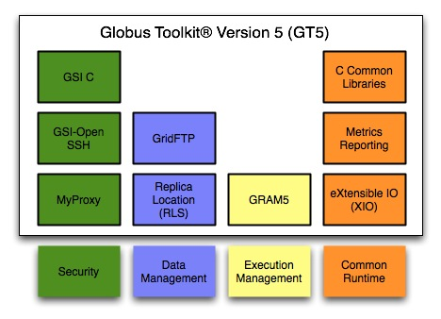
Architecture

Slide 37
Synchronization in C/C++ in Globus
In the main Program:
globus_mutex_lock(&mutex);
while(done==GLOBUS_FALSE)
globus_cond_wait(&cond, &mutex);
globus_mutex_unlock(&mutex);
In the callback function:
globus_mutex_lock(&mutex);
done = GLOBUS_TRUE;
globus_cond_signal(&cond);
globus_mutex_unlock(&mutex);

Slide 38
Google’s MapReduce
MapReduce is a programming model, introduced by Google in 2004, to simplify distributed processing of large datasets on clusters of commodity computers.
Currently, there exist several open-source implementations including Hadoop.
MapReduce became the model of choice for many web enterprises, very often being the enabler for cloud services.
Recently, it also gained significant attention in scientific community for parallel data analysis e.g. Rhipe.

Slide 39
MapReduce by Google
Objectives and Web Link
A web programming model for scalable data processing on large cluster over large datasets, applied in web search operations
Attractive Features Implemented
A map function to generate a set of intermediate key/value pairs. A Reduce function to merge all intermediate values with the same key

Slide 40
MapReduce
Input
map
reduce

Slide 41
MapReduce
Users specify a map function that processes a key/value pair to generate a set of intermediate key/value pairs
A reduce function that merges all intermediate values associated with the same intermediate key.
Many real world tasks are expressible in this model.

Slide 42
MapReduce
Programs written in this functional style are automatically parallelized and executed on a large cluster of commodity machines.
The run-time system takes care of the details of partitioning the input data, scheduling the program's execution across a set of machines, handling machine failures, and managing the required inter-machine communication.
This allows programmers without any experience with parallel and distributed systems to easily utilize the resources of a large distributed system.

Slide 43
MapReduce Code Example
The map function emits each word plus an associated count of occurrences (just `1' in this simple example).
The reduce function sums together all counts emitted for a particular word.

Slide 44
MapReduce Code Example
Counting the number of occurrences of each word
map(String key, String value):
// key: document name
// value: document contents
for each word w in value:
EmitIntermediate(w, "1");
reduce(String key, Iterator values):
// key: a word
// values: a list of counts
int result = 0;
for each v in values:
result += ParseInt(v);
Emit(AsString(result));

Slide 45
Limitations with MapReduce
Cannot express many scientific applications
Low physical node utilization → low ROI
For example, matrix operation cannot be expressed in MapReduce easily
Complex communication patterns not supported

Slide 46
Communication Topology
Parallel applications can utilize various communication constructs to build diverse communication topologies. E.g., a matrix multiplication and graph algorithms
The current cloud runtimes, which are based on data flow models such as MapReduce and Dryad, do not support this behavior

Slide 47
Parallel Computing on Cloud
Most “pleasingly parallel” applications can be performed using MapReduce technologies such as Hadoop, CGL-MapReduce, and Dryad, in a fairly easy manner.
However, many scientific applications, which require complex communication patterns, still require optimized runtimes such as MPI.

Slide 48
What Next?
Most vendors will no longer support MPI, OpenMP, HP Fortran.
Uses can only implement their codes using available cloud tools/programming models such as MapReduce.
What are the solutions?

Slide 49
Limitations of Current Programming Models
Expressibility Issue of applications
MapReduce
Performance Issue
Hadoop, Microsoft Azure
Hard to code and time consuming
Microsoft Azure – Table, Queue and Blob for communication

Slide 50
Possible Solutions
Improve and Generalize MapReduce’s functionalities so that more applications can be parallelized.
The problem is that the more general of the model, the more complicated to implement the runtimes.
Automatic translation –
between high-level languages and cloud languages
among cloud languages
New models. E.g., Bulk Synchronous Processing Model (BSP)?
Redesign of algorithms - matrix multiplication using MapReduce by adopting a row/column decomposition approach to split the matrices

Slide 51
Improvement
Scalable but not efficient
Fault-tolerance mechanism
No pipelined parallelism – blocking operations
One-to-one shuffling strategy
Simple runtime scheduling
Batch processing – large latency
Prepare inputs in advance
Data stream, data flow, push data, incremental processing, real time

Slide 52
I/O Optimization
Index structure
Column-Oriented storage
Data compression

Slide 53
Improvements
No high level language
Tedious to code
Time consuming
Big learning curve
Only experts can do the coding
Declarative query languages – SCOPE, Pig, HIVE
Automatic translation
Intermediate languages - XML

Slide 54
Fixed Data Flow
Only single data input and output
Repeatedly read data from disks
Flexible data flow
Global state information in the middle
iMapReduce - Cache tasks and data – reduce time
–Pregel – Each node has its own inputs and transfers only necessary data – reduce traffic
Map-Reduce-Merge – binary operator requires 2 inputs, combine two reduced outputs into one

Slide 55
Scheduling
Block level runtime scheduling with a speculative execution
Heuristic
Solutions
Context sensitive
Lowest progress – re-execution
Not suitable for heterogeneous system
Parallax – prerun with a sample data
ParaTimer – find the longest path as estimate
MRShare – multi-user case

Slide 56
iMapReduce
iMapReduce is a modified Hadoop MapReduce Framework for iterative processing
It improves performance by
reducing the overhead of creating jobs repeatedly
eliminating the shuffling of static data
allowing asynchronous execution of map tasks

Slide 57
Iterative MapReduce
iterations
Input
map
reduce

Slide 58
Iterative MapReduce
Iterate
Static
data
Configure()
User Program
Map(Key, Value)
δ flow
Reduce (Key, List<Value>)
Combine (Map<Key,Value>)
Close()

Slide 59
More Extension on MapReduce
Pij

Slide 60
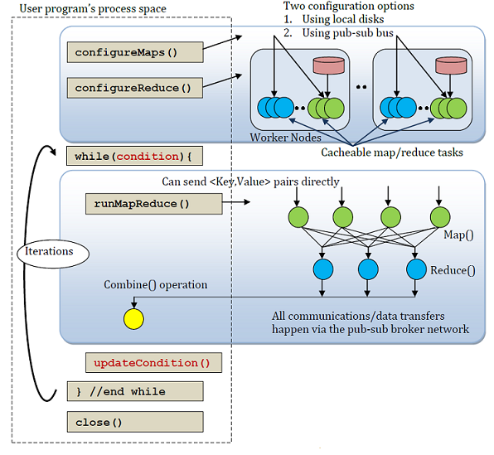
Twister

Slide 61
Performance Improvement of TWISTER
Cacheable map/reduce task
Cache static data in each iteration
Combine step
Use pub/sub messaging for data communication instead of via file systems
Data access via local disks

Slide 62
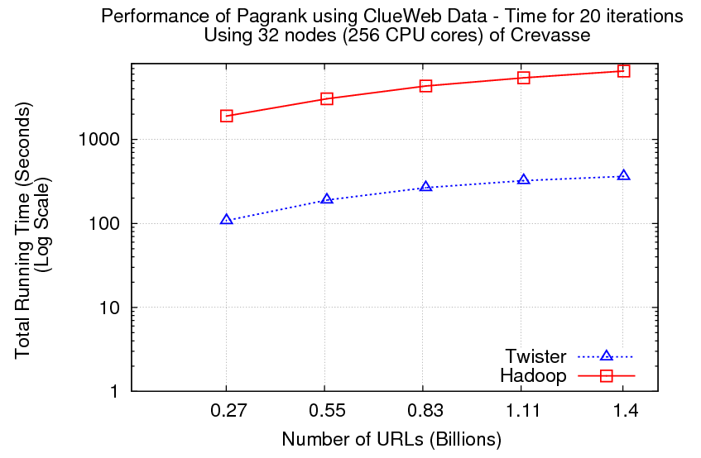
Well-known pagerank algorithm [1]
Used ClueWeb09 [2] (1TB in size) from CMU
Twister is an implementation of iterative MapReduce
Reuse of map tasks and faster communication pays off

Slide 63
What is M2M ?
M2M is a translator for translating Matlab codes to Hadoop MapReduce codes.

Slide 64
Why M2M?
X-to-MapReduce (X is a program language) translator is a possible solution to help traditional programmers easily deploy an application to cloud systems.
Existing translators, like Hive, YSmart focus on translating SQL-like queries to MapReduce.
M2M focus on Numerical Computation to MapReduce.

Slide 65
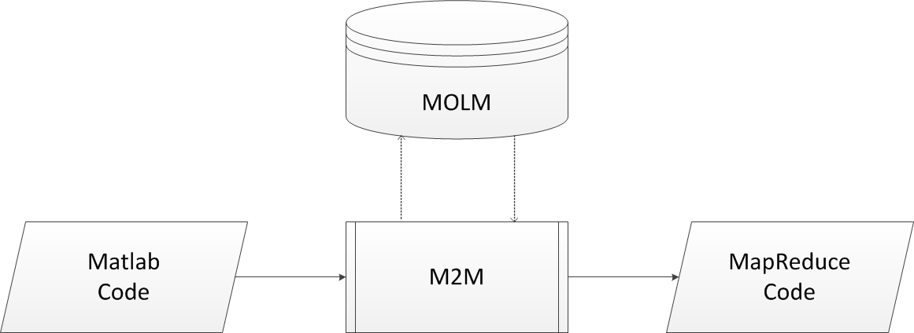
Single command to MapReduce
MOLM: Math Operation Library based on MapReduce

Slide 66
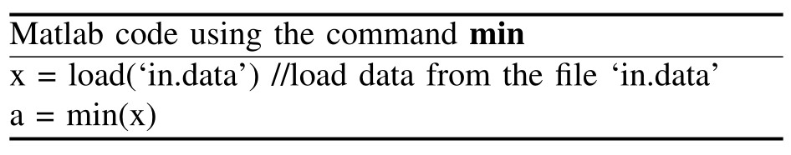
Example: A simple Matlab code to Hadoop MapReduce code

Slide 67
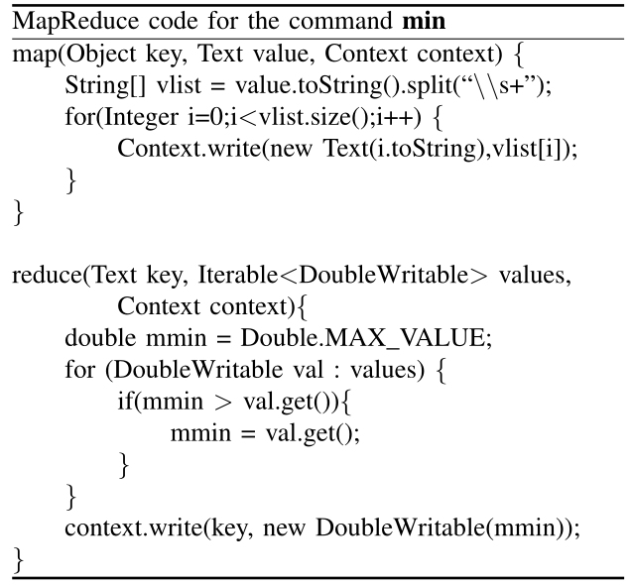
Example: A simple Matlab code to Hadoop MapReduce code

Slide 68
Translation Example
Example: 5 MATLAB commands
MATLAB code’s length: 6 → HADOOP MAPREDUCE code’s length: 348

Slide 69
MATLAB code
x = load("matrix.data") m_min = min(x); m_max = max(x); m_mean = mean(x); m_length = length(x); m_sum = sum(x);

Slide 70
package cs.gsu.edu.m2m.auto;
import java.io.*;
import java.util.*;
...
...
import org.apache.hadoop.fs.*;
public class Ex5Cmds extends Configured implements Tool {
public static class MinMap extends Mapper<Object, Text, Text, DoubleWritable>{
...
}
public static class MinCombine extends Reducer<Text,DoubleWritable,Text,DoubleWritable> {
...
}
public static class MinReduce extends Reducer<Text,DoubleWritable,Text,DoubleWritable> {
...
}
public static class MaxMap extends Mapper<Object, Text, Text, DoubleWritable>{
...
}
public static class MaxCombine extends Reducer<Text,DoubleWritable,Text,DoubleWritable> {
...
}
public static class MaxReduce extends Reducer<Text,DoubleWritable,Text,DoubleWritable> {
...
}
public static class MeanMap extends Mapper<LongWritable, Text, Text, Text> {

Slide 71
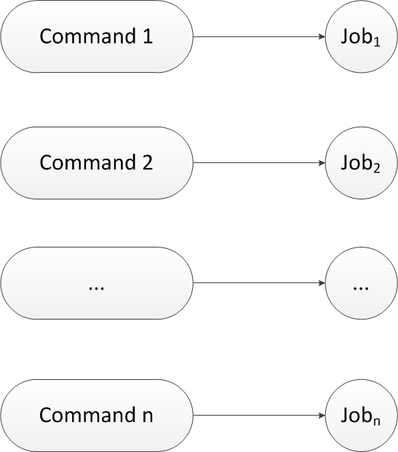
Independent commands to MapReduce

Slide 72
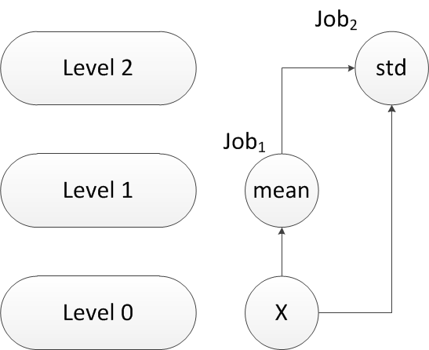
Dependent commands to MapReduce Matlab command std: 2-level view

Slide 73
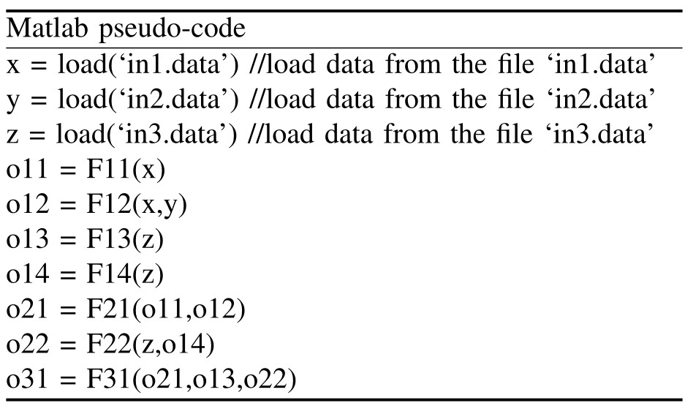
Example: Matlab code with multiple dependent commands
Notes:
F11, F12, F13, F14, F21, F22, and F31 are Matlab commands.

Slide 74
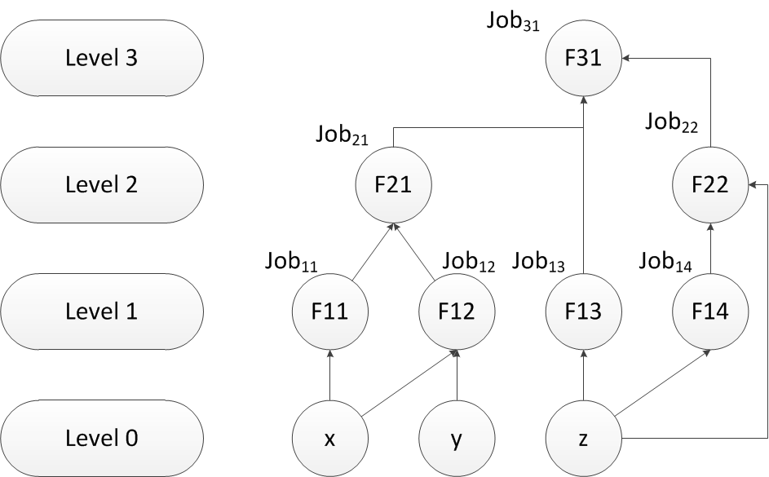
Build multi-level dependency graph

Slide 75
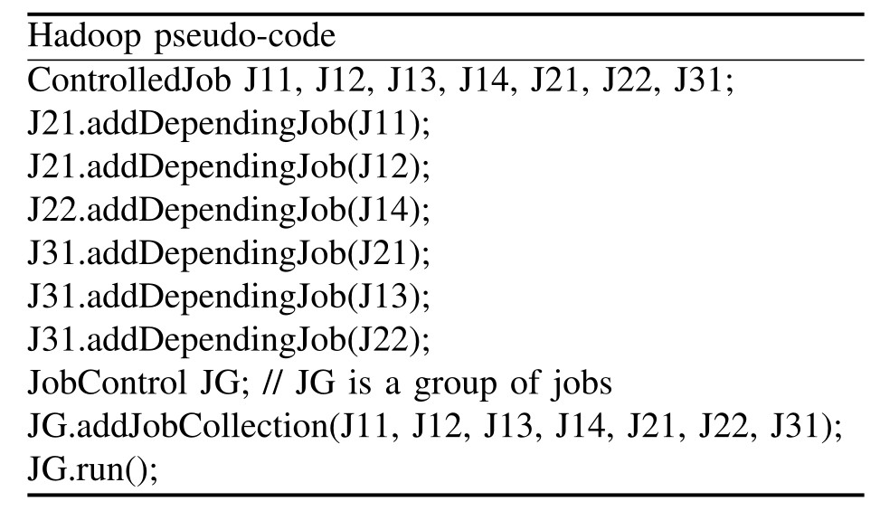
Generate Hadoop MapReduce Code

Slide 76
Experimental Setting
A local cluster: Cheetah at GSU http://help.cs.gsu.edu/cheetah
We uses five nodes, each has
Memory: 16 GB
CPUs: AMD Opteron 2376 (8 cores, 2.3 GHz)
One node is used to run JobTracker
The other four 8-core nodes are used to run TaskTracker, each is configured to provide 8 task slots – 4 for Map and 4 for reduce (1 task per core)

Slide 77
Simple Scheduling
Initially, 15 Map tasks are created (based data size and parameter setting)
Since we have 16 cores (16 tasks) for MAP tasks, one core is idle and can be allocated to the next job (MATLAB command).
Then FCFS allocation for the following commands
Similarly for REDUCE tasks – FCFS
Not perfect for load balancing – future research

Slide 78
Runtime & Data Set
MapReduce runtime system: Hadoop 1.0.1 & JDK 1.7.0_05
Data set: 200000×1000 matrix and its size is 933MB.

Slide 79
M2M vs. Hand-coded

Slide 80
M2M With vs. W/O task parallelism on independent commands

Slide 81
M2M With vs. W/O task parallelism on dependent commands

Slide 82
Future Work
M2M is still at early stages and only supports some basic Matlab commands.
To do
Support loop commands
Enhance MOLM (Math Operation Library based on MapReduce)
Use XML as an intermediate language

Slide 83
Bulk Synchronous Processing Model
BSP is a decomposition explicit, mapping implicit model with communication being implied by the location of the processes and synchronization taking place across the whole program.

Slide 84
BSP
BSP (abstract) program consists of processes and divided into supersteps.
Each superstep consists of:
a computation where each processor uses only locally held values,
a global message transmission from each processor to any subset of the others and
a barrier synchronization.

Slide 85
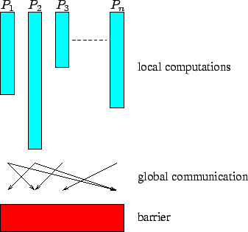

Slide 86
BSP
The barrier synchronization takes place at regular intervals of time units.
After each period of time units, if all processors have finished their work (are synchronized) then the machine proceeds to the next superstep, otherwise the current superstep is continued in the next time units.

Slide 87
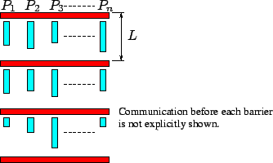

Slide 88
Communication Optimization
Communication all happens together at the end of each superstep, automatic optimization of the communications pattern is possible
bundle the messages together
reshuffled to avoid network congestion
intelligent routing to avoid hot spots

Slide 89
Automatic Translation
Automatic translation for certain programming languages
SQL to MapReduce
Mathlab to MapReduce
Translation among different cloud codes (see example later)
Simple loops to MapReduce – similar to OpenMP
BSP to cloud software?

Slide 90
Domain Specific Framework
No need to code in MapReduce, only filling the details of a framework for certain applications with common characteristics:
K-Mean Clustering
PDE solver
Simulation and modeling
Analysis of large social networks
Biological network analysis

Slide 91
Simple MPI API
Implement MPI API on Azure or MapReduce
Easy to code
Easy to translate legacy MPI code
Ignore all details such as Queue, Table or Blob
Automatic translation of legacy MPI codes

Slide 92
Twister to Twister4Azure
Developers need to code in Java and C# for Twister and Twister4Azure
Automatic translation will help
Users need only learn one language to code and can still run on different platforms.

Slide 93
Parallel Computing on Cloud
Current clouds are mainly for data applications and data centers
If MPI, Globus, OpenMP are no longer supported by vendors, parallel computing may become a problem on clouds
Vendors will lose a large portion of customers
It is a trend to consider more broadly including scientific computing

Slide 94
Conclusions
Cloud computing has been a commercial success for data-parallel applications
Its use in speeding up scientific computing applications is still in its infancy.

Slide 95
Conclusions
We propose a few approaches
Extension of current models
Automatic translation
New programming models
Redesign of parallel algorithms
We firmly believe that cloud computing will be a success not only in data-intensive applications, but also in compute-intensive applications in the near future.

Slide 96
Grid vs Cloud Computing
Grid adopts a socialist economic model
Resources are pooled together by authority and on a voluntary base
More successful in China
Cloud computing adopts a capitalist economic model
Pay per use and profit
More suitable in USA

