Slide 1
analytical text detection system
By timur Ionov Ics9-61b
Superviser: kharitonova A.V.

Slide 2
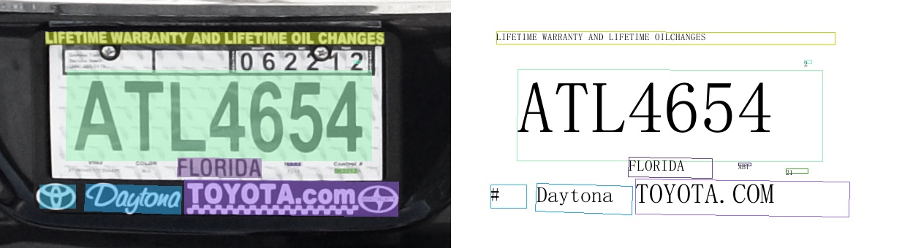
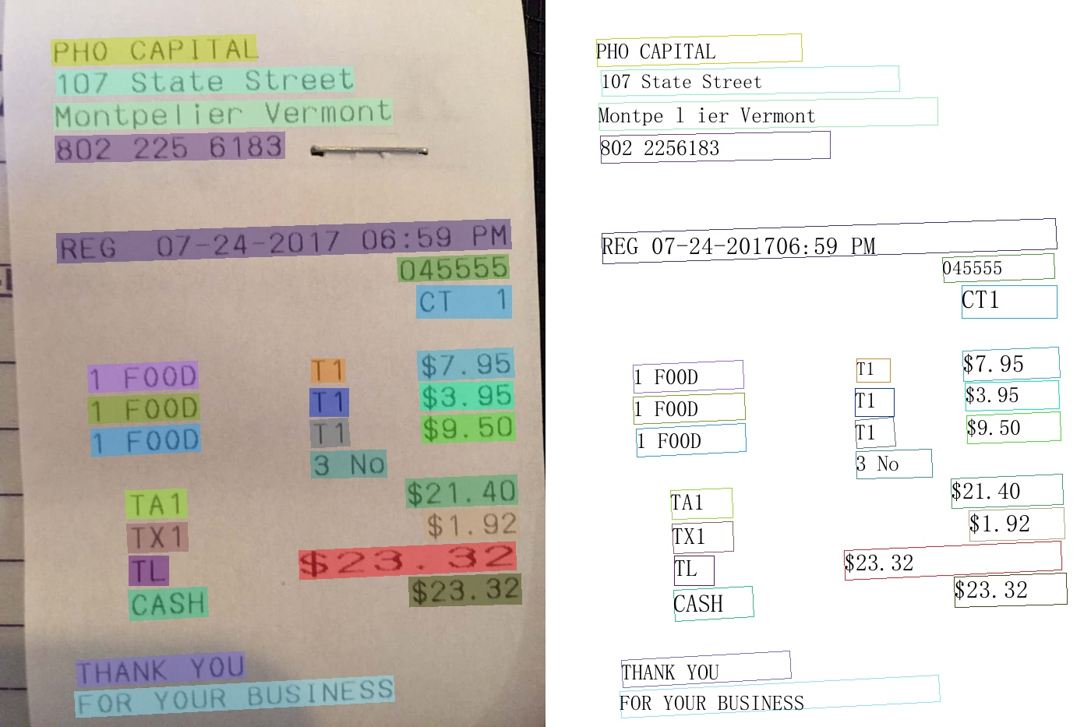
Use cases
- Healthcare
- Banking
- State institution
- Post

Slide 3
challenges in text detection
- Poor image quality
- Skew document orientation
- Variety document structure
- Hard - to - separate structural elements

Slide 4
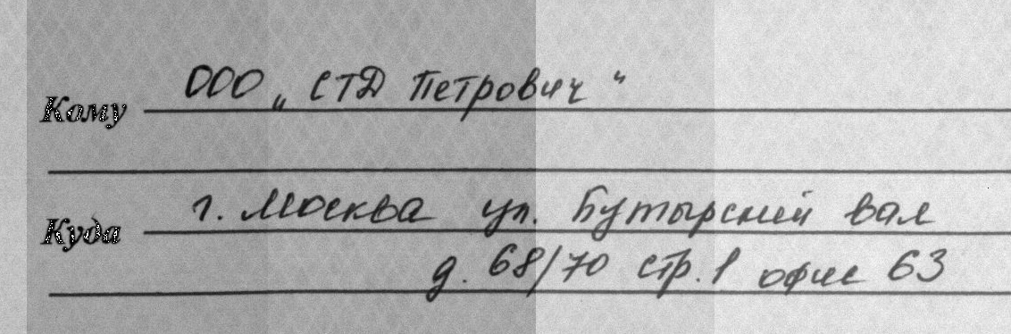
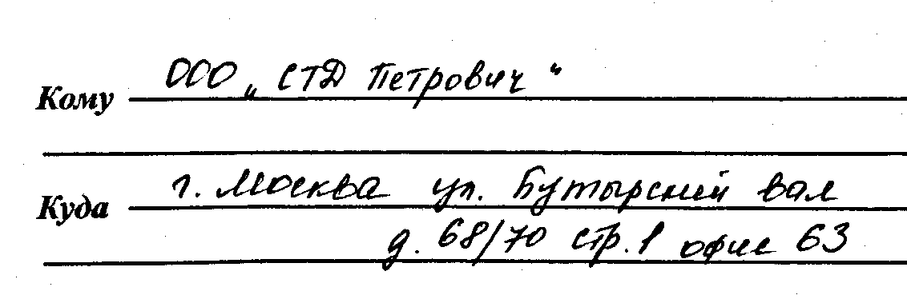
Adaptive binarization
Adaptive binarization determines the threshold for a pixel based on a small region around it.

Slide 5
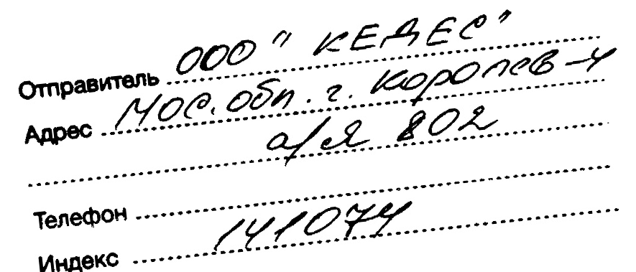
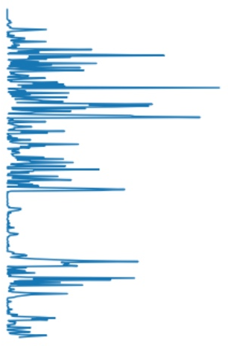
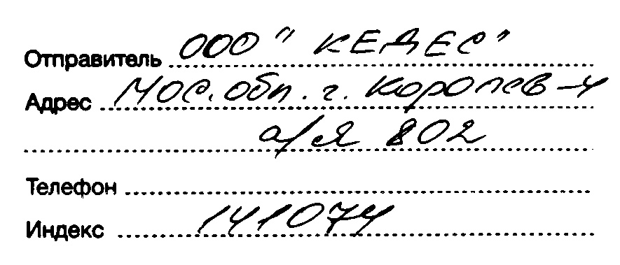
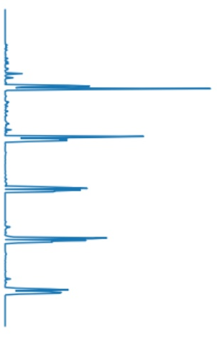





Skew correction
score $=0.8 ∗{10}^{9}$
$${10}^{7}$$
check every angle in range from -10 to +10, trying maximize score
$$score=\sum_{i=1}^{n}{{({row}_{i} −{row}_{i−1})}^{2}}$$
score $=3.5 ∗{10}^{9}$
$${10}^{9}$$

Slide 6
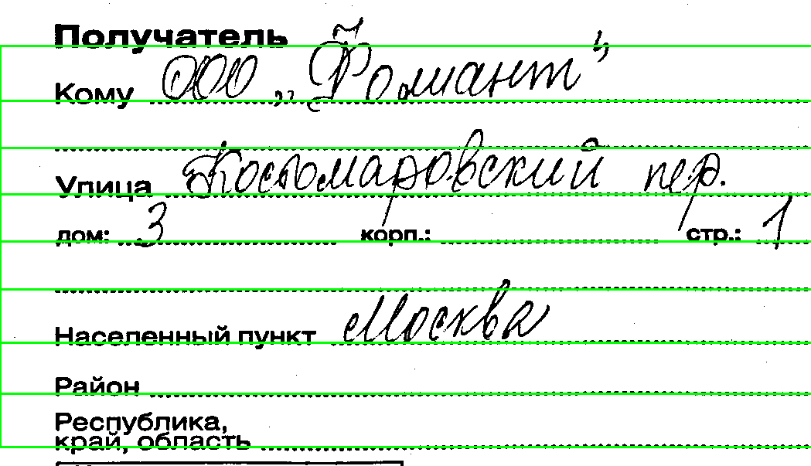
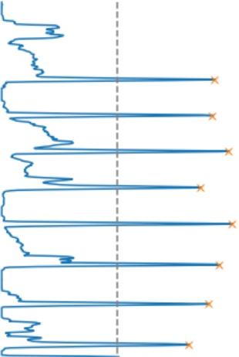
Lines extraction
Extract the highest peaks on histogram – lines with the highest black pixel concentration

Slide 7
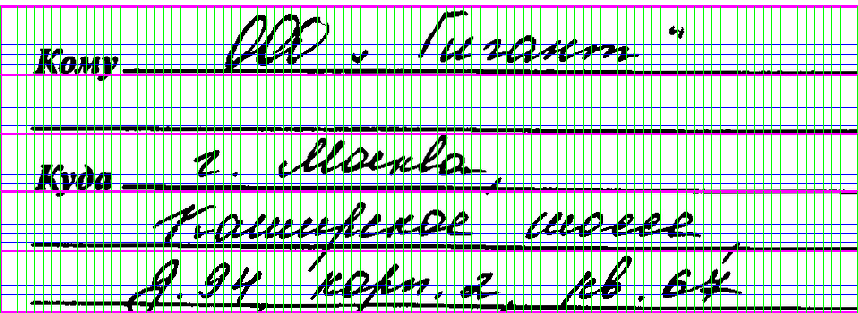
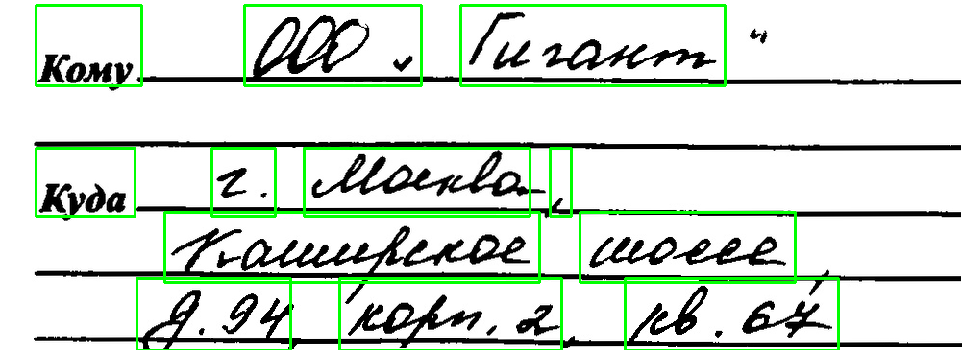
sentences extraction
Splitting each line into blocks size of 1% image width. Merging non-empty adjacent blocks.

Slide 8
summary
Today, we’ve looked at analytical text detection system including following steps:
- Adaptive binarization
- Skew correction
- Lines extraction
- Sentences extraction

Slide 9
Thank you for your attention
Mail: t-ionov@list.ru
github.com/sir-timio

