Slide 1
Presentation
Support Agent

Slide 2
Table of Content
Agent Core
Backend
Frontend

Slide 3
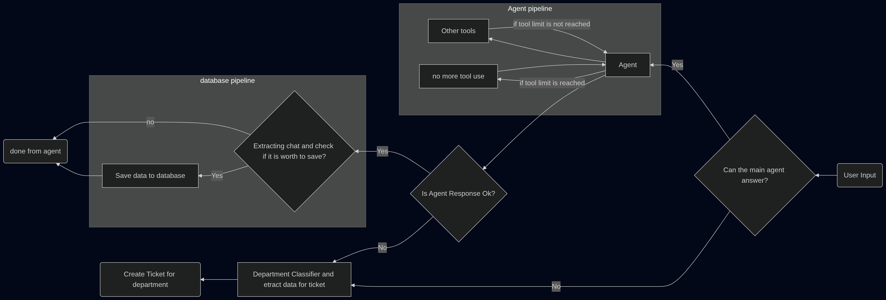
Agent Core

Slide 4
Agent Core
How agent uses PostgreSQL database?
Agent uses PostgreSQL database as an AsyncSaver and AsyncStore.
It can handel it by itself because we pass it autocommit argument with True.

