Slide 1
Data Manipulation Language

Slide 2
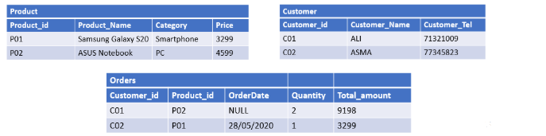

Slide 3
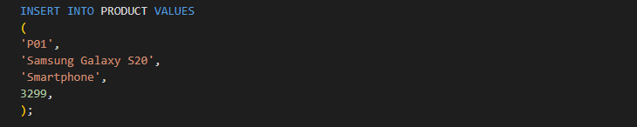
Insert in table product

Slide 4
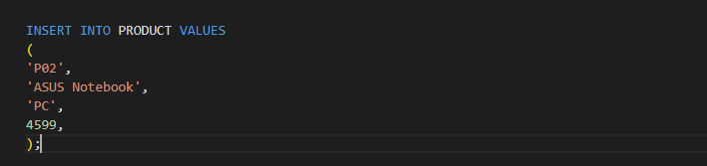
Insert in table Product

Slide 5
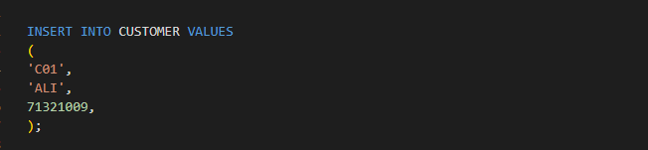
Insert in table Customer

Slide 6
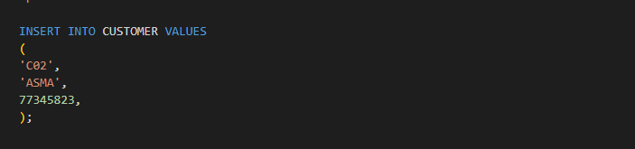
Insert in table Customer

Slide 7
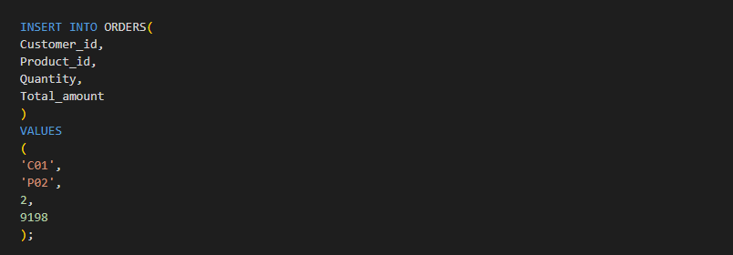
Insert in table Orders

Slide 8
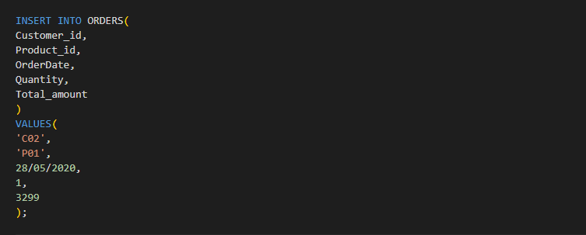
Insert in table Orders

