Slide 1

INSY 669 Text Analytics Group Assignment 2
Ali Al Samuraee
Cristina Esposito
Alya Gabsi
Siraj Hatoum
Yashica NA

Slide 2
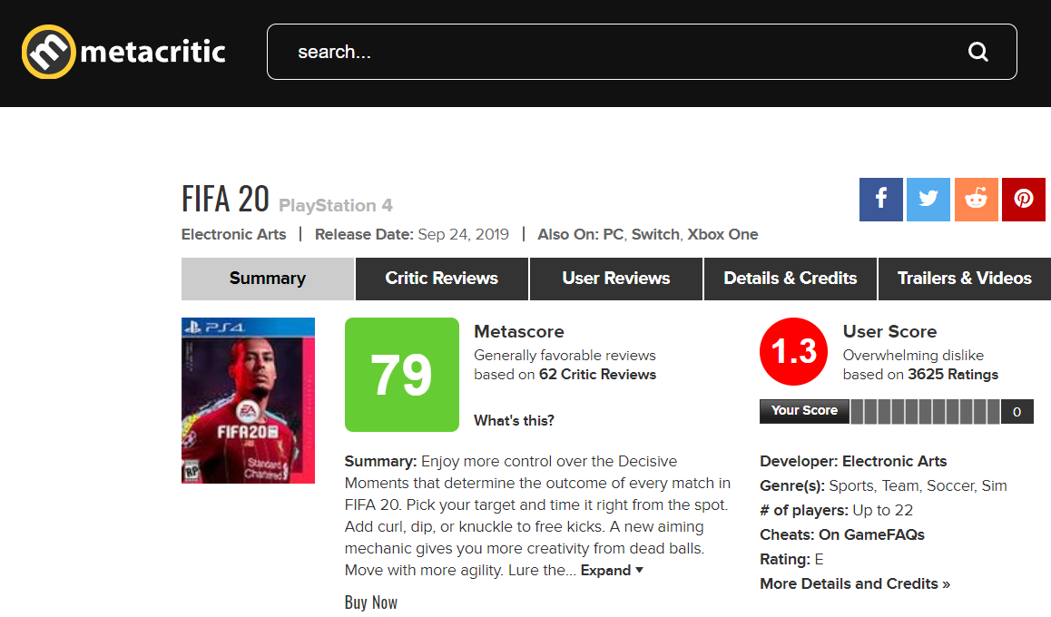
General Overview
Industry Context
Data Generator
In recent years the growth of the industry has accelerated due to Covid related to stay-at-home advisories and lockdowns. Video games emerged as a tool to “connect with friends remotely and socialize online.” (Statista, 2020)
10.5%
Metacritic is a review aggregator much like Rotten Tomatoes, that generates an overall rating (metascore) based on the mean rating provided by multiple independent publications. Through incorporating the outlook of multiple sources, this reduces potential bias and increase reader confidence in the critic score.
One popular source of consumer information is the published game review, which provides in-depth analysis of gameplay experience from an experienced journalist. A survey conducted in 2016 revealed that 26% of participants frequent these gaming publications to inform their purchasing decisions. (Statista, 2017)
Notes:
45 seconds

Slide 3
Project Overview
Problem Statement
Solution Approach
Lack of transparency when using the metascore as a key metric
Does not provide enough information to guide consumer purchase decisions
Absence regarding the strength and weaknesses of the game which are often weighted differently based on customer preference
Topic modeling: Identify a list of game-defining attributes and the words most associated with them in critic reviews.
Topic-to-word mapping: Extract text segments that are related to each topic.
Sentiment analysis: Produce a sentiment score on each segment, then aggregated by game to arrive at a rating for each identified attribute.
→ Attribute values (AV)
Metascore prediction modeling: Enhance a baseline prediction model using attribute values and compare feature importance.
Goal: Assess predictive value of insights and relative importance of each game attribute in perceived quality
Game clustering and recommendation: Perform clustering and similarity analysis using attribute values.
Goal: Evaluate validity of the insights as features for user recommendations
Time series analysis: Descriptive analysis of multiple releases of a game franchise.
Goal: Provide insights into the evolution of a brand.
Project Objective
Improve UX of Metacritic readers
By providing separate ratings on a number of game attributes (e.g. visuals, narrative, technical performance) based on each game’s review blurbs.
The feature will be implemented using text analytics techniques to automate the process and reduce overhead cost of updating and maintaining these scores.
Notes:
1:15

Slide 4
Attribute values process results
Topic to-word-mapping
Sentiment Analysis
OBJECTIVE
Identify the game attributes most frequently discussed in critic reviews and the words that are related to them
Provide Metacritic readers with a deeper understanding of the different components of games through attribute specific sentiment scoring
Apply topic modelling to the processed critic reviews
Manually inspect the topic groupings to validate topic number parameter
Define generated topics based on their associated words and extracted topics that are related to game attributes
Develop the attribute specific sentiment scores for each game using VADER with neighboring words (5-grams)
Aggregation of scores to compute the average sentiment score per attribute per game
APPROACH
Generate topic to word-mapping (17 attributes) for attribute specific scoring
Positive score: Metacritic users that critic reviewers are positively judging that game’s attribute
Negative score: Metacritic users that critic reviewers are negatively judging that game’s attribute
OUTCOME
Notes:
1

Slide 5
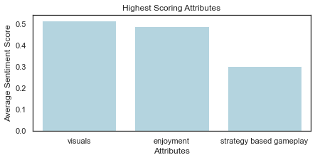
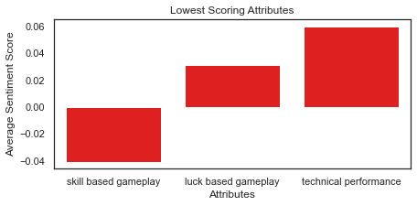
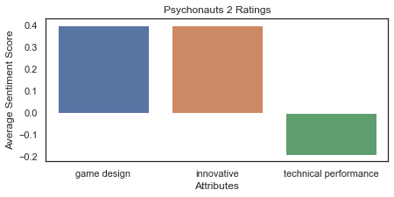
Attribute values process results
Topic to-word-mapping
Sentiment Analysis
Attribute | Related Words | Example
game design | 18 | gameplay
innovative | 13 | inspiration
enjoyment | 11 | fun
tone | 11 | sad
technical performance | 8 | issue
skill based gameplay | 7 | shooter
narrative | 6 | storyline
world building | 6 | openworld
visuals | 6 | aesthetic
strategy based gameplay | 6 | strategy
playthrough time | 6 | time
difficulty | 4 | challenge
value | 2 | money
multiplayer | 2 | coop
sound track | 1 | music
Notes:
1

Slide 6
Prediction Modeling
To validate the value of insights provided by the attribute-specific sentiment scores per game, we have decided to run a multivariate linear regression model based on our 15 ranking metrics.
VADER fails multiple times at identifying the true sentiment of reviews
Rsquared : 0.080
We have performed our text analysis on review snippets and not on full reviews
Although, a low R square, the model is significant at 5% level, we assume that our model is incomplete and missing other attributes.
However, three attributes stand out as relevant.
1
0.1116 : The more a game is positively seen as being strategy focused, the more likely it is given a higher score by critic reviewers
Strategy-based gameplay (7.0%)
2
-0.1008: The more a game is positively seen as being innovative, the less likely it is given a higher score by critic reviewers
Innovative (8.1%)
3
Technical performance (0.8%)
-0.1515: The more a game is seen as having less technical issues, the less likely it is given a higher score by critic reviewers
Notes:
1 min
1. Since vader was used to compute our attribute specific sentiment scores, one could argue that the model’s poor performance could be attributed to that.
2. Performing sentiment analysis on review snippets may fail to capture the true sentiment of critic reviewers for a given game.

Slide 7
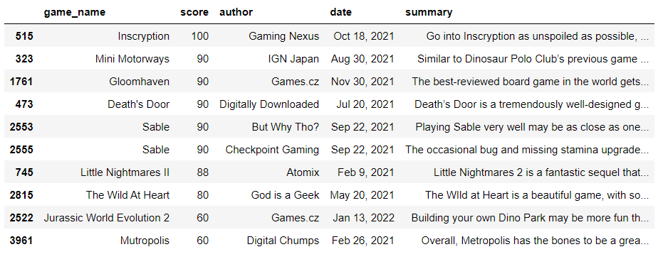
User Search Recommendation
Process:
Get user input
Count vectorizer on lemmatized reviews
Cosine similarity
Output positive reviews that are most similar
Overall benefit: improves user experience on Metacritic by allowing users to broaden their search criteria

Slide 8
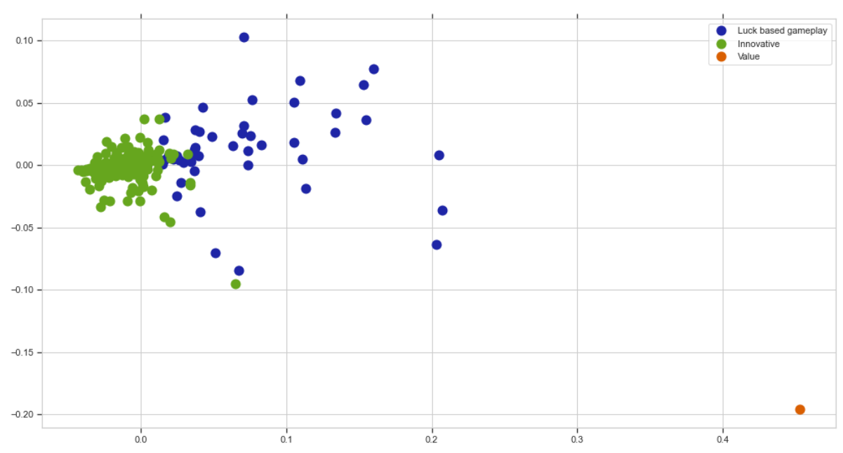
Clustering Recommendation
Process:
Count vectorizer on lemmatized reviews
Filter for positive reviews
Group word frequencies by topic
Cosine similarity
Kmeans cluster with elbow method (3 clusters)
Plot clusters based on similarity
Overall benefit: allows user to search games with similar cluster topics
Notes:
1 mintue

Slide 9
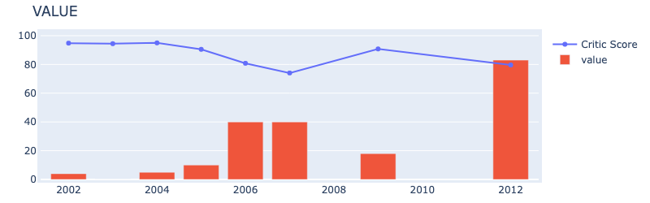
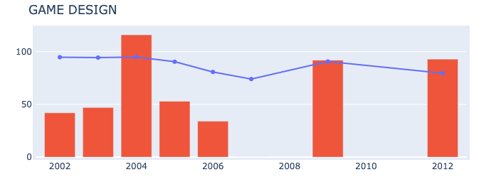
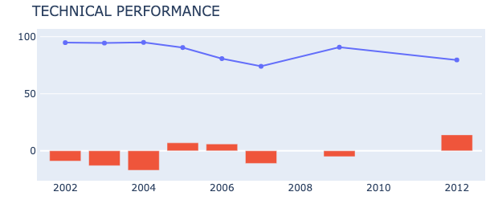
Time Series Analysis
Time series analysis
OBJECTIVE
Analyse the improvements in the game attributes for a game, in this case Grand Theft Auto, over the years.
Scrape reviews for all releases and apply topic modelling to the processed critic reviews
Sentiment analysis on the extracted topics that are related to game attributes.
Plot the sentiment score for game releases over the year
APPROACH
The technical performance has improved over the years. Game design seems to be an important attribute for critics. The overall value of the latest release has a high sentiment score compared to those launched before 2012.
OUTCOME
Notes:
30 seconds to 1 minute

Slide 10
Questions?

Slide 11
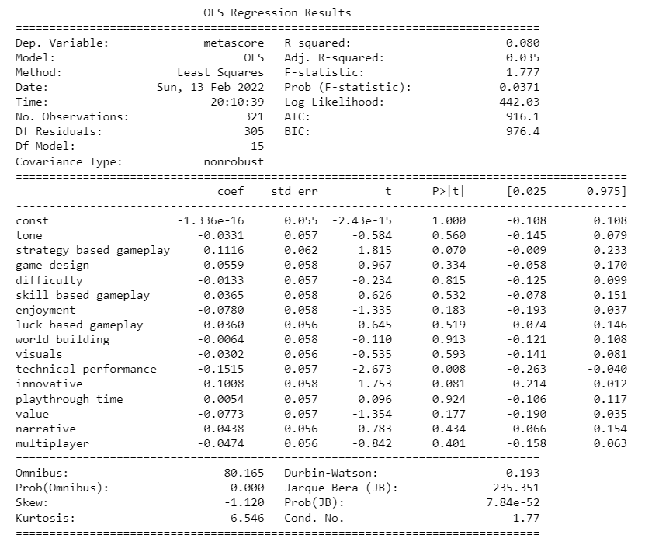
Appendix: Modeling Analysis
Notes:
30 seconds to 1 minute

