Slide 1
The Running Project
By: Jeremy Gonzalez, Abdulaziz Siraj, Seungyoon Choe

Slide 2

Overview
The Running Project is a fitness app specific to running and the runner community (new and experienced).
Gives the user the tools to improve to reach a goal
User profile to determine
Current running level (beginner, advanced, etc.)
User’s goal
Interacts with user
Set’s up a personalized workout schedule

Slide 3
App Architecture
Main Activity: Holds basic variables of your user profile
Your Goal: Holds info about your goal
Final: Reads inputs from Main Activity and Your Goal to print an output (your workout schedule)

Slide 4
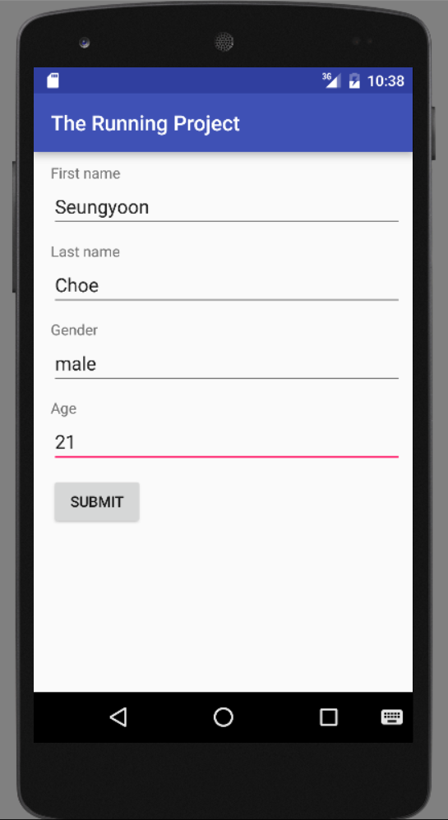
User’s Profile Setup
Asks User to input:
First Name
Last Name
Gender
Age
These values are written to the TextEdit class

Slide 5
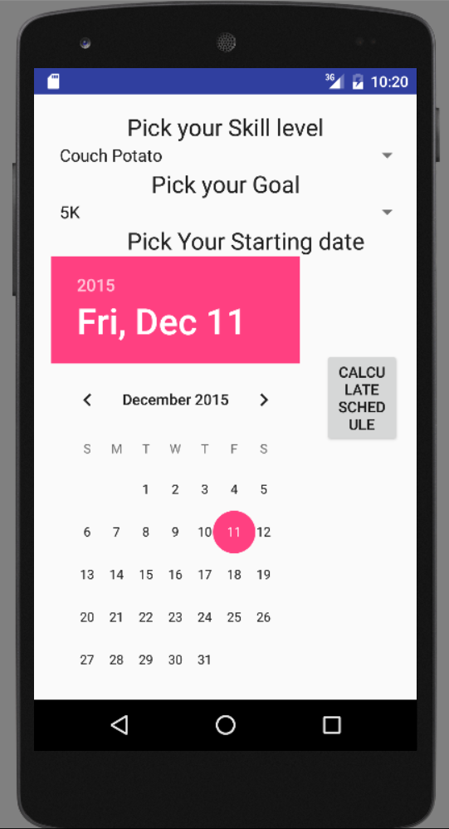
User’s Goals
User is then asked to input their goals based on
Skill Level
Distance Goal
Use of drop down menus
Start date
These values are also written to the TextEdit class

Slide 6
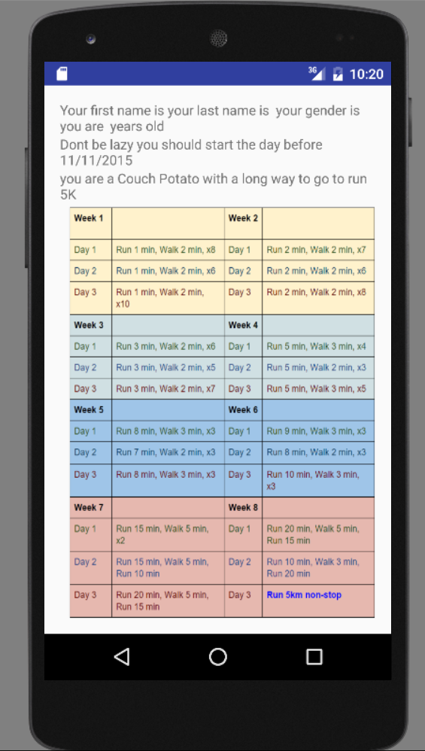
Output
Information from the User Profile derived from TextEdit class
Easy to follow workout program giving workouts
Separated into weeks
Workout corresponds to day

Slide 7
Accomplishments
Creating Basic Android application
User input
Reading
Manipulating for our purposes
Giving custom output based on user inputs
Calendar
Input of start date
Reading input to the user profile

Slide 8
Future Implementation
GPS tracker
Track how far you went
Tracks your pace
Workout Log
After your workout you can save what you ran and leave any comments about it (how you felt etc.)
Build a Community
Gets you connected with other runners around you
Share running routes
Set up meeting time to run with other people
Notifies you of upcoming races based on your goal
New found motivation by a possible partnership with a running company for coupons after you reach your goal!

Slide 9
Thank You!!!

