Slide 1
IOT Early Flood Detection & Avoidance
“IoT Early Flood Detection & Avoidance System” is an intelligent system which keeps close watch over various natural factors to predict a flood, so we can embrace ourselves for caution, to minimise the damage caused by the flood. Natural disasters like a flood can be devastating leading to property damage and loss of lives. To eliminate or lessen the impacts of the flood, the system uses various natural factors to detect flood. The system has a wifi connectivity, thus it’s collected data can be accessed from anywhere quite easily using IoT.
To detect a flood the system observes various natural factors, which includes humidity, temperature, water level and flow level. To collect data of mentioned natural factors the system consist of different sensors which collects data for individual parameters. For detecting changes in humidity and temperature the system has a DHT11 Digital Temperature Humidity Sensor

Slide 2
It is a advanced sensor module with consists of resistive humidity and temperature detection components. The water level is always under observation by a float sensor, which work by opening and closing circuits (dry contacts) as water levels rise and fall. It normally rest in the closed position, meaning the circuit is incomplete and no electricity is passing through the wires yet. Once the water level drops below a predetermined point, the circuit completes itself and sends electricity through the completed circuit to trigger an alarm. The flow sensor on the system keeps eye on the flow of water. The water flow sensor consists of a plastic valve body, a water rotor, and a hall-effect sensor. When water flows through the rotor, rotor rolls. Its speed changes with different rate of flow.
The system also consist of a HC-SR04 Ultrasonic Range Finder Distance Sensor. The Ultrasonic sensor works on the principle of SONAR and is designed to measure the distance using ultrasonic wave to determine the distance of an object from the sensor. All the sensors are connected to Arduino UNO, which processes and saves data. The system has wifi feature, which is useful to access the system and its data over IoT.

Slide 3
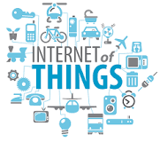
The Internet of Things (IOT), is the network of physical objects or "things" embedded with electronics, software, sensors, and network connectivity, which enables these objects to collect and exchange data.
The Internet of Things allows objects to be sensed and controlled remotely across existing network infrastructure, creating opportunities for more direct integration between the physical world and computer-based systems, and resulting in improved efficiency, accuracy and economic benefit. Each thing is uniquely identifiable through its embedded computing system but is able to interoperate within the existing Internet infrastructure. Experts estimate that the IOT will consist of almost 50 billion objects by 2020.

Slide 4
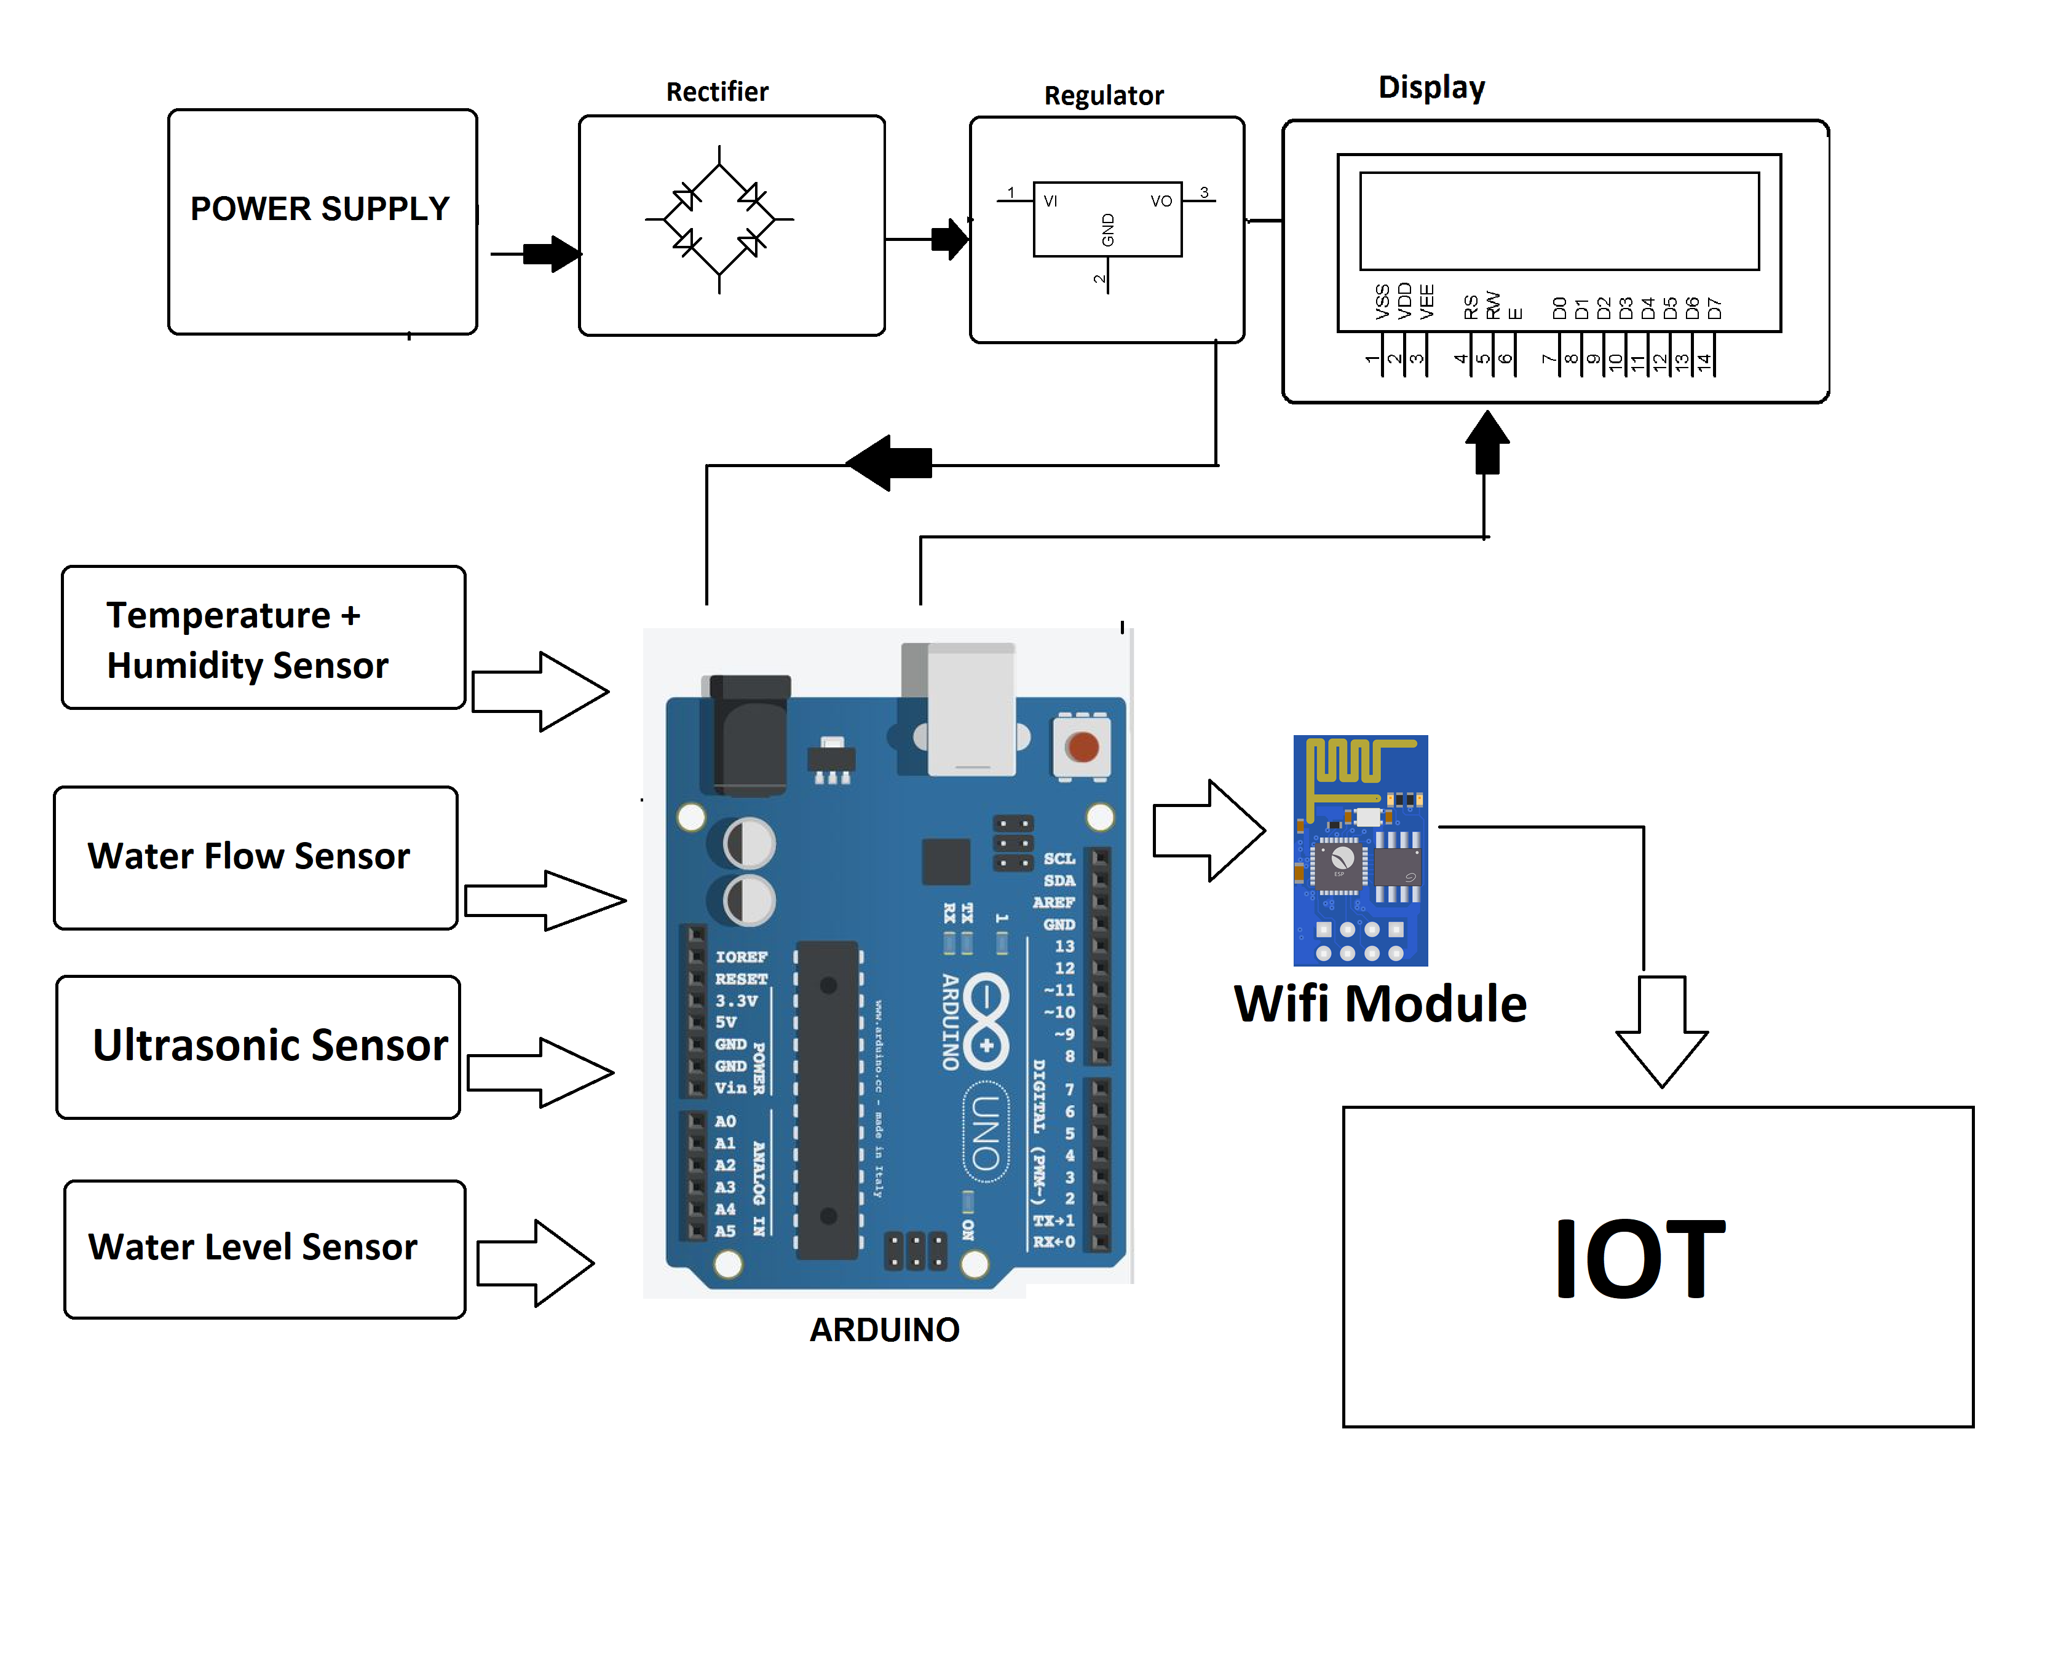

Slide 5

Project Development Stages
Choosing Microcontroller
Circuit Design
Components Procurement
Soldering
Testing for Connectivity & Issues
PCB Printing
Coding

Slide 6
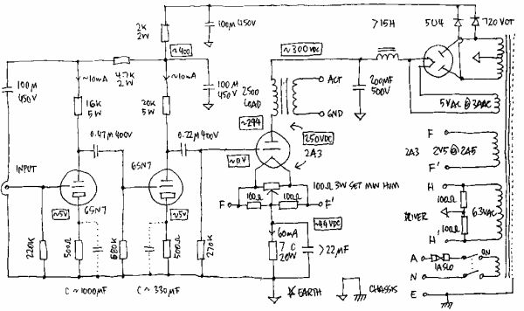
Circuit Design
A circuit is actually any loop through which matter is carried. For an electronic circuit, the matter carried is the charge by electronics and the source of these electrons is the positive terminal of the voltage source .When this charge flows from the positive terminal, through out the loop and reaches the negative terminal, the circuit is said to be completed. However this circuit consists of a number of components which affects the flow of charge in many ways. Some may provide hindrance to the flow of charge, some simple store or dissipate charge. Some require external source of energy, some supply energy.
Circuit Design Tools:
Eagle, Kicad, Proteus
Circuit Digest Capacitor Calculator

Slide 7
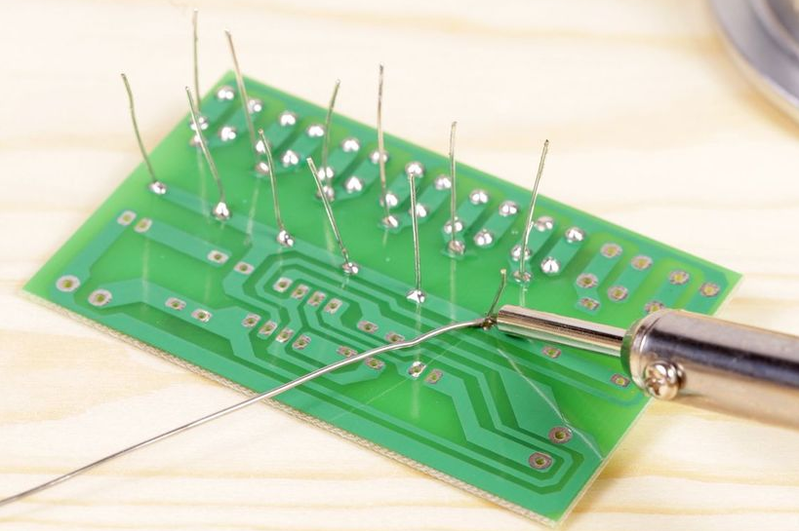
Soldering
With silver soldering, small pieces of solder wire are placed onto the metal prior to heating. A flux, often made of boric acid and denatured alcohol, is used to keep the metal and solder clean and to prevent the solder from moving before it melts.

Slide 8
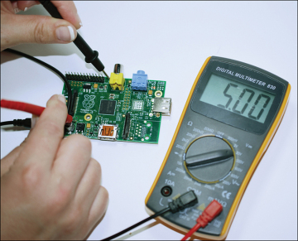
Testing for Connectivity & Issues
Testing Tools:
Multimeter
Power Supply
Oscilloscope

Slide 9
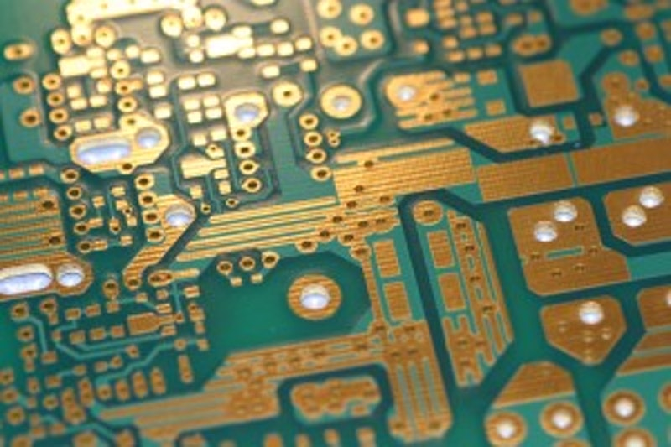
PCB Printing
A printed circuit board mechanically supports and electrically connects electronic components or electrical components using conductive tracks, pads and other features etched from one or more sheet layers of copper laminated onto and/or between sheet layers of a non-conductive substrate.

Slide 10

Coding
A code editor is also called an integrated development environment, or IDE. An IDE is a software application for formatting your code, checking syntax, as well as running and testing your code. Some IDEs can work with multiple programming languages, while some are very specific for only one language

Slide 11
HARDWARE REQUIREMENTS
ATmega328P Microcontroller
DHT11 Temperature + Humidity sensor
Water flow sensor
Ultrasonic sensor
Lcd
Wifi module
Resistors
Capacitors
Push Button
Crystal Oscillator
Cables & Connectors
Diodes
PCB
LED’s
Transformer/Adapter

Slide 12
Atmega328P Microcontroller
The high performance Microchip 8-bit AVR RISC-based microcontroller unites 32KB ISP flash memory with read-while-write capabilities, 1KB EEPROM, 2KB SRAM, 23 general purpose I/O lines, 32 general purpose working registers, three adjustable timer/counters with compare modes, internal and external interrupts, serial programmable USART, a byte-oriented 2-wire sequential interface, SPI serial port, 6-channel 10-bit A/D converter (8-channels in TQFP and QFN/MLF packages), programmable watchdog timer with internal oscillator, and five software selectable power saving modes.

Slide 13
Why Atmega328P Microcontroller ?
23 general purpose I/O lines
A 6-channel 10-bit ADC (analog input)
6 output PWM channels(analog output)
A serial programmable USART
This allows very fast start-up combined with low power consumption
Easily available in Market
Low Cost and easy to use

Slide 14
Atmega328P Working & Features
Program Memory Type | Flash
Program Memory Size (KB) | 32
CPU Speed (MIPS/DMIPS) | 20
SRAM Bytes | 2,048
Data EEPROM/HEF (bytes) | 1024
Digital Communication Peripherals | 1-UART, 2-SPI, 1-I2C
Capture/Compare/PWM Peripherals | 1 Input Capture, 1 CCP, 6PWM
Timers | 2 x 8-bit, 1 x 16-bit

Slide 15

Software Requirements
The Arduino integrated development environment is a cross-platform application that is written in the programming language Java. It is used to write and upload programs to Arduino board. The source code for the IDE is released under the GNU General Public License.
Easy to Program and Use
Efficiency in embedded development and embedded learning

Slide 16
Software Requirements
The Arduino project provides the Arduino integrated development environment (IDE), which is a cross-platform application written in the programming language Java. It originated from the IDE for the languages Processing and Wiring. It is designed to introduce programming to artists and other newcomers unfamiliar with software development. It includes a code editor with features such as syntax highlighting, brace matching, and automatic indentation, and provides simple one-click mechanism to compile and load programs to an Arduino board. A program written with the IDE for Arduino is called a "sketch".
The Arduino IDE supports the languages C and C++ using special rules to organize code. The Arduino IDE supplies a software library called Wiring from the Wiring project, which provides many common input and output procedures. A typical Arduino C/C++ sketch consist of two functions that are compiled and linked with a program stub main() into an executable cyclic executive program:

Slide 17
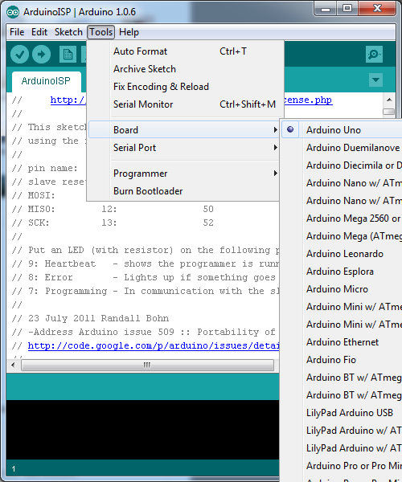
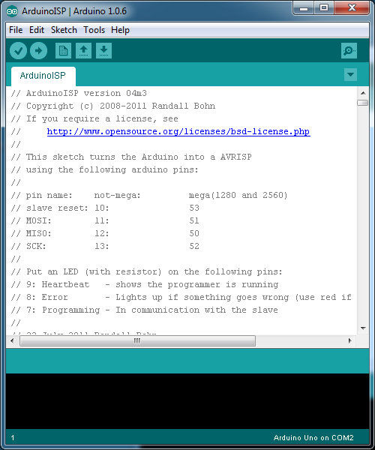
After compiling and linking with the GNU toolchain, also included with the IDE distribution, the Arduino IDE employs the programavrdude to convert the executable code into a text file in hexadecimal coding that is loaded into the Arduino board by a loader program in the board's firmware.
Arduino programs may be written in any programming language with a compiler that produces binary machine code. Atmel provides a development environment for their microcontrollers, AVR Studio and the newer Atmel Studio, which can be used for programming Arduino.

Slide 18
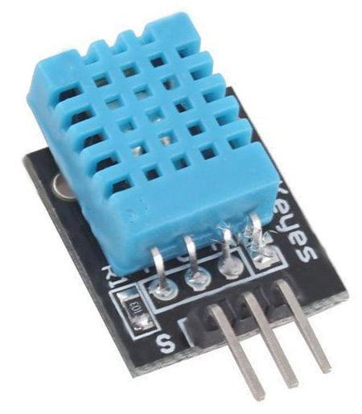
DHT11 Digital Temperature Humidity Sensor
The sensor module consists of resistive humidity detection components and ntc temperature testing The perfect computerized temperature sensing sensor module is associated with 8-byte mcu
The perusing made by DHT11 is extremely compact and stable; however, the client needs to refresh the perusing of the sensor in each 2 sec with a specific end goal to stay away from past signal gathering of information.
The sensor is versatile and very steady, can be utilized for embedded gadgets for weather observing and similar kinds of utilizations. Single information line is utilized for recovering the estimation made by the sensor.

Slide 19
DHT11 Specifications:
Operating Voltage: 3.5V to 5.5V
Operating current: 0.3mA (measuring) 60uA (standby)
Output: Serial data
Temperature Range: 0°C to 50°C
Humidity Range: 20% to 90%
Resolution: Temperature and Humidity both are 16-bit
Accuracy: ±1°C and ±1%

Slide 20
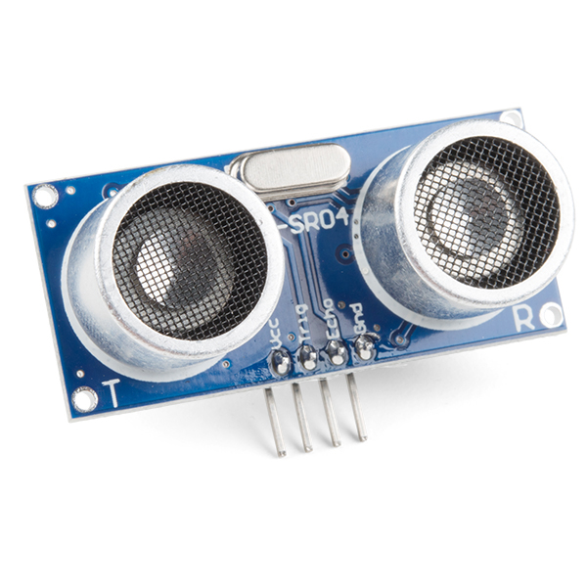
HC-SR04 Ultrasonic Module
The HCSR04 measures object distance using ultrasonic ranging. It offers incredible range accuracy and stable readings in a simple to-use bundle. It 's working isn 't influenced by daylight or dark material like sharp range discoverers are (delicate materials like fabric can be hard to distinguish).
The fundamental basic principle of operation is beneath, use IO port TRIG to trigger running. It needs 10 us abnormal state signal in any event module will send eight 40kHz square wave automatically and will test if there is any signal returned. In the event that there is signal returned, yield will be abnormal state signal through IO port ECHO. The span of the abnormal state signal is the time from transmitter to getting with the ultrasonic. Testing separation = length of abnormal state x sound velocity(340m/s)/2 You can use the above figuring to discover the separation between the impediment and the ultrasonic module.

Slide 21
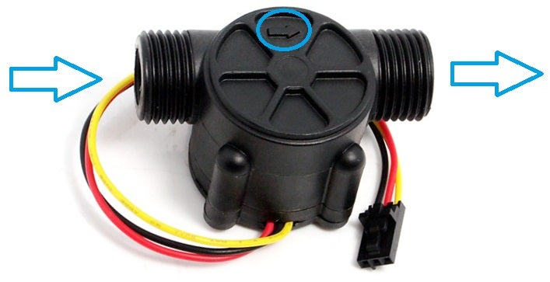
Water Flow Sensor
Water flow sensor may be utilized to assess the flow of liquids, i.e. the usage of fluids in domestic or industrial use. By way of instance, you may earn a custom cocktail dispensing machine, also may use this sensor to accurately quantify components like Soda, Water, etc.. Water flow sensor is made up of plastic valve system, a water rotor, plus a hall-effect detector. Its rate varies with another speed of flow. The hall-effect sensor outputs the corresponding heartbeat.
Features
Lowest rated working voltage | DC4.5 5V-24V
Maximum operating current | 15 mA (DC: 5V)
Working voltage range | DC 5~18V
Load capacity | ≤ 10 mA (DC 5V)
Temperature | ≤ 80 ℃
Operating humidity range | 35%~90%RH (no frost)
Allowed pressure | pressure 1.75Mpa
Temperature | -25~+80 °C
External threads | 1/2″

Slide 22
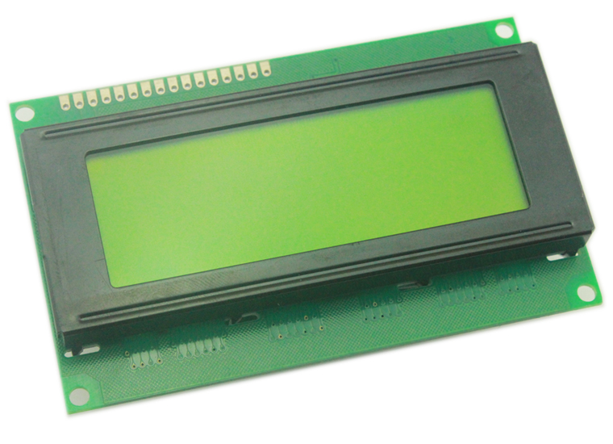
LCD Display
An LCD is an electronic display module which uses liquid crystal to produce a visible image. The 16×2 /20x4 LCD display is a very basic module commonly used in DIYs and circuits. In this LCD each character is displayed in pixel matrix. The command register stores the control directions given to the LCD. A command is an instruction given to LCD to perform a predefined task like initializing it, clearing its display, placing the cursor position, controlling screen etc. The data register stores the data to be displayed on the LCD. The information is the ASCII value of this character to be shown on the LCD.

Slide 23
Features
Operating Voltage is 4.7V to 5.3V
Current consumption is 1mA without backlight
Alphanumeric LCD display module, meaning can display alphabets and numbers
Consists of two rows and each row can print 16 characters.
Each character is build by a 5✕8 pixel box
Can work on both 8-bit and 4-bit mode
It can also display any custom generated characters
Available in Green and Blue Backlight

Slide 24
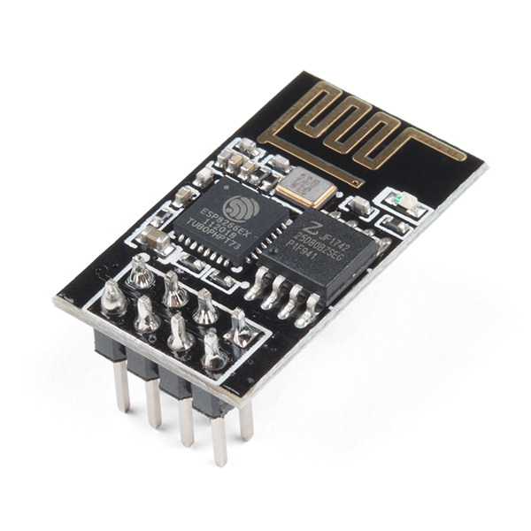
ESP8266 Wifi Module
ESP8266 WiFi Module is an integrated TCP/IP protocol stack with an independent SOC with that can give any microcontroller access to your WiFi network.
The chip at first grabbed the attention of western makers in August 2014 with the ESP-01 module, made by a third-party manufacturer, Ai-Thinker.
Each ESP8266 module comes pre-customized with an AT command set firmware, which means, you can basically attach this to your Arduino gadget and get about as much WiFi-ability as a WiFi Shield offers (and that is simply out of the case)! The ESP8266 module is a to a great degree savvy board with a tremendous, and consistently developing, group.

Slide 25
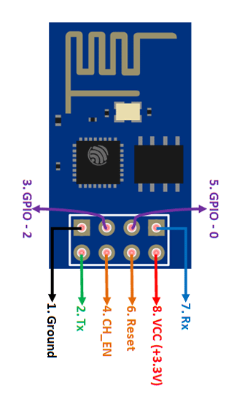
Features
Low cost, compact and powerful Wi-Fi Module
Power Supply: +3.3V only
Current Consumption: 100mA
I/O Voltage: 3.6V (max)
I/O source current: 12mA (max)
Built-in low power 32-bit MCU @ 80MHz
512kB Flash Memory
Can be used as Station or Access Point or both combined
Supports Deep sleep (<10uA)
Supports serial communication hence compatible with many development platform like Arduino
Can be programmed using Arduino IDE or AT-commands or Lua Script

Slide 26
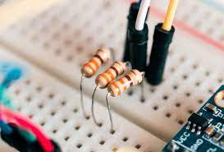
Resistors
The resistor is a passive electrical component to create resistance in the flow of electric current. In almost all electrical networks and electronic circuits they can be found. The resistance is measured in ohms. An ohm is the resistance that occurs when a current of one ampere passes through a resistor with a one volt drop across its terminals. The current is proportional to the voltage across the terminal ends. This ratio is represented by Ohm’s law:
formula with ohm's law: R=V/I
Resistors are used for many purposes. A few examples include delimit electric current, voltage division, heat generation, matching and loading circuits, control gain, and fix time constants. They are commercially available with resistance values over a range of more than nine orders of magnitude. They can be used to as electric brakes to dissipate kinetic energy from trains, or be smaller than a square millimeter for electronics.

Slide 27
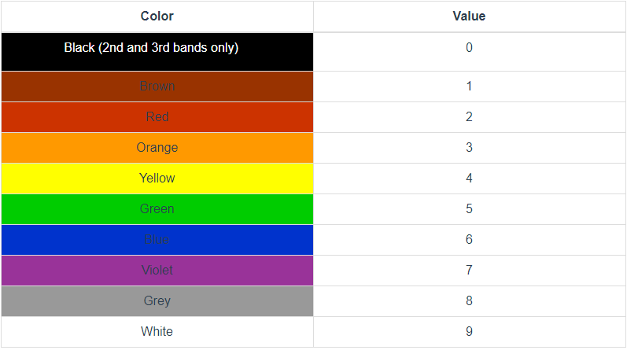
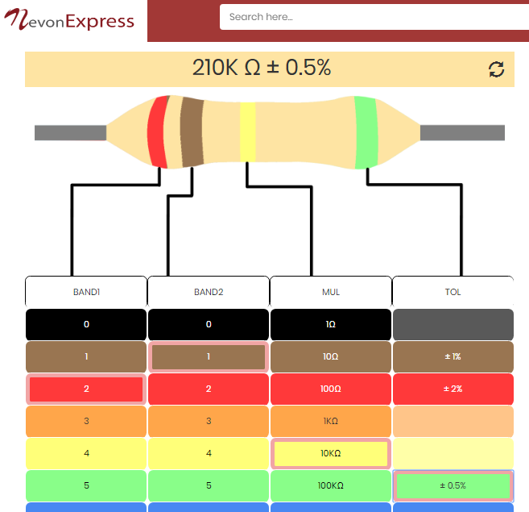
Resistors Code Calculation
Resistor Calculations requires color code charts for resistor value calculations.
For fast and efficient calculations of resistors color codes from values or vice versa we can use free online tool available at nevonexpress.com > resistor color code calculator

Slide 28
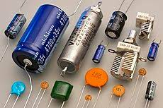
Capacitors
The capacitor is a component which has the ability or “capacity” to store energy in the form of an electrical charge producing a potential difference (Static Voltage) across its plates, much like a small rechargeable battery.
There are many different kinds of capacitors available from very small capacitor beads used in resonance circuits to large power factor correction capacitors, but they all do the same thing, they store charge.
In its basic form, a capacitor consists of two or more parallel conductive (metal) plates which are not connected or touching each other, but are electrically separated either by air or by some form of a good insulating material such as waxed paper, mica, ceramic, plastic or some form of a liquid gel as used in electrolytic capacitors. The insulating layer between a capacitors plates is commonly called the Dielectric.
Due to this insulating layer, DC current can not flow through the capacitor as it blocks it allowing instead a voltage to be present across the plates in the form of an electrical charge.
The conductive metal plates of a capacitor can be either square, circular or rectangular, or they can be of a cylindrical or spherical shape with the general shape, size and construction of a parallel plate capacitor depending on its application and voltage rating.

Slide 29
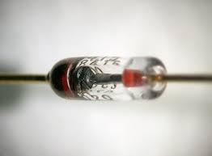
Diodes
A diode is a two-terminal electronic component that conducts current primarily in one direction (asymmetric conductance); it has low (ideally zero) resistance in one direction, and high (ideally infinite) resistance in the other. A diode vacuum tube or thermionic diode is a vacuum tube with two electrodes, a heated cathode and a plate, in which electrons can flow in only one direction, from cathode to plate. A semiconductor diode, the most common type today, is a crystalline piece of semiconductor material with a p–n junction connected to two electrical terminals.[5] Semiconductor diodes were the first semiconductor electronic devices. The discovery of asymmetric electrical conduction across the contact between a crystalline mineral and a metal was made by German physicist Ferdinand Braun in 1874. Today, most diodes are made of silicon, but other materials such as gallium arsenide and germanium are used.
The most common function of a diode is to allow an electric current to pass in one direction (called the diode's forward direction), while blocking it in the opposite direction (the reverse direction). As such, the diode can be viewed as an electronic version of a check valve.

Slide 30
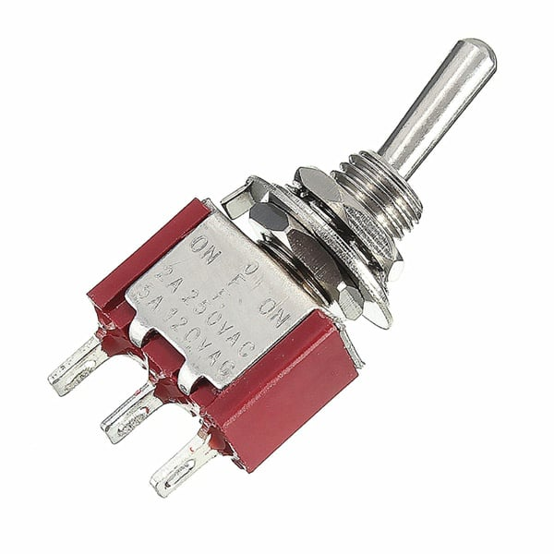
Buttons & Switches
A push-button (also spelled pushbutton) or simply button is a simple switch mechanism for controlling some aspect of a machine or a process. Buttons are typically made out of hard material, usually plastic or metal.[1] The surface is usually flat or shaped to accommodate the human finger or hand, so as to be easily depressed or pushed. Buttons are most often biased switches, although many un-biased buttons (due to their physical nature) still require a spring to return to their un-pushed state. Terms for the "pushing" of a button include pressing, depressing, mashing, slapping, hitting, and punching.

Slide 31
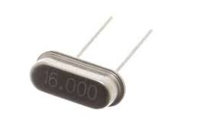
Crystal Oscillator
A crystal oscillator is an electronic oscillator circuit that uses the mechanical resonance of a vibrating crystal of piezoelectric material to create an electrical signal with a precise frequency. This frequency is often used to keep track of time, as in quartz wristwatches, to provide a stable clock signal for digital integrated circuits, and to stabilize frequencies for radio transmitters and receivers. The most common type of piezoelectric resonator used is the quartz crystal, so oscillator circuits incorporating them became known as crystal oscillators, but other piezoelectric materials including polycrystalline ceramics are used in similar circuits.
A crystal oscillator, particularly one made of quartz crystal, works by being distorted by an electric field when voltage is applied to an electrode near or on the crystal. This property is known as electrostriction or inverse piezoelectricity. When the field is removed, the quartz - which oscillates in a precise frequency - generates an electric field as it returns to its previous shape, and this can generate a voltage. The result is that a quartz crystal behaves like an RLC circuit.

Slide 32
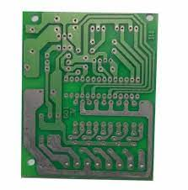
PCB – Printed Circuit Board
A printed circuit board (PCB) mechanically supports and electrically connects electronic components or electrical components using conductive tracks, pads and other features etched from one or more sheet layers of copper laminated onto and/or between sheet layers of a non-conductive substrate. Components are generally soldered onto the PCB to both electrically connect and mechanically fasten them to it.
Printed circuit boards are used in all but the simplest electronic products. They are also used in some electrical products, such as passive switch boxes.
Alternatives to PCBs include wire wrap and point-to-point construction, both once popular but now rarely used. PCBs require additional design effort to lay out the circuit, but manufacturing and assembly can be automated. Specialized CAD software is available to do much of the work of layout. Mass-producing circuits with PCBs is cheaper and faster than with other wiring methods, as components are mounted and wired in one operation. Large numbers of PCBs can be fabricated at the same time, and the layout only has to be done once. PCBs can also be made manually in small quantities, with reduced benefits.

Slide 33
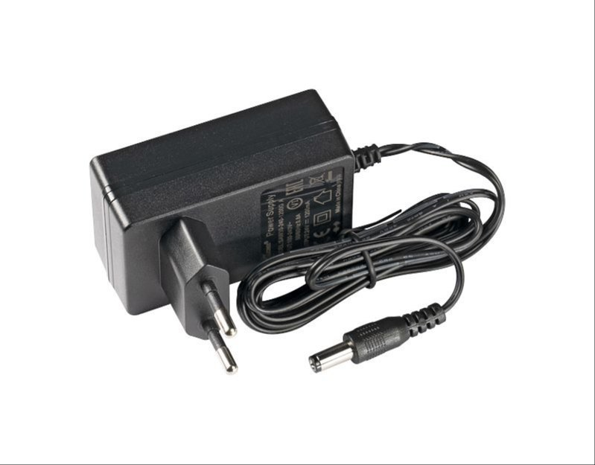
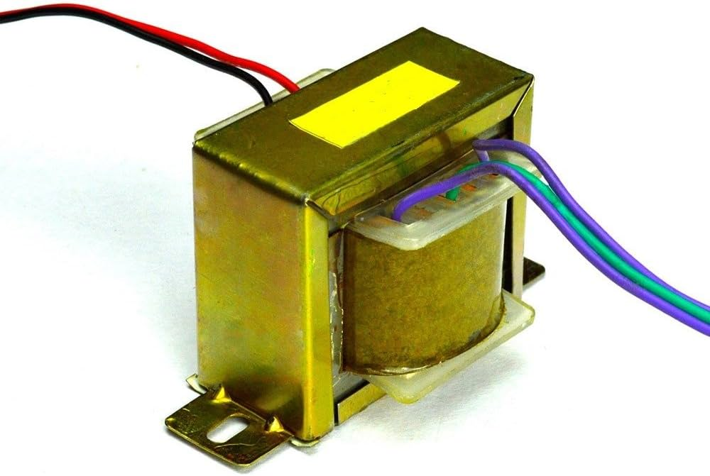
Transformer & Adapters
A transformer is a static electrical device that transfers electrical energy between two or more circuits. A varying current in one coil of the transformer produces a varying magnetic flux, which, in turn, induces a varying electromotive force or "voltage" across a second coil wound around the same core.
An AC adapter, AC/DC adapter, or AC/DC converter is a type of external power supply, often enclosed in a case similar to an AC plug. Other common names include plug pack, plug-in adapter, adapter block, domestic mains adapter, line power adapter, wall wart, power brick, and power adapter.

Slide 34
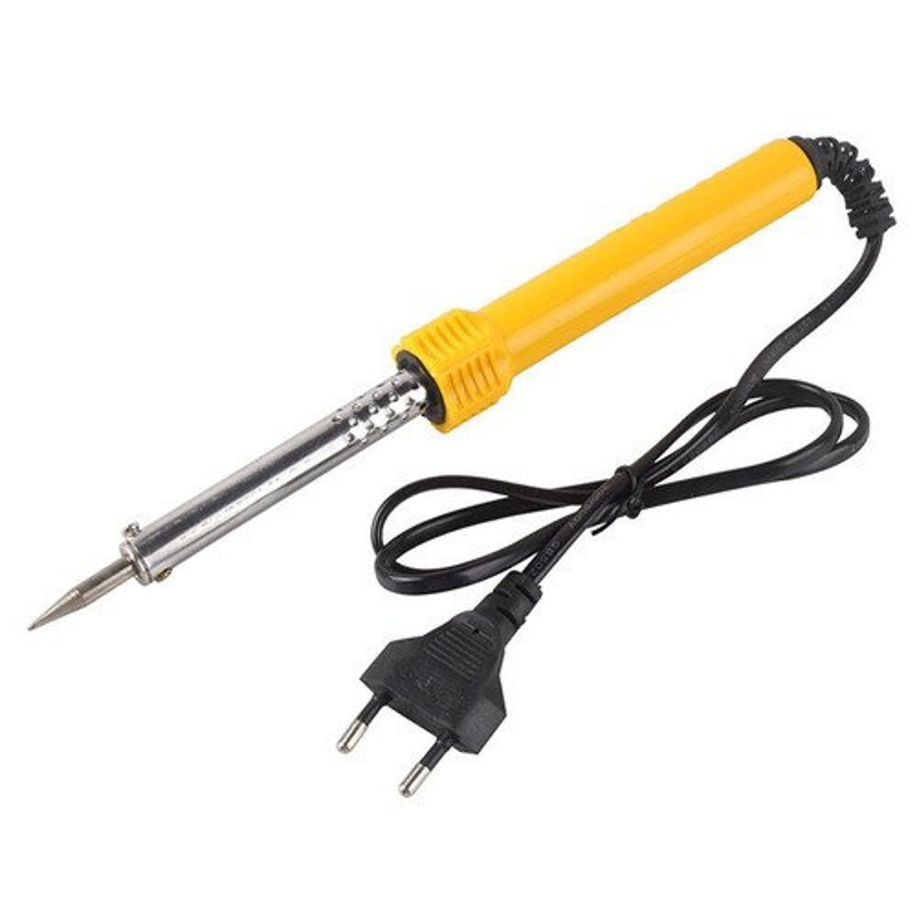
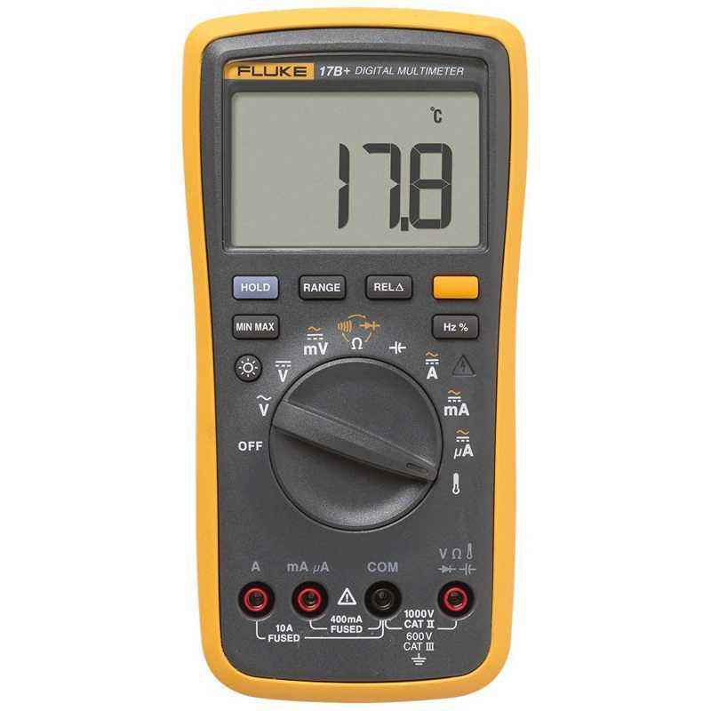
Tools Needed
Multimeter is needed for testing of electronics pcb based projects for voltage, connectivity and other issues.
Soldering iron is used along with soldering accessories to ensure proper connectivity between components and the pcb surface and ensure proper working of the system.

Slide 35
THANK YOU

