Slide 1


RAAHI
Y O U R W A Y F O R W A R D
A voice copilot that reads the page airlines
actually publish — and tells a stranded
passenger what to do next.
Siraj · Astha · Farman
BUiD Voice Agents Hackathon, Dubai · 8 August 2026

Slide 2
THE PROBLEM
Two sentences decide whether she should get in a taxi
“The UAE will not allow entry to travellers who have recently been in the
Democratic Republic of Congo, Uganda, or South Sudan, unless the traveller
has been outside of these countries for more than 21 days.”
“The entry and transit restrictions apply to all travellers, even those
arriving by indirect routings.”
Not in any database. Prose on emirates.com/help/travel-updates — changed in June, will change again.
Buried. Between a lounge refurbishment notice and Schengen biometrics.
Decisive. Kampala → Dubai → London is blocked. The queue to ask is measured in hours.

Slide 3
THE DEMO
One booking reference → five live checks → one decision
“My booking reference is K seven X two M nine — should I leave for the airport?”
transit_rules live advisory — restriction keys off ORIGIN, not destination
disruption_status live advisory — is London itself affected
entry_requirements live advisory + gov.uk + europa.eu — UK ETA
track_aircraft live ADS-B transponder — where the aircraft physically is
weather_ops live METAR — Dubai station conditions
Answered in 1.98 seconds, fanned out in parallel. Control case: P3L8QK — Mumbai → London.
Same destination. Opposite answer. Because the restriction depends on where you have BEEN.

Slide 4
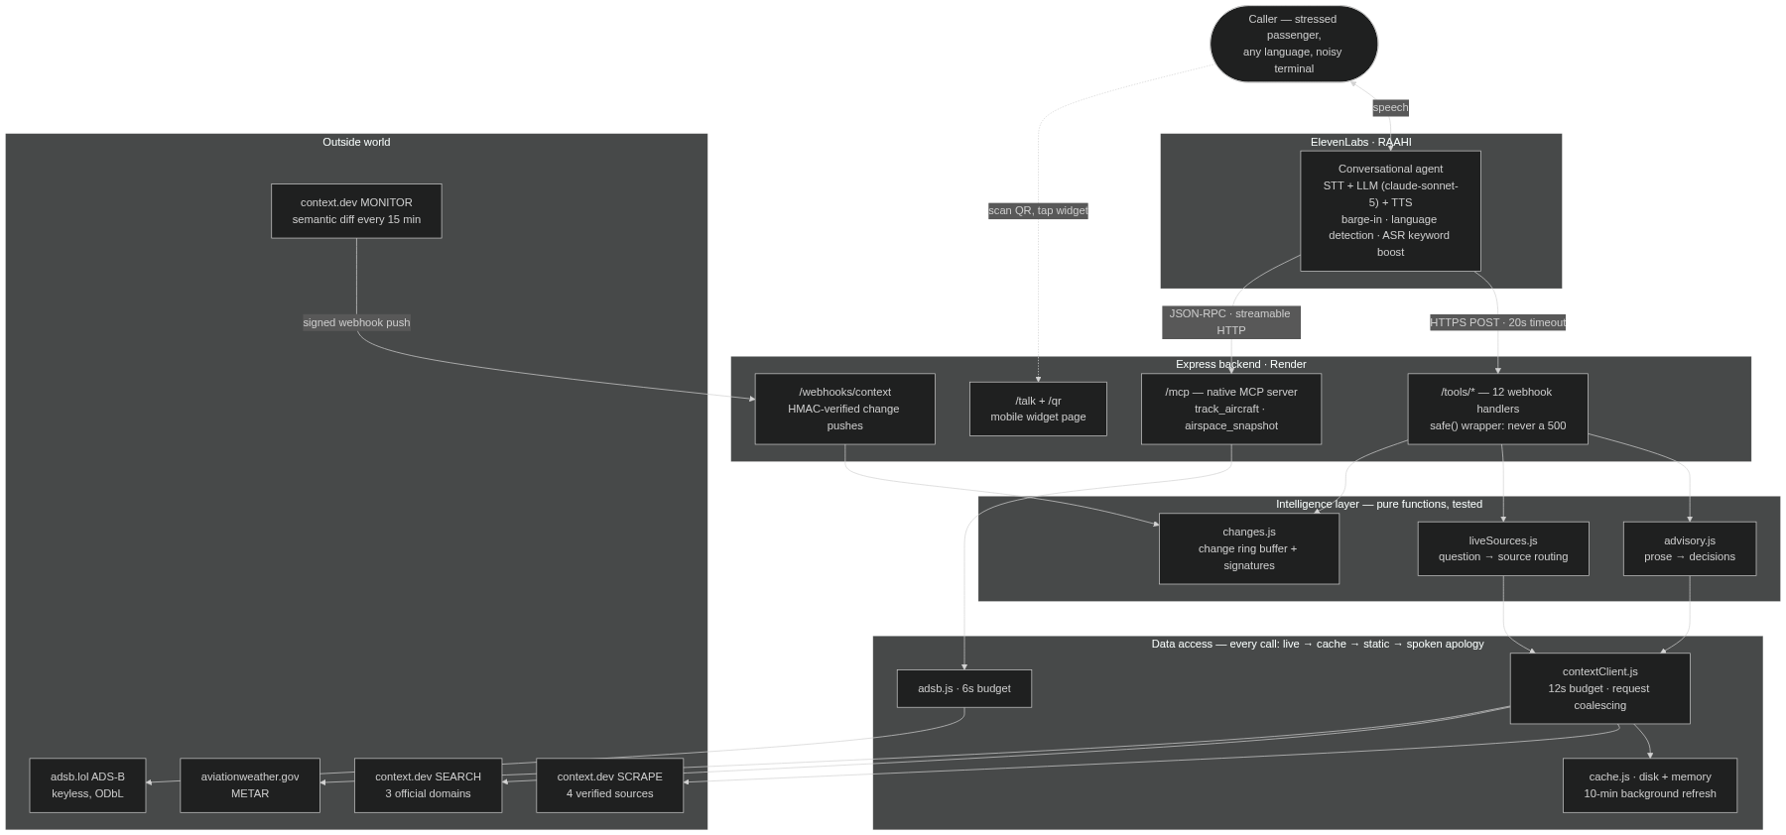
ARCHITECTURE
Five layers, and failure flows down gracefully

Slide 5
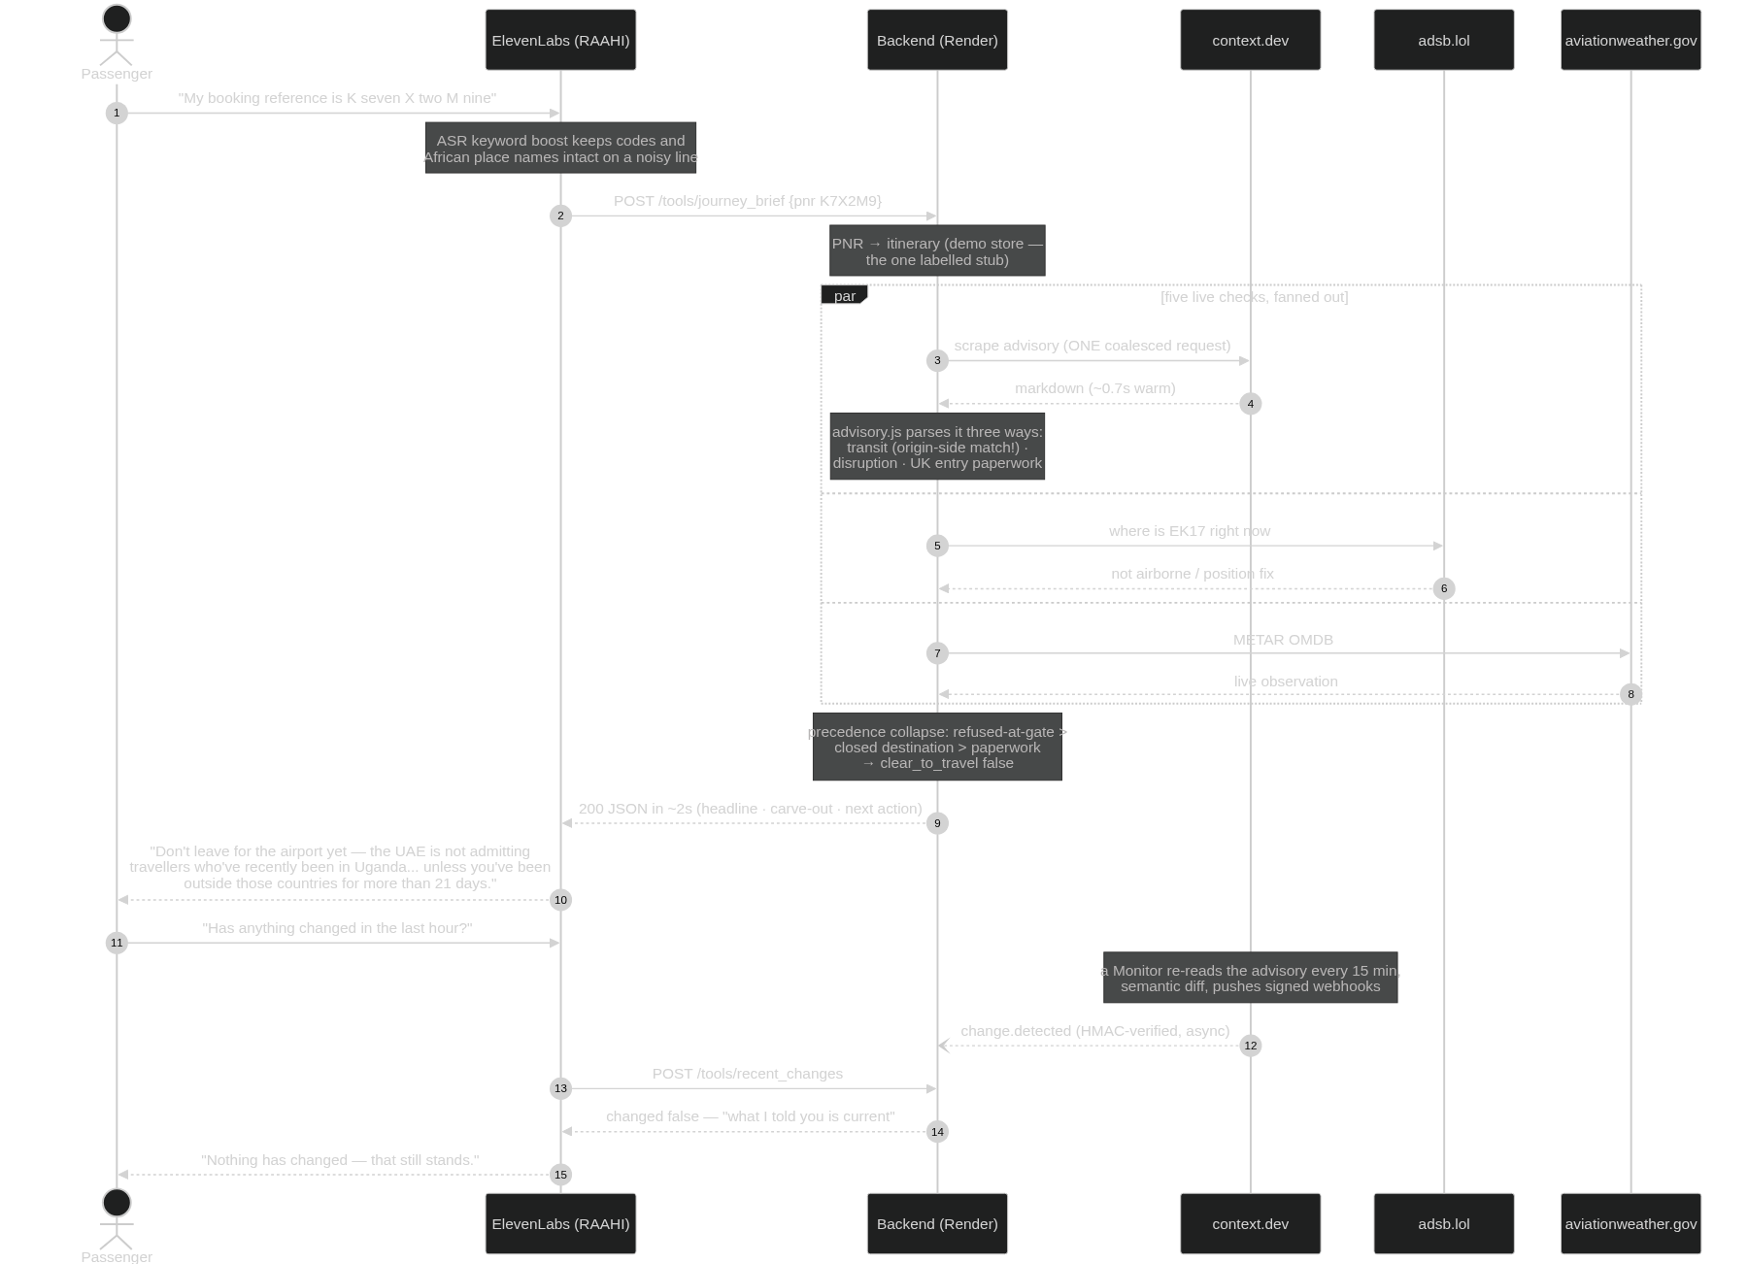
THE CALL FLOW
PNR in, decision out — with the parallel fan-out

Slide 6
THE INTELLIGENCE
What a keyword match would get wrong
Two-sided matching Restrictions key off where you have BEEN. Destination-only checking tells the Kampala passenger she is fine. She is not.
Sentence windows The qualifier that changes the answer sits in a neighbouring sentence, so every match reads one either side.
Effective-from ≠ until “effective 6 June 2026 (until further notice)” contains a date that is not an end date. Returns open_ended, not a lifted restriction.
Main-clause classification “If you do NOT need a visa… you WILL need an ETA.” The negation is in the subordinate clause. Filing that as an exemption gets someone denied boarding.
Alias resolution Callers say “DRC”, “the Congo”, “Kampala”. The page says “Democratic Republic of Congo”, “Uganda”.

Slide 7
SPONSOR TECHNOLOGY
context.dev and ElevenLabs, used to their edges
CONTEXT.DEV — 4 CAPABILITIES
ELEVENLABS — BOTH INTEGRATION PATHS
scrape/markdown 4 verified sources
12 webhook tools schedule & policy
web/search allowlisted to 3 official domains
Native MCP server live ADS-B tracking
monitors semantic diff every 15 min, signed webhook
ASR keyword boost callsigns, codes, Arabic terms
scrape/html evaluated; markdown sufficed
Language presets AR · HI · ZH · FR, switches mid-call
Guardrails focus, injection, content, 2 custom
Eval criteria every call scored post-hoc
Plus: adsb.lol ADS-B (keyless, ODbL) · aviationweather.gov METAR · Render · Node 18 / Express

Slide 8
WHAT IS ACTUALLY LIVE
Every response carries its own source field
Live on every call disruption_status · transit_rules · entry_requirements · weather_ops · recent_changes · travel_intel · track_aircraft · airspace_snapshot
Split-source, labelled flight_status — ADS-B position live, schedule static. Two source fields so the live half cannot lend credibility to the static half.
Static by design policy_lookup — entitlements do not change hourly.
WHAT WE DO NOT CLAIM
No real PNR lookup. emirates.com/manage-booking is auth-gated — we scraped it and got a login redirect. The booking store is a labelled stub; everything downstream is live.
No live gates or delays. Commercial data. ADS-B gives position, not schedule, and we label it as position.
No push into a live turn. The monitor pushes to us in minutes; the agent learns on its next tool call.

Slide 9
RELIABILITY & GUARDRAILS
The demo has to survive venue wifi
Never a 500 Any throw becomes 200 + a spoken-friendly message. A failed tool call is a voice agent going silent mid-sentence.
live → cache → static → apology Four-step degradation on every source call, with the honest label attached.
58 tests, key blank The offline path is the one tested hardest.
Two guardrail layers Platform guardrails outside the LLM + prompt rules. Verified adversarially: 5/5.
Backend redaction Cards, CVVs, IBANs, passports scrubbed from logs — Luhn-checked so ticket numbers survive.
Injection defanged Scraped prose is untrusted input handed to an LLM. Neutralised at the choke point.

Slide 10
TWO BUGS WORTH ADMITTING
Both found by testing, both pinned
The agent invented an all-clear. Given an unreadable tool result it said “clear to travel, proceed to the airport.” The backend said BLOCKED. It would have sent her to be refused at the gate. Now: an unreadable result is never good news, and it will not soften under a repeated question.
One sentence could flip blocked → allowed. The origin-side check asked a document-level question of a ±1 sentence window. An intervening sentence pushed the proof out and reversed the answer — reachable by Emirates simply editing their page. Scope is now read document-wide.

Slide 11
One question. Every layer. Two seconds.
Voice · live advisory prose · entry rules · real aircraft · change detection — resolved into one
sentence a passenger can act on, in the language they are frightened in.

Slide 12

Scan and talk to Raahi
No app. A phone browser and a microphone.
irops-copilot-backend.onrender.com/talk
Try: “My booking reference is K seven X two M nine.” github.com/sirajtechy/Airlines-Voice-Agent

