Slide 1







Survey results
TOCH DAVY
November 9th, 2024

Slide 2



OUTLINE
Executive Summary
Introduction
Methodology
Results
Visualization – Charts
Dashboard
Discussion
Findings & Implications
Conclusion
Appendix

Slide 3

EXECUTIVE SUMMARY
This report is a data analysis done on a surveys on Stack Overflow. The survey contain data related to:
Current and desired IT skills
Demographic background (gender, location, …)
Psychological characteristics (introvert vs extravert, …)
Key takeaways of the data analysis:
Invest more in trying to get the gender ratio more balanced.
Developers skilled in PHP or C++ will become more difficult to find.

Slide 4

INTRODUCTION
Point1
Point2
Point3
Point4
Sub Point1
Sub Point2

Slide 5

METHODOLOGY
Data collection was done using
Stack Overflow survey result (CSV file)
Web Scraping of Wikipedia pages
Exploratory data analysis was performed including
Data Wrangling (removing duplicates, replacing null values, …)
Data Statistical Analysis (median, …)
Data Visualization

Slide 6
RESULTS

Slide 7
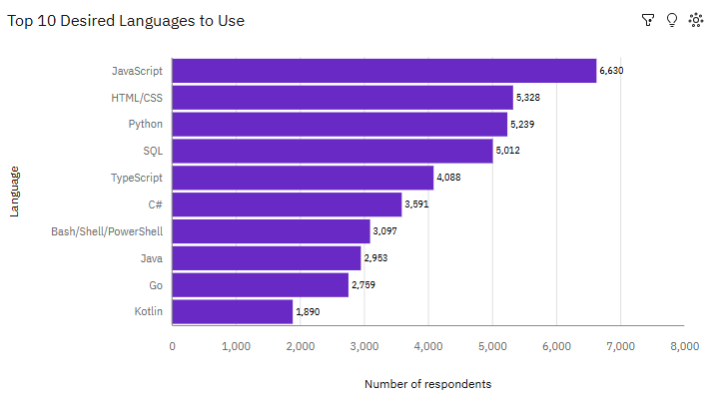
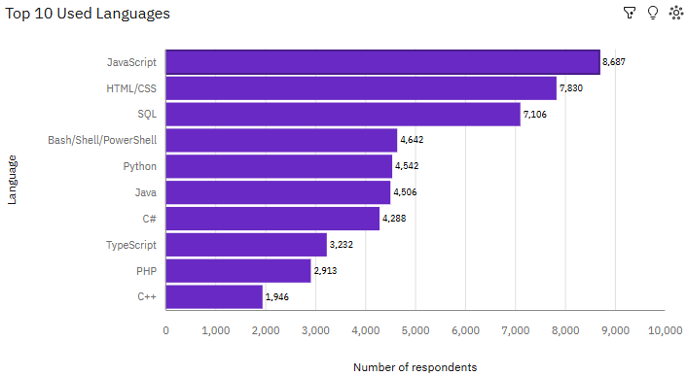
PROGRAMMING LANGUAGE TRENDS
Current Year
Next Year

Slide 8
PROGRAMMING LANGUAGE TRENDS - FINDINGS & IMPLICATIONS
Findings
Web-related languages like JavaScript and HTML/CSS will still be relevant as part of the skillset the next year.
There will be less interest in PHP and C++.
Newer languages like Go and Kotlin will have an increased interest.
Implications
Web-related languages are skills that people still want to develop their skills in (except PHP)
There will probably more difficulty to find people wanting to develop in PHP and C++.

Slide 9
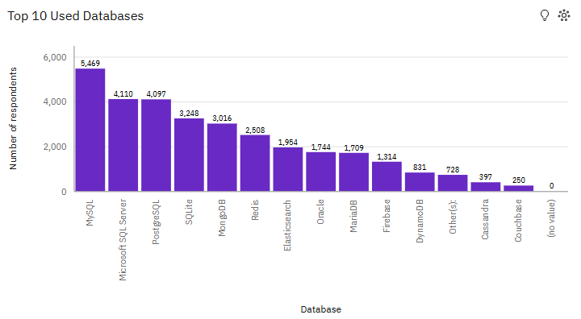
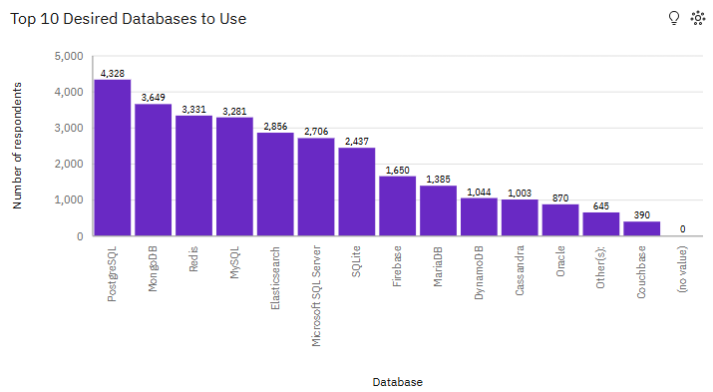
DATABASE TRENDS
Current Year
Next Year

Slide 10
DATABASE TRENDS - FINDINGS & IMPLICATIONS
Findings
MySQL and MS SQL Server will lose a bit of interest next year.
Non-SQL databases like Elastic Search, Cassandra, … will have an increased interest.
PostgreSQL will have the same kind of interest next year.
Implications
It might become a bit more difficult to find people wanting to learn MySQL and MS SQL Server.
Non-SQL databases might become a preference for most developers.
Interest in PostgreSQL remains constant.

Slide 11

DASHBOARD
The PDF document containing the dashboard screenshots can be found in GitHub:
https://github.com/sirasen/sandbox/blob/main/data_analyst_lab/Capstone_Dashboard_Cognos_Analytics.pdf

Slide 12
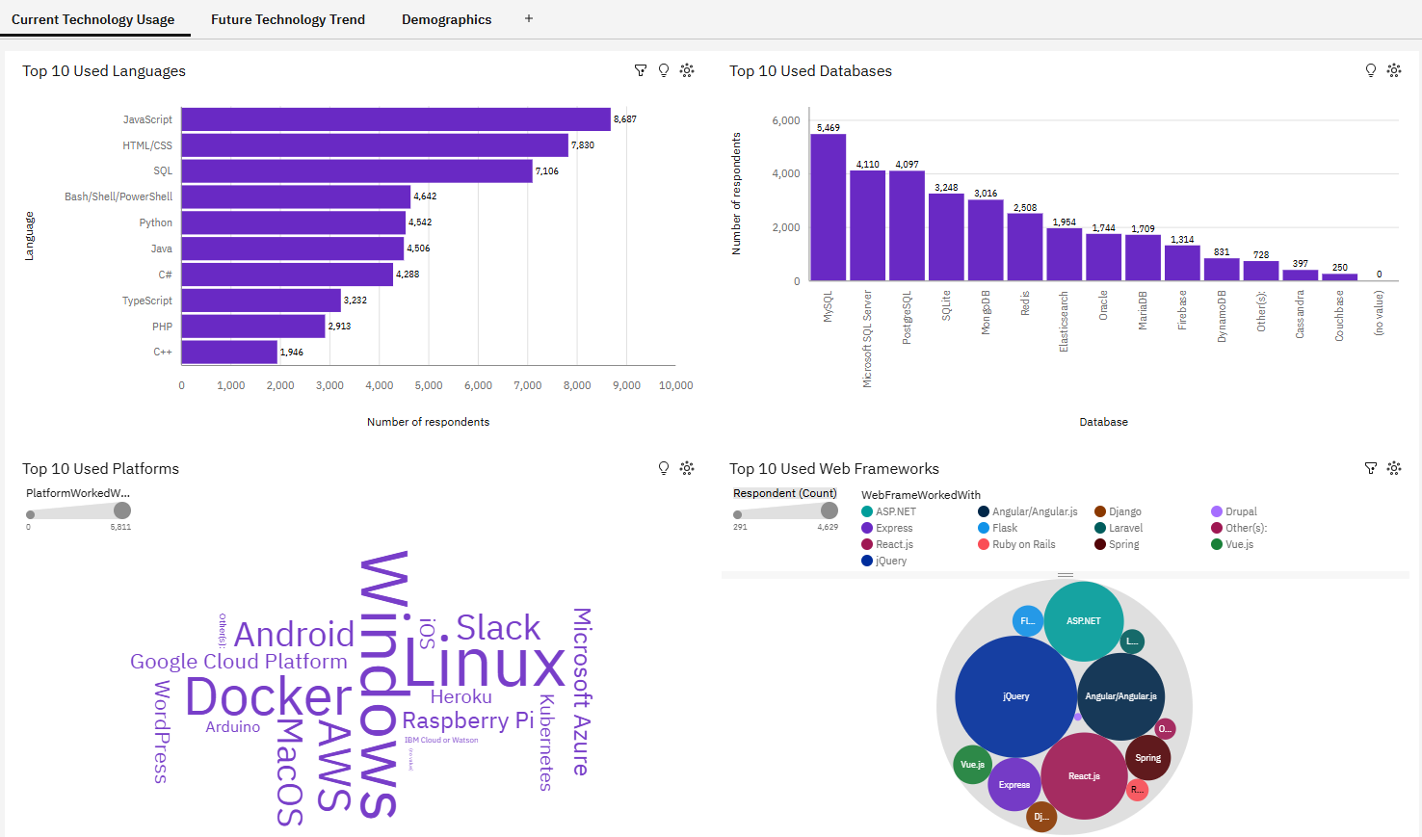
DASHBOARD TAB 1

Slide 13
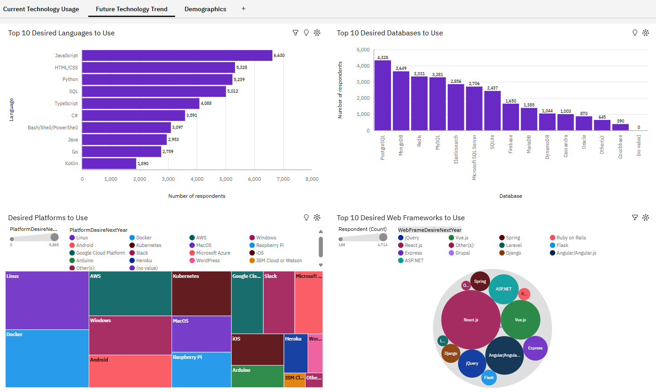
DASHBOARD TAB 2

Slide 14
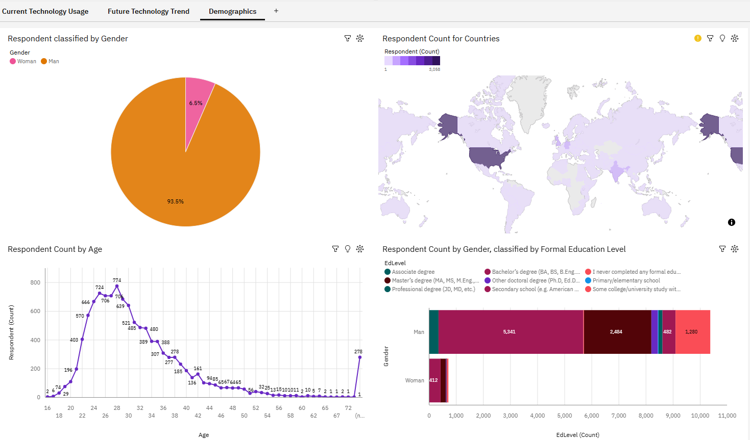
DASHBOARD TAB 3

Slide 15
DISCUSSION

Slide 16
OVERALL FINDINGS & IMPLICATIONS
Findings
Still a lot more men than women in the developer field.
Web languages like JavaScript and HTML/CSS are still high on the list of skills developers want to have.
Implications
Invest more in trying to get the men-woman ratio more balanced.
Developers skilled in PHP or C++ will become more difficult to find.

Slide 17

CONCLUSION
Invest more in trying to get the gender ratio more balanced.
Developers skilled in PHP or C++ will become more difficult to find.

Slide 18

APPENDIX
None.

Slide 19
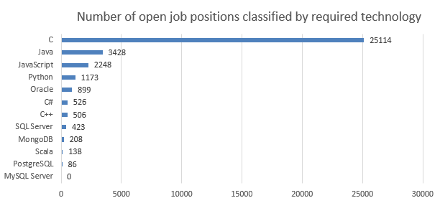
JOB POSTINGS

Slide 20
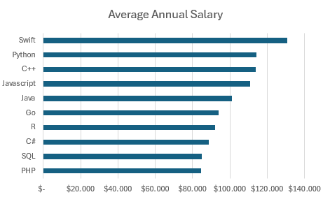
POPULAR LANGUAGES

