Slide 1
<CAL – AVR Assembler operations> I will help you the best I can, but I am just a student like you!
.equ: Label a value
.def: Symbol for a register
ldi: Load immediate value
mov: Move. Copy register
cp: Compare registers
cpi: Compare immediate
Branching is take 1 or 2 clock
Use labels (e.g. loop)
brne: Branch if not equal
breq: Branch if equal
brge: Branch if greater or equal
brlo: Branch if lower
Use labels
rjmp: Small jump, 2 clock
jmp: Big jump, 2 clock
call: Call subroutine
ret: Return from sub routine
com: 1’s complement
neg: 2’s complement (minus)
nop: No operation. 1 clock
push: Push register value onto stack
pop: Pop from stack into register
;My own algorithm for dividing with AVR Assembler
.def a = r16 ; To hold dividend. The .def is just to make the naming more readable
.def b = r17 ; To hold divisor. Actually my use of letters for the .def is not descriptive
.def c = r19 ; Count for whether you reached the value of a
.def d = r21 ; Copies c and decrements. Used as c-1 to see whether c is greater than a
.def i = r18 ; Result.
.def r = r20 ; Remainder. Copies a and substracts c from it.
ldi a, 6 ; ldi means load immediate into register. This is used for values
ldi b, 3 ; In a similar fashion you can use ld. E.g. ld r16, r17.
ldi i, 0
ldi c, 0
loop: ; “loop” is basically a tag that you can use for the branch operations
add c, b ; You simply add the value of b to the value within the c register
inc i ; You simply increment the value of r18 by one
cp a, c ; cp is compare. Good to use before breaks.
brge loop ; Should jump to the start of the loop if a >= c
mov d, c ; Move. You copy the value of c into d
dec d ; Decrement by one
cp d, a; ; Compare for jumping with branches!
brge correction ; Branch if d is greater than a. If c > a then correct the i and c count remainder:
mov r, a
sub r, c ; Substract c from r!
rjmp start ; Then when that is done jump back to start! The program was completed
correction: ; I could as have called the loop Ice Cream and it would work the same
sub c, b
dec i
rjmp remainder

Slide 2
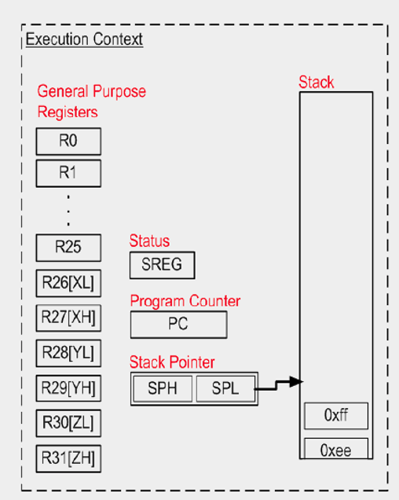
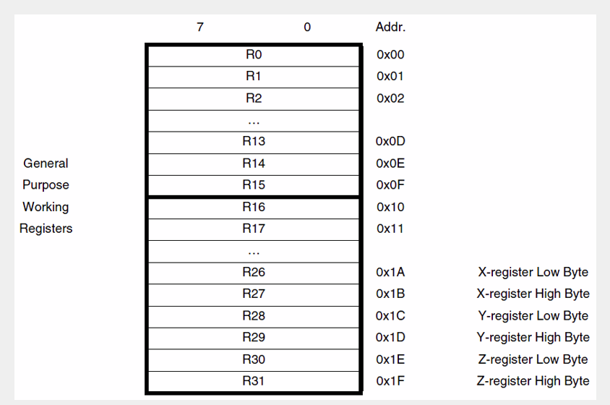
<CAL – Registers and stack> I will help you the best I can, but I am just a student like you!
All registers: r0-r31 All the available registers
Lower registers: r0-r15 Access to ALU, Data Memory and more
Simple upper registers: r16-r23 Used for smaller values
Special upper register pairs: r24&r25, r26&r27 (X), r28&r29 (Y), r30&r31 (Z) Used as pairs for greater values

Slide 3
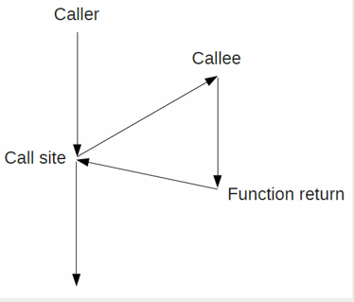
<CAL – Calling> I will help you the best I can, but I am just a student like you!
call: Call subroutine
ret: Return from sub routine
e.g. seen here https://github.com/sirasmu/sir_asm/blob/master/fibonacci.asm

Slide 4
<Contact info and references> I will help you the best I can, but I am just a student like you!
Check out the code I have uploaded on GitHub: https://github.com/sirasmu (*cough* you can steel my Assembler projects *cough*)
Contact me on my VIA email: 246676@via.dk
Or write me on Facebook: https://www.facebook.com/facesign (don’t ask me why this is my URL)
Some neat links I found just now:
http://ccrs.hanyang.ac.kr/webpage_limdj/microprocessor/Assembler.pdf
https://www.youtube.com/watch?v=QXjU9qTsYCc

