Slide 1
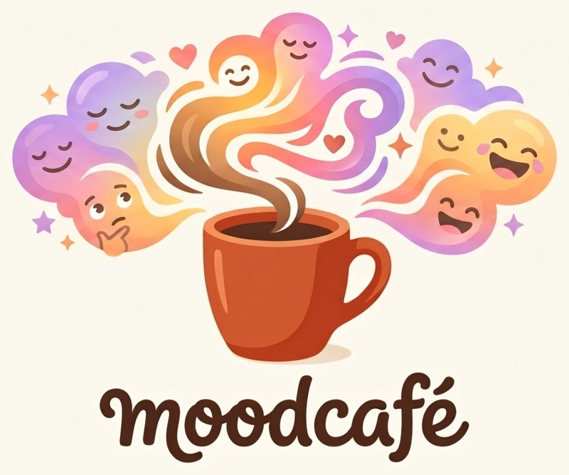
MoodCafe • a student project by Sirat , Anshal & Swapna
Problem Statement
Many of us feel stressed by exams, family, money and the future, yet we rarely have a simple, friendly place to notice how we feel and do something small about it.
How can checking in with your mood feel as easy as ordering a coffee?

Slide 2
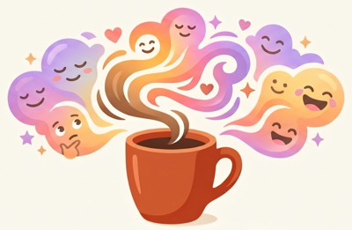
Problem Identification & Motivation
What we noticed, and why it matters to us
What we noticed
Why it matters to us
😟
Moods change many times a day, but heavy ones often go unnoticed until they turn into stress.
“Noticing how we feel is the first step.”
📚
Pressure comes from many places: studies, family, money, friends and the future.
After that, small habits like deep breathing, a walk, good music and healthy food can make a big difference. We wanted that first step to feel warm, not clinical.
🤷
Many people don't know a small, easy first step, so they do nothing.
MoodCafe
2 / 6

Slide 3
Our Solution
A cozy corner where your mood gets a menu
😊
1
💬
2
🍽️
3
Share your mood
Answer 5 gentle questions
Get your Relax Menu
Pick how you feel from 6 moods and tell us your name.
Energy, sleep, focus, thoughts and patience, nothing complicated.
See your stress level and ideas made just for you.
Your stress level:
Low • 5–9
Medium • 10–14
High • 15–20
MoodCafe
3 / 6

Slide 4
Major Project Features
Everything you can do inside MoodCafe
📝
Mood Check-in
📊
Stress Report
🍽️
Relax Menu
6 moods, 5 gentle questions and what's on your mind.
A score out of 20 shown as Low, Medium or High.
Meditation, exercise, music and food ideas for you.
💜
High Stress Care
🌬️
Breathing Circle
🧭
Easy Navigation
Grounding steps, a support box and a Help page.
A calming animated circle you can follow in one minute.
Dropdown, quick-jump links and a phone-friendly menu.
MoodCafe
4 / 6

Slide 5
Technologies Used
Simple tools, no sign-up, no server
HTML5
Structure of all 5 pages and the check-in form
Built to be simple
No server or database
Answers stay on your device
Poppins font from Google Fonts
Works on desktop and phone
Easy to access
CSS3
Gradients, animations and a layout that adapts to phones
JavaScript
Scoring logic, personalised results and the menu
localStorage
Remembers your check-in in the browser
MoodCafe
5 / 6

Slide 6
Key Outcomes & Features
What MoodCafe gives you
✓
A complete, working 5-page website
🌱 What's next
✓
Results that change with your stress level: Low, Medium or High
A mood journal to see how you feel over time, and a music page with playlists for every mood.
✓
Extra care for High stress with calm steps and helplines
✓
Smooth navigation on both computers and phones
Made with care by Sirat, Anshal & Swapna.
✓
Private by design: nothing leaves your browser
MoodCafe
6 / 6

