Slide 1
DISTRIBUTED SYSTEMS ENGINEERING SUBMISSION // NOVEMBER 13, 2026
CHRONOS
Instrumented Distributed Observability and Controlled Failure-Experiment Platform
CORRELATED TELEMETRY
• Canonical ChronosEvent JSONB schema
• Server-generated run_id + REST topology
• PostgreSQL 16 durable event log
ISOLATED FAULT ENGINE
• Network-isolated Failure Controller
• Allowlisted Payment SIGKILL control
• Fail-closed locks & Cognito RBAC
VERIFIED PRODUCTION MVP
• 132 backend + 10 frontend unit tests
• EC2 + Caddy TLS + AWS Amplify + ECR
• Hardened non-root UID 1001 containers

Slide 2
01 // PROBLEM FRAMING
Problem Statement: Pinpointing Partial Failures Across Boundaries
Cross-Service Ambiguity
• A user checkout traverses Browser -> Orders -> Payment -> Database.
• When Payment fails or disconnects, callers see generic HTTP 502/503/504 errors without service-level causality.
• Without shared run identity, log files cannot prove whether failure occurred before or during a request.
Privilege & Reproducibility Gap
• Naively mounting /var/run/docker.sock in a public API exposes host root control.
• Docker restart: unless-stopped hides crash state during rapid manual experiments.
• CHRONOS makes fault causality observable, repeatable, and strictly bounded.
Client / UI
HTTPS + JWT
Orders API
POST /checkout
Payment Service
DOWN / SIGKILL
PostgreSQL
503 Fault Logged
CHRONOS // Distributed Observability & Controlled Failure-Experiment Platform
02 / 15

Slide 3
02 // MOTIVATION
Why Distributed Failure Observability Matters
Observability Blind Spots
• Status codes alone mask failure origin (network vs upstream HTTP vs timeout).
• Ad-hoc logs lack deterministic chronological correlation across retries.
• Operators need structured evidence showing service participation and error propagation.
Heavyweight Trade-offs
• Enterprise APM + chaos suites (Kafka, Kubernetes, Chaos Mesh) add steep overhead.
• Toy examples skip durable state, concurrency safety, auth, and security isolation.
• CHRONOS preserves core rigor inside 4 lightweight Docker services.
CHRONOS Threefold Answer
• What ran? Derived DAG topology from recorded SERVICE_CALL events.
• What broke? Explicit FAILURE_INJECTED -> SERVICE_ERROR causal linkage.
• Can we audit it? Durable PostgreSQL runs browsable in React console.
CHRONOS // Distributed Observability & Controlled Failure-Experiment Platform
03 / 15

Slide 4
03 // OBJECTIVES
Project Objectives & Measurable Milestones
1. Normalized Observability Contract
• Capture every request lifecycle event under canonical ChronosEvent Pydantic schema.
• Derive live service nodes and deduplicated directed edges cleanly over REST (/topology).
2. Controlled Causal Experimentation
• Kill only the designated payment container on operator request without host compromise.
• Guarantee deterministic failure hold (restart: 'no') until explicit operator recovery.
3. Replayable Run Inspection
• Persist runs and JSONB event timelines in PostgreSQL 16 Alpine.
• Inspect runs via interactive timeline zoom/scrubber + offline PREVIEW mode fallback.
4. Zero-Trust Security & Delivery
• Enforce Cognito RS256 JWKS verification, group RBAC, and strict CORS allowlists.
• Run all 3 app containers as non-root UID 1001 behind Caddy HTTPS & Amplify CDN.
CHRONOS // Distributed Observability & Controlled Failure-Experiment Platform
04 / 15

Slide 5
04 // SYSTEM DESIGN
System Architecture & Isolation Boundaries
Operator Browser
Chrome / PKCE
Caddy v2 Proxy
Let's Encrypt :443
Amazon Cognito
User Pool ap-south-1
AWS EC2 HOST (t3.small, Ubuntu 24.04) // NO SSH PORT 22 (ADMIN VIA AWS SSM) // S3 BACKUPS
Orders API :8000
127.0.0.1 / uid=1001
Payment :8001
restart: no / uid=1001
AWS Amplify CDN
React 18 + Vite UI
Docker Daemon
payment SIGKILL only
PostgreSQL 16
Named Vol :5432
Failure Controller
internal: true / cap ALL
CHRONOS // Distributed Observability & Controlled Failure-Experiment Platform
05 / 15

Slide 6
05 // STACK
Technology Stack (Frozen MVP Stack)
Layer | Technology / Library | Production Role & Hardening
Backend API | Python 3.14, FastAPI 0.143, Uvicorn 0.54 | Orders orchestrator, Payment health/mock, strict Pydantic contracts
Persistence | PostgreSQL 16-alpine, psycopg 3.3.7 | ACID run claims, JSONB ChronosEvent store, indexed run lookups
Identity & RBAC | Amazon Cognito + PyJWT[crypto] 2.15.1 | RS256 JWKS verification, token_use=access, operator/admin group checks
Fault Control | Docker SDK 7.2.0 (isolated sidecar) | read_only rootfs, cap_drop ALL, no-new-privileges, internal Docker net
Frontend UI | React 18, TypeScript 5.6, Vite 6.4, Tailwind | Bertone cockpit console, @xyflow/react DAG, AWS Amplify v6 PKCE
Verification | pytest 9.2 (132), Node node:test (10) | Unit, DB concurrency, Cognito JWT, controller safety & live E2E tests
AWS Cloud | EC2, Caddy v2, Amplify, ECR, S3, SSM | ap-south-1 OCI images (securityfix1), Let's Encrypt TLS, S3 dumps
CHRONOS // Distributed Observability & Controlled Failure-Experiment Platform
06 / 15

Slide 7
06 // TELEMETRY CONTRACT
Request Correlation & Canonical ChronosEvent Schema
Field | Type | Semantics
event_id | UUID (uuid4) | Unique per-event identifier
run_id | UUID (FK) | Shared experiment correlation key
timestamp | TIMESTAMPTZ | UTC time (controller time on kill)
service_id | str | Emitting service (e.g. orders)
trace_id | str | None | Optional trace correlation
event_type | Literal[6] | Strict semantic event taxonomy
source | str | orders-api or chronos-control
payload | JSONB dict | order_id, error_type, container_id
severity | Literal[3] | INFO | WARNING | ERROR
6 Canonical Event Types
• REQUEST_START / REQUEST_END
• SERVICE_CALL (derives topology edges)
• RESPONSE (HTTP 200 approved)
• SERVICE_ERROR (502 / 503 / 504)
• FAILURE_INJECTED (controlled kill)
Derived Service Topology
• GET /runs/{id}/topology builds DAG directly from persisted events.
• Deduplicates repeated SERVICE_CALL edges cleanly without WebSockets.
CHRONOS // Distributed Observability & Controlled Failure-Experiment Platform
07 / 15

Slide 8
07 // STATE MACHINE
Run Lifecycle & Concurrency-Safe Checkout
COMPLETED (HTTP 200)
Events: START -> CALL -> RESP -> END
POST /runs
Status: IN_PROGRESS
claim_run_checkout()
Row lock + INSERT REQUEST_START
FAILED (HTTP 502/503/504)
Events: [INJ] -> START -> CALL -> ERR -> END
Concurrency & Race Protection
• SELECT ... FOR UPDATE locks the run row briefly during checkout claim.
• DB lock is committed & released BEFORE calling Payment over HTTP.
• Concurrent or duplicate checkouts on the same run_id return HTTP 409.
• Active failure injection blocks checkout with HTTP 409 immediately.
Audit-Preserving Error Paths
• Checkout supports explicit X-Run-ID or auto-generates run_id cleanly.
• Payment ConnectionError maps to 503; Timeout maps to 504; invalid JSON maps to 502.
• finally: block always persists REQUEST_END and final run status.
CHRONOS // Distributed Observability & Controlled Failure-Experiment Platform
08 / 15

Slide 9
08 // FAULT ARCHITECTURE
Controlled Failure Injection & Security Isolation
Orders Service
No Docker socket/SDK
Single-flight + DB lock
failure-control Net
Docker internal: true
Bearer hmac digest
Failure Controller
uid=1001, cap_drop ALL
read_only: true
Payment Kill
Compose labels
SIGKILL Exit 137
Hardened Control Guards
• Feature-flagged: ENABLE_FAILURE_INJECTION=true required.
• Target allowlist rejects everything except target='payment' (HTTP 400).
• Compose project + service label checks prevent cross-container targeting.
• Pre-check fails closed with HTTP 503 if PostgreSQL cannot verify run state.
Post-Kill Accuracy
• Controller polls container state up to 10 checks (50ms interval) after SIGKILL.
• Controller returns exact UTC kill timestamp applied to FAILURE_INJECTED.
• Bounded 3-attempt retry loop persists event cleanly in PostgreSQL.
CHRONOS // Distributed Observability & Controlled Failure-Experiment Platform
09 / 15

Slide 10
09 // FAULT LIFECYCLE
Failure Detection, Observation & Explicit Recovery
1. Deterministic Outage
• Payment uses restart: 'no' in local and prod Compose.
• Once killed (Exit 137), container stays stopped cleanly.
• Eliminates auto-restart race conditions during experiments.
2. Health & Fault Telemetry
• GET /health probes Payment (:8001/health) with 500ms timeout.
• Live status switches to payment: 'unreachable' immediately.
• Next checkout logs SERVICE_ERROR (503) & marks run FAILED.
3. Controlled Recovery
• Operator triggers docker compose start payment.
• Payment /health turns healthy (~6-7s verified in prod).
• Next run restores payment: 'healthy' and COMPLETED.
CHRONOS // Distributed Observability & Controlled Failure-Experiment Platform
10 / 15

Slide 11
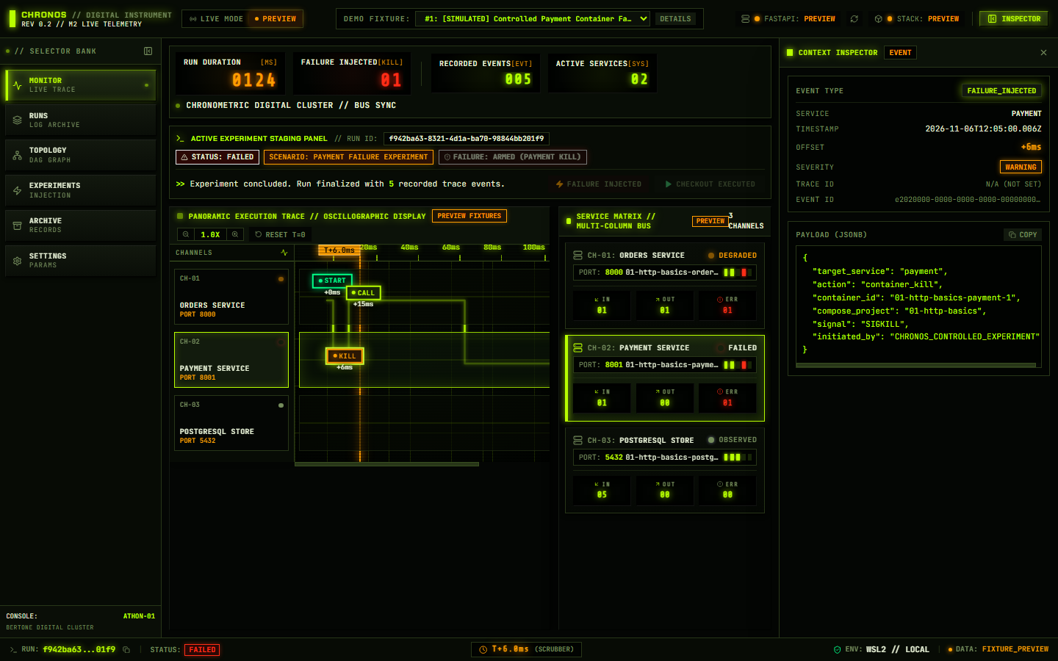
10 // WEB CONSOLE UI
Cockpit Dashboard: Multi-Track Trace & Service Matrix
Verified Instrument Features
• Bertone Athon digital cluster aesthetic (100% offline @fontsource fonts).
• Oscillographic lanes: Orders, Payment, Postgres + PRE-execution fault bay.
• Interactive 0.75X-2.5X zoom & time scrubber cursor.
• Service Matrix computes inbound, outbound & error counters live.
• Inspector shows full JSONB payloads & headers.
• Honest LIVE vs labeled PREVIEW fixture isolation.
CHRONOS // Distributed Observability & Controlled Failure-Experiment Platform
11 / 15

Slide 12
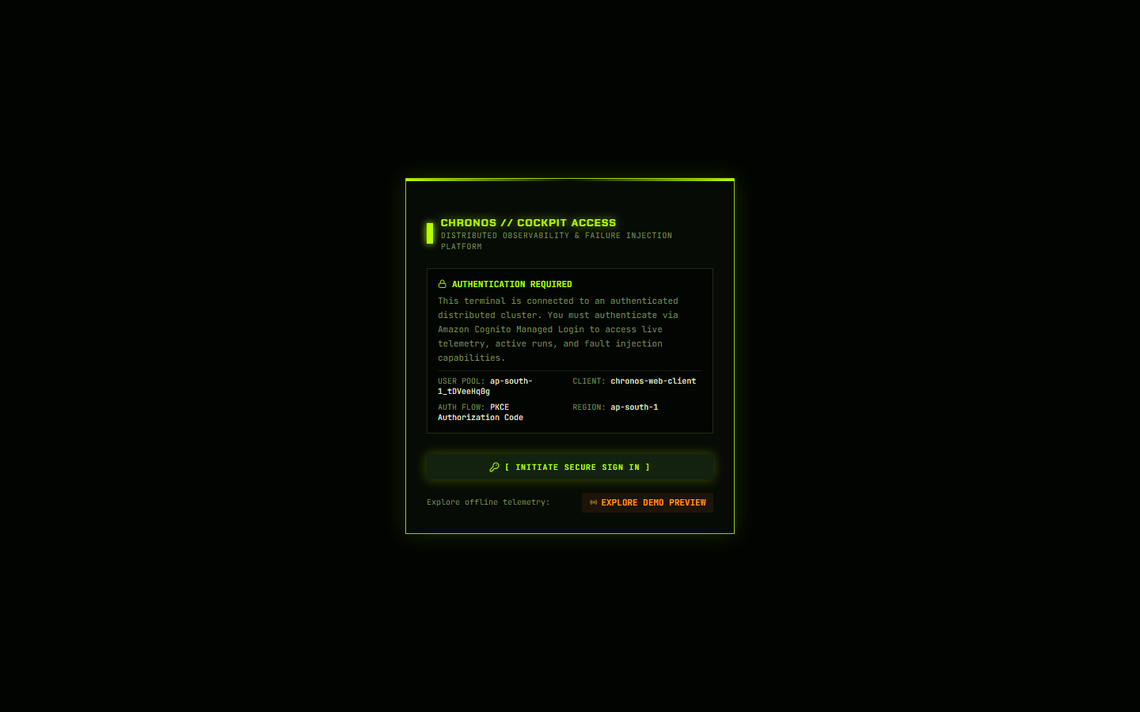
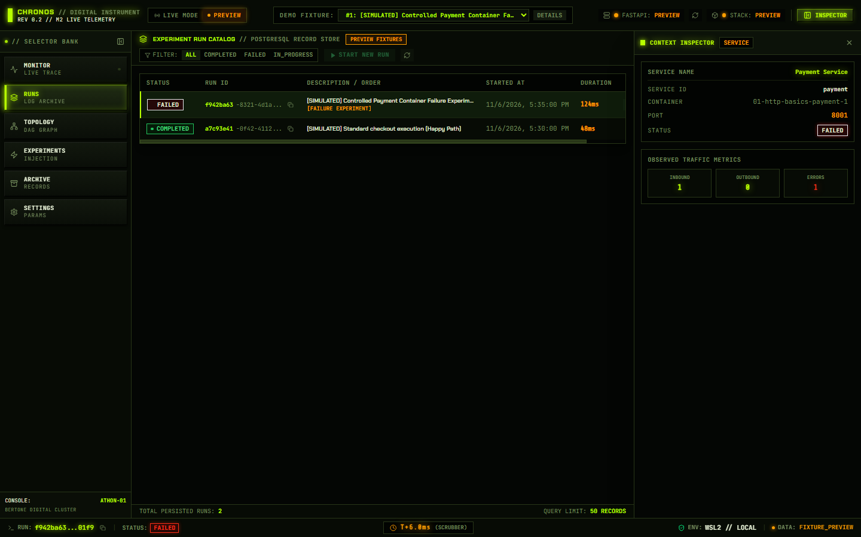
11 // SECURITY & AUTH
Security: Cognito PKCE Auth Gate, RBAC & Run Archive
Amazon Cognito OAuth2 PKCE + RS256 JWKS
• Amplify v6 Authorization Code + PKCE flow acquires short-lived access tokens.
• Backend PyJWT verifies RS256 signature against Pool JWKS (1h cache + kid rotation).
• Explicitly enforces token_use == 'access' (ID tokens rejected with 401).
• Startup aborts if production Cognito config is missing (fail-closed guarantee).
RBAC, Network & Image Remediation
• POST /runs/{id}/failure requires cognito:groups chronos-admins or chronos-operators (403 else).
• Hardened securityfix1 images: non-root chronos (1001), zlib1g patched, Payment 25->15 pkgs.
• Caddy v2 terminates TLS publicly; Orders bound strictly to 127.0.0.1:8000.
CHRONOS // Distributed Observability & Controlled Failure-Experiment Platform
12 / 15

Slide 13
12 // EVIDENCE
Testing & Live AWS Production Verification Results
132 PASSED
• pytest unit & integration suite (0 failed, 1 warning)
10 PASSED
• Frontend telemetry, RBAC & layout suite + Vite build
3 ZLIB FIXED
• ECR High CVEs 4->2; Med 11->10; 0 PyPI OSV advisories
LIVE EC2 PASS
• securityfix1 deployed Nov 12; E2E fail+recovery OK
Verification Scope | Executed Check | Verified Outcome
Pre-Deploy Backup | pg_dump custom format + S3 round-trip SHA256 | chronos_postgres_20261112_104946Z.dump (4,221 B) verified
Production Rollout | Compose --no-deps recreate of 3 app services only | Postgres untouched (up since Nov 8); HTTPS /health payment=healthy
Security & CORS | Public HTTPS /runs unauth + Amplify CORS + JWKS | 401 fail-closed confirmed; Amplify CORS 200; 2 JWKS keys loaded
Prod E2E Handlers | run1 (101 OK) -> run2 (SIGKILL + 503) -> start -> run3 | COMPLETED -> FAILED (exit 137) -> recovered 7s -> COMPLETED; DB runs 4->7
Unverified Boundary | Interactive browser Cognito PKCE -> EC2 E2E | Not run non-interactively (no stored Cognito pwd + Fortinet DPI proxy)
CHRONOS // Distributed Observability & Controlled Failure-Experiment Platform
13 / 15

Slide 14
13 // BOUNDARIES & ROADMAP
Documented Limitations, Residual Risks & Future Scope
Current MVP Limitations & Residual Risks
• 16 glibc CVEs (2 HIGH, 10 MED, 4 LOW) remain in Debian trixie (nodsa / upstream open; none reachable in pure-Python CHRONOS).
• Docker kill & PostgreSQL write are non-atomic across process boundaries (no transactional outbox yet).
• Single fault target (payment) and manual recovery (docker compose start payment).
• No automated timeline playback animation controls or package.json test wrapper.
• Corporate SSL proxies (e.g. Fortinet DPI) intercept untrusted external TLS unless bypassed or trusted.
Post-GATE / Stage 2 Enhancements
• Transactional Outbox: guarantee zero divergence between container kill and DB telemetry.
• Interactive Controls: play/pause/step timeline animation + authenticated recovery API.
• OpenTelemetry & Jaeger: export standard spans alongside ChronosEvent storage.
• Toxiproxy Faults: latency injection, partial packet loss, and multi-target failure experiments.
• NATS, Redis & Go: decoupled event transport and selective high-concurrency workers.
CHRONOS // Distributed Observability & Controlled Failure-Experiment Platform
14 / 15

Slide 15
14 // READY FOR DEMO
Conclusion & Live Demonstration Protocol
Submission Verdict
• End-to-end MVP architecture verified locally (132 + 10 tests) and deployed on AWS EC2 + Amplify.
• Actionable container CVEs patched, non-root execution enforced, and live S3 DB backup confirmed.
• Clear, honest documentation of residual glibc advisories and demo network prerequisites.
Production Endpoints
• Frontend UI: https://main.d2d2s69fek5544.amplifyapp.com/
• Backend API: https://chronos-mvp.duckdns.org/health
• Fallback Demo: Built-in offline PREVIEW fixtures available anytime.
4-Step Live Showcase Walkthrough (From Unrestricted Demo Network)
• 1. Sign in via Amazon Cognito PKCE on Amplify console (or inspect PREVIEW fixtures if offline).
• 2. Create Run -> Execute Order 101 Checkout -> Inspect 4-event COMPLETED trace & Orders -> Payment React Flow DAG.
• 3. Create Run -> Trigger Payment SIGKILL -> Inspect payment: unreachable health & 503 FAILED cascade in PRE bay.
• 4. Recover Payment via SSM (docker compose start payment) -> Run Order 205 Checkout -> Confirm recovery.
CHRONOS // Distributed Observability & Controlled Failure-Experiment Platform
15 / 15

