Slide 1
“My Story” by JS
JS had to "look like Java" only less so, [it had to] be Java's dumb kid brother or boy-hostage sidekick. Plus, it had to be done in ten days or something worse than JS would have happened
—Brendan Eich
it first shipped in beta releases of Netscape Navigator 2.0 in September 1995 as LiveScript, later changed to JS to tap into hype around java
JavaScript was formalized in the ECMAScript language standard

Slide 2
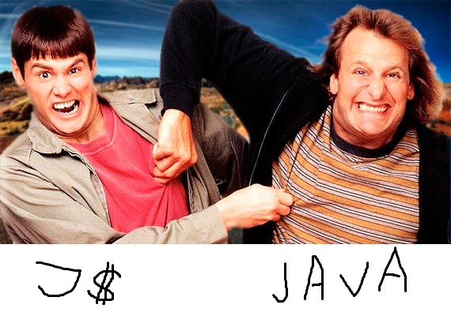
Java and JS

Slide 3
Data Types
String (no Char) – double or single quotes
Number – 64 bit float. 11.0 is the same as 11. Don’t do financial Math in JS!
Object
Boolean
Array
Undefined - is the value of a variable with no value. (when you call a method that doesn’t exist)
Null - Variables can be emptied by setting the value to null

Slide 4
Dynamically Typed
You do not declare variable types
JavaScript's typing is dynamic (meaning a variable can hold an object of any type and cannot be restricted).

Slide 5
Var Scope
Global - set on window when you run <script>
Function – set privately inside of the function
No block scope
this keyword – refers to object currently running the function
Demo

Slide 6
Operators & Statements
Almost same set of operators as Java
++ (addition and String concatenation) (addition and String concatenation), -, ** / , /
&&, ||, ++, --, etc
Comments - Same as in Java (/* ... */ and // ...)

Slide 7
== and === Example
– The == comparison (just value, type coercion)
– The The === operator (value and type)
DEMO
Prefer === (strings can be compared with ==)
Reference: MDN

Slide 8
Semicolons
Semicolons are not mandatory (but helpful!):
Example
return x
return
x
In the second one JS will first return, then evaluate x

Slide 9
Boolean values
FALSY VALUES
“true”: anything else (including the string “false”)
Trick 1
Trick 2
Value | Type
0 | Number
‘’ (empty string) | String
NaN | Number
false | Boolean
null | Object
undefined | Undefined

Slide 10
Function 1st Citizen
Functions are objects that can be referenced, passed and assigned to (e.g. other function, null, etc).
Examples:
Demo 1
Demo 2

Slide 11
Functions and ()
We now know that function is an object
To execute function you use ()
Self executing function example:
Demo 1
Notes:
Notes: html doc is parsed top-bottom. JS scripts are evaluated and executed (where poss).

Slide 12
Anonymous Function
Similar to anonymous classes in Java
Have no name
var car;
car.drive = function (){
console.log(‘vroooom’);
}
Demo

Slide 13
Namespaces!
Namespaces var BOB= {}; BOB.doSmthng() = {}

Slide 14
jQuery Intro

Slide 15
Background
Released in 2006 by John Resig.
Used by over 55% of the 10,000 most visited websites, jQuery is the most popular JavaScript library in use today

Slide 16
WTF is it?
Simplifies DOM element selection and manipulation
Uses Sizzle CSS selector engine
Events, AJAX, Animations and FX
Multi-browser
Extensible!

Slide 17
Document Object Model
defines standard way for accessing and manipulating HTML documents
represents html document as a tree structure

Slide 18
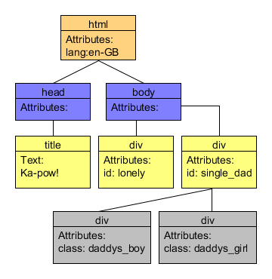
Document Object Model
<!DOCTYPE HTML> <html lang="en-GB"> <head> <title>Ka-pow!</title> </head> <body> <div id="lonely"></div> <div id="single_dad"> <div class="daddys_boy"></div> <div class="daddys_girl"></div> </div> </body> </html>
1. Use Chrome Dev Tools Elements Tab to View and Edit DOM
2. Note: there can only be one element with a given id, but many with the same class.

Slide 19
Selecting Elements in JS
Pure JS way (often requires traversing collections of returned objects):
elements = document.getElementsByTagName(name); //returns Nodelist
MDN reference
elements = document.getElementsByClassName(names); //returns Nodelist
MDN reference
elements = document.getElementsByName(name); //returns HTMLCollection
MDN reference
element = document.getElementById(id); //returns Element Object
MDN reference
Demo

Slide 20
jQuery Selectors
Basic CSS selectors and some extra ones
Demo
HTML | jQuery selector
<div id=“kickass” /> | $(‘#kickass’) //ids are unique!
<div class=“small_box” /> <div class=“small_box” /> | $(‘.small_box’) //matches 2 divs
<input type=“email” /> <input type=“email” /> | $(‘input[type=email]’) //matches both
<input type=“date” /> <input type=“datetime” /> | $(‘input[type*=date]’) //matches both
<input type=“date” /> <input type=“datetime” /> | $(‘input[type$=ate]’) //matches first one
<div> <img src=“bla.jpg” id=“1” /> </div> <img src=“bla.jpg” id=“2” /> | $(‘div > img’) //matches first one, id=1

Slide 21
jQuery Selectors Wrapper
$(selector) wrap the matched elements in a jQuery wrapper object.
jQuery wrapper is never null
Use length === 0 to test for existence (if 0 then nothing matched
Demo

Slide 22
jQuery Selectors – multiple match
No need to iterate over, just apply method/function you want
//change all divs background to red
$(‘div’).css(‘background’ , ’red’);
$(‘div’).addClass(‘someClass’);
Demo

Slide 23
find()
Find - Get the descendants of each element in the current set of matched elements, filtered by a selector, jQuery object, or element.
var divs = $(‘div’); //remember, divs is a jQuery wrapper
var thumbs = divs.find(‘.thumb’);//elems with class thumb
API DOC

Slide 24
Traversal methods – next()
next() - Get the immediately following sibling of each element in the set of matched elements. If a selector is provided, it retrieves the next sibling only if it matches that selector
DEMO

Slide 25
Traversal methods - prev()
Get the immediately preceding sibling of each element in the set of matched elements, optionally filtered by a selector.
DEMO

Slide 26
Traversal methods - closest()
For each element in the set, get the first element that matches the selector by testing the element itself and traversing up through its ancestors in the DOM tree.

Slide 27
index()
Search for a given element from among the matched elements.
DEMO

Slide 28
JS Events Binding
Old school:
target.addEventListener(type, listener)
OR in IE < 9
target.attachEvent('onclick', modifyText);
Example:
myBut.addEventListener(‘onclick’, function(){alert(‘yo’)})
Or
myBut.attachEvent(‘onclick’, myOtherFunc)

Slide 29
jQuery Events Binding
element.bind(eventType,[data], handler(eventObject))
Example: $('#bob').bind('click', function() { alert(‘I lav ya man’); });
DEMO

Slide 30
Event Shorthand
Many common event listeners have shorthand versions, for example:
element.click(function(evt){//do smthng})
Full list: http://api.jquery.com/category/events/

Slide 31
Events bubbling vs capturing
Capturing – Netscape
Click will first fire on id=1 then on id=2
Bubbling – Microsoft
Click will first fire on id=2, then on id=1
<div id=“1”>
<div id=“2”></div>
</div>
There is more! For example W3C Event model or some events don’t bubble and so on.
http://www.quirksmode.org/js/events_order.html
https://developer.mozilla.org/en-US/docs/DOM_Client_Object_Cross-Reference/DOM_Events

Slide 32
Helper stop event function
function stopEvent(e) {
//we don’t like nulls
if(!e) var e = window.event;
  //e.cancelBubble is supported by IE -
  // this will stop the bubbling process.
  e.cancelBubble = true;
  e.returnValue = false;
//if supported – DO IT!
if(e.stopPropagation) e.stopPropagation();
if(e.preventDefault) e.preventDefault();
return false;
}

Slide 33
Ready vs Load
DOM – browsers construct Document for each html doc; tree structure
JS onLoad event – when all loaded (img, css, etc)
jQuery document ready event – when DOM constructed (onDOMContentLoaded )
In IE not poss to know when, so they wait for scroll bar to appear

Slide 34
Ready vs Load sample
<body onload=“doThis()” />
$(document).ready(function() {
// do something});

Slide 35
DOM load exercise (Timeline)
Open Chrome Dev Tools, then Timeline
Go to a content heavy page
Click record button
When finished loading stop recoding
Observer thin blue and red lines (dom ready and load complete)

Slide 36
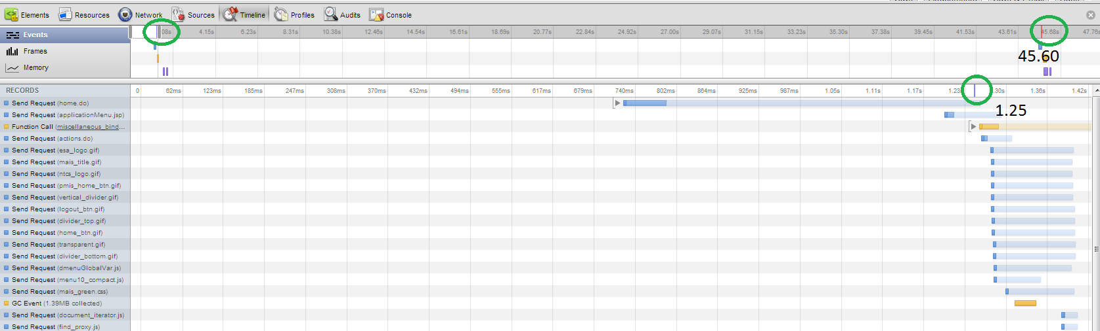
Screenshot of Timeline (MAIS)

Slide 37
Callbacks

Slide 38
AJAX speaks JSON
Object Literal example
What is JSON, syntax + rules
TODO

Slide 39
Jquery AJAX()
What is it, how to use it, example

Slide 40
jQuery getJSON() sendJSON()

Slide 41
Slide Effect(s)

Slide 42
Console.log func - Dev Tools
Console.log
(function() {
var method;
var noop = function noop() {};
var methods = [
'assert', 'clear', 'count', 'debug', 'dir', 'dirxml', 'error',
'exception', 'group', 'groupCollapsed', 'groupEnd', 'info', 'log',
'markTimeline', 'profile', 'profileEnd', 'table', 'time', 'timeEnd',
'timeStamp', 'trace', 'warn'
];
var length = methods.length;
var console = (window.console |= window.console | {});
while (length--) {
method = methods[length];
// Only stub undefined methods.
if (!console[method]) {
console[method] = noop;
}
}
}());
Taken from html5 boiler plate project

Slide 43
jquery always returns this + chaining

Slide 44
https://developer.mozilla.org/en/docs/
https://developers.google.com/chrome-developer-tools/

