Slide 1

Profiling Internet Users Through Web History Analysis with LLMs
Eric Xu/Frank Xu/Hongmei Chi
Summer 2024

Slide 2
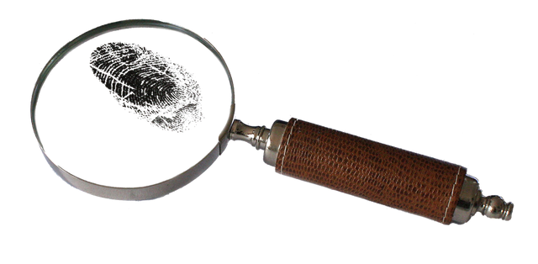
Introduction
Profiling internet users is essential for law enforcement to counter digital crimes effectively
Profiling:
Profiling involves gathering and analyzing data to create detailed user profiles.
Techniques include data mining, statistical analysis, and machine learning.
Different Profiling Sources: Social media, email, web history

Slide 3
Background
The rise of online activity and crime has made it increasingly important to use internet data for profiling.
Manual methods while effective, are labor-intensive and time-consuming, often requiring extensive experience and intuition from the investigators.
Large Language Models (LLMs), such as ChatGPT and Gemini are pretrained on extensive datasets and can perform tasks with few-shot learning, making them adaptable and efficient
The project explores leveraging the capabilities of Large Language Models (LLM) to perform profiling tasks.

Slide 4
Problem statement
Profiling users faces multiple issues:
Efficiency: Manual methods while effective, are labor-intensive and time-consuming, often requiring extensive experience and intuition from the investigators.
Privacy: A large dataset for AI training is needed but not feasible due to privacy concerns
Adaptability: AI powered tools are usually specialized into one task, and changing requires retraining.

Slide 5

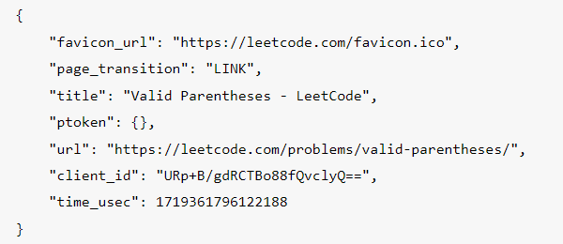
Dataset
The dataset is the Chrome browser history taken using Google Takeout.
Taken from 5 volunteers from the US
Ground truth comes from self identification.

Slide 6
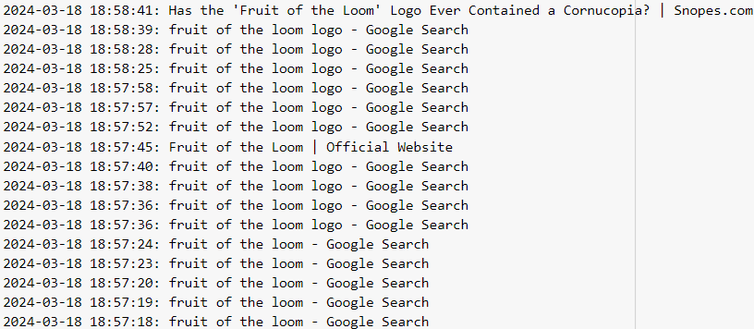
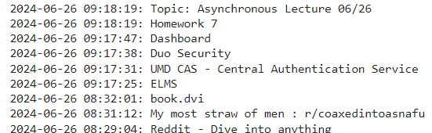
Data Processing
Extracted just the title and timestamp of websites visited
Removed repeats and titles that shared similar keywords that were in quick succession
Grouped into files of 200 entries
Demo uses 113

Slide 7
LLMs
What are LLMs?
Large Language Models (LLMs) are a type of artificial intelligence (AI) designed to generate human language.
They are trained on large amounts of text data, like books, websites, and articles, to learn patterns in language.
How do LLMs Work?
By analyzing text, LLMs learn to predict the next word in a sentence.

Slide 8
LLM Setup
Langchain
A popular open-source framework
Designed to simplify the development of applications using LLMs
Gemini
API is free
Popular large language model
Tasks
Evaluate age, interests, and State in the US

Slide 9
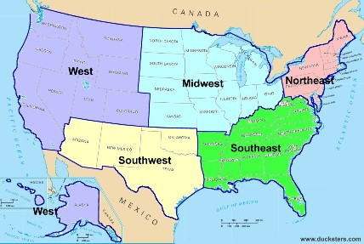
Evaluation
Age: Score of 1 if it is correct and 0.5 if it is off by one
10-19, 20-29, 30-39, 40-49, 50-59, and 60+
Age is 30-39 and the prediction is 50-59 or 20-29), we will give 0.5 score
Interests: Score is the number of correct interests over the largest number of interests guessed
Technology and Gadgets, Entertainment, Sports and Fitness, Travel and Adventure, Food and Cooking, Hobbies and Crafts, Health and Wellness, Education and Learning, Socializing and Community, Nature and Environment, Fashion and Style, and Pets and Animals
If 4 interests are predicted and 3 are correct, it will be given a score of 3/4 or 0.75
Location: Score of 1 if prediction is correct. Score of 0.6 if the state borders the state. 0.3 if they are the same section of the United States.
Northeast, Southeast, Midwest, Southwest, and West

Slide 10
Task 0 - Downloading dataset
In task 1 we will:
Download our dataset
Demo uses a small sample of data provided
You can use your own data using Google Takeout

Slide 11
Task 1 - Installing packages
Import necessary libraries
google-generativeai
langchain-google-genai
python-dotenv
langchain_experimental langchain_core
Upgrade necessary dependencies

Slide 12
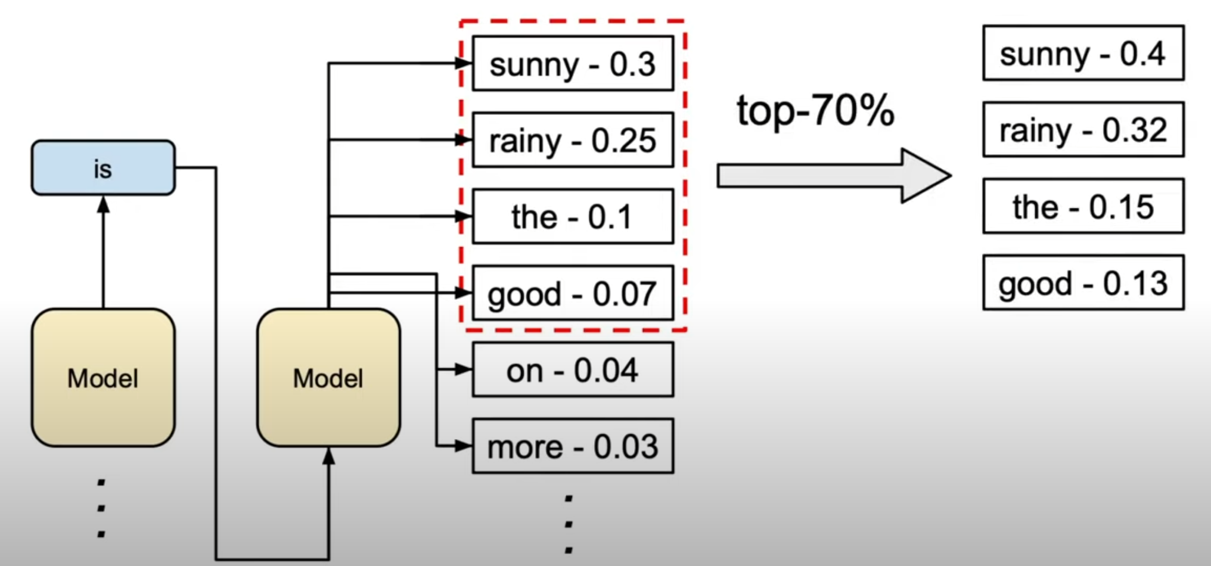
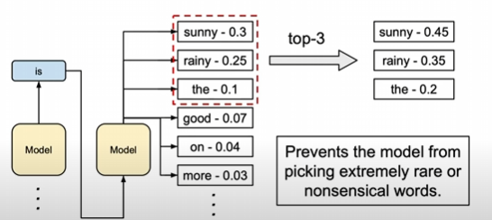
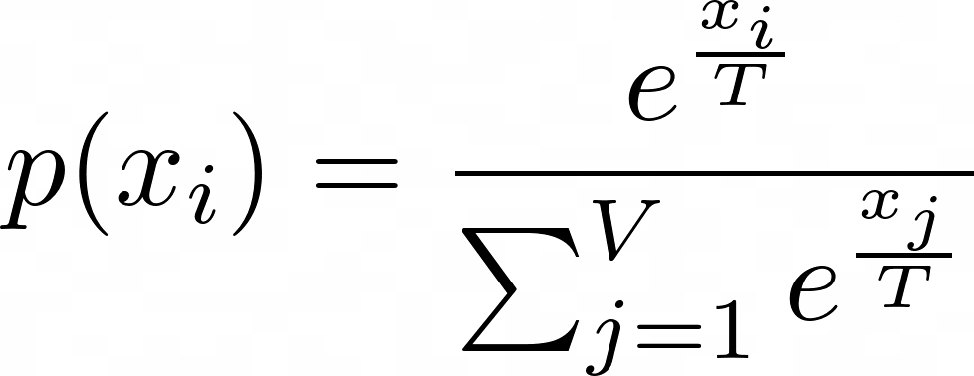
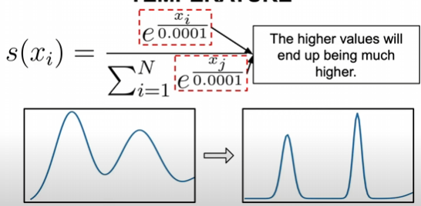
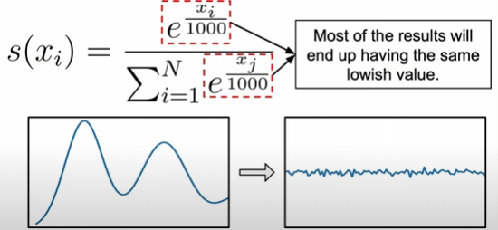
Task 2 - Create our Config LangChain for gemini
Set LangChain to use your Gemini Api key
Adjust safety settings:
These will block certain content from being inputted or outputted
Remove any filters
Generation Configuration:
Top P
Top K
Temperature

Slide 13
Task 3: Building a Gemini model
LangChain provides a ChatGoogleGenerativeAI method.
Allows us to interact with Gemini’s API

Slide 14
Task 4: Create a prompt template
Prompt templates are a special form of prompt.
Templates are reusable and provide a base structure that allows us to quickly adjust prompts and standardize the structure of prompts.

Slide 15
Task 5 - Creating a LangChain Processing Chain
Flow of operation chain = prompt | model | output_parser
The prompt is first formatted and sent to the model.
The model processes the prompt and generates a response.
The output parser then processes the model's response, ensuring it's in the correct string format.
Can interpret CSV or JSON. We will use string
chain.invoke method executes the chain

Slide 16
Results
Struggled to or refused to identify location unless given specific information
University websites, government websites, etc.
Good at identifying age and interests
Prompts did not significantly impact performance
 | Age | Interests | Location | Total
Gemini | ~0.66 | ~0.76 | ~0.24 | ~1.66/3
Table 1: Average Score for each category

Slide 17
Conclusion
Large Language Models (LLMs) have the advantage of ease of use and smaller data requirements
Leveraging LLMs can significantly enhance the efficiency of profiling and produce results quickly. With access to more data and the use of multi-shot prompts, we could see improvements in accuracy.
LLMs can predict some aspects of a person accurately from web history data. Leveraging this can allow us to automatically examine and profile some traits of a criminal.
The integration of LLMs into profiling tools can potentially streamline and improve the accuracy of investigations, providing valuable support in the fight against cybercrime.

Slide 18
REFERENCE.
R. Kocsis, What Is Criminal Profiling?. Springer, 2006.
N. Nykodym, R. Taylor, and J. Vilela, “Criminal profiling and insider cyber crime,” Computer Law & Security Review, vol. 21, no. 5, pp. 408–414, 2005
Wójcicki, K., et al. "Internet of things in industry: Research profiling, application, challenges and opportunities—a review," in Energies, vol. 15, no. 5, pp. 1806, 2022.
B. E. Turvey, Criminal profiling: An introduction to behavioral evidence analysis. Academic press, 2011.
T. Marwala and L. G. Mpedi, “Criminal Justice System and AI,” in Artificial Intelligence and the Law, Springer, 2024, pp. 47–64.

