Slide 1
Concurrency in targeting and addition tasks
Christopher Best

Slide 2
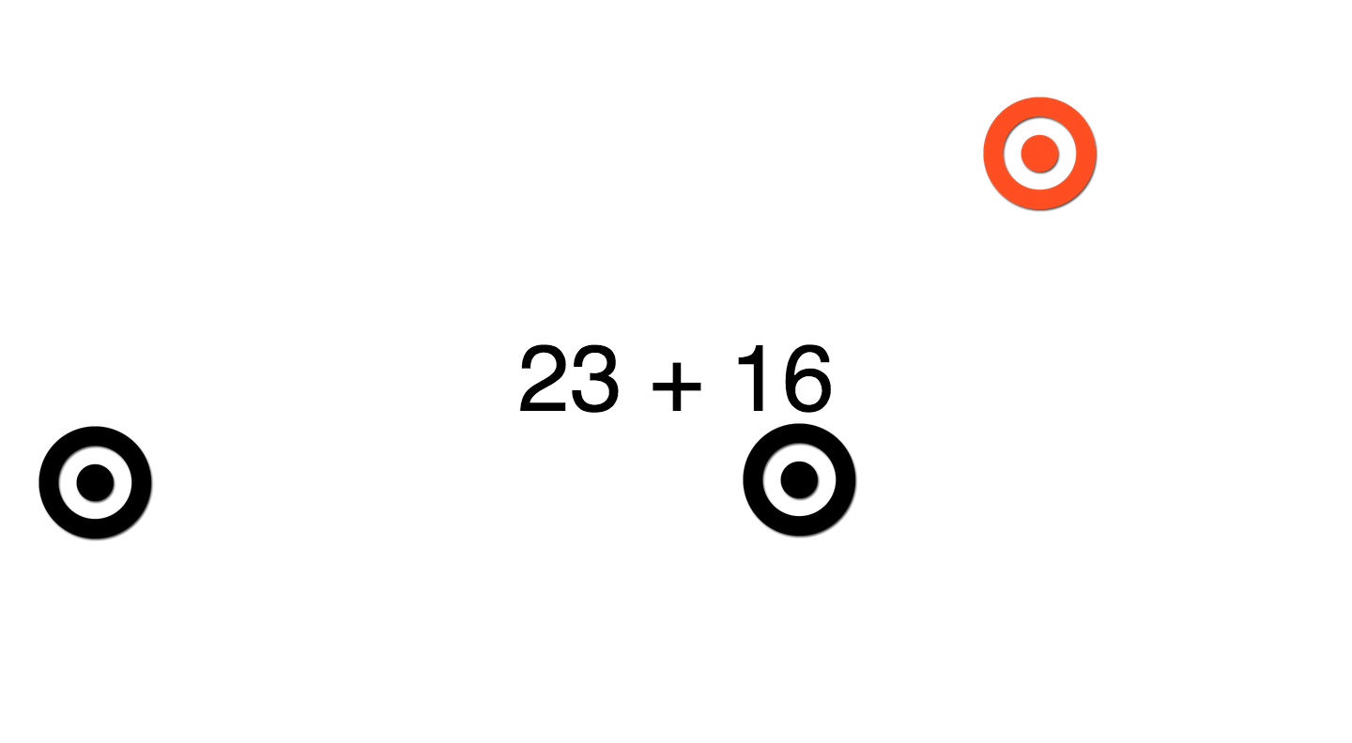

Task

Slide 3
Addition Difficulty

Slide 4
Targeting Difficulty

Slide 5
Low difficulty

Slide 6
High Difficulty

Slide 7
Task Order

Slide 8
Concurrency

