Slide 1
Intro to Game Programing
https://godotengine.org/

Slide 2
What are the basic building blocks?
Images
Sounds
Text
Buttons
User Interface
Health Bar
Animations
Music
Story?

Slide 3
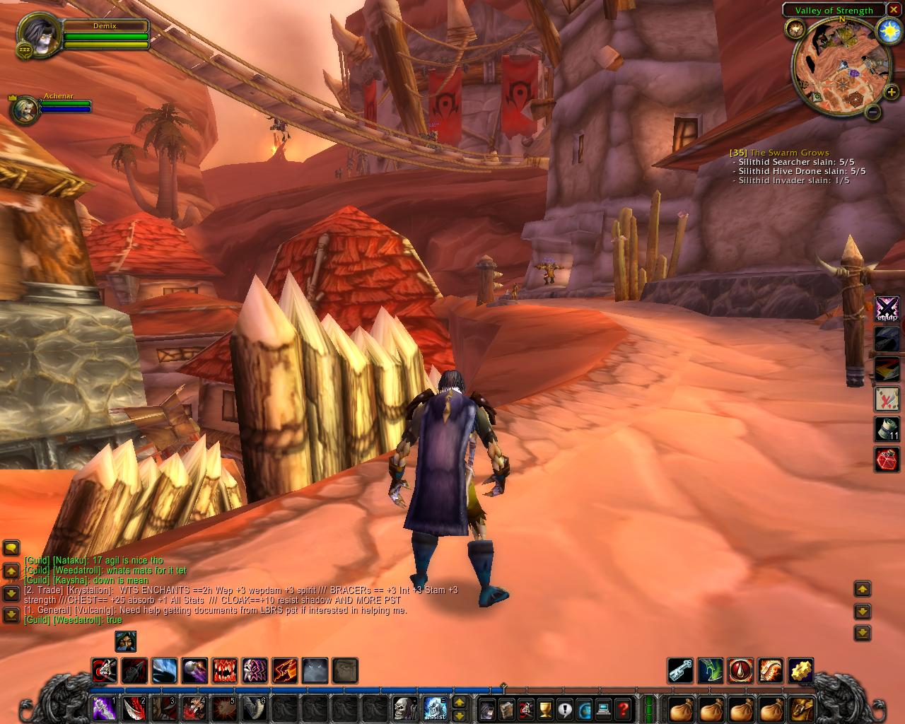
World of Warcraft

Slide 4
Getting to know Godot: The interface
Nodes – Common Types: 2DNode, Control, Button, Label
Scene – Like shots in a movie?, Used to organize a bunch of nodes. Use it for reusability.
Scene tree – Parent, Child
Filesystem – How is this different than Scene Tree
Inspector – For editing Text on a button and other items in a node.
Middle panel
Signals – Used to connect events to actions.
Scripts – Tied to a node, allow you to program your game and handle signals.
Play buttons

Slide 5
Getting started
Create a new project named “Intro”
Create a scene with type User Interface
Rename it to “MainMenu” and save scene
  Talk about the importance of picking good names. Button33 is not okay.
Create a scene with 2Dnode
Rename it “Game” and save scene
Talk about saving your work

Slide 6
Game Scene
Add a Label with Text Welcome to the game
Add a Texture Rec and load your background image into it
Add an AudioPlayer and load our sound
  Set the sound to loop
Save the scene

Slide 7
MainMenu
Add A label with Text Main Menu
Add a Quit button rename it and move it
Add a New Game button rename it and move it
Add a script to MainMenu and Signals to your two buttons.
Make quit quit (google quit button godot)
Make play change scene to our Game Scene (again google it)
Save the scene

Slide 8
Playing our game
Set the default scene
Play the game
Play the game scene
Make a typo and debug it
  Always make sure you have exited playing, save and test
  Edit the script and change the quit() to qquit()
  Try playing our game again.

Slide 9
General Layout
Make New Game parent of Quit
Move New Game
In the Game Menu reorder background and Label
In MainMenu make an hbox
  Put Title, and buttons in the hbox
  Change hbox to vbox
Use anchors to place vbox

Slide 10
Tutorials
Godot create a new project
Godot basics
godot making a main menu
Godot 4 essential building blocks
Layout basics

