Slide 1
Themes
Making things look good

Slide 2
Review old stuff
Project settings(Default scene, Keyboard/Joystick Input, Display settings)
Filesystem (Scenes,Images, Music, scripts)
Scene Tree (View nodes in a scene)
Inspector (View/change node settings)
Types of nodes:
  2DNode
  ColorRect, TextRect
  Button
  Sprite2D
  AudioPlayer
  Hboxcontainer, Vboxcontainer
  Label
Connecting signals to an action(Button press, mouse enter)

Slide 3
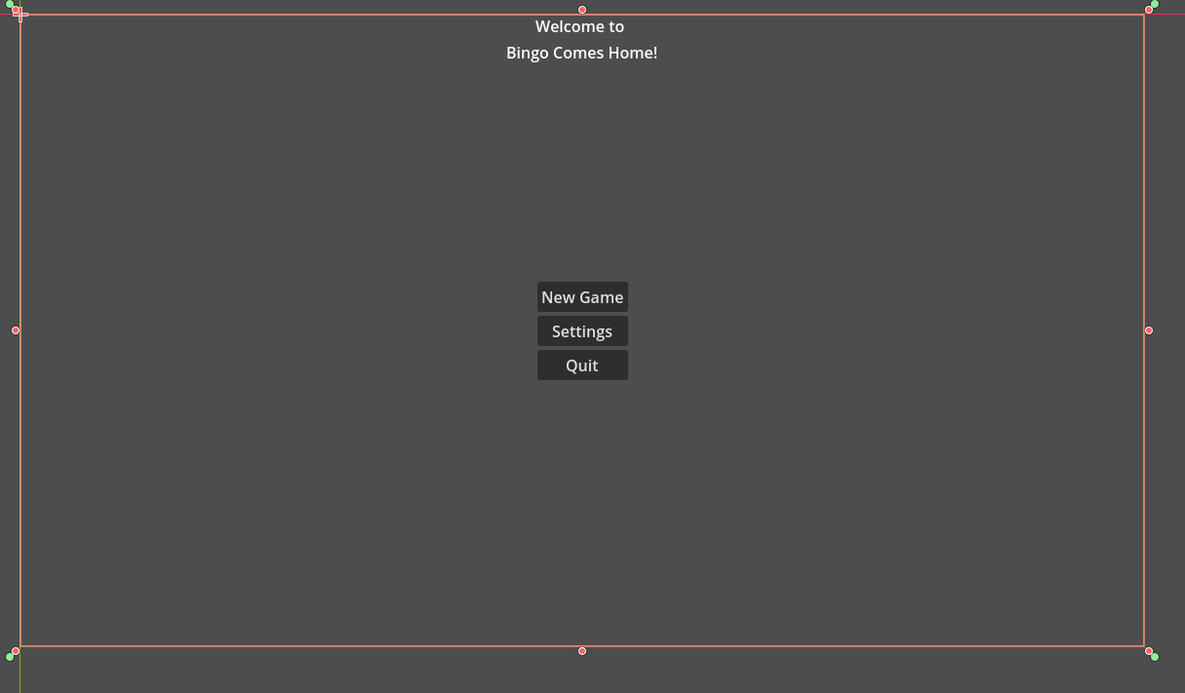
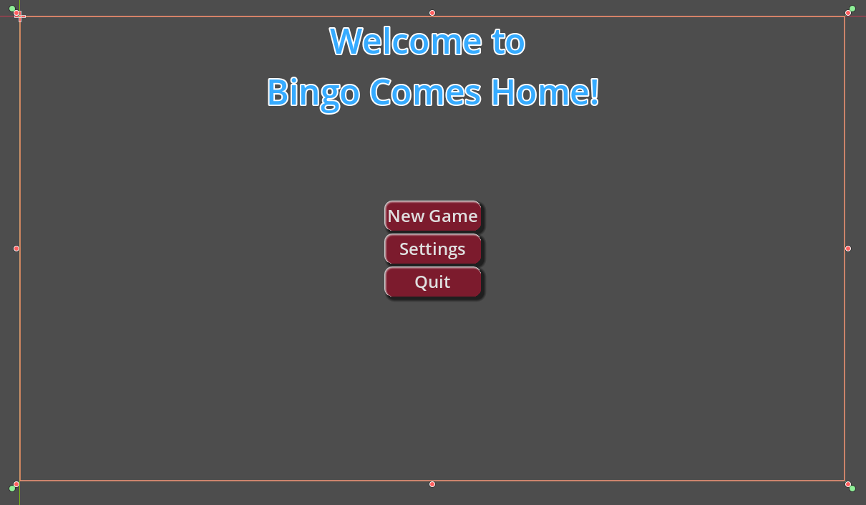
Working with Themes
Create a new user interface scene(control) and duplicate our main menu
  Add a Title(Label)
  Add a vbox
    Add a New Game button
    Add an options button
    Add a quit button
Rename main and all of the other nodes and save
Duplicate the scene using save as: Main_themed
Selec the Main_themed scene.
Under Theme create a new theme and double click it.
  This should open up a preview.
  Save the theme: base_theme.tres
Mody the theme
  In the preview click on button and Manage settings
    Click on button and load all
    Click on label and load all
  Add a new flat stylebox to the normal button and click it.
  Make set the corner radius to 10 on each corner
  Add a border with of 5 on each side
  Change the color of the normal button and the border color.
  Add a shadow to the button theme.
  Under label change the font and load a font file of your choice.
  Save your theme in the root folder base_theme.tres

Slide 4
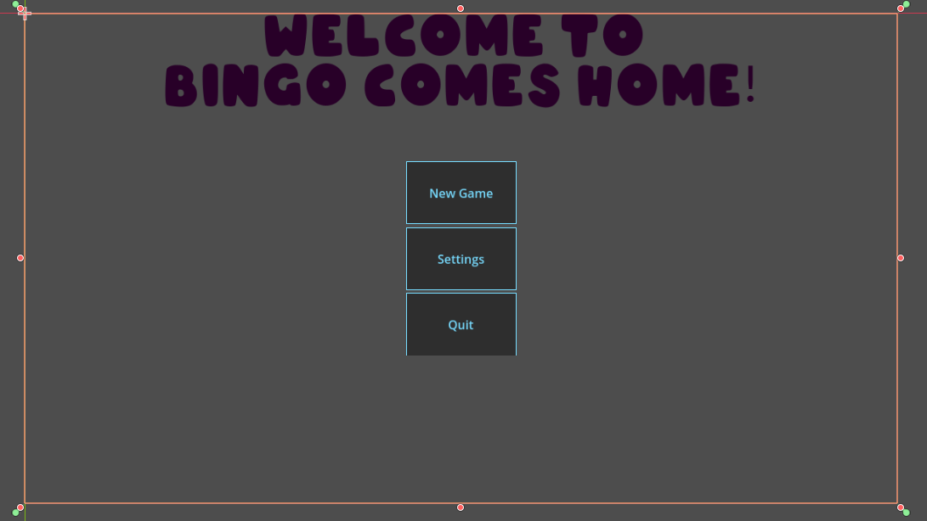
Working with Themes 2
Look at each scene and play it (unthemed and themed)
You can save work using themes
  Set up one button the way you want it and just load it for all buttons.
  You can use multiple themes in one project.
  You can also override individual items on a single button.

Slide 5
Tutorials
Instant Better UI with Godot
How to use Themes and Styles
Everything you need to know about UI in godot 4

