Slide 1
UI
Making things look good

Slide 2
Review old stuff
Project settings(Default scene, Keyboard/Joystick Input, Display settings)
Filesystem (Scenes,Images, Music, scripts)
Scene Tree (View nodes in a scene)
Inspector (View/change node settings)
Types of nodes:
  2DNode
  ColorRect, TextRect
  Button
  Sprite2D
  AudioPlayer
  Hboxcontainer, Vboxcontainer
  Label
Connecting signals to an action(Button press, mouse enter)

Slide 3
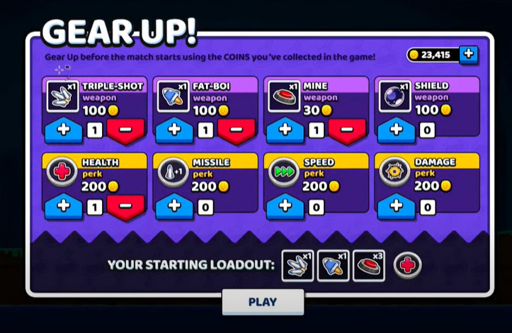
Attempt to recreate this with the provided files
Hboxcontainer
Vboxcontainer
Button
Label
Texturerect
PanelContainer
MarginContainer

Slide 4

Creating a reusable Scene
New Scene
Root is hboxcontainer
Rename it to AmountButtons
Import our files from shared drive
Add two TextureButtons
  Rename upbutton and downbutton
  Load up and down Images
Add panelContainer
  Add child ColorRect (White)
  Add child Label
    Set text to 1
    Set horizontal alignment to center
  Move Panel to middle of buttons
  Set MinX 40
Save your Scene (Amount.tscn)

Slide 5
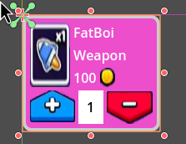
Working with Scenes
Create a new Scene type PanelContainer named Item and save
  Under Theme Overrides add a new flat style box
  Set border widths to 4
  Set Corner radius to 10
  Pick a color for background and borders
Add a Margin Container
  Under theme overrides/Constants Set the margins to 5
  Add a Vbox
    Add an hbox
      Add a textrect Rename it ItemImage
        Drag in the Fatboi.png
        Set it to keep aspect ratio
      Add a vbox
        Add a Label named Name and set name to FatBoi
        Add a Label named type set type to weapon
        Add an hbox rename it to costbox
        Add a Label renamed to cost and set it to 100
        Add a textrect rename it to coinIcon
          Set the coin.png to the texture
    Add a copy of our AmountButtons

Slide 6
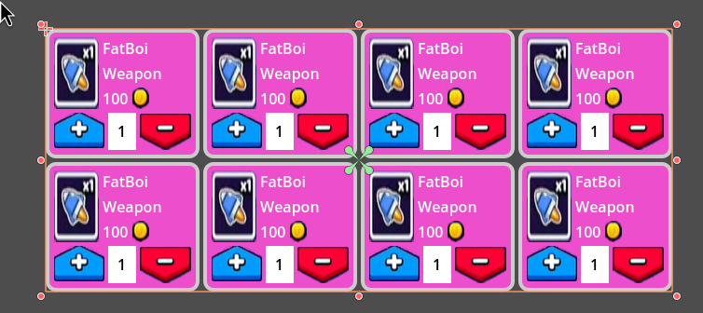
Scenes of Scenes
Create a new Scene named ‘Main’ and save it (User Interface)
Add a Grid container
  Set Columns to 4
  Drag in your Item scene
  Duplicate it 7 times

Slide 7
Tutorials
Instant Better UI with Godot
How to use Themes and Styles
Everything you need to know about UI in godot 4

