Slide 1
Animating with aseprite
Aesprite (https://www.aseprite.org/)

Slide 2
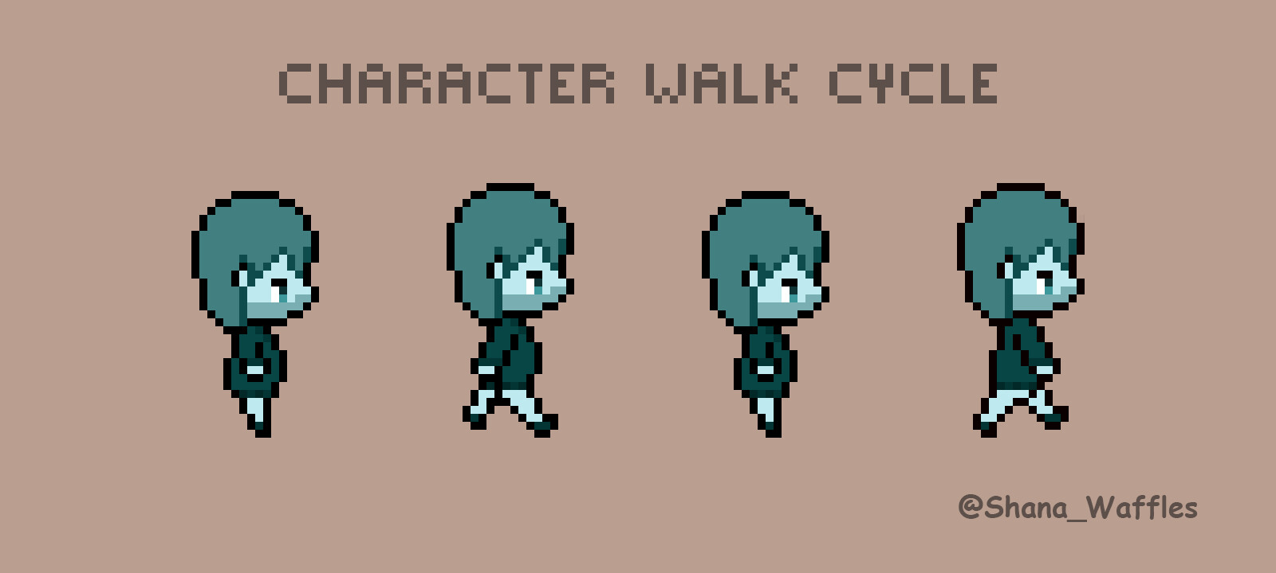
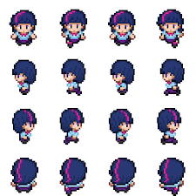
A Walk Cycle
Notes:
Note first is 2d platformer
Second is a top down first row =walk down
Second walk left, etc..

Slide 3
Getting started with aseprite
Aseprite (https://www.aseprite.org/)
Get your steam key from Kent (Need to install steam)

Slide 4
Creating animations with aseprite

Slide 5
Tutorials
aseprite fundamentals
more in depth tutorial
Intro animating with aseprite
Animating with aseprite
Using aseprite and godot
More options for aseprite and godot

