Slide 1
Google
Super Fan

Slide 2
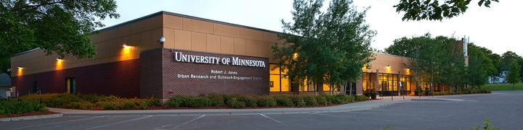
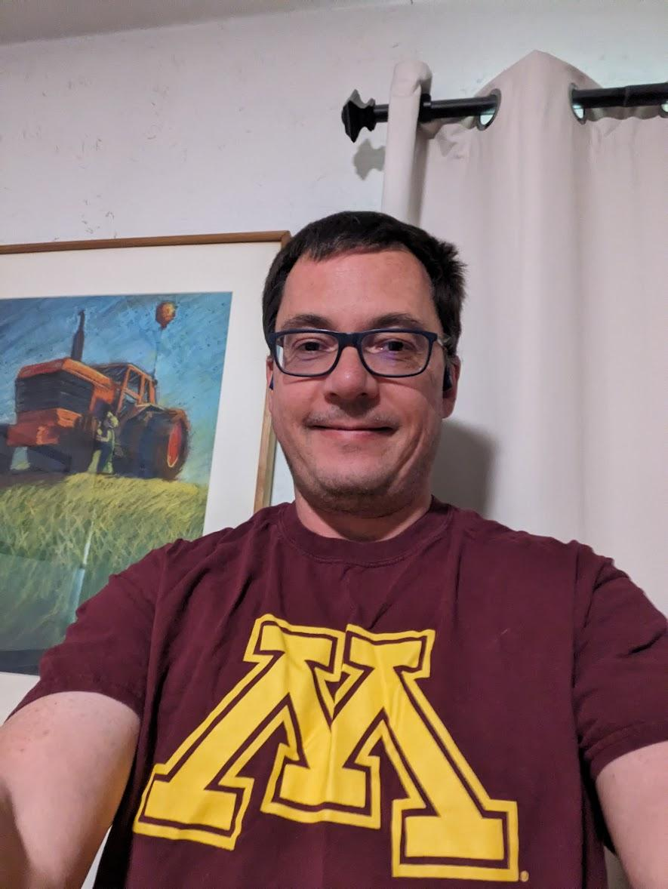
Outside UROC
Hi I’m Kent Mein
I’m Here today at UROC in Minneapolis
Making a quick Video.
I’m a google SUPERFAN!

Slide 3

SUPERFAN

Slide 4
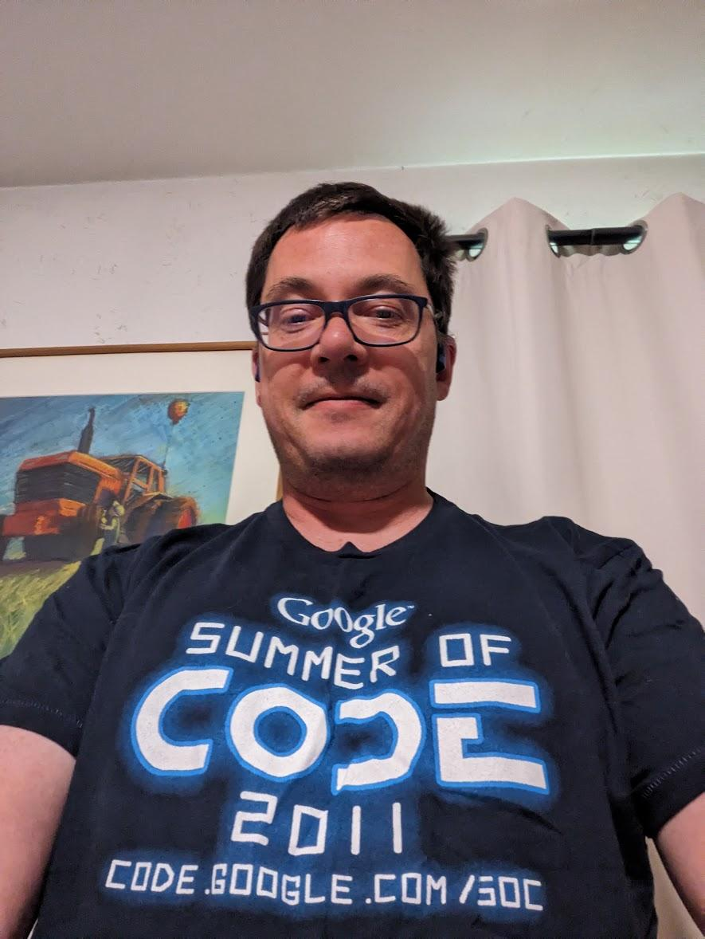
Somewhere Inside UROC
I’m asking for your help,
To spread Google LOVE
The G-LOVE!
Notes:
I asking for your help,
to spread “google Love”
The GLOVE!

Slide 5

G-LOVE
Image of the word “G-LOVE”
Notes:
Like Batman POW!

Slide 6
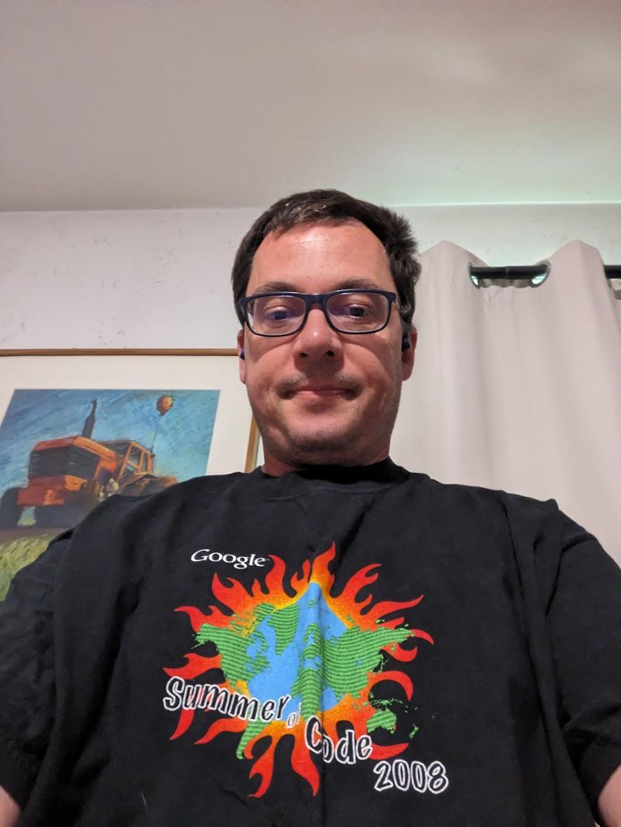
First Up! (Somewhere else in UROC)
The first thing I want to do
Is give khymera a new google
Phone!

Slide 7
Another POW

Slide 8
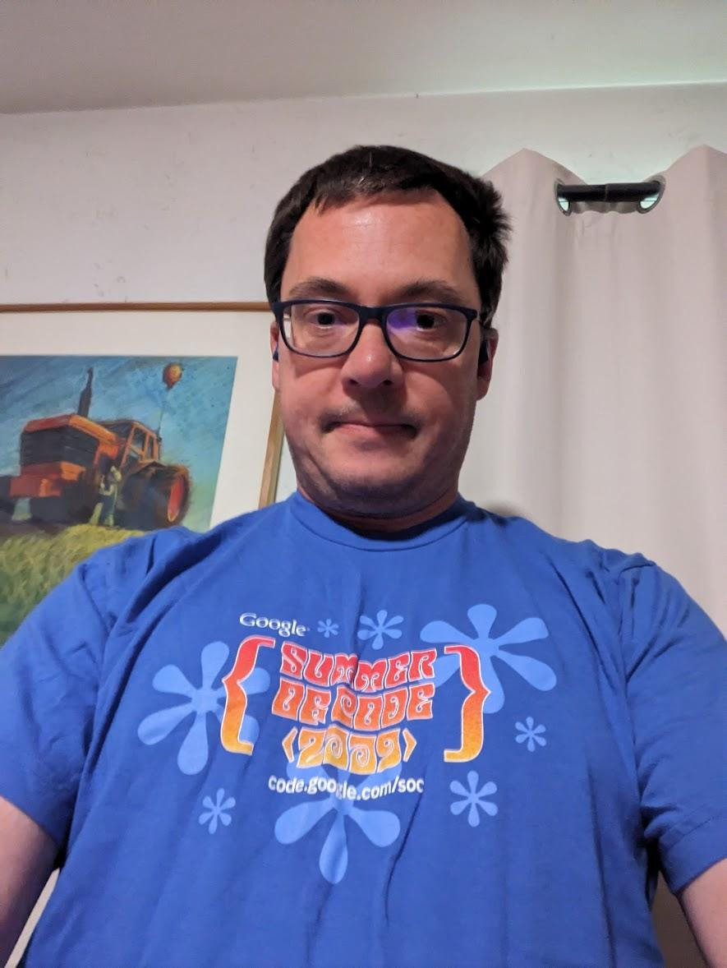
Why Them? (Third location in UROC)
Notes:
Need a Transition word for the next slide!

Slide 9
Another POW

Slide 10
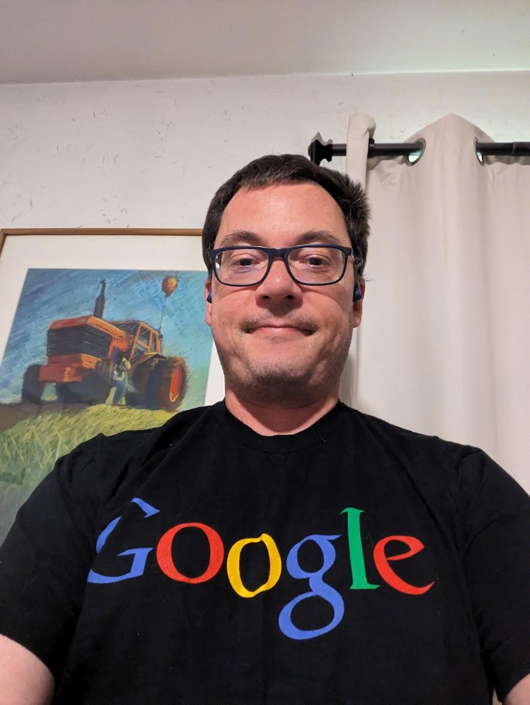
Ending! (4th Location in UROC)
I could go on and on about ____.
Help me spread the G-LOVE!
We can do great things together!

Slide 11
G-LOVE
Animated G-LOVE!

Slide 12
Khymera Crenshaw
Khymera Crenshaw
Really into Drawing and needs a device to work with
She is a googlefan as well
Take notes
Organizing my stuff work my new job
Underprivileged youth in foster care
Notes:
Like Batman POW?

Slide 13
OUT Take
Image of my Son in his “Google Room”.
This video was created with help from my Son Zach!
Notes:
Only if we have time.

Slide 14
Roles
Actor/Editor: Kent Mein
Actor: Khymera Crenshaw
Actor: Moha Yusuf
Actor: Cory Foss
Actor/Assistant: Ronald Carlson
Lights/Actor: Aaron Wilson
Actor/Producer: ilhan jama
Assistant Cinematographer: Daniel Stocker
Cinematographer: Brandon Jackson
Director: Teng Yang
murder mystery

