Slide 1
HTML Documents and JavaScript
Tom Horton
Alfred C. Weaver
CS453 Electronic Commerce

Slide 2
Overview
Some basic HTML
  And principles and issues
W3C Standards that are relevant
  DOM, XML, XHTML, ECMAScript
JavaScript introduction
Your tasks:
  HTML, JavaScript exercises in VirtualLabs
  Homework 2 on JavaScript

Slide 3
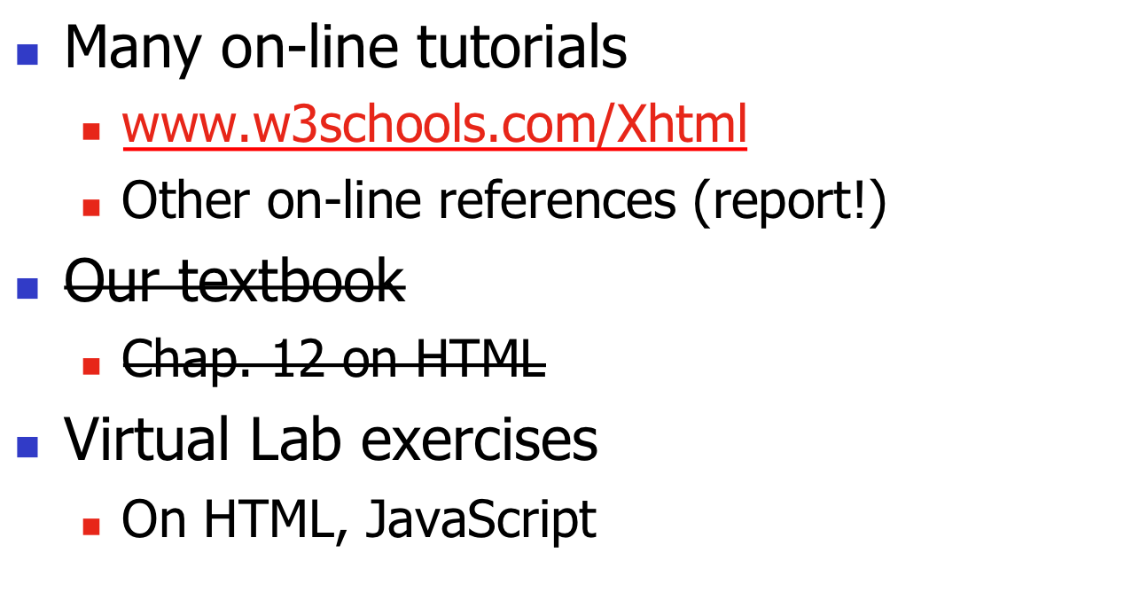
Readings

Slide 4
HTML Background
Many “markup” languages in the past
SGML: Standard Generalized Markup Language
  HTML (Hypertext Markup Language) based on SGML
XML (eXtensible Markup Language) “replaces” SGML
  XHTML is replacing HTML

Slide 5
Principles
Distinguish structure from presentation
  Presentation based on structure
  Presentation may vary, perhaps based on display characteristics, user-preference, etc.
People like to ignore this idea
  E.g. use <B> vs. <EM>
  <font> tag?
XML and CSS or XSL

Slide 7
Tags and Elements
Example of an element:
<name attr1=“attrval”>content</name>
Begin and end tags set off a section of a document
  Has a semantic property by tag-name
  Modified by attributes
“content” can contain other elements
  Elements nest, don’t “overlap”
Empty-elements: no end tag
  <br /> <img … />
  Note space before />

Slide 8
Basic HTML Structure
Comments:
<!-- … -->
Example:
<html>
<head>
…
</head>
<body>
….
</body>
</html>
<--- title, meta-tags, etc. (not displayed)
<--- main content (displayed)

Slide 9
Larger Example
<html>
<head>
<title>An Example</title>
</head>
<body>
<h3><hr>An Example</h3>
<p align="left">
<font face="Comic Sans MS" size="4"><b>
Hello World!</b></font>
</p>
<p align="right">
<font size="5"><u>I am 21.</u></font>
</p>
<!-- see next column -->
<p>
<ol type="I" start=7>
<li><font color=#00FF00>Green</font></li>
<li>Yellow</li>
<ul type=square>
<li>John</li>
<li>Mike</li>
</ul>
</ol>
</p>
</body>
</html>

Slide 10
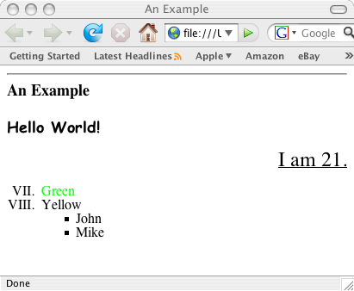
Displays As…

Slide 11
Basic Tags
Text display:
  <em>, <strong>, <em>
Structure:
  <h1>, <h2>, <h3>
  <p>
  <ul>, <ol>, <blockquote>
Attributes:
  Align, text, bgcolor, etc.

Slide 12
Basic Tags (2)
Links:
<a href=“…”>…</a>
Images:
  <img src=“…”> an empty tag
Tables
  Use an editor!
Forms: later

Slide 13
More HTML
Learn on your own
You may never code in “raw” HTML
You may need to tweak HTML files created by a tool
You will need to understand HTML to code in JavaScript etc.
You will need to understand HTML to know limitations on how docs on the web can be structured

Slide 14
Question:
You’re writing software to process an HTML page
  A web-browser engine, for example
What data structure would best represent an HTML document?
  Why?

Slide 15
Discuss and give me details

Slide 16
Document Object Model (DOM)
An model for describing HTML documents (and XML documents)
  A standard (ok, standards)
  Independent of browser, language
    (ok, mostly)
  A common set of properties/methods to access everything in a web document
APIs in JavaScript, for Java, etc.

Slide 17
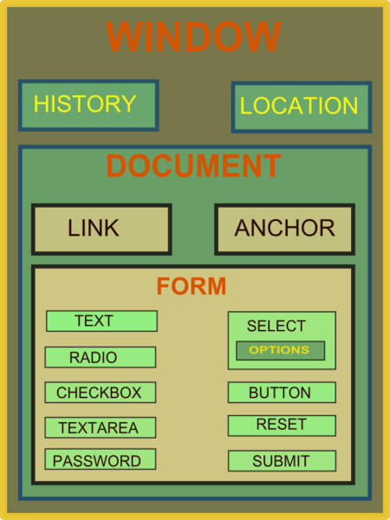
DOM
You get
anything you
want from…
More info: http://en.wikipedia.org/wiki/Document_Object_Model

Slide 18
W3C Standards
XML, XHTML
CSS, XSL
XSLT
DOM
ECMAScript
etc

Slide 19
JavaScript
An example of a “scripting” langauge that is embedded in HTML documents
  The browser’s display engine must distinguish from HTML and Script statements
Others like this:
  PHP (later in the course)

Slide 20
History
JavaScript created by Netscape
JScript created by Microsoft
IE and Netscape renderings are slightly different
Standardized by European Computer Manufacturers Association (ECMA)
http://www.ecma-international. org/publications /standards/Ecma-262.htm

Slide 21
General Format
  <!doctype ...>
  <html>
  <Head>
  <Title> Name of web page </title>
  <script type="text/javascript">
  ...script goes here
  </script>
  </head
  <body>
  ...page body here: text, forms, tables
  ...more JavaScript if needed
  ...onload, onclick, etc. commands here
  </body>
  </html>

Slide 22
Characteristics
Case sensitive
Object oriented
Produces an HTML document
Dynamically typed
Standard operator precedence
Overloaded operators
Reserved words

Slide 23
Characteristics
Division with / is not integer division
Modulus (%) is not an integer operator
5 / 2 yields 2.5
5.1 / 2.1 yields 2.4285714285714284
5 % 2 yields 1
5.1 % 2.1 yields 0.8999999999999995

Slide 24
Characteristics
" and ' can be used in pairs
Scope rules for variables
Strings are very common data types
Rich set of methods available
Arrays have dynamic length
Array elements have dynamic type
Arrays are passed by reference
Array elements are passed by value

Slide 25
JavaScript Topics
code placement
document.writeln
document tags
window.alert
user input/output
parseInt and parseFloat
arithmetic
arithmetic comparisons
for loops
while loops
do-while loops
if-else
variable values in tags
math library
switch
break
labeled break
continue
Booleans

Slide 26
JavaScript Topics
functions
random numbers
rolling dice
form input
form output
submit buttons
games
arrays
searching
strings
substrings
string conversions
markup methods

Slide 27
JavaScript’s Uses Include:
“Dynamic” web-pages
  What’s DHTML? (in a second)
Image manipulation
  Swapping, rollovers, slide shows, etc.
Date, time stuff (e.g. clocks, calendars)
HTML forms processing
  Verifying input; writing output to fields
Cookies

Slide 28
What’s DHTML?
Purpose: make dynamic / interactive web-pages on the client side
Use of a collection of technologies together to do this, including
  Markup language (HTML, XML, etc.)
  Scripting language (JavaScript, etc.)
  Presentation language (CSS etc.)

Slide 29
Other References
CS453 Virtual Lab exercises
The Web Wizard’s Guide To JavaScript, Steven Estrella, Addison-Wesley
JavaScript for the World Wide Web, Gesing and Schneider, Peachpit Press
http://www.w3schools.com/js/
www.javascript.com
E-books in UVa’s Safari On-line Books:
http://proquest.safaribooksonline.com/search

Slide 30
Browser Compatability
Use of:
<script type=”text/javascript" language=”javascript" >
<!--
// ends script hiding -->
</script>
“language=“ for pre IE5 and NS6
Comment for very old browsers (e.g. IE2)
  BTW, comments in HTML vs. in JavaScript

Slide 31
Organization of JavaScript
Create functions (non-OO style)
  Define in header
  Or load a .js file in header:
  <script type="text/javascript" language="javascript" src="mylib.js">
Functions called in <BODY>
  Often in response to events, e.g.
  <input type="button"… onclick="myFunc(…);">
Global variables

Slide 32
JavaScript
Programming by example

Slide 33
document.writeln
<!DOCTYPE html PUBLIC "-//W3C//DTD HTML 4.0 Transitional//EN">
<HTML>
<!– Welcome to JavaScript -->
<HEAD>
<TITLE> Welcome to JavaScript </TITLE>
<SCRIPT TYPE="text/javascript">
document.writeln( "<FONT COLOR='magenta'><H1>Welcome to ",
"JavaScript Programming!</H1></FONT>" );
</SCRIPT>
</HEAD>
<BODY>
</BODY>
</HTML>

Slide 34
document.write
<!DOCTYPE html PUBLIC "-//W3C//DTD HTML 4.0 Transitional//EN">
<HTML>
<HEAD>
<TITLE> Using document.write </TITLE>
<SCRIPT TYPE="text/javascript">
document.write ( "<H1>Welcome to ");
document.writeln( "JavaScript Programming!</H1>" );
</SCRIPT>
</HEAD>
<BODY>
</BODY>
</HTML>

Slide 35
window.alert
<!DOCTYPE HTML PUBLIC "-//W3C//DTD HTML 4.0 Transitional//EN">
<HTML>
<HEAD>
<TITLE> Using window.alert </TITLE>
<SCRIPT TYPE="text/javascript">
window.alert( "Welcome to\nJavaScript\nProgramming!" );
</SCRIPT>
</HEAD>
<BODY>
<P>Click Refresh (or Reload) to run this script again.</P>
</BODY>
</HTML>

Slide 36
User input/output
<SCRIPT TYPE="text/javascript">
var firstNumber, // first string entered by user
secondNumber, // second string entered by user
number1, // first number to add
number2, // second number to add
sum; // sum of number1 and number2
// read in first number from user as a string
firstNumber = window.prompt("Enter first integer", "0" );
// read in second number from user as a string
secondNumber = window.prompt( "Enter second integer", "0" );
// convert numbers from strings to integers
firstNumber = parseInt(firstNumber);
number2 = parseInt( secondNumber );
// add the numbers
sum = firstNumber + number2;
// display the results
document.writeln( "<H1>The sum is " + sum + "</H1>" );
</SCRIPT>

Slide 37
Functions
<SCRIPT TYPE = "text/javascript">
var input1 = window.prompt( "Enter first number", "0" );
var input2 = window.prompt( "Enter second number", "0" );
var input3 = window.prompt( "Enter third number", "0" );
var value1 = parseFloat( input1 );
var value2 = parseFloat( input2 );
var value3 = parseFloat( input3 );
var maxValue = maximum( value1, value2, value3 );
document.writeln( "First number: " + value1 +
"<BR>Second number: " + value2 +
"<BR>Third number: " + value3 +
"<BR>Maximum is: " + maxValue );
// maximum method definition (called from above)
function maximum( x, y, z ) {
return Math.max( x, Math.max( y, z ) );
}
</SCRIPT>

Slide 38
Random Numbers
<SCRIPT TYPE="text/javascript">
var value;
document.writeln( "<H1>Random Numbers</H1>" +
"<TABLE BORDER = '1' WIDTH = '50%'><TR>" );
for ( var i = 1; i <= 20; i++ ) {
value = Math.floor( 1 + Math.random() * 6 );
document.writeln( "<TD>" + value + "</TD>" );
if ( i % 5 == 0 && i != 20 )
document.writeln( "</TR><TR>" );
}
document.writeln( "</TR></TABLE>" );
</SCRIPT>

Slide 39
Roll the Die
<SCRIPT TYPE="text/javascript">
var frequency1 = 0, frequency2 = 0,
frequency3 = 0, frequency4 = 0,
frequency5 = 0, frequency6 = 0, face;
// summarize results
for ( var roll = 1; roll <= 6000; ++roll ) {
face = Math.floor( 1 + Math.random() * 6 );
switch ( face ) {
case 1: ++frequency1; break;
case 2: ++frequency2; break;
case 3: ++frequency3; break;
case 4: ++frequency4; break;
case 5: ++frequency5; break;
case 6: ++frequency6; break;
}
}
document.writeln( "<TABLE BORDER = '1' WIDTH = '50%'>" ); .....

Slide 40
Rules of Craps
First roll:
  7 or 11 is a win
  2, 3, or 12 is a lose
  otherwise, roll becomes your point
Subsequent rolls:
  rolling your point is a win
  7 or 11 is a lose
  otherwise continue to roll

Slide 41
Craps
<SCRIPT TYPE="text/javascript">
// variables used to test the state of the game
var WON = 0, LOST = 1, CONTINUE_ROLLING = 2;
// other variables used in program
var firstRoll = true, // true if first roll
sumOfDice = 0, // sum of the dice
myPoint = 0, // point if no win/loss on first roll
gameStatus = CONTINUE_ROLLING; // game not over yet

Slide 42
Craps
// process one roll of the dice
function play() {
if ( firstRoll ) {
// first roll of the dice
sumOfDice = rollDice();
switch ( sumOfDice ) {
case 7: case 11:
// win on first roll
gameStatus = WON;
document.craps.point.value = ""; // clear point field
break;
case 2: case 3: case 12:
// lose on first roll
gameStatus = LOST;
document.craps.point.value = ""; // clear point field
break;

Slide 43
Craps
default:
// remember point
gameStatus = CONTINUE_ROLLING;
myPoint = sumOfDice;
document.craps.point.value = myPoint;
firstRoll = false;
}
}
else {
sumOfDice = rollDice();
if ( sumOfDice == myPoint ) gameStatus = WON;
else if ( sumOfDice == 7 ) gameStatus = LOST;
}

Slide 44
Craps
if ( gameStatus == CONTINUE_ROLLING ) window.alert ("Roll again");
else {
if ( gameStatus == WON ) {
window.alert ("Player wins. " + "Click Roll Dice to play again.");
document.craps.point.value = " ";
}
else {
window.alert ("Player loses. " + "Click Roll Dice to play again.");
document.craps.point.value = " ";
}
firstRoll = true;
}
}

Slide 45
Craps
// roll the dice
function rollDice() {
var die1, die2, workSum;
die1 = Math.floor( 1 + Math.random() * 6 );
die2 = Math.floor( 1 + Math.random() * 6 );
workSum = die1 + die2;
document.craps.firstDie.value = die1;
document.craps.secondDie.value = die2;
document.craps.sum.value = workSum;
return workSum;
}
</SCRIPT>

Slide 46
Poker Hand
<SCRIPT TYPE="text/javascript">
function rand1toN(N) {
return Math.floor( 1+Math.random()*N );
}
function dealcard(card) {
var rank = new Array(0,"A","2","3","4","5","6","7",
"8","9","T","J","Q","K");
var suit = new Array(0, "Spades", "Hearts", "Diamonds", "Clubs");
card[0] = rank[rand1toN(13)];
card[1] = suit[rand1toN(4)];
}

Slide 47
Poker Hand
var card = new Array(2);
var player = new Array(10);
var dealer = new Array(10);
for (var i=0; i<=4; i++) {
dealcard(card);
player[i*2] = card[0];
player[i*2+1] = card[1];
dealcard(card);
dealer[i*2] = card[0];
dealer[i*2+1] = card[1];
}

Slide 48
Poker Hand
document.writeln("<H1> PLAYER </H1>");
document.writeln("<TABLE BORDER='1' >");
for (var i=0; i<=4; i++) {
document.writeln("<TR><TD><P>" + player[i*2] + "</TD>"
+ "<TD><P>" + player[i*2+1] + "</TD></TR>");
}
document.writeln("</TABLE> </HTML>");
</SCRIPT>

Slide 49
Character Processing
<SCRIPT TYPE="text/javascript">
var s = "ZEBRA";
var s2 = "AbCdEfG";
document.writeln( "<P> Character at index 0 in '"+
s + '" is " + s.charAt( 0 ) );
document.writeln( "<BR>Character code at index 0 in '" +
s + "' is " + s.charCodeAt( 0 ) + "</P>" );
document.writeln( "<P>'" + String.fromCharCode( 87, 79, 82, 68 ) +
"' contains character codes 87, 79, 82 and 68</P>" );
document.writeln( "<P>'" + s2 + "' in lowercase is '" +
s2.toLowerCase() + "'" );
document.writeln( "<BR>'" + s2 + "' in uppercase is '" +
s2.toUpperCase() + "'</P>" );
</SCRIPT>

Slide 50
Dates and Times
<SCRIPT LANGUAGE = "JavaScript">
var current = new Date();
document.writeln(current);
document.writeln( "<H1>String representations and valueOf</H1>" );
document.writeln( "toString: " + current.toString() +
"<BR>toLocaleString: " + current.toLocaleString() +
"<BR>toUTCString: " + current.toUTCString() +
"<BR>valueOf: " + current.valueOf() );
document.writeln( "<H1>Get methods for local time zone</H1>" );
document.writeln( "getDate: " + current.getDate() +
"<BR>getDay: " + current.getDay() + "<BR>getMonth: " +
current.getMonth() + "<BR>getFullYear: " + current.getFullYear() +
"<BR>getTime: " + current.getTime() + "<BR>getHours: " +
current.getHours() + "<BR>getMinutes: " + current.getMinutes() +
"<BR>getSeconds: " + current.getSeconds() + "<BR>getMilliseconds: " +
current.getMilliseconds() + "<BR>getTimezoneOffset: " +
current.getTimezoneOffset() );

Slide 51
Dates and Times
document.writeln( "<H1>Specifying arguments for a new Date</H1>" );
var anotherDate = new Date( 1999, 2, 18, 1, 5, 3, 9 );
document.writeln( "Date: " + anotherDate );
document.writeln( "<H1>Set methods for local time zone</H1>" );
anotherDate.setDate( 31 );
anotherDate.setMonth( 11 );
anotherDate.setFullYear( 1999 );
anotherDate.setHours( 23 );
anotherDate.setMinutes( 59 );
anotherDate.setSeconds( 59 );
document.writeln( "Modified date: " + anotherDate );
</SCRIPT>

Slide 52
Radio buttons
Assure that at least one radio button is clicked before taking action

Slide 53
Checkboxes
Respond to selections made with checkboxes

Slide 54
Textboxes
Detecting an empty textbox

Slide 55
Self-grading Tests
Collecting and evaluating answers to questions

Slide 56
Character String Processing
Validate an email address

Slide 57
Cookies
Write a cookie on the client's device

Slide 58
Events
JavaScript can execute a statement (typically, call a function) when an event occurs
<… oneventname="javascript stmt;">
<BODY … ONLOAD="func();">
<INPUT TYPE="submit" … ONSUBMIT="f();">

Slide 59
Events
onsubmit - call when submit button is clicked
onclick - call when this button is clicked
onreset - call when the reset button is clicked
onload - call after page loads
onmouseover - call when mouse pointer enters image area
onmouseout - call when mouse pointer leaves image area
onfocus - call when control receives focus
onblur - call when a control loses focus
onchange - call when a control loses focus and the value of its contents has changed
many more

Slide 60
Mouse Events
Illustrate onmouseover and onmouseout

Slide 61
Handling Time
Create a simple JavaScript clock

Slide 62
Controlling Time
Turn a clock on and off and format the time string

Slide 63
Handling Images
Create a slide show

Slide 64
Generate Real-Time Data
Simulate monitoring real-time information from a device

Slide 65
Continuous Update
Gather data synchronously using the clock as the event generator

Slide 66
End of Examples

