Slide 1
Project Title Machine Learning-Based Prediction and Optimization of Renewable Energy Production
Name: VENKATASAISIREESHA BOLISETTY
STUDENT ID: 23036931
Supervisor: Professor Hyungrok Kim
UNIVERSITY OF HERTFORDSHIRE

Slide 2
Introduction
Why Renewable Energy?
The increasing need for sustainable energy sources due to climate change.
Renewable energy is essential to reduce carbon emissions and dependency on fossil fuels.
Growing investments and government policies supporting green energy transition.
Why Machine Learning?
Machine learning allows data-driven decision-making, enhancing efficiency in energy production.
Improves forecasting accuracy for energy generation based on historical data and external factors.
Helps optimize energy distribution to balance supply and demand effectively.
AI-driven models can automate smart grid management and resource allocation.

Slide 3
Project Overview
Research Question: How can machine learning techniques be applied to predict and optimize renewable energy production?
Objectives:
Identify key factors influencing renewable energy production.
Collect and preprocess large-scale historical energy data.
Develop predictive models using machine learning techniques.
Apply optimization strategies to enhance energy efficiency.
Validate and compare model performance for decision-making applications.
Provide policy recommendations for sustainable energy management.

Slide 4
Dataset Selection
Dataset Link: EIA Renewable Energy Data

Slide 5
Exploratory Data Analysis (EDA)
Purpose: Gain insights into historical trends and relationships between variables.
Analysis Methods:
Time-series visualization to detect patterns and seasonality.
Statistical summaries to assess data distribution and variance.
Correlation analysis between energy production and weather conditions.
Identifying anomalies and outliers in the dataset.
Key Observations:
Solar energy production peaks during summer months.
Wind energy has high variability depending on seasonal wind patterns.
Hydropower is directly influenced by rainfall levels.
Dataset Justification & Selection
Why EIA Dataset?
Provides official, government-verified energy production data.
Covers a long historical range (1973-2024) for trend analysis.
Reliable and unbiased compared to crowd-sourced data sources.
Allows comparative analysis with global energy datasets.
Alternative Considerations:
NASA POWER Dataset: Includes weather conditions but lacks structured energy records.
UK Renewable Energy Statistics: Limited dataset for regional forecasting.
Final Decision: EIA dataset was selected for its completeness, accuracy, and reliability.

Slide 6
Project Plan & Timeline
Weeks | Start Date | End Date | Task | Task Description
01-Feb | 20-Jan | 27-Jan | Literature Review & Dataset Exploration | Reviewing academic papers on renewable energy forecasting, dataset selection, and feasibility study
03-Apr | 03-Feb | 10-Feb | Data Preprocessing & Feature Engineering | Handling missing values, normalization, encoding categorical features, and feature selection for model input
05-Jun | 17-Feb | 24-Feb | Baseline Model Implementation | Developing initial predictive models using ARIMA, Linear Regression, and Decision Trees for benchmarking
07-Aug | 03-Mar | 10-Mar | Advanced Model Development & Evaluation | Implementing advanced models like LSTM, XGBoost, and Prophet for renewable energy forecasting
09-Oct | 17-Mar | 24-Mar | Model Optimization & Comparison | Hyperparameter tuning, feature importance analysis, and model selection based on RMSE and R² scores
11-Dec | 31-Mar | 07-Apr | Results Analysis & Code Review | Interpreting model results, comparing performance, debugging issues, and ensuring code quality
13-15 | 14-Apr | 13-May | Final Report, Presentation & Viva | Preparing the final project report, creating PowerPoint slides, and rehearsing for viva assessment

Slide 7
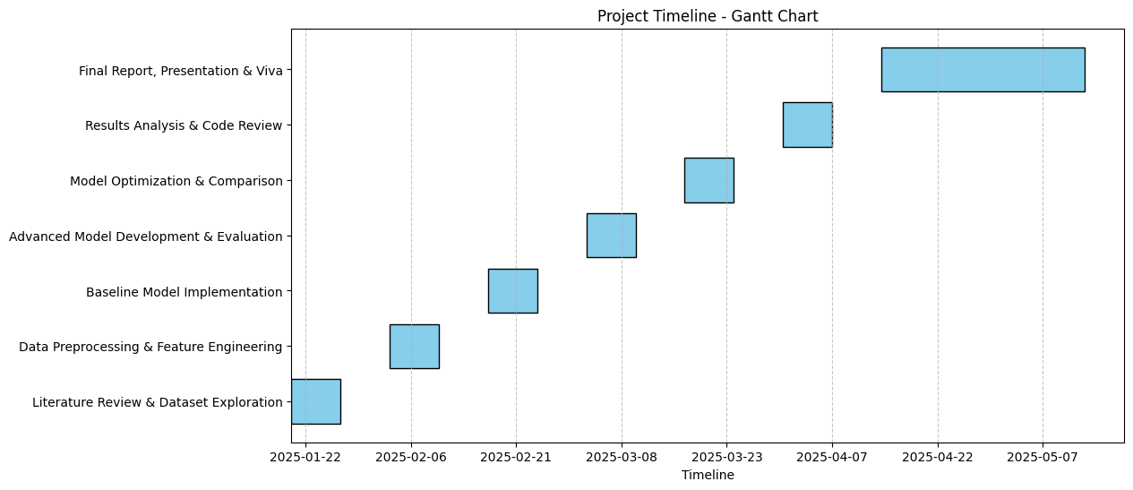
Gantt Chart: Visual representation of the project timeline.

Slide 8
Machine Learning Models
Forecasting Models Considered:
ARIMA & SARIMA: Traditional statistical models for time-series analysis.
LSTM (Long Short-Term Memory): A deep learning model ideal for sequential data.
Prophet Model: Developed by Facebook for handling missing data and trend forecasting.
Regression-Based Models:
XGBoost & Random Forest: High-performance models for numerical prediction.
Model Selection Criteria:
RMSE, MAE, and R² scores for accuracy measurement.
Computational efficiency and interpretability.
Comparison based on training time and predictive power.
Model | Strengths | Limitations
ARIMA | Good for short-term forecasting | Struggles with long-term dependencies
LSTM (Deep Learning) | Captures long-term patterns | Requires large datasets and training time
XGBoost | Works well with structured data | Less effective with sequential data
Prophet Model | Handles seasonality well | Less effective for sudden fluctuations

Slide 9

Version Control & Security
GitHub Link:
GitHub Repository: Weekly commits and updates.
Backup System: Secure storage on OneDrive.
Data Privacy Measures: Compliance with data regulations.
https://github.com/sireesha1010/Renewable_energy_production

Slide 10
Model Training & Evaluation
Training Methodology:
Splitting dataset into training (80%) and testing (20%) subsets.
Cross-validation to prevent overfitting.
Performance Metrics:
RMSE (Root Mean Squared Error) to assess predictive accuracy.
MAE (Mean Absolute Error) for error measurement.
R² Score to determine model reliability.
Hyperparameter Tuning:
Grid search and Bayesian optimization for model improvement.
Challenges & Mitigation
Challenges:
Data quality issues, such as missing or inconsistent values.
Model overfitting due to excessive parameter tuning.
Computational constraints for deep learning models.
Mitigation Strategies:
Data cleaning pipelines for robust preprocessing.
Regularization techniques to prevent overfitting.
Utilizing cloud-based computing resources to handle large-scale data.

Slide 11
Optimization & Future Enhancements
Optimization Strategies:
AI-driven decision-making for energy allocation.
Reinforcement learning models to adapt predictions dynamically.
Real-World Applications:
Google DeepMind’s AI for Energy Grids – Improves power distribution.
Tesla Energy Management System – AI-based solar and wind optimization.
Future Enhancements:
Integrating real-time monitoring systems for accurate energy forecasting.
Expanding dataset scope to include global renewable energy statistics.
Collaboration with energy policymakers for sustainable energy planning.
Expected Outcomes
Accurate energy production forecasting for different renewable sources.
Optimized energy distribution models for real-world applications.
Scalable machine learning models applicable to multiple energy sectors.
Contribution to academic research and industry innovations.

Slide 12
Conclusion & Questions
Summary of Key Takeaways:
Machine learning enhances renewable energy forecasting accuracy.
Proper dataset management ensures robust model performance.
Optimization strategies improve energy efficiency and reliability.
Open Floor for Questions:
Seeking feedback and discussion on future applications.
Encouraging collaboration opportunities for advanced research.

Slide 13
References
Hyndman, R.J. and Athanasopoulos, G., 2018. Forecasting: Principles and Practice. 2nd ed. Melbourne: OTexts. Available at: https://otexts.com/fpp2/ [Accessed 9 February 2025].
Makridakis, S., Spiliotis, E. and Assimakopoulos, V., 2020. The M4 Competition: Results, findings, conclusion and way forward. International Journal of Forecasting, 36(1), pp.54-74. Available at: https://www.sciencedirect.com/science/article/pii/S0169207019301128 [Accessed 9 February 2025].
Rahman, M.M. and Saha, T.K., 2022. Machine learning-based forecasting of renewable energy production: A review. Renewable Energy Reports, 8, pp.229-248. Available at: https://www.sciencedirect.com/science/article/pii/S2352484722000051 [Accessed 9 February 2025].
U.S. Energy Information Administration (EIA), 2024. Total Energy Data Browser. [online] Available at: https://www.eia.gov/totalenergy/data/browser/ [Accessed 9 February 2025].

Slide 14
THANK YOU

